Slide 1
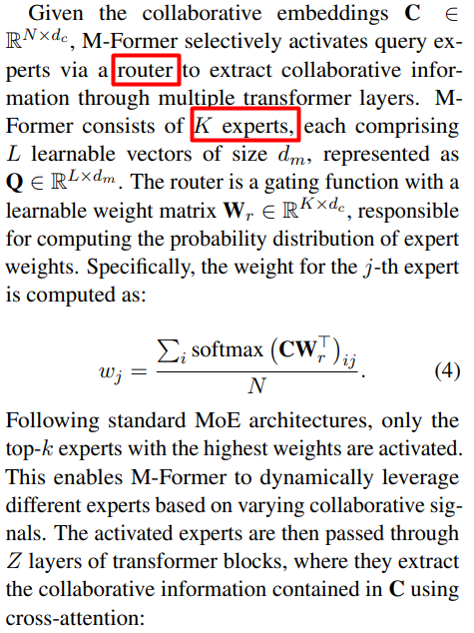
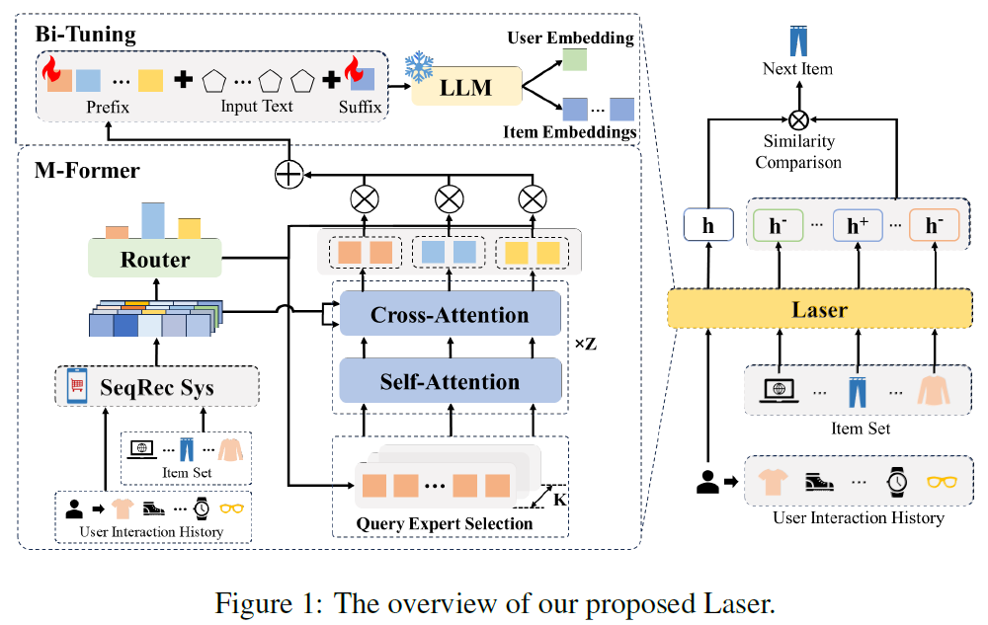
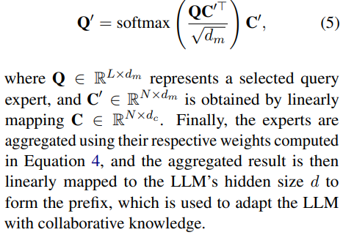
2025_ACL_Laser_Bi-Tuning with Collaborative Information for Controllable LLM-based Sequential Recommendation
提出一种新的MoE策略，比以往工作更复杂。

