Slide 1
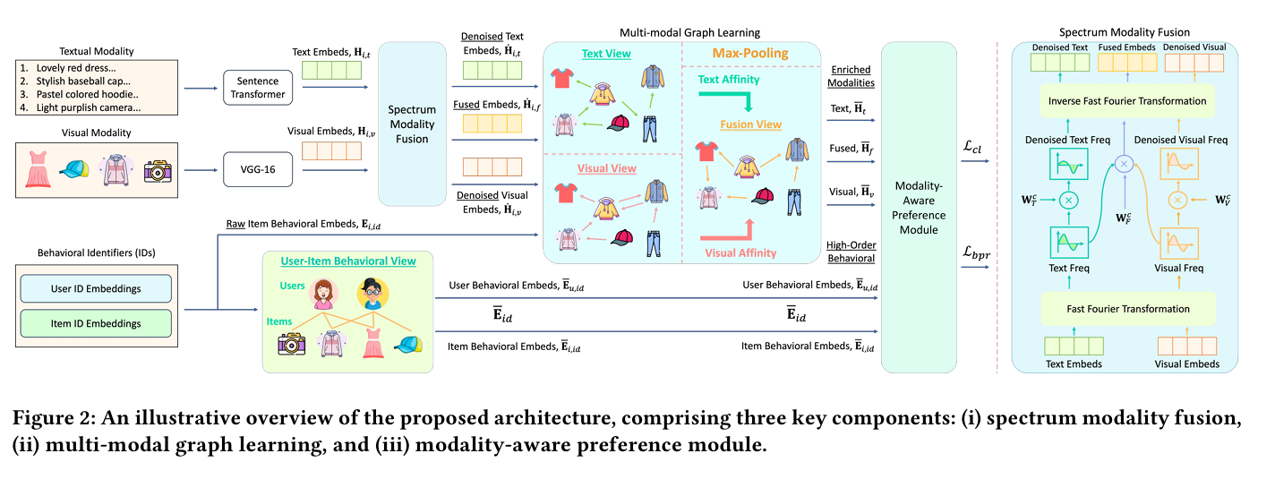
WSDM_2025_Spectrum-based Modality Representation Fusion Graph Convolutional Network
for Multimodal Recommendation

Slide 2
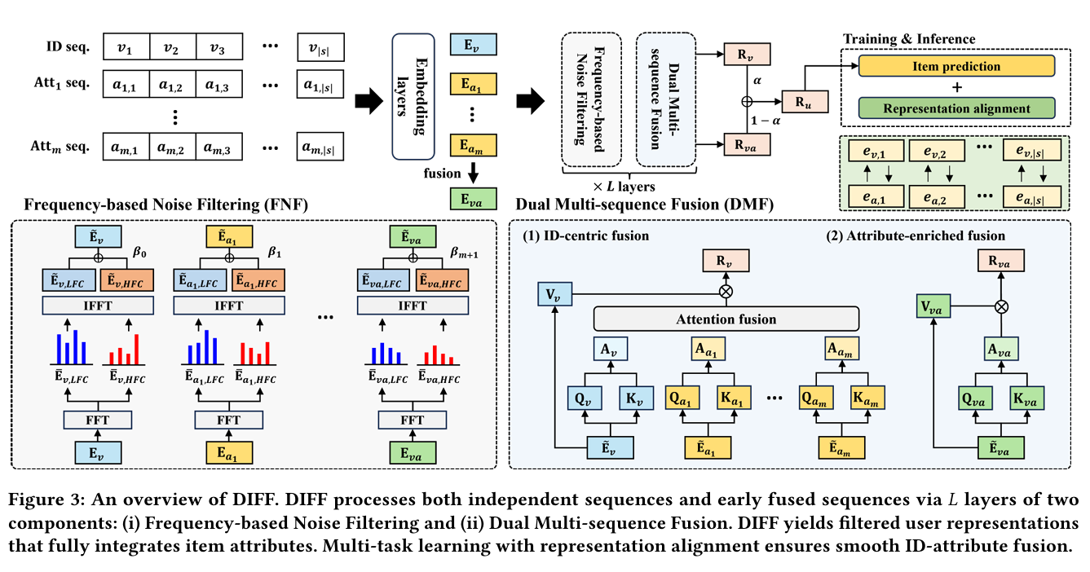
SIGIR_2025_DIFF: Dual Side-Information Filtering and Fusion for Sequential Recommendation

Slide 3
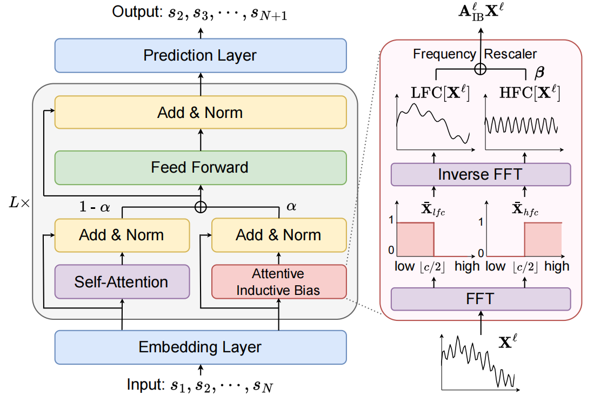
2024_AAAI_An Attentive Inductive Bias for Sequential Recommendation beyond the Self-Attention

Slide 4
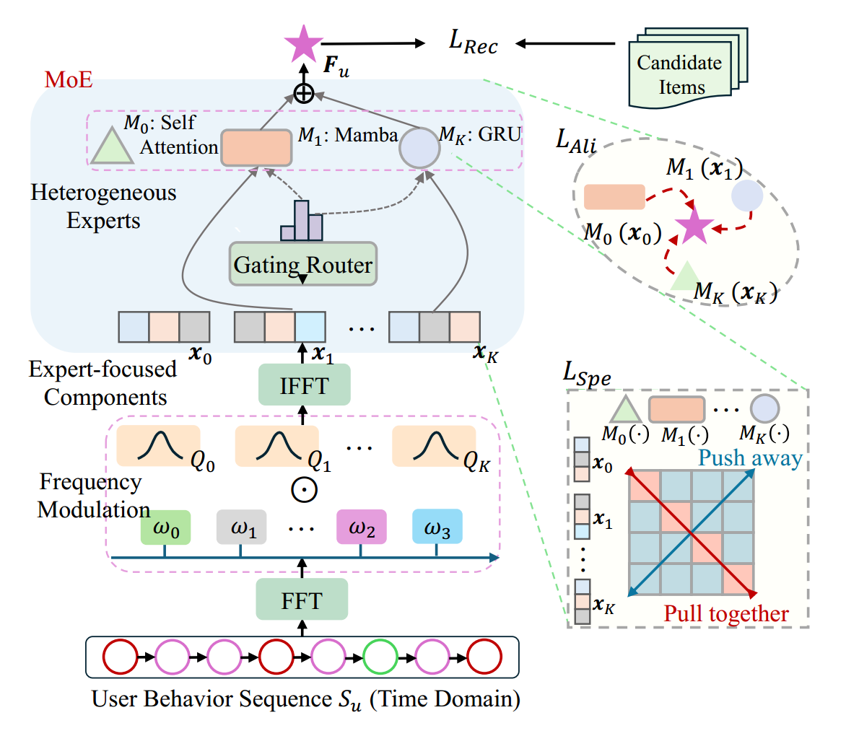
WWW_2025_Frequency-Augmented Mixture-of-Heterogeneous-Experts
Framework for Sequential Recommendation

