Slide 1


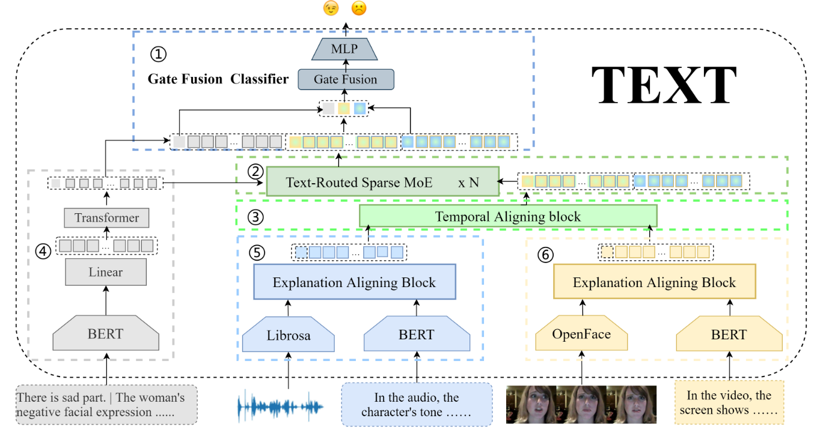
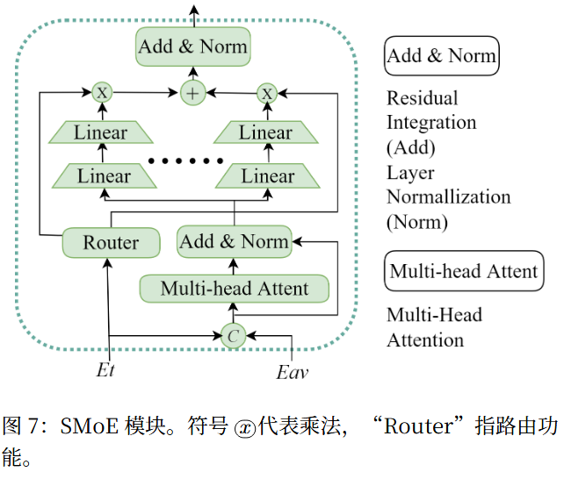
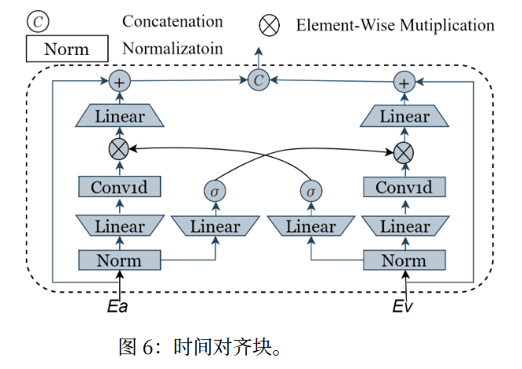
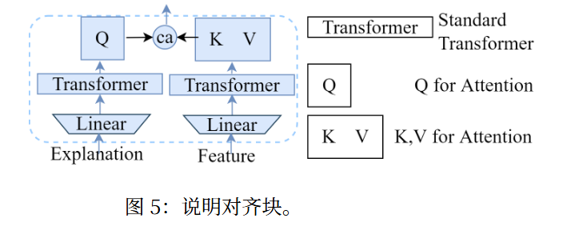


ChongqingUniversity of Technology
ATAI
AdvancedTechniqueof
Artificial Intelligence
ATAI
ChongqingUniversity _{AdvancedTechniqueof}
of Technology Artificial Intelligence
2026_AAAI_A Text-Routed Sparse Mixture-of-Experts Model with Explanation and Temporal Alignment for Multi-Modal Sentiment Analysis

Slide 2
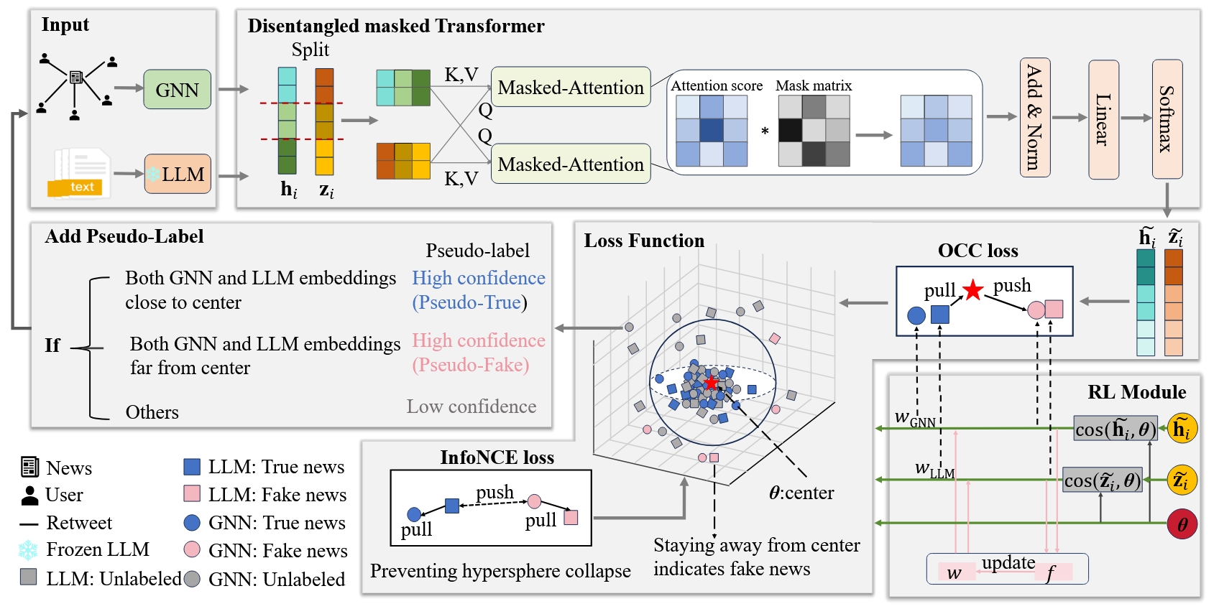


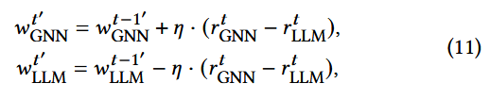



ChongqingUniversity of Technology
ATAI
AdvancedTechniqueof
Artificial Intelligence
ATAI
ChongqingUniversity _{AdvancedTechniqueof}
of Technology Artificial Intelligence
2026_WWW_Semi-Supervised Fake News Detection with Mixture of Experts

Slide 3
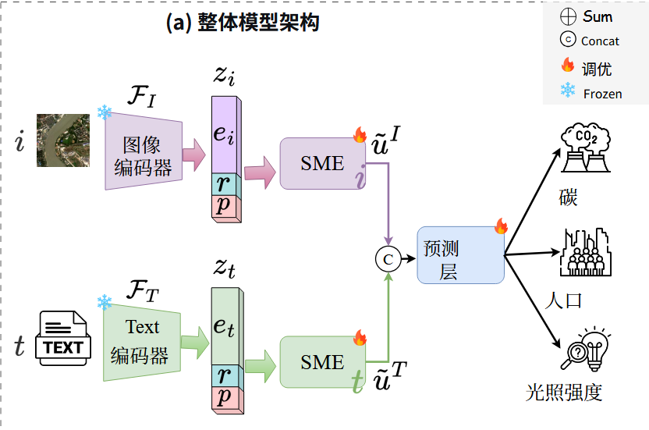





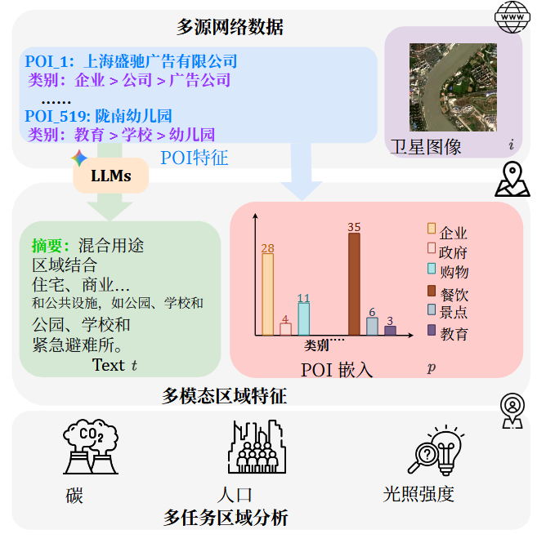
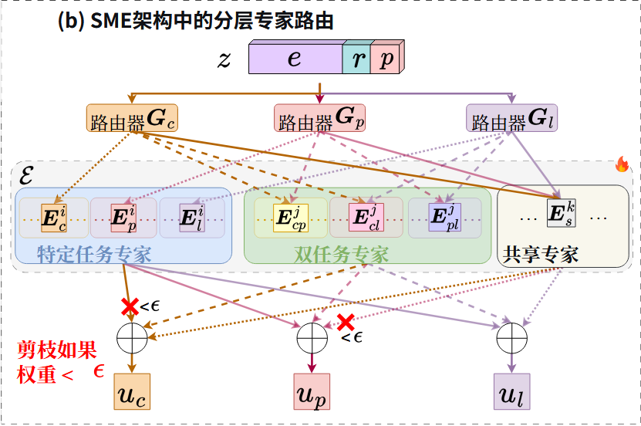
ChongqingUniversity of Technology
ATAI
AdvancedTechniqueof
Artificial Intelligence
ATAI
ChongqingUniversity _{AdvancedTechniqueof}
of Technology Artificial Intelligence
2026_WWW_UrbanMoE: A Sparse Multi-Modal Mixture-of-Experts Framework for Multi-Task Urban Region Profiling

