Slide 1


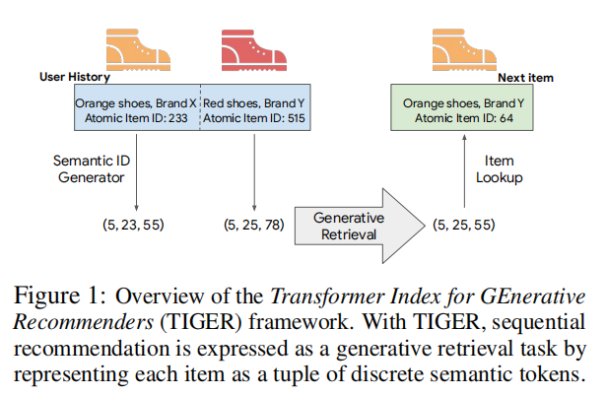
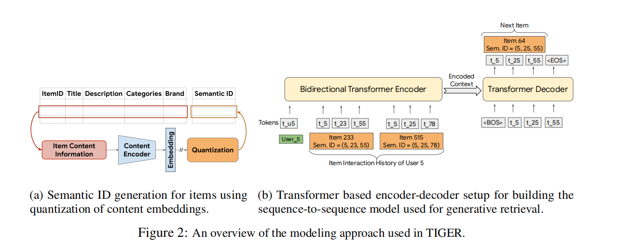

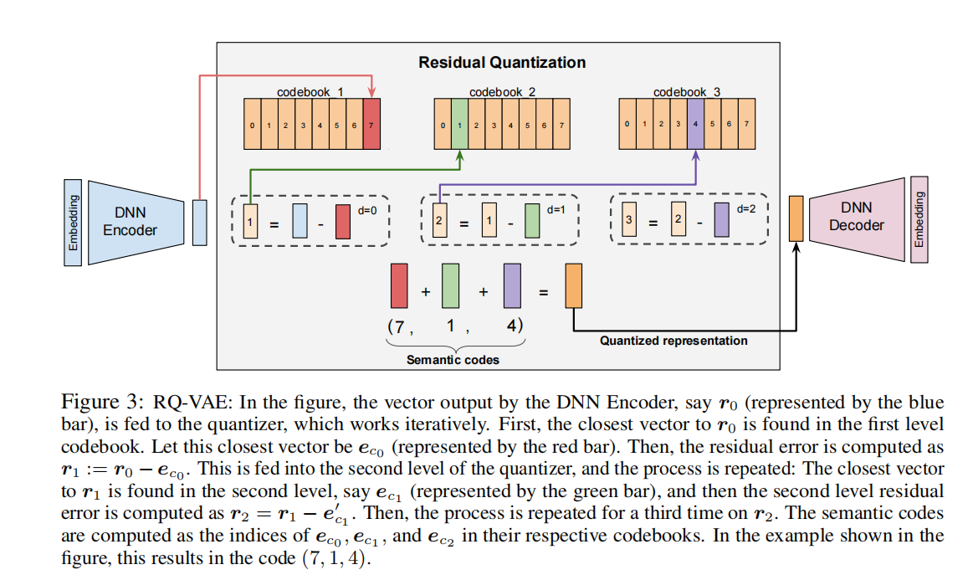







Overview
ATAI
Advanced Technique of
Artificial Intelligence
ATAI
ChongqingUniversity _{AdvancedTechniqueof}
of Technology Artificial Intelligence
Chongqing University of Technology
For each level, a codebook of cardinality 256 is maintained, where each vector in the codebook has a dimension of 32.
2023_NeurIPS: Recommender Systems with Generative Retrieval
Notes:
1.语义码：
（1）核心定义
语义码是物品语义特征的离散化索引，是构成物品Semantic ID的基本单元。它本质是对物品高维语义嵌入进行量化后，对应码本中向量的索引标识，而非向量本身。
（2）语义属性
层级关联性：不同位置的语义码对应不同粒度的物品语义。
相似性共享：语义相近的物品，其语义码会存在重叠。
（3）生成逻辑
语义码通过RQ-VAE 残差量化生成：先将物品的文本特征（标题、品牌等）用 Sentence-T5 转为 768 维语义嵌入，再压缩为 32 维潜向量；随后通过多级量化器迭代匹配潜向量的残差，每级匹配的码本向量索引即为该层级的语义码。

Slide 2

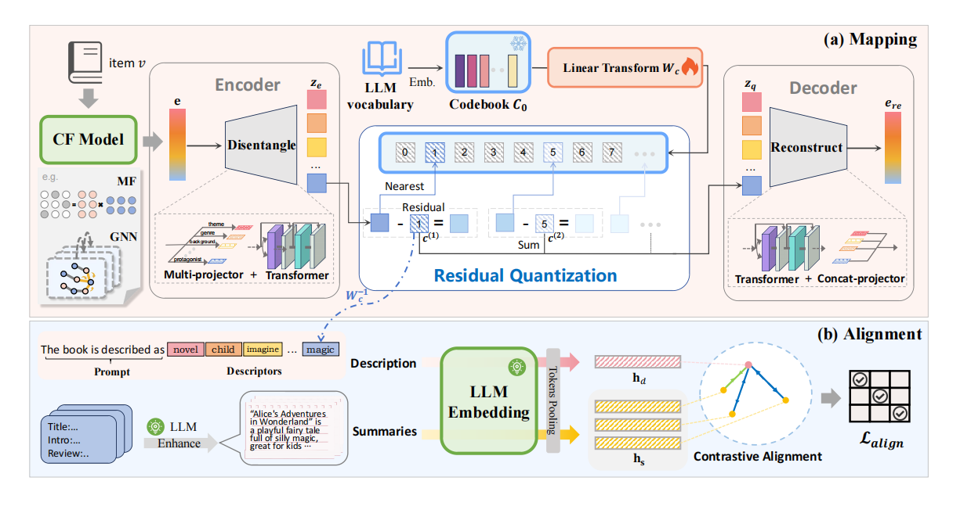
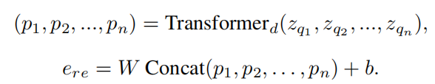
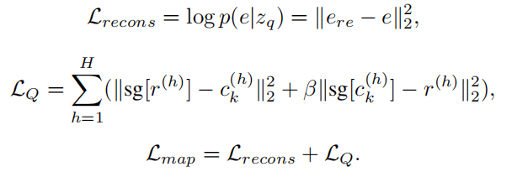


Overview
ATAI
Advanced Technique of
Artificial Intelligence
ATAI
ChongqingUniversity _{AdvancedTechniqueof}
of Technology Artificial Intelligence
Chongqing University of Technology
2025_NeurIPS_ FACE: A General Framework for Mapping Collaborative Filtering Embedding into LLM Tokens

Slide 3
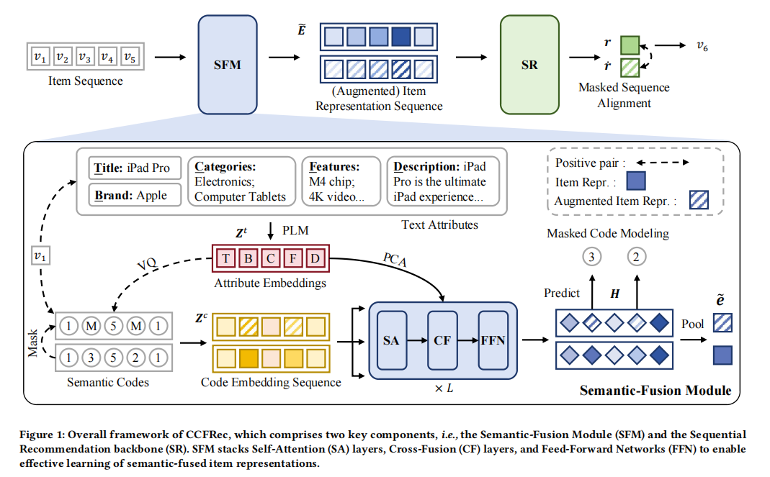
Overview
ATAI
Advanced Technique of
Artificial Intelligence
ATAI
ChongqingUniversity _{AdvancedTechniqueof}
of Technology Artificial Intelligence
Chongqing University of Technology
2025_KDD_Bridging Textual-Collaborative Gap through Semantic Codes for Sequential Recommendation

Slide 4
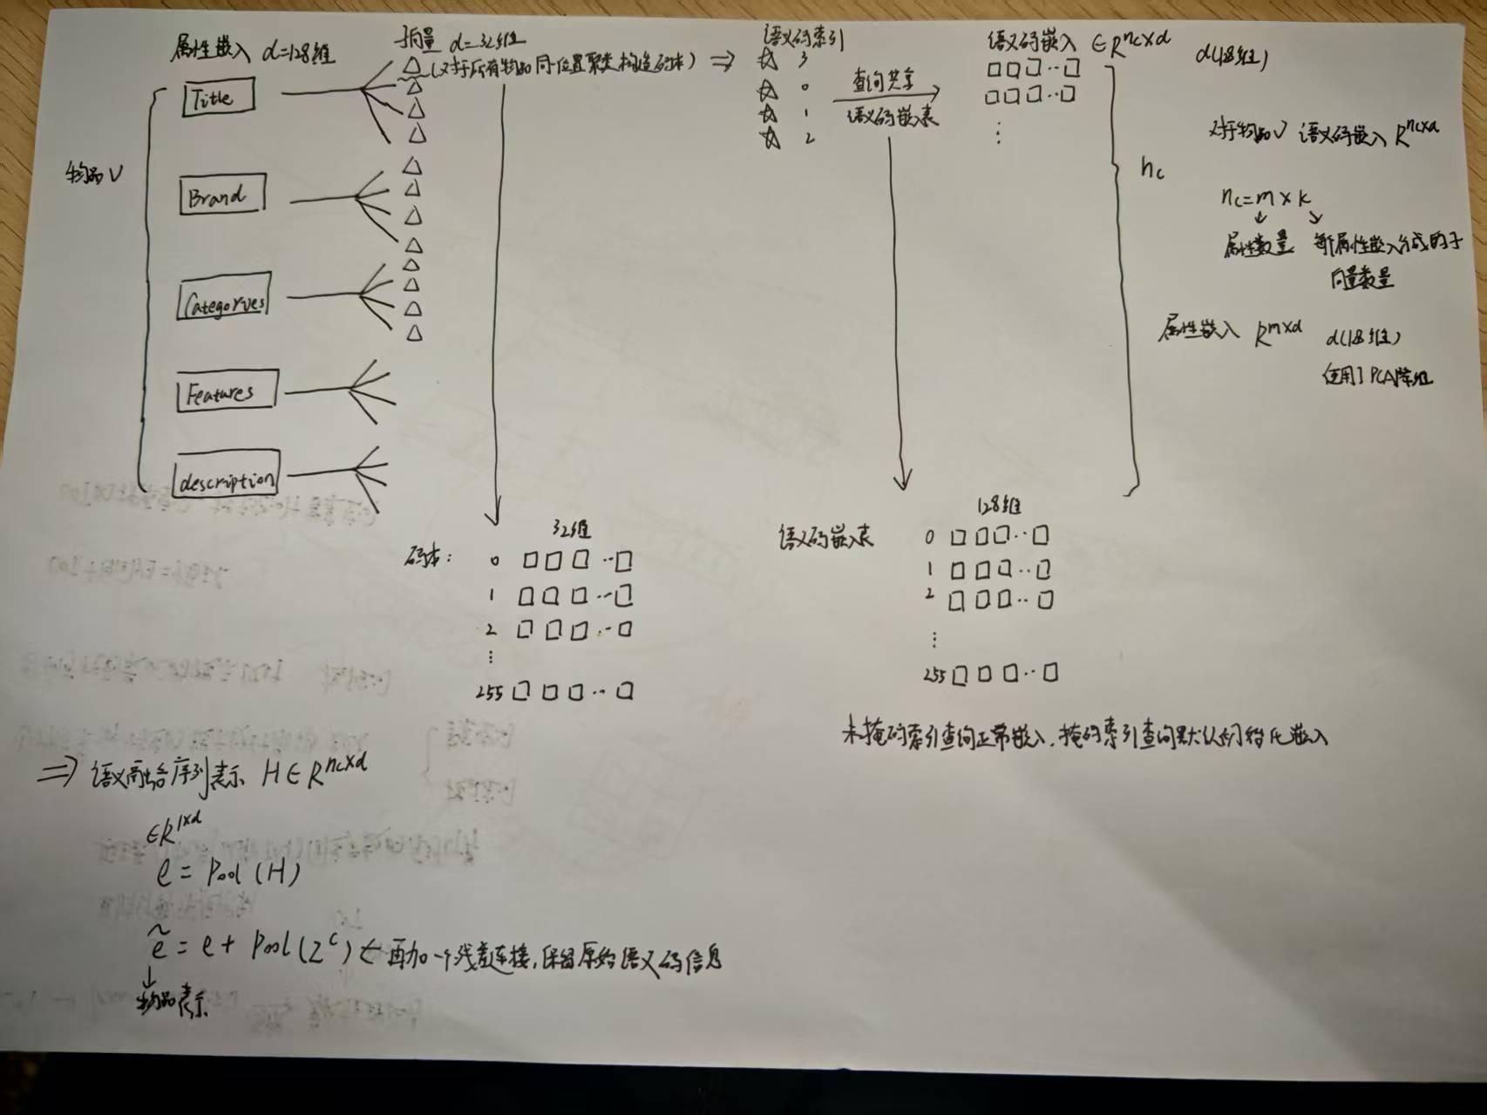
Overview
ATAI
Advanced Technique of
Artificial Intelligence
ATAI
ChongqingUniversity _{AdvancedTechniqueof}
of Technology Artificial Intelligence
Chongqing University of Technology
each attribute vector is quantized into 4 sub-vectors with a codebook size of 256
2025_KDD_Bridging Textual-Collaborative Gap through Semantic Codes for Sequential Recommendation

Slide 5
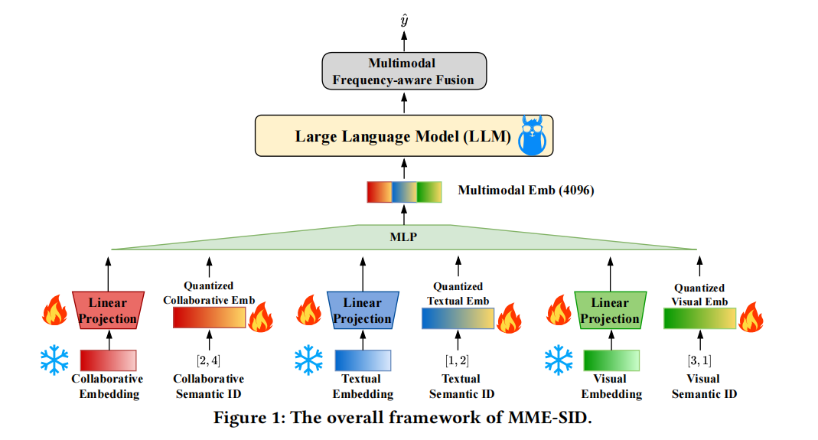

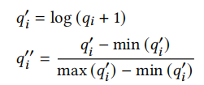
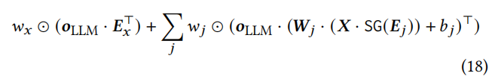
Overview
ATAI
Advanced Technique of
Artificial Intelligence
ATAI
ChongqingUniversity _{AdvancedTechniqueof}
of Technology Artificial Intelligence
Chongqing University of Technology
2025_CIKM_Empowering Large Language Model for Sequential Recommendation via Multimodal Embeddings and Semantic IDs

Slide 6
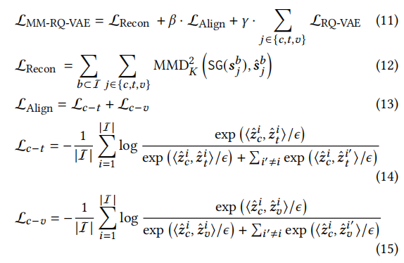
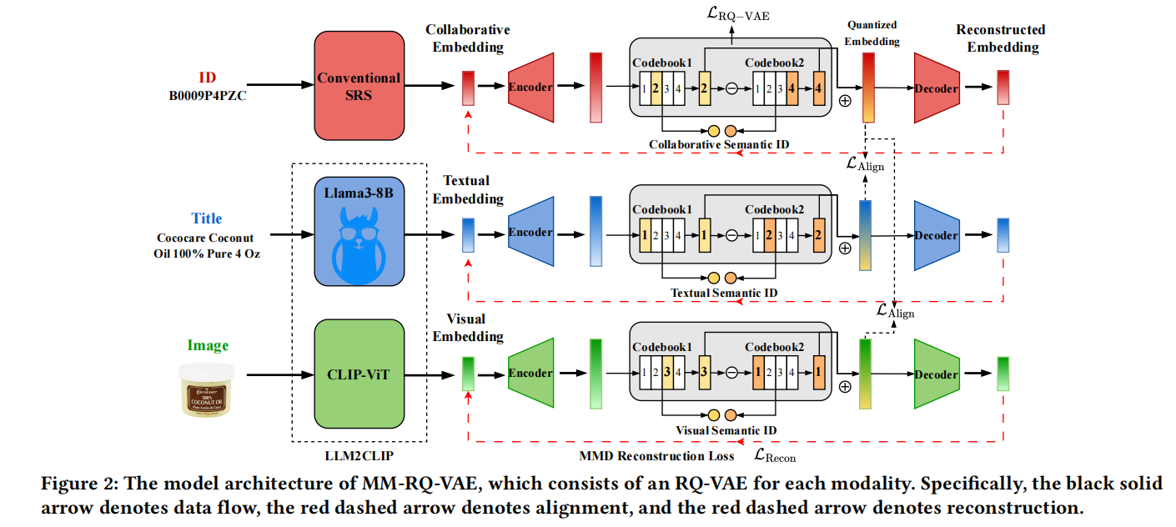
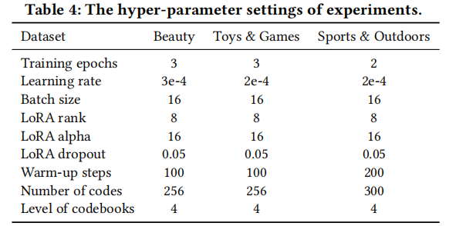
Overview
ATAI
Advanced Technique of
Artificial Intelligence
ATAI
ChongqingUniversity _{AdvancedTechniqueof}
of Technology Artificial Intelligence
Chongqing University of Technology
2025_CIKM_Empowering Large Language Model for Sequential Recommendation via Multimodal Embeddings and Semantic IDs

Slide 7
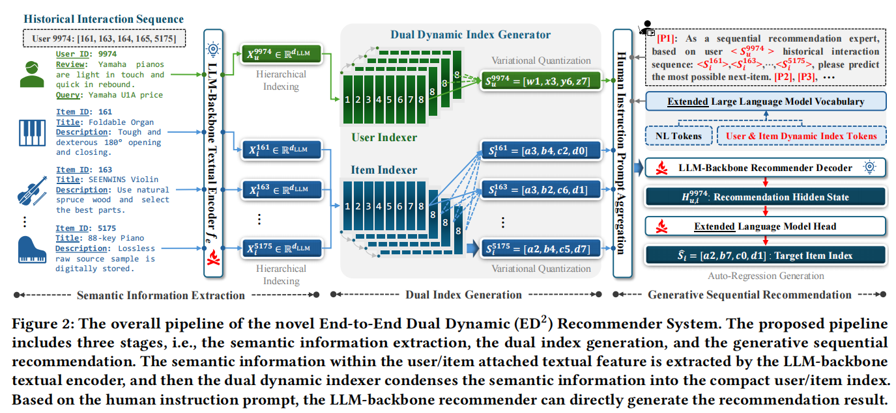
Overview
ATAI
Advanced Technique of
Artificial Intelligence
ATAI
ChongqingUniversity _{AdvancedTechniqueof}
of Technology Artificial Intelligence
Chongqing University of Technology
2025_WWW_Unleash LLMs Potential for Sequential Recommendation by Coordinating Dual Dynamic Index Mechanism

Slide 8
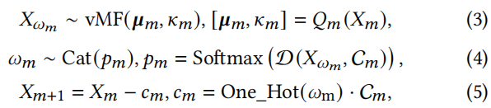

Overview
ATAI
Advanced Technique of
Artificial Intelligence
ATAI
ChongqingUniversity _{AdvancedTechniqueof}
of Technology Artificial Intelligence
Chongqing University of Technology
For the dual dynamic index generator, the dual index length L is set as 4, and thus both the item and the user branch have 4 hierarchically cascade quantization codebooks, respectively. Each quantization codebook consists of 256 quantization embeddings whose dimension is set to 64.
2025_WWW_Unleash LLMs Potential for Sequential Recommendation by Coordinating Dual Dynamic Index Mechanism

Slide 9
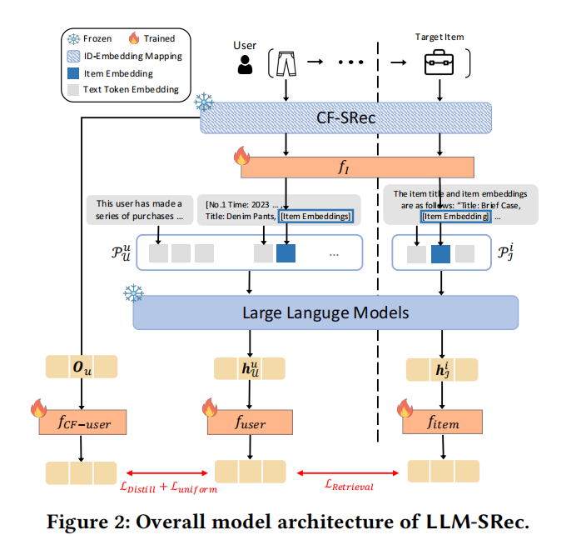
Overview
ATAI
Advanced Technique of
Artificial Intelligence
ATAI
ChongqingUniversity _{AdvancedTechniqueof}
of Technology Artificial Intelligence
Chongqing University of Technology
2025_KDD_Lost in Sequence: Do Large Language Models Understand Sequential Recommendation

Slide 10
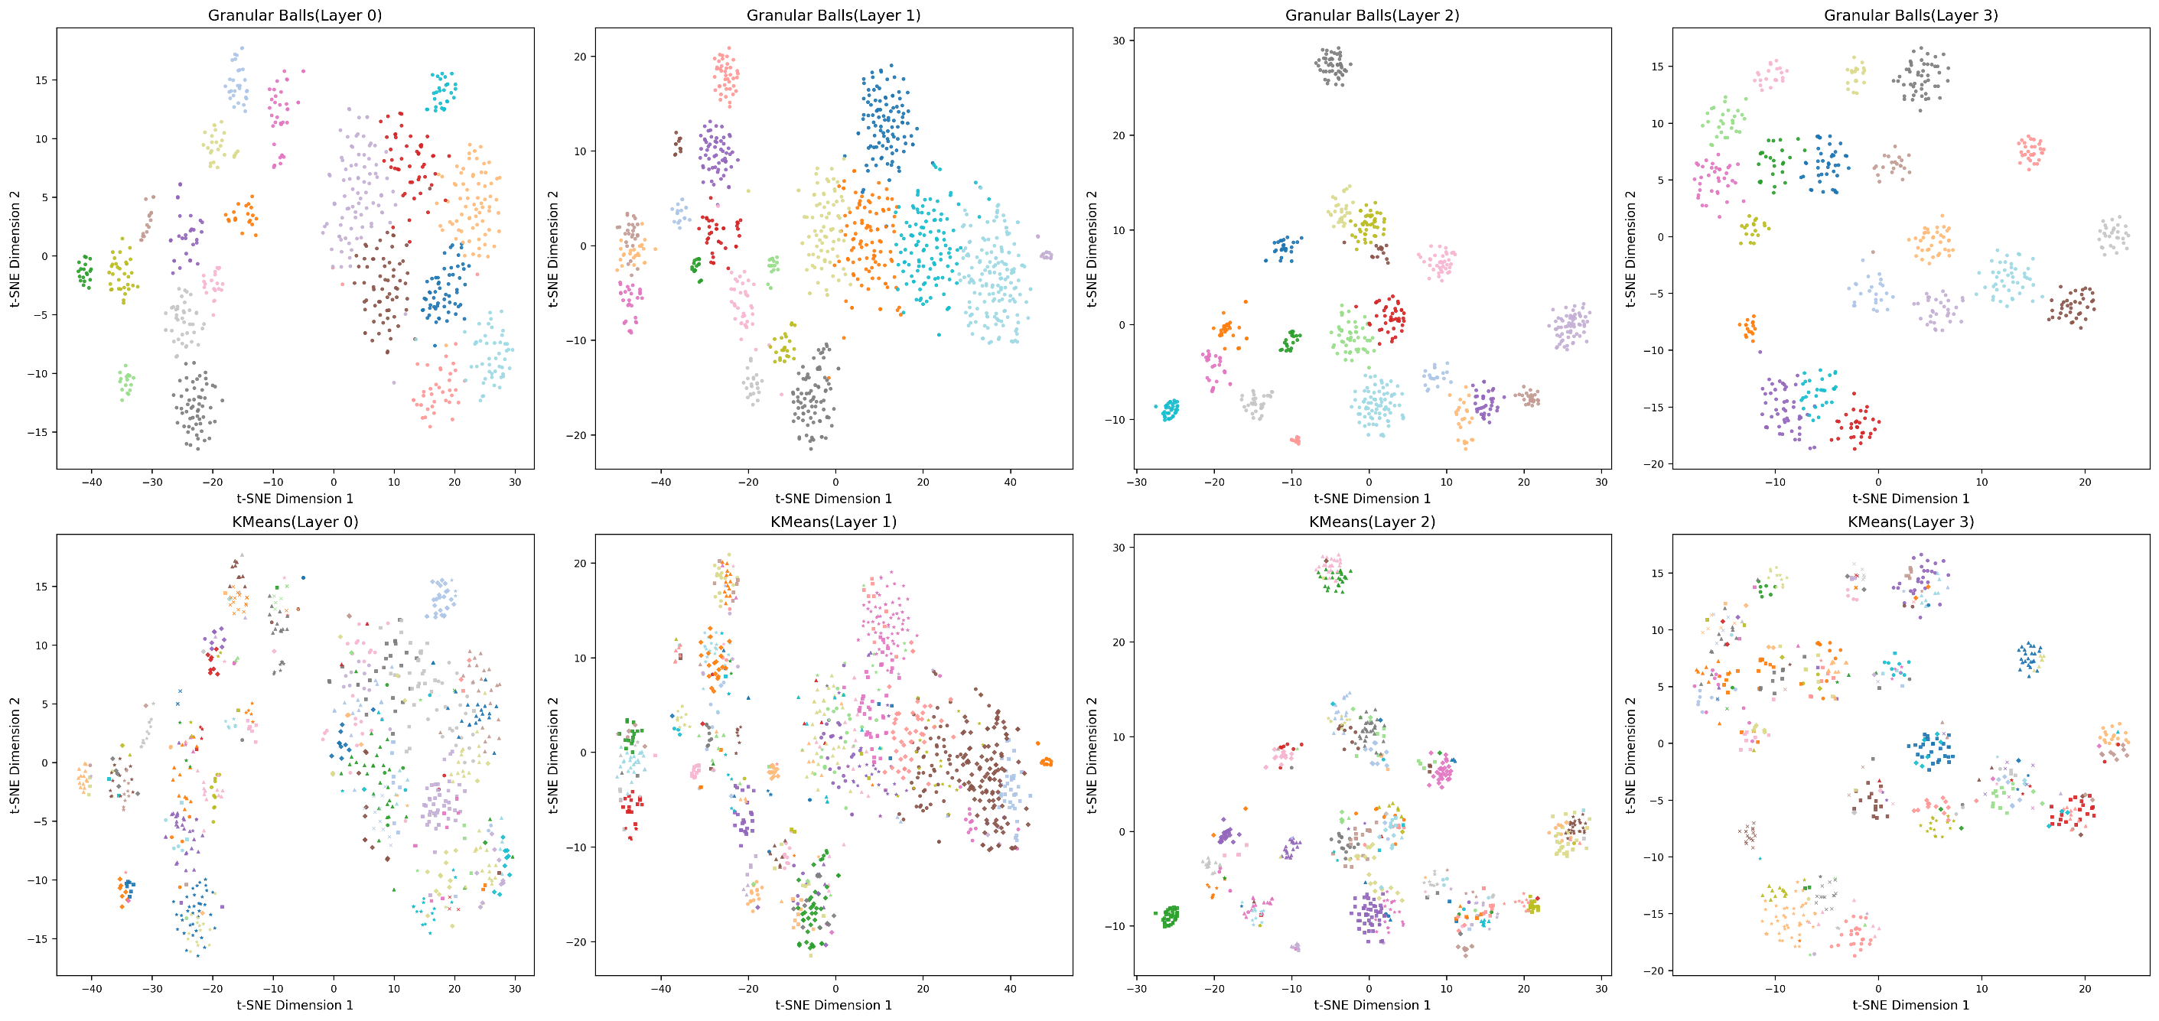
Overview
ATAI
Advanced Technique of
Artificial Intelligence
ATAI
ChongqingUniversity _{AdvancedTechniqueof}
of Technology Artificial Intelligence
Chongqing University of Technology

Slide 11
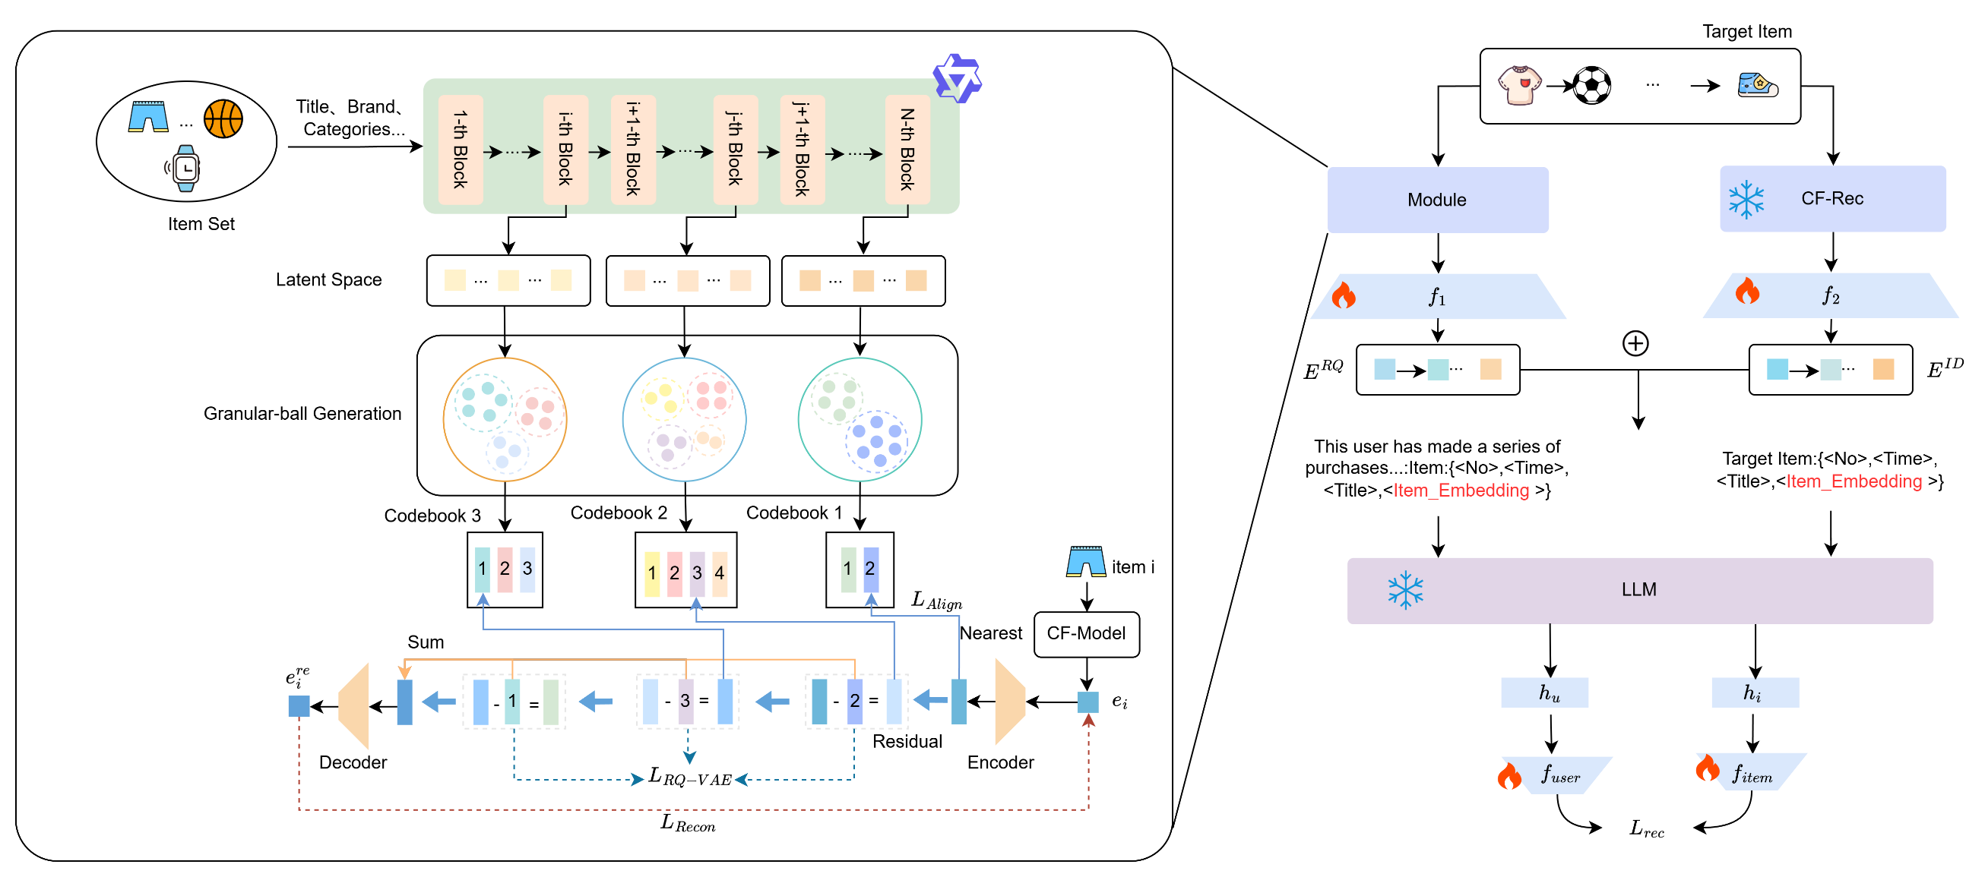
Overview
ATAI
Advanced Technique of
Artificial Intelligence
ATAI
ChongqingUniversity _{AdvancedTechniqueof}
of Technology Artificial Intelligence
Chongqing University of Technology

Slide 12
Overview
ATAI
Advanced Technique of
Artificial Intelligence
ATAI
ChongqingUniversity _{AdvancedTechniqueof}
of Technology Artificial Intelligence
Chongqing University of Technology
创新点：
（1）大模型分层得到物品表示聚类构建码本，和残差量化过程实现更好的融合协同语义。残差量化过程是由粗到细的过程，通过一系列码本按顺序进行编码，每一步都专注于量化前一步剩余的残差。第一步负责捕获输入向量最主要、最粗粒度的信息，如物品的大类或主要风格，后面的步骤主要逐步捕获细节，修正误差。大模型浅层关注局部、具体的词汇和句法特征，对应信息的基础细节，深层关注全局、抽象的语义和推理，对应信息的核心主题或抽象概念。残差量化的过程可以和大模型深层到浅层对应。
（2）使用粒球代替kmeans对物品表示聚类，码本大小不在固定了。若码本过小，不同语义被粗暴合并、发生语义损失；若码本过大，则会在稀疏区域产生冗余簇，引入噪声并降低泛化能力。粒球聚类通过“密度 + 半径”自适应生成聚类球体，使码本大小自动随语义分布调整：语义密集区域自动生成更多粒球以刻画细粒度差异，而语义稀疏区域只保留必要的代表性粒球，从而既避免语义粗化也避免冗余量化。

Slide 13
Overview
ATAI
Advanced Technique of
Artificial Intelligence
ATAI
ChongqingUniversity _{AdvancedTechniqueof}
of Technology Artificial Intelligence
Chongqing University of Technology
toys | NDCG10 | HR10 | NDCG20 | HR20
LLM-SRec | 0.25065 | 0.418133 | 0.286551 | 0.5609
kmeans | 0.258288 | 0.423 | 0.293796 | 0.5641
最后一层 | 0.267567 | 0.4356 | 0.303026 | 0.576333
Ours | 0.26924 | 0.4462 | 0.305051 | 0.588467
Sports | NDCG10 | HR10 | NDCG20 | HR20
LLM-SRec | 0.26989 | 0.462033 | 0.309224 | 0.617567
kmeans | 0.298207 | 0.497167 | 0.337768 | 0.6536
最后一层 | 0.305016 | 0.505267 | 0.345761 | 0.664133
Ours | 0.307203 | 0.5075 | 0.347338 | 0.669033
yelp | NDCG10 | HR10 | NDCG20 | HR20
LLM-SRec | 0.437695 | 0.7345 | 0.477442 | 0.890553
kmeans | 0.437881 | 0.745067 | 0.477261 | 0.8996
最后一层 | 0.447347 | 0.74895 | 0.485846 | 0.9036
Ours | 0.450356 | 0.751967 | 0.489367 | 0.905167

Slide 14


ATAI
Advanced Technique of
Artificial Intelligence
ATAI
ChongqingUniversity _{AdvancedTechniqueof}
of Technology Artificial Intelligence
Chongqing University of Technology
Thanks!

