Slide 1
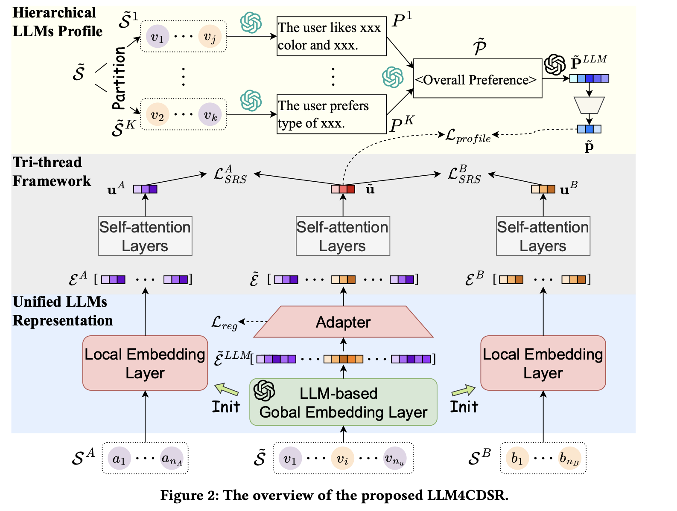
2025_SIGIR_LLM4CDSR_Bridge the Domains: Large Language Models Enhanced Cross-domain Sequential Recommendation

Slide 2
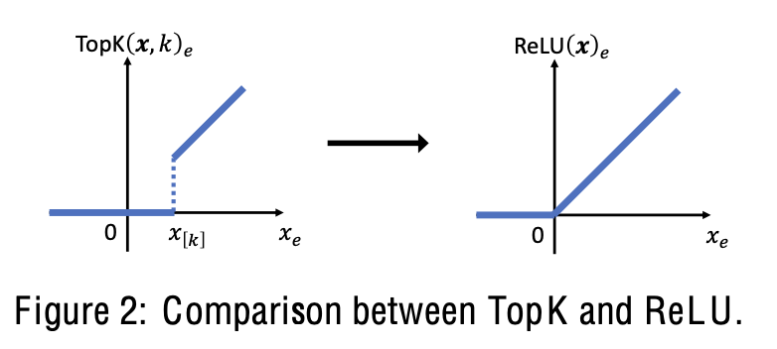
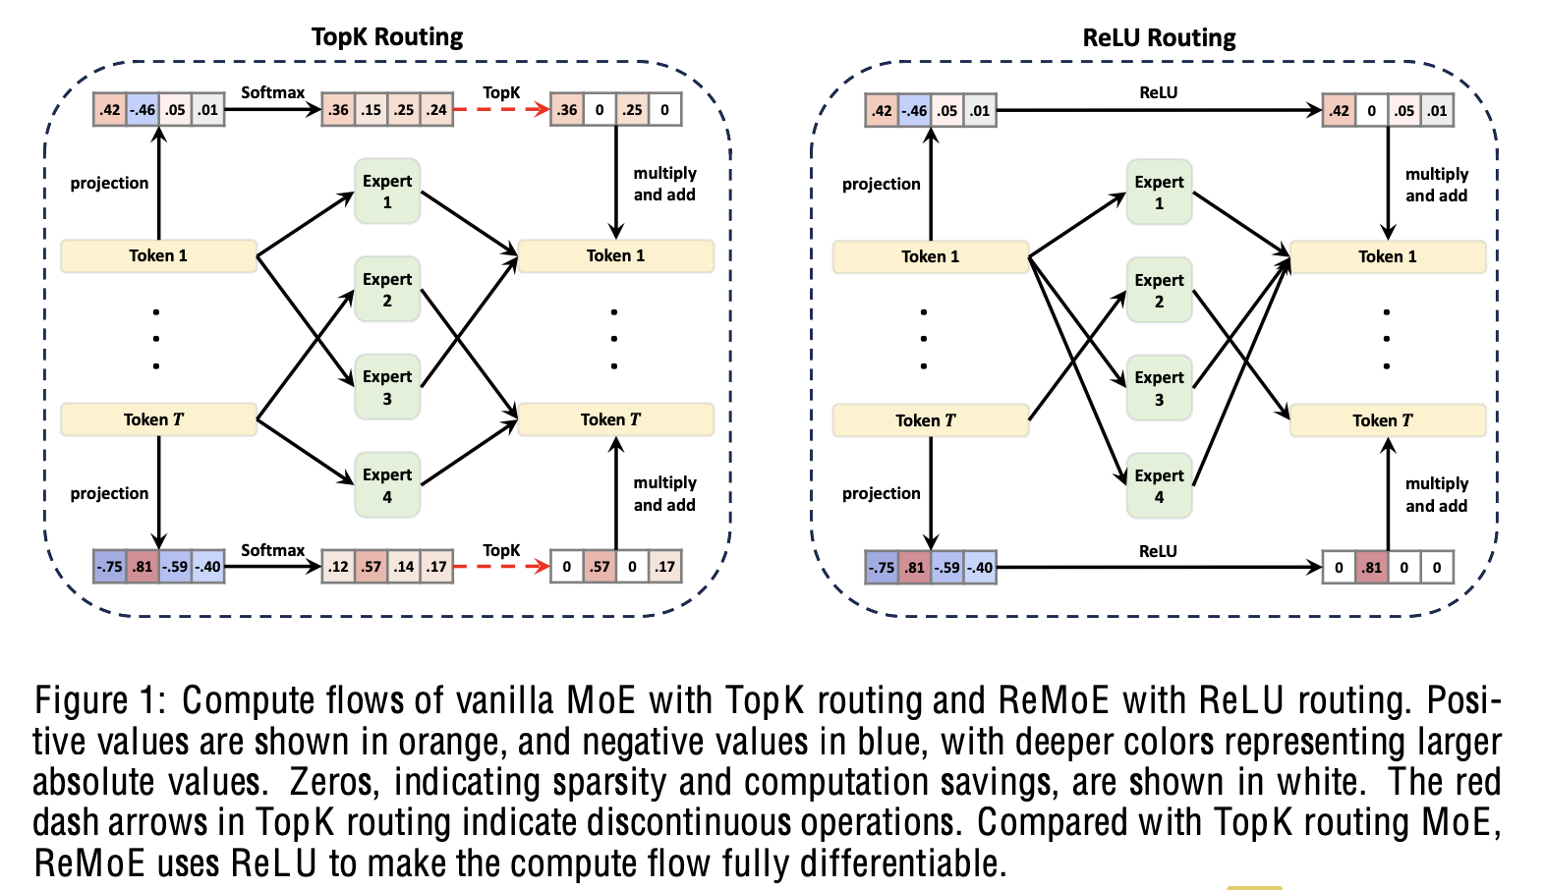


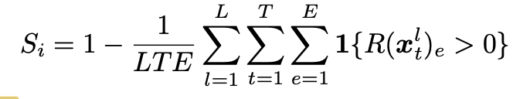
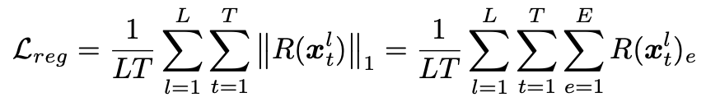
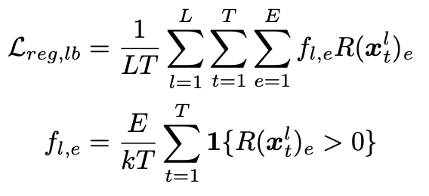
2025_ICLR_REMOE: FULLY DIFFERENTIABLE MIXTURE-OF-EXPERTS WITH RELU ROUTING

Slide 3
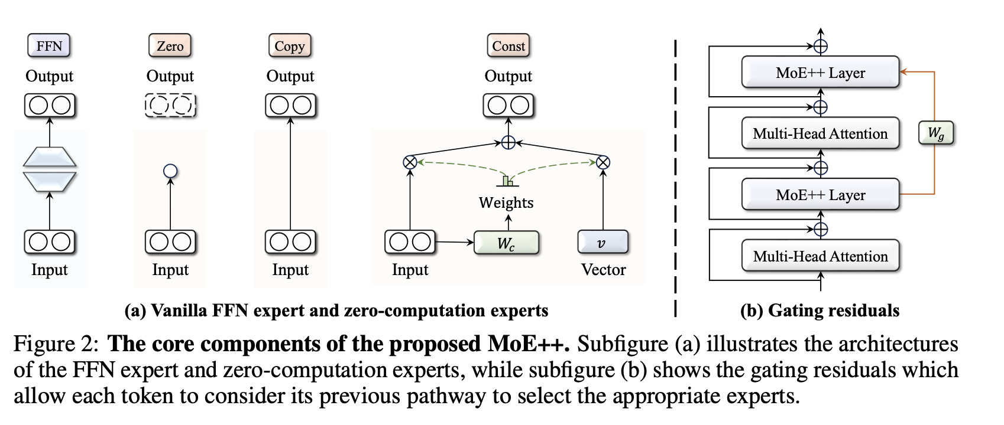
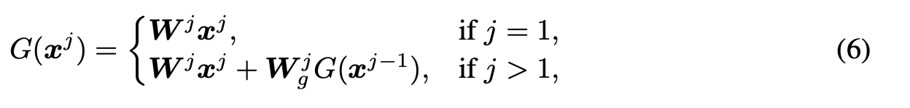
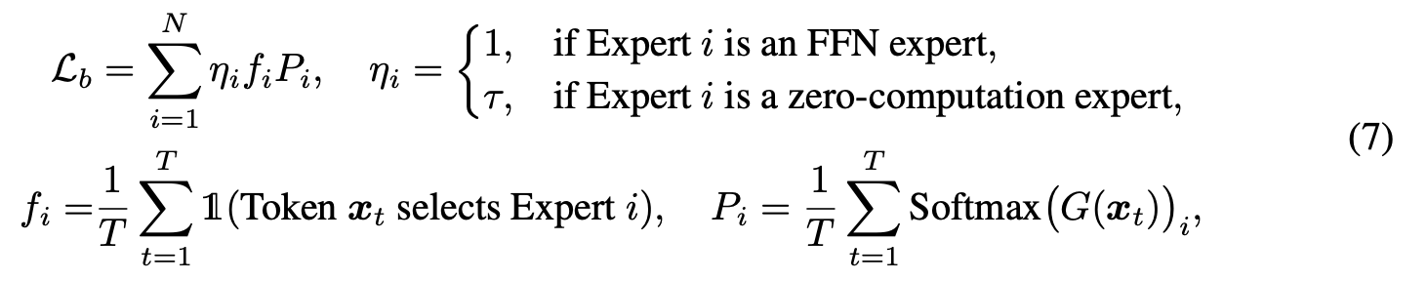
2025_ICLR_MOE++: ACCELERATING MIXTURE-OF-EXPERTS METHODS WITH ZERO-COMPUTATION EXPERTS

Slide 4
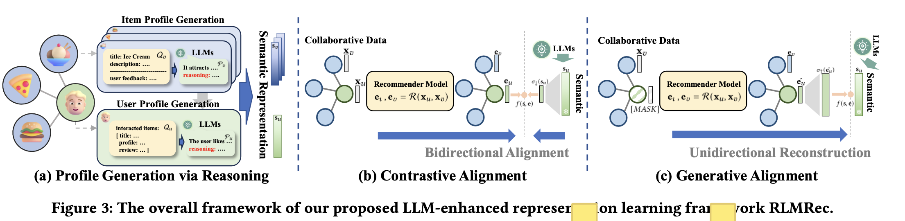
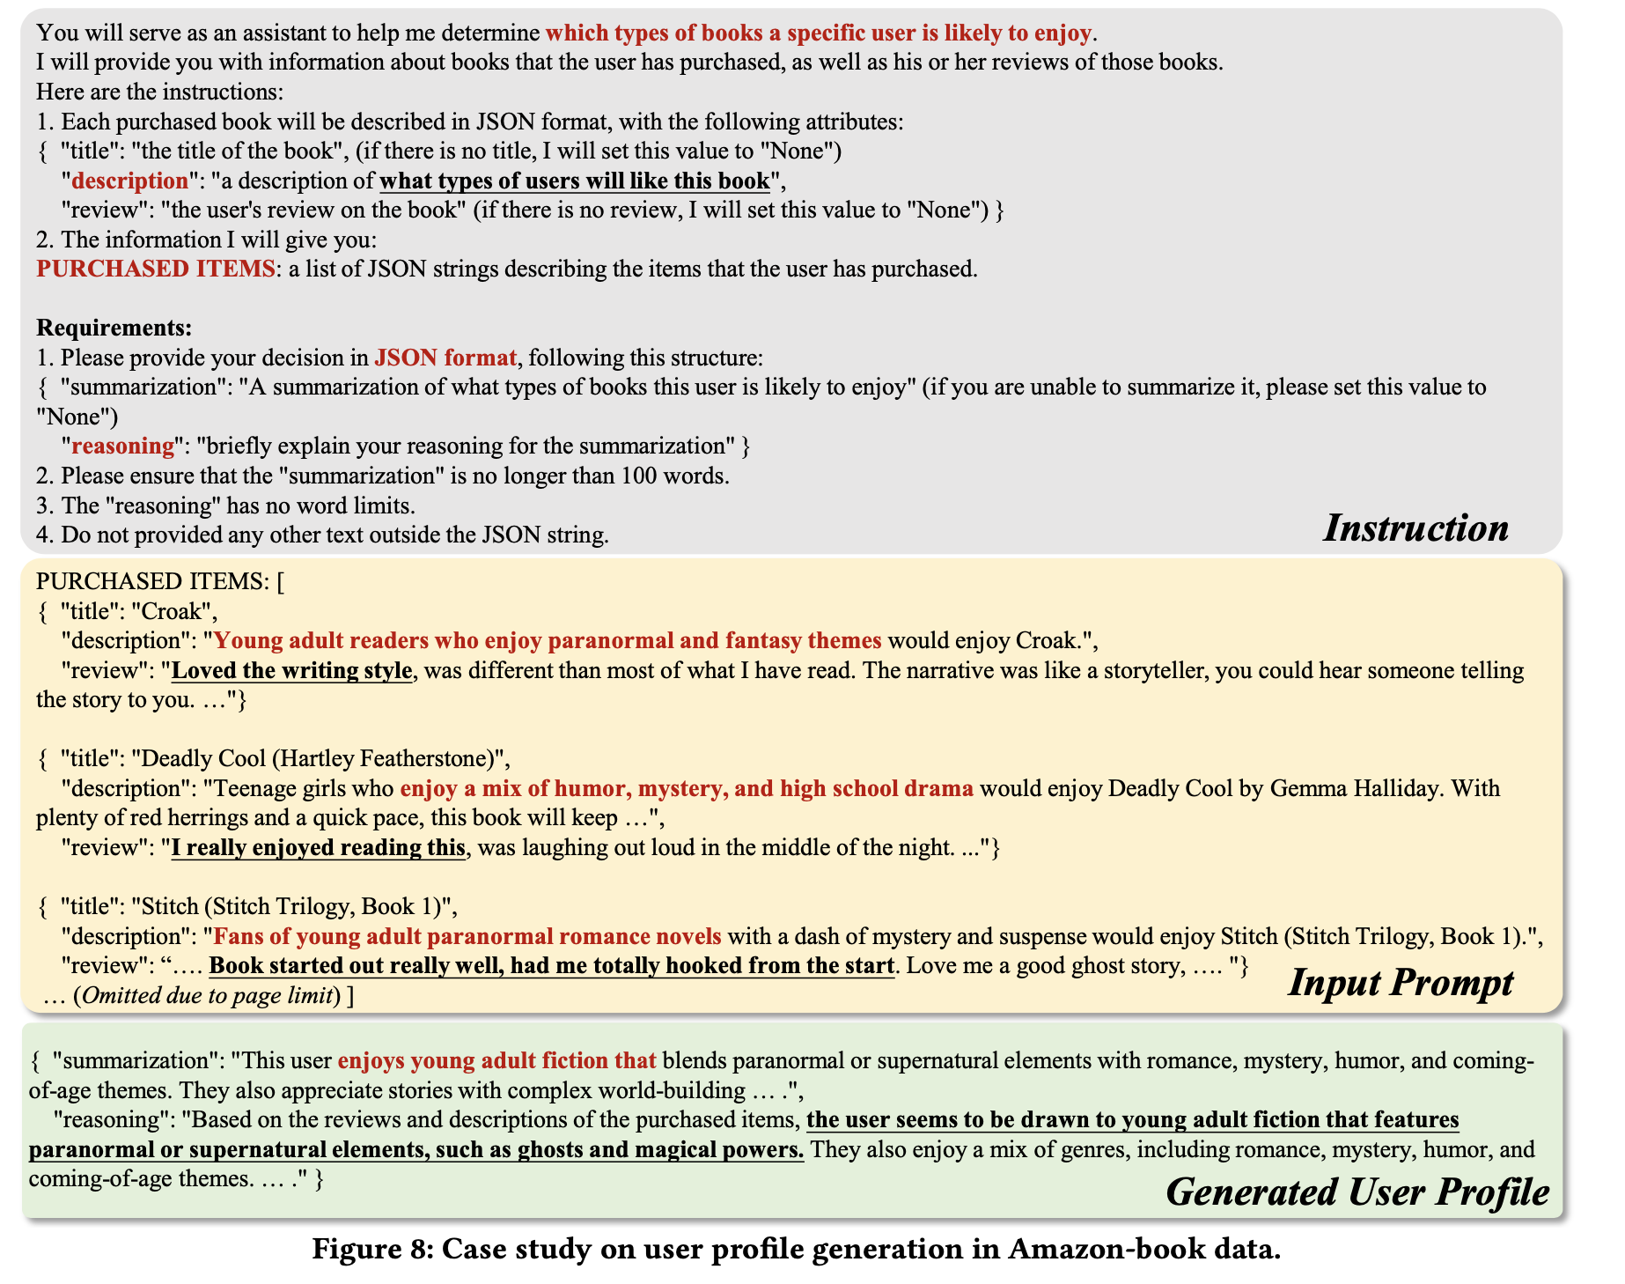
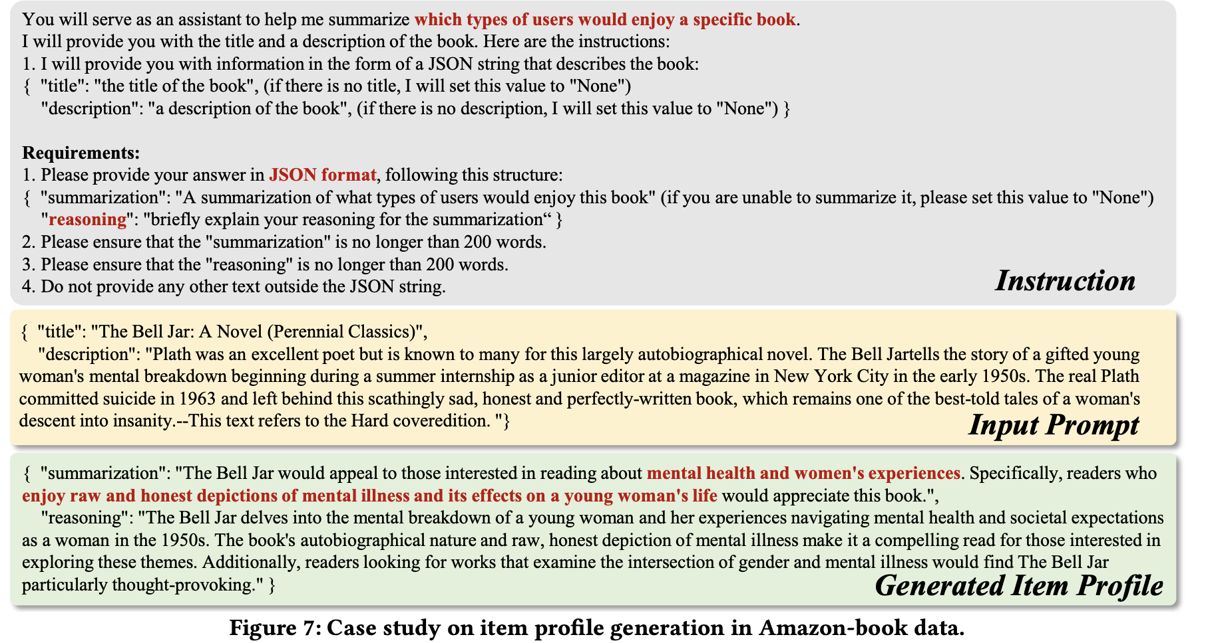
2024_WWW_Representation Learning with Large Language Models for Recommendation

Slide 5
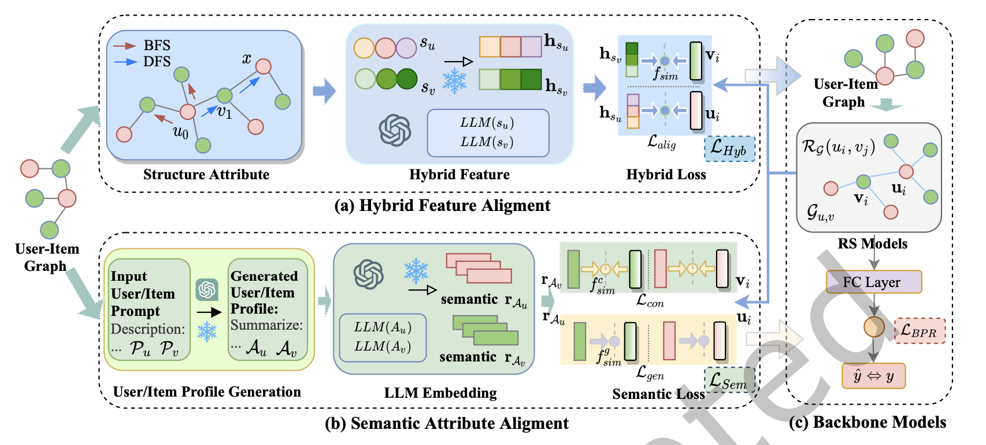
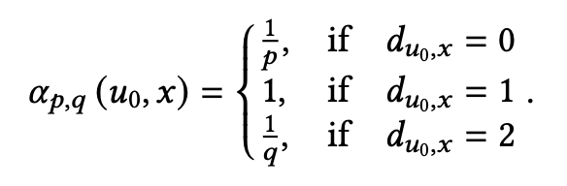

2024_arXiv_DALR_Denoising Alignment with Large Language Model for Recommendation

Slide 6
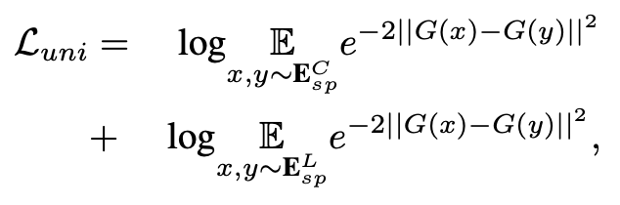
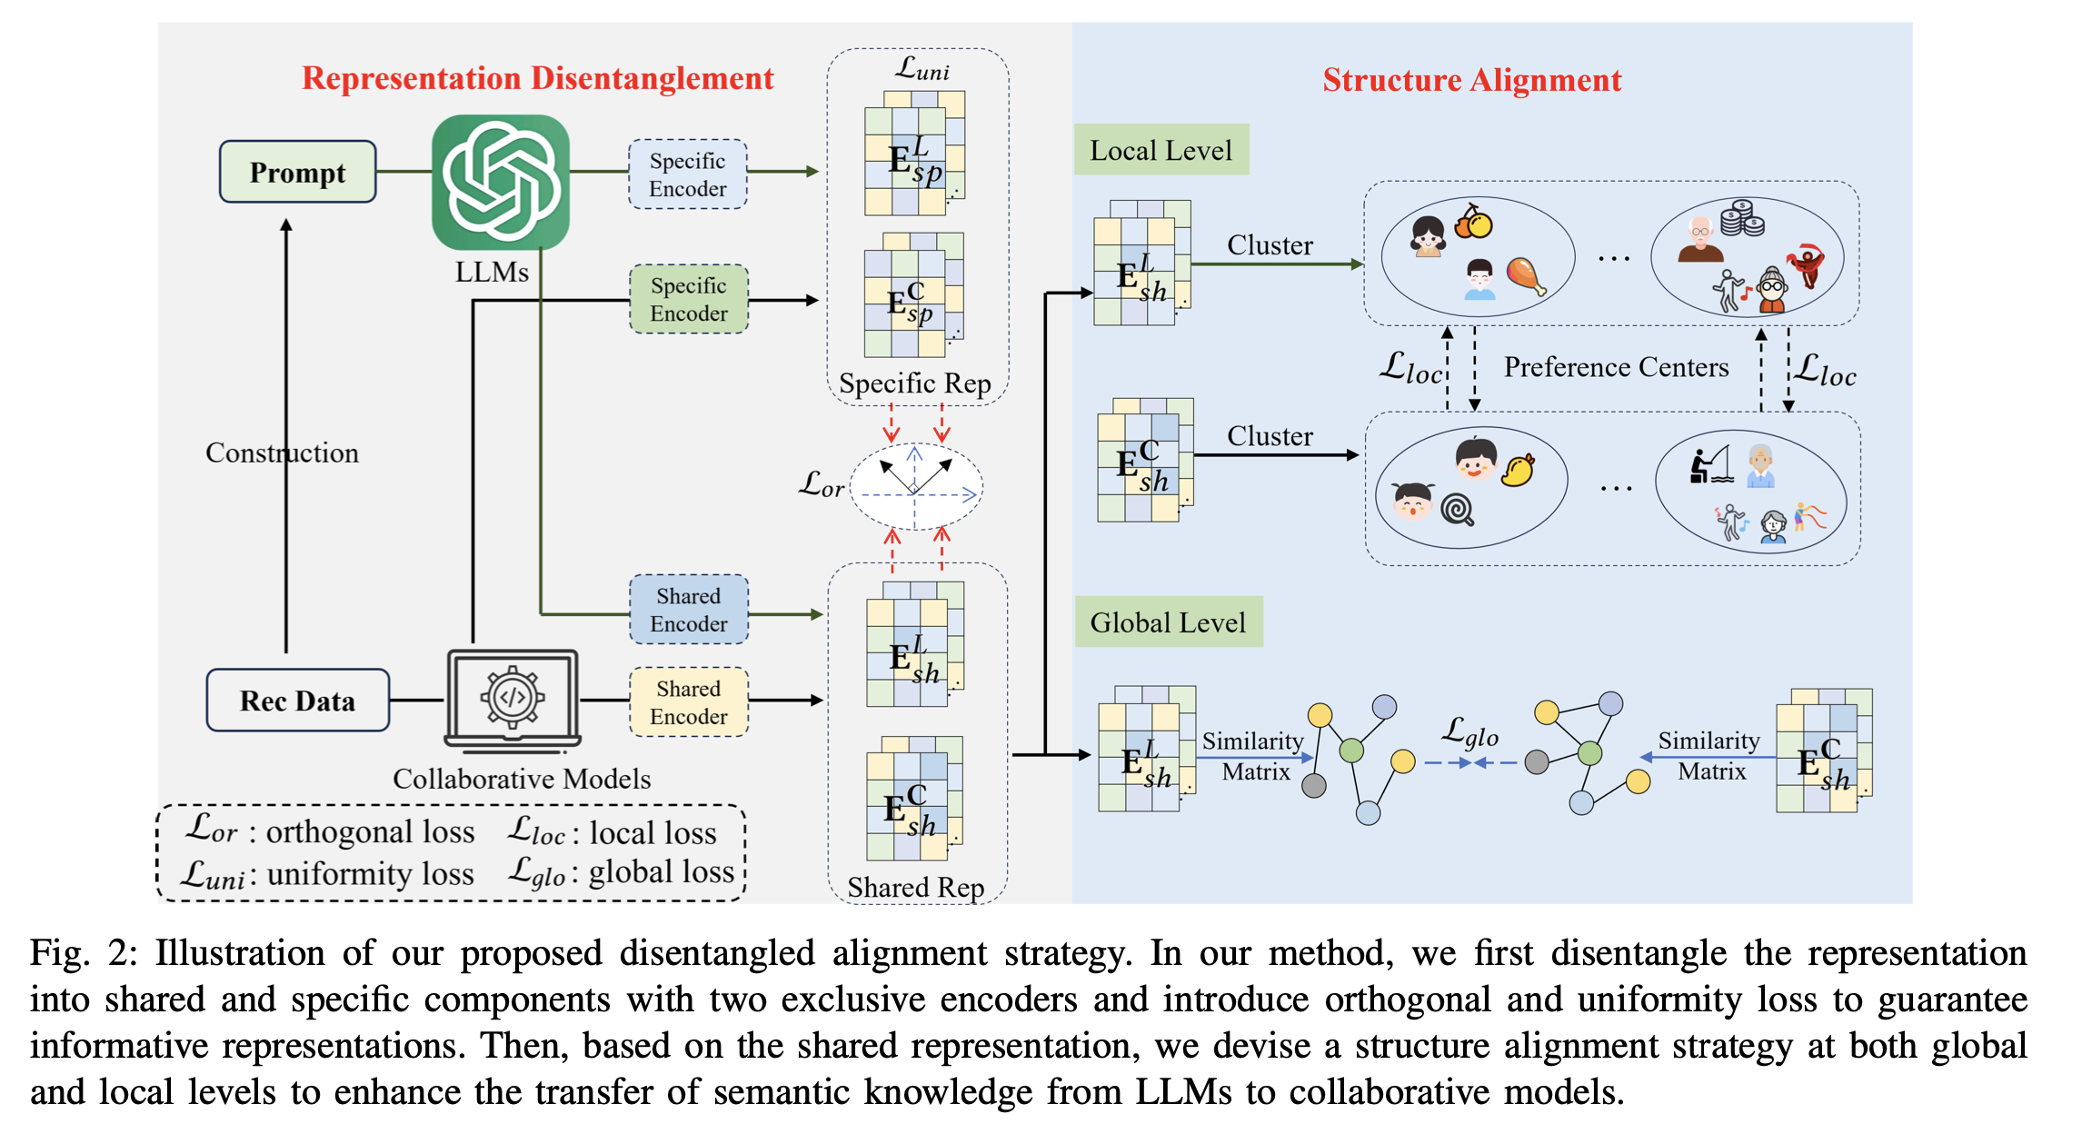
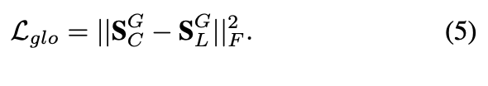

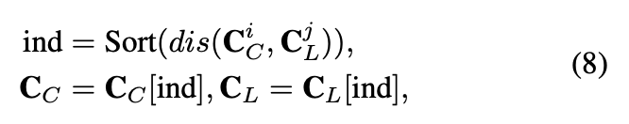
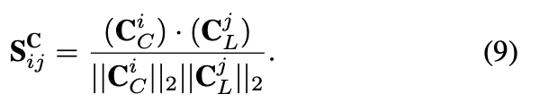
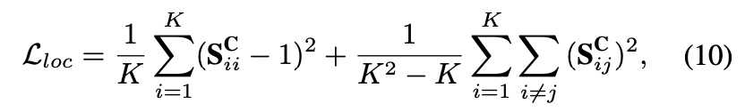
2025_ICDM_DaRec: A Disentangled Alignment Framework for Large Language Model and Recommender System

Slide 7
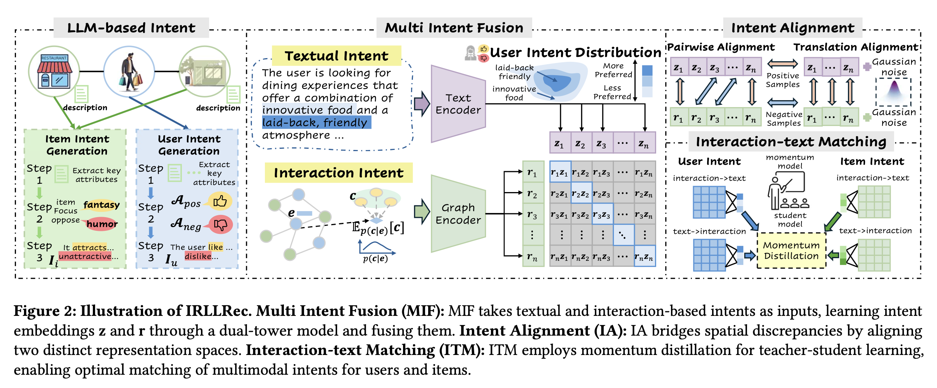
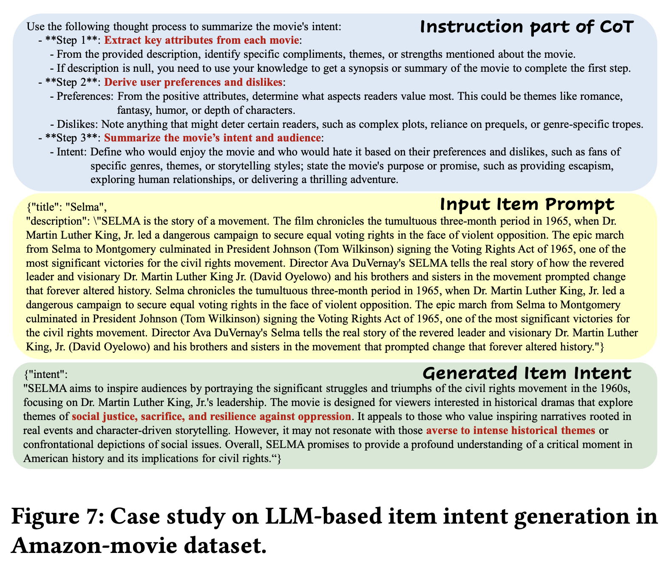
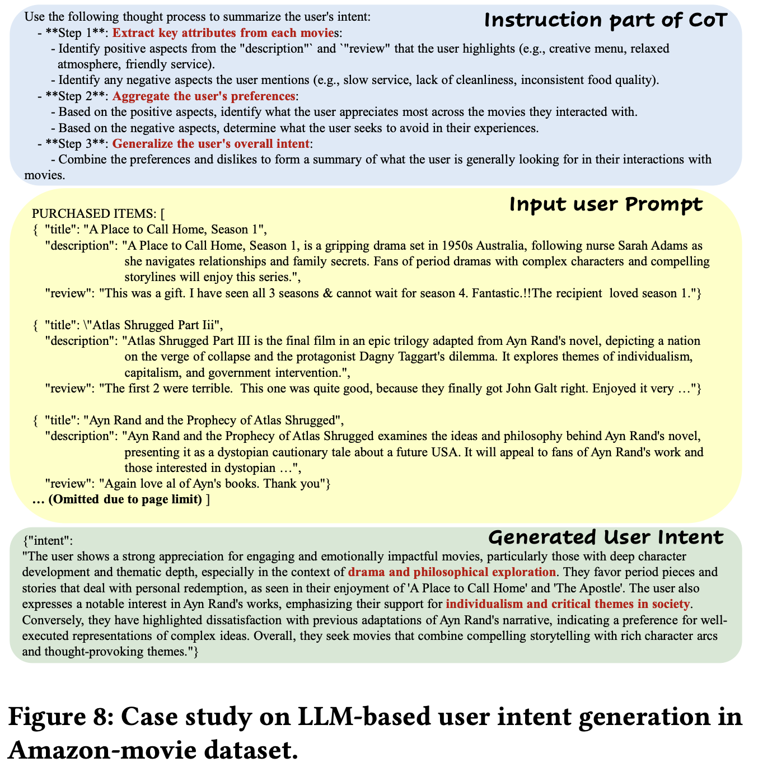
2025_SIGIR_IRLLRec_Intent Representation Learning with Large Language Model for Recommendatio

Slide 8
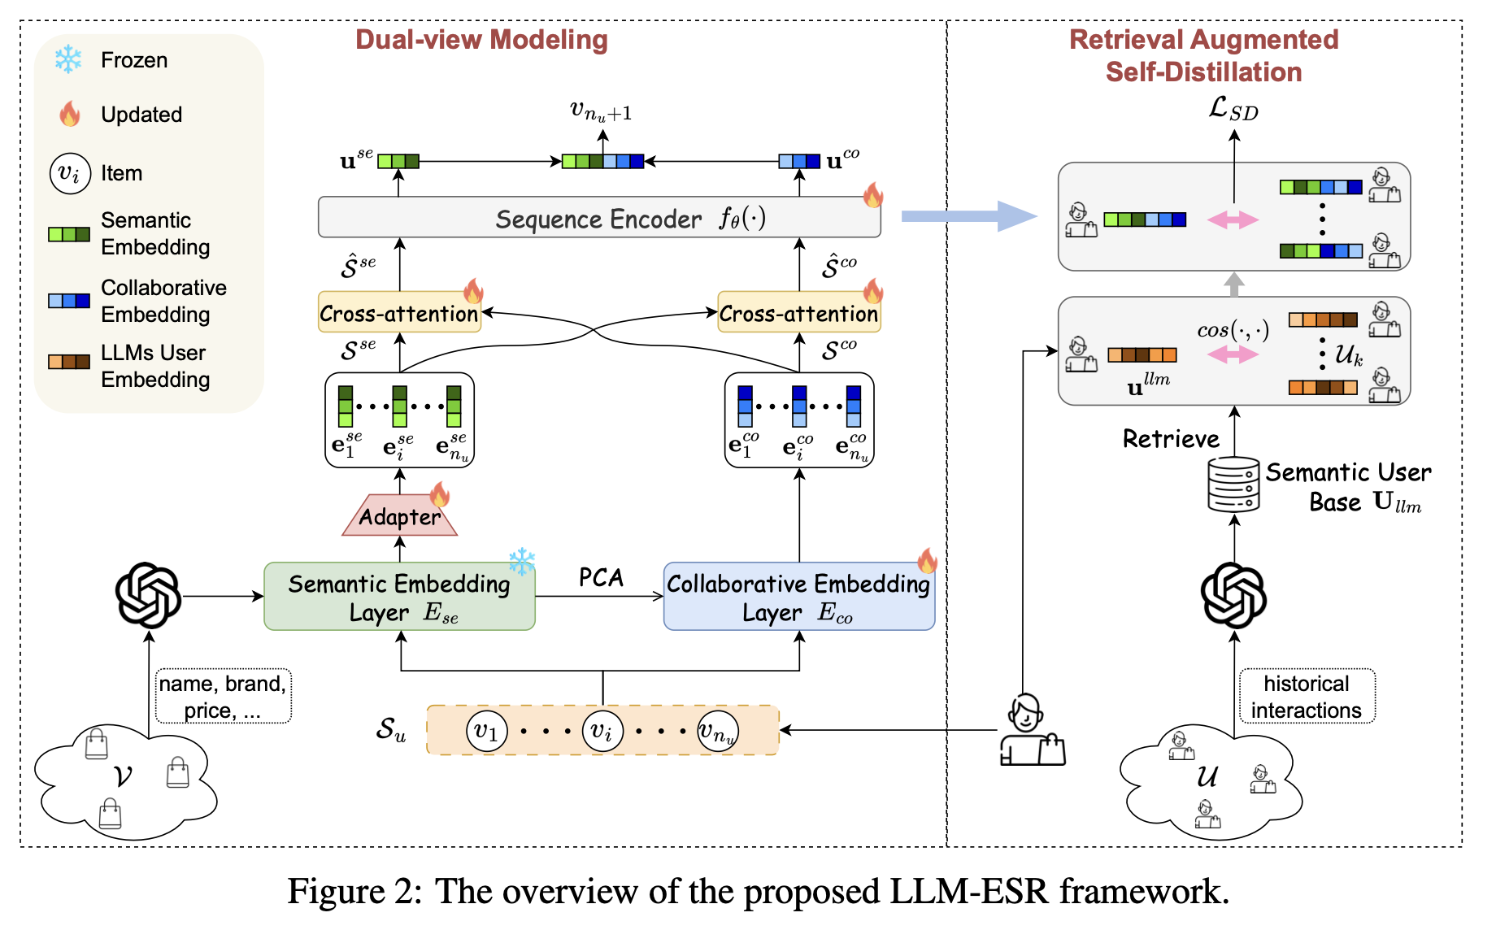
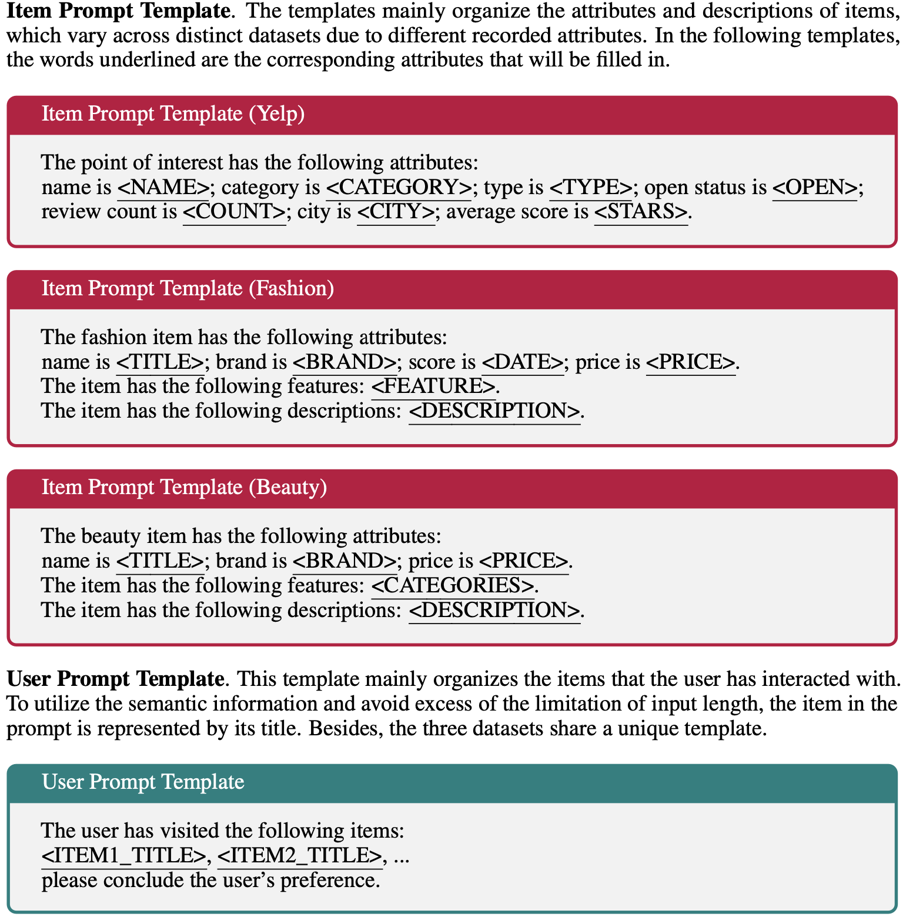
2024_NIPS_LLM-ESR: Large Language Models Enhancement for Long-tailed Sequential Recommendation

Slide 9
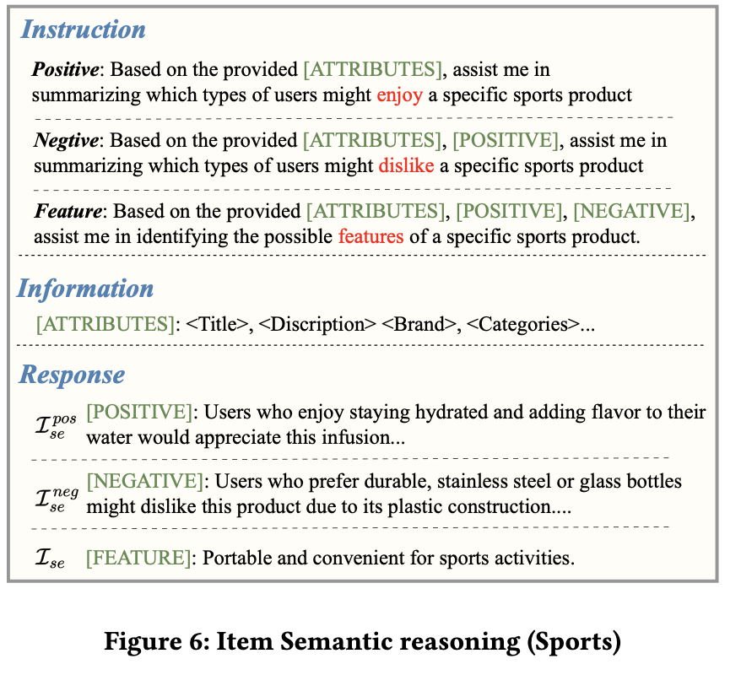
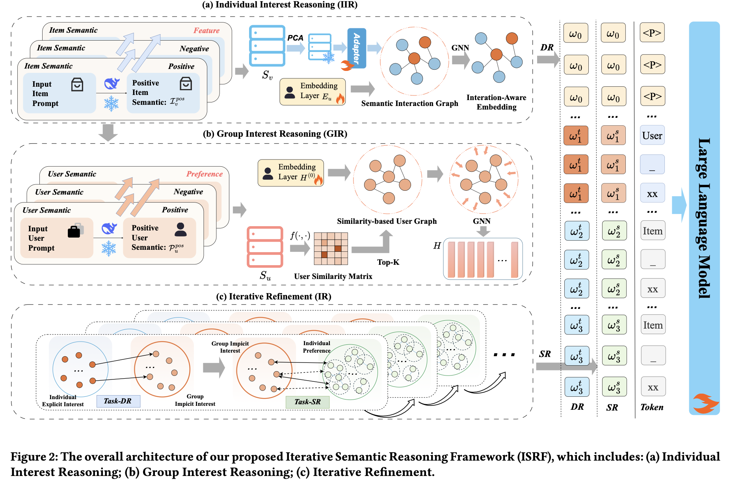
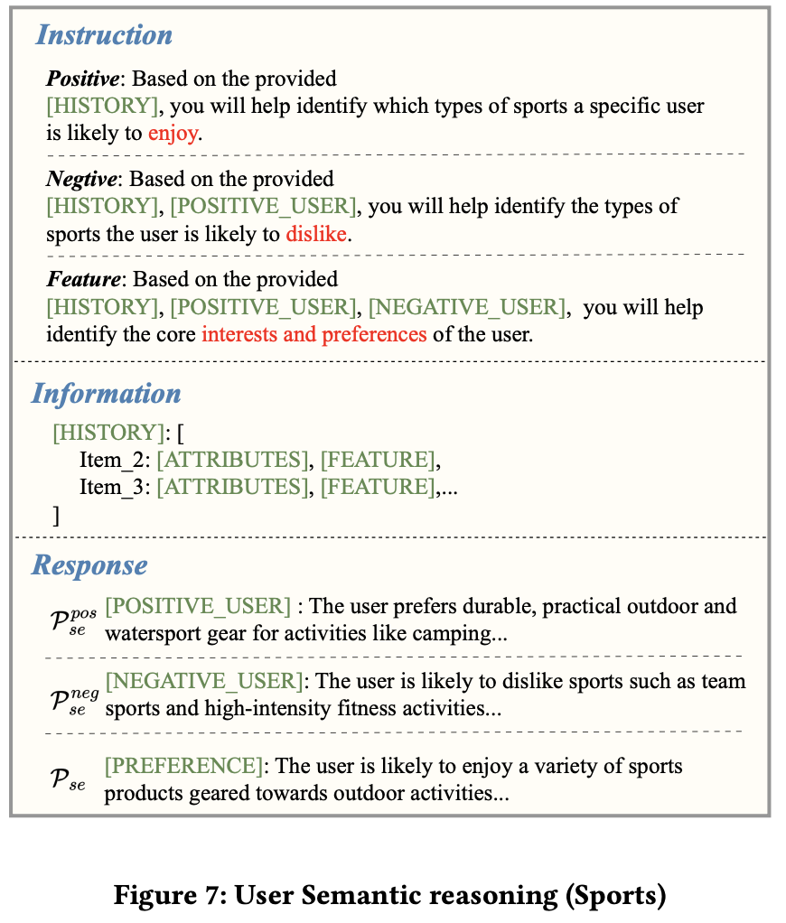
2026_WWW_ISRF_Iterative Semantic Reasoning from Individual to Group Interests for Generative Recommendation with LLMs

