Slide 1




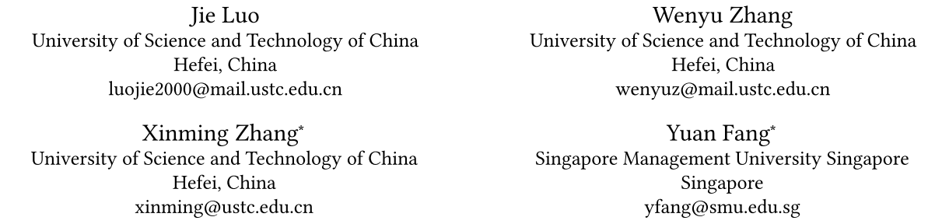





ATAI
Advanced Technique of Artificial Intelligence
ATAI
ChongqingUniversity _{AdvancedTechniqueof}
of Technology Artificial Intelligence
Chongqing University of
Technology
Chongqing University ^{ATAI}
_{of Technology} Advanced Techniqueof
Artificial Intelligence
Chongqing University of Technology
Chongqing University of Technology
Time-Aware Adaptive Side Information Fusion for Sequential
Recommendation
Code : https://github.com/jluo00/TASIF
—— WSDM’2026
2026.1.11. • ChongQing
Reported by YaoYao Zhang
1

Slide 2
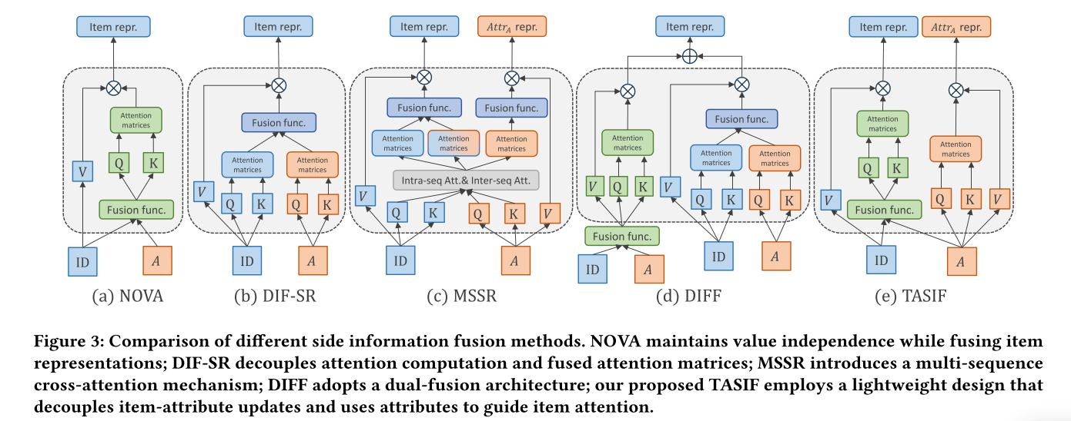
ATAI
Advanced Technique of Artificial Intelligence
ATAI
ChongqingUniversity _{AdvancedTechniqueof}
of Technology Artificial Intelligence
Chongqing University of
Technology
Chongqing University ^{ATAI}
_{of Technology} Advanced Techniqueof
Artificial Intelligence
Chongqing University of Technology
Chongqing University of Technology
Motivation
i) Most advanced fusion models largely overlook the effective modeling of rich dynamic patterns embedded in precise timestamps.
ii)Previous frequency-filtering approaches that rely on fixed frequency selection are overly rigid and thus unable to distinguish between noise and valuable signals.
iii)To maximize the utility of side information, some models employ computationally intensive cross-sequence attention mechanisms, which introduce substantial overhead and limit their applicability in real-world scenarios.
Notes:
大多数先进的融合模型在很大程度上忽视了对精确时间戳中所蕴含的丰富动态模式的有效建模
2)以前依赖固定频率选择的频率过滤方法过于僵化，因此无法区分噪声和有价值的信号，例如可能共存于高频分量中的短期兴趣突发。

Slide 3
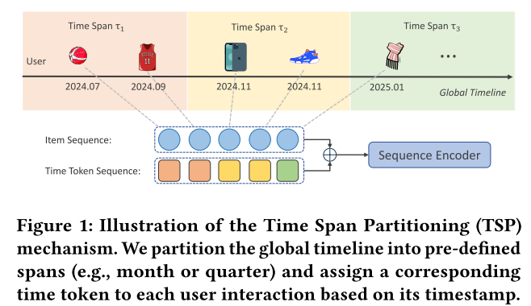
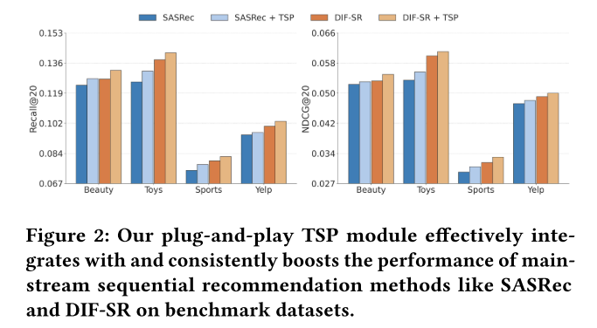
ATAI
Advanced Technique of Artificial Intelligence
ATAI
ChongqingUniversity _{AdvancedTechniqueof}
of Technology Artificial Intelligence
Chongqing University of
Technology
Chongqing University ^{ATAI}
_{of Technology} Advanced Techniqueof
Artificial Intelligence
Chongqing University of Technology
Chongqing University of Technology
Notes:
TSP将全局时间线离散成统一的跨度，提供一个共享的时间锚来比对不同的用户序列和捕获周期性行为。

Slide 4
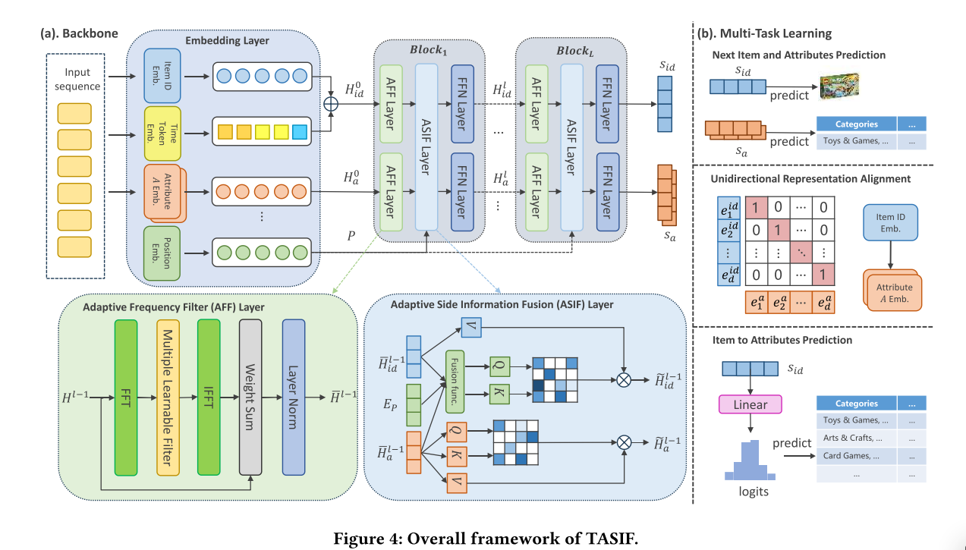
ATAI
Advanced Technique of Artificial Intelligence
ATAI
ChongqingUniversity _{AdvancedTechniqueof}
of Technology Artificial Intelligence
Chongqing University of
Technology
Chongqing University ^{ATAI}
_{of Technology} Advanced Techniqueof
Artificial Intelligence
Chongqing University of Technology
Chongqing University of Technology

Slide 5
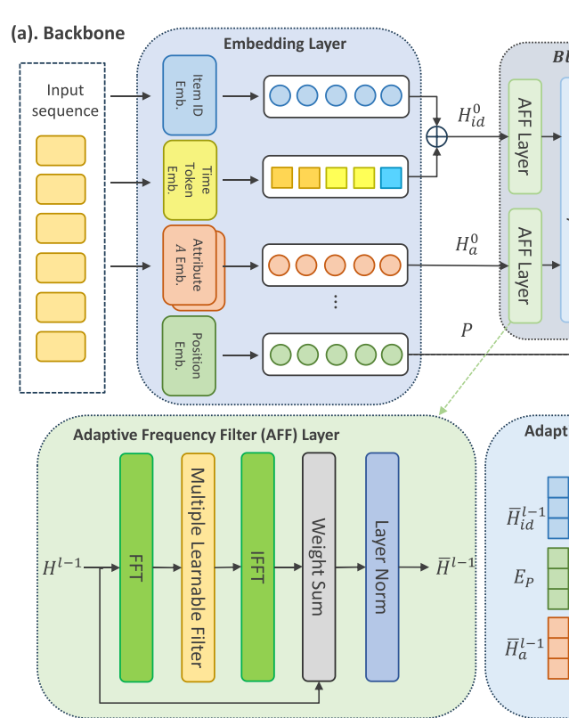




ATAI
Advanced Technique of Artificial Intelligence
ATAI
ChongqingUniversity _{AdvancedTechniqueof}
of Technology Artificial Intelligence
Chongqing University of
Technology
Chongqing University ^{ATAI}
_{of Technology} Advanced Techniqueof
Artificial Intelligence
Chongqing University of Technology
Chongqing University of Technology

Slide 6

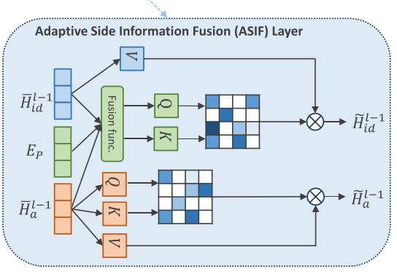

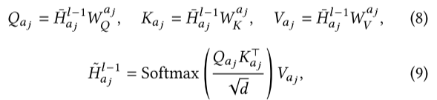

ATAI
Advanced Technique of Artificial Intelligence
ATAI
ChongqingUniversity _{AdvancedTechniqueof}
of Technology Artificial Intelligence
Chongqing University of
Technology
Chongqing University ^{ATAI}
_{of Technology} Advanced Techniqueof
Artificial Intelligence
Chongqing University of Technology
Chongqing University of Technology
Method

Slide 7
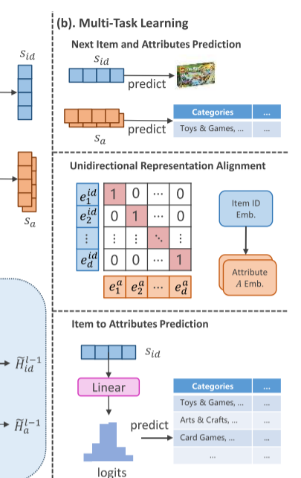
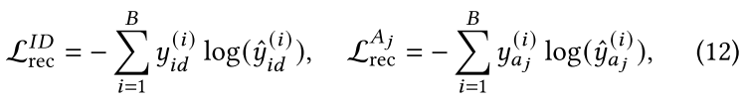
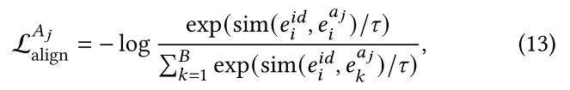

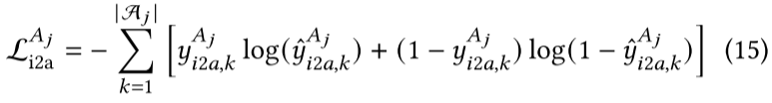
ATAI
Advanced Technique of Artificial Intelligence
ATAI
ChongqingUniversity _{AdvancedTechniqueof}
of Technology Artificial Intelligence
Chongqing University of
Technology
Chongqing University ^{ATAI}
_{of Technology} Advanced Techniqueof
Artificial Intelligence
Method
Chongqing University of Technology
Chongqing University of Technology

Slide 8


ATAI
Advanced Technique of Artificial Intelligence
ATAI
ChongqingUniversity _{AdvancedTechniqueof}
of Technology Artificial Intelligence
Chongqing University of
Technology
Chongqing University ^{ATAI}
_{of Technology} Advanced Techniqueof
Artificial Intelligence
Method
Chongqing University of Technology
Chongqing University of Technology

Slide 9
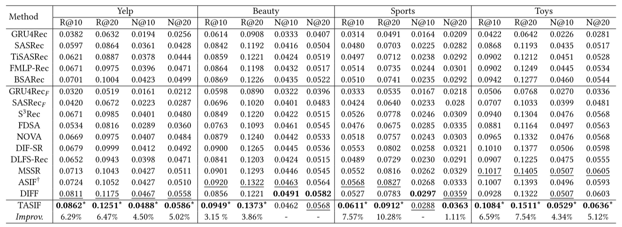
ATAI
Advanced Technique of Artificial Intelligence
ATAI
ChongqingUniversity _{AdvancedTechniqueof}
of Technology Artificial Intelligence
Chongqing University of
Technology
Chongqing University ^{ATAI}
_{of Technology} Advanced Techniqueof
Artificial Intelligence
Method
Chongqing University of Technology
Chongqing University of Technology

Slide 10
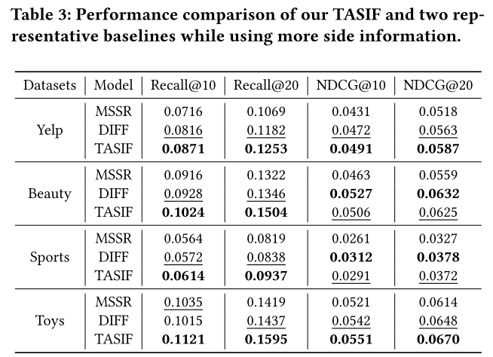
ATAI
Advanced Technique of Artificial Intelligence
ATAI
ChongqingUniversity _{AdvancedTechniqueof}
of Technology Artificial Intelligence
Chongqing University of
Technology
Chongqing University ^{ATAI}
_{of Technology} Advanced Techniqueof
Artificial Intelligence
Method
Chongqing University of Technology
Chongqing University of Technology

Slide 11
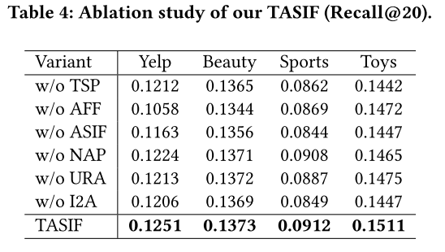
ATAI
Advanced Technique of Artificial Intelligence
ATAI
ChongqingUniversity _{AdvancedTechniqueof}
of Technology Artificial Intelligence
Chongqing University of
Technology
Chongqing University ^{ATAI}
_{of Technology} Advanced Techniqueof
Artificial Intelligence
Method
Chongqing University of Technology
Chongqing University of Technology

Slide 12
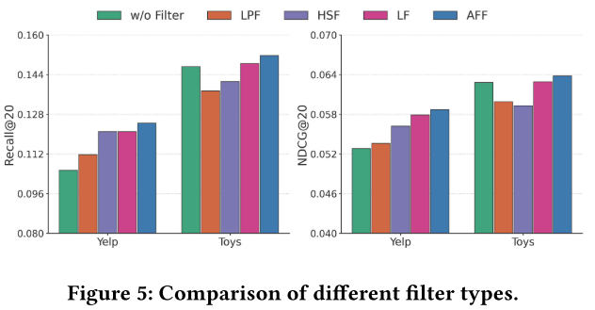
ATAI
Advanced Technique of Artificial Intelligence
ATAI
ChongqingUniversity _{AdvancedTechniqueof}
of Technology Artificial Intelligence
Chongqing University of
Technology
Chongqing University ^{ATAI}
_{of Technology} Advanced Techniqueof
Artificial Intelligence
Method
Chongqing University of Technology
Chongqing University of Technology

Slide 13
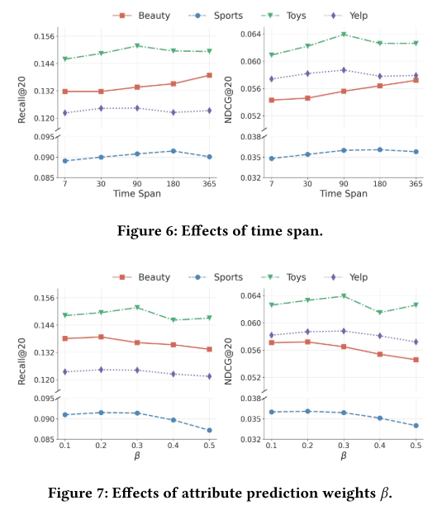
ATAI
Advanced Technique of Artificial Intelligence
ATAI
ChongqingUniversity _{AdvancedTechniqueof}
of Technology Artificial Intelligence
Chongqing University of
Technology
Chongqing University ^{ATAI}
_{of Technology} Advanced Techniqueof
Artificial Intelligence
Method
Chongqing University of Technology
Chongqing University of Technology

Slide 14
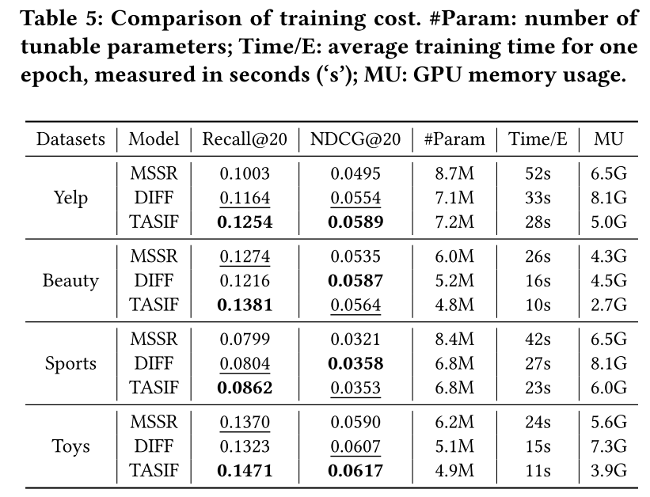
ATAI
Advanced Technique of Artificial Intelligence
ATAI
ChongqingUniversity _{AdvancedTechniqueof}
of Technology Artificial Intelligence
Chongqing University of
Technology
Chongqing University ^{ATAI}
_{of Technology} Advanced Techniqueof
Artificial Intelligence
Method
Chongqing University of Technology
Chongqing University of Technology

Slide 15
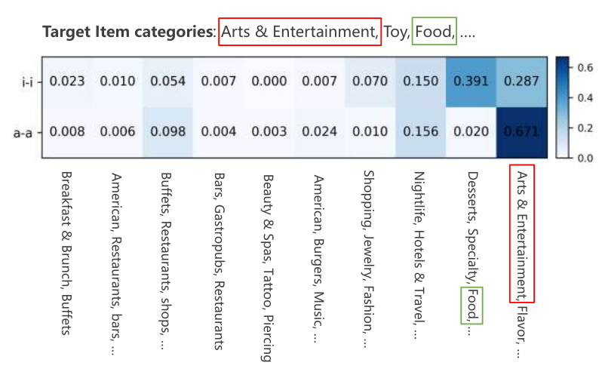
ATAI
Advanced Technique of Artificial Intelligence
ATAI
ChongqingUniversity _{AdvancedTechniqueof}
of Technology Artificial Intelligence
Chongqing University of
Technology
Chongqing University ^{ATAI}
_{of Technology} Advanced Techniqueof
Artificial Intelligence
Method
Chongqing University of Technology
Chongqing University of Technology

Slide 16
ATAI
Advanced Technique of Artificial Intelligence
ATAI
ChongqingUniversity _{AdvancedTechniqueof}
of Technology Artificial Intelligence
Chongqing University of
Technology
Chongqing University ^{ATAI}
_{of Technology} Advanced Techniqueof
Artificial Intelligence
Chongqing University of Technology
Chongqing University of Technology
Thanks!

