Slide 1




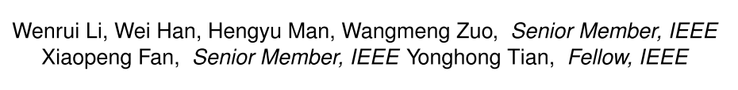



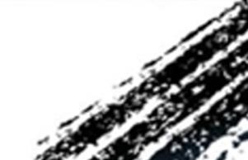

ATAI
Advanced Technique of Artificial Intelligence
ATAI
ChongqingUniversity _{AdvancedTechniqueof}
of Technology Artificial Intelligence
Chongqing University of
Technology
Chongqing University ^{ATAI}
_{of Technology} Advanced Techniqueof
Artificial Intelligence
Chongqing University of Technology
Chongqing University of Technology
Language-Guided Graph Representation Learning for Video Summarization
Code : https://github.com/liwrui/LGRLN.
2025.12.24. • ChongQing
—— TPAMI’2025
Reported by YaoYao Zhang
1

Slide 2
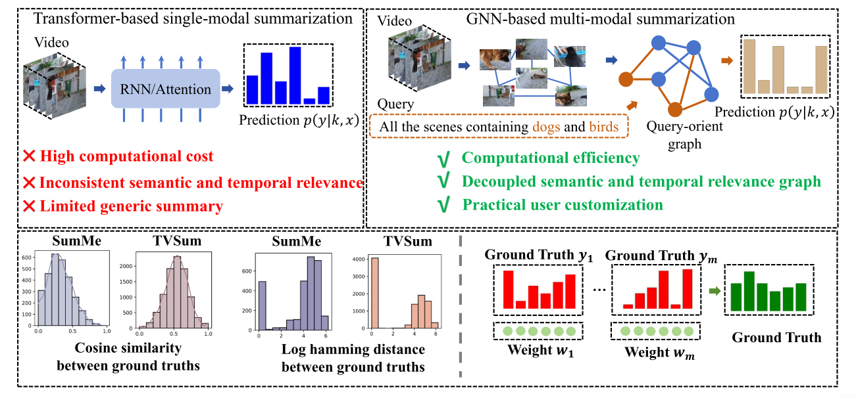
ATAI
Advanced Technique of Artificial Intelligence
ATAI
ChongqingUniversity _{AdvancedTechniqueof}
of Technology Artificial Intelligence
Chongqing University of
Technology
Chongqing University ^{ATAI}
_{of Technology} Advanced Techniqueof
Artificial Intelligence
Chongqing University of Technology
Chongqing University of Technology
Motivation
1)Traditional sequential models struggle to capture long-range dependencies in videos, which makes it difficult to produce high quality summaries.
2)Traditional methods typically only select a fixed strategy, while there are multiple ways to summarize a video, and different user needs may require different summarization strategies.
Notes:
传统的基于 RNN 或注意力机制的方法存在高计算开销、时间和语义关系不一致、生成的摘要泛化能力差等问题
Cosine 相似性：用于衡量不同标注者之间的标签相似度。,在视频摘要任务中，不同标注者可能会对视频帧的摘要选择有不同的看法，Cosine 相似性通过计算标注间的相似度来评估标注的一致性。
汉明距离：衡量不同标注者之间标签差异的数量。如果两个标注者对视频帧的标注不同，汉明距离会计算它们之间不同标记的个数。
许多视频摘要方法没有很好地解决标注者间标签不一致的问题。标注者的差异可能源自于个人的偏好、对视频内容的理解差异等。如果直接对所有标注者的标签进行平均或简单处理，可能会导致信息丢失或摘要质量下降。

Slide 3
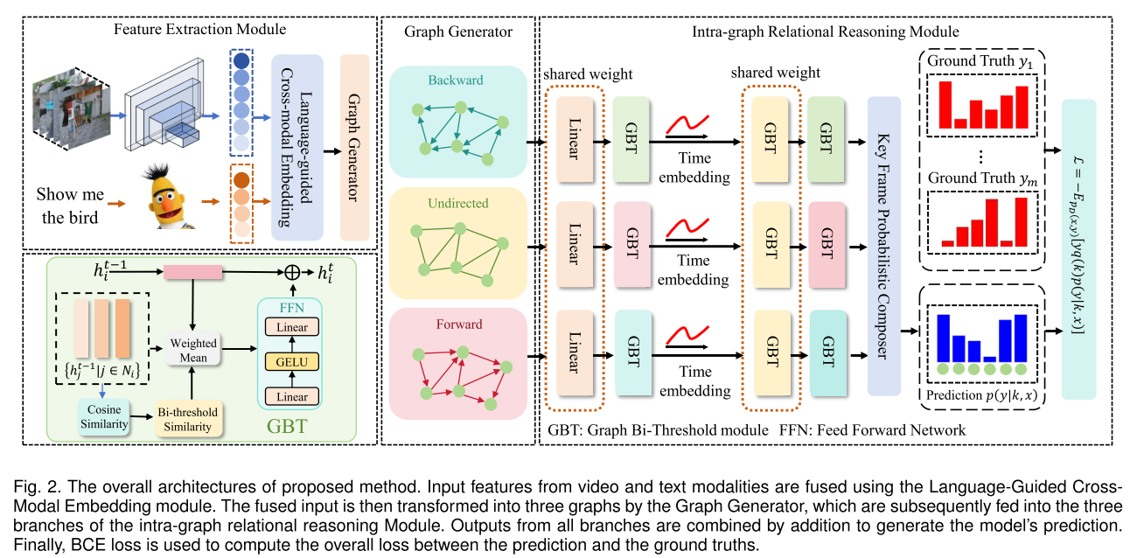
ATAI
Advanced Technique of Artificial Intelligence
ATAI
ChongqingUniversity _{AdvancedTechniqueof}
of Technology Artificial Intelligence
Chongqing University of
Technology
Chongqing University ^{ATAI}
_{of Technology} Advanced Techniqueof
Artificial Intelligence
Method
Chongqing University of Technology
Chongqing University of Technology
Notes:
每一帧成为一个图的节点，每个节点 都包含对应的视频帧的视觉特征
GBT:先验分布三元组：三元分布在训练初期，节点之间的相似度还不准确，模型也不至于过度依赖这些初始的错误信息。
加权平均利用邻居信息来更新每个节点的特征表示

Slide 4


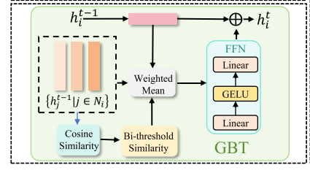
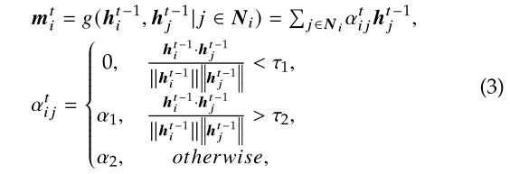

ATAI
Advanced Technique of Artificial Intelligence
ATAI
ChongqingUniversity _{AdvancedTechniqueof}
of Technology Artificial Intelligence
Chongqing University of
Technology
Chongqing University ^{ATAI}
_{of Technology} Advanced Techniqueof
Artificial Intelligence
Chongqing University of Technology
Chongqing University of Technology
Method
Notes:
我们使用变分推理得到𝑞z在网络中的实际值

Slide 5

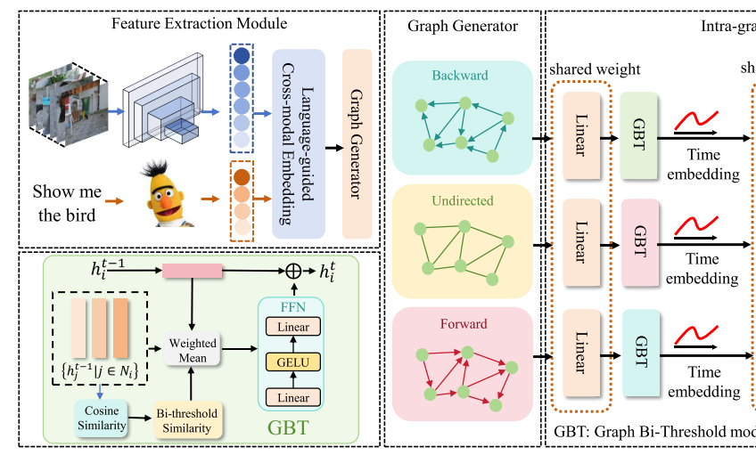

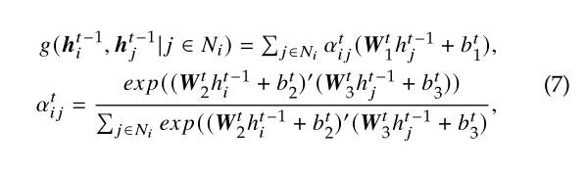
ATAI
Advanced Technique of Artificial Intelligence
ATAI
ChongqingUniversity _{AdvancedTechniqueof}
of Technology Artificial Intelligence
Chongqing University of
Technology
Chongqing University ^{ATAI}
_{of Technology} Advanced Techniqueof
Artificial Intelligence
Method
Chongqing University of Technology
Chongqing University of Technology
Notes:
使用图注意机制代替双阈值作为聚合函数𝑔的权重

Slide 6
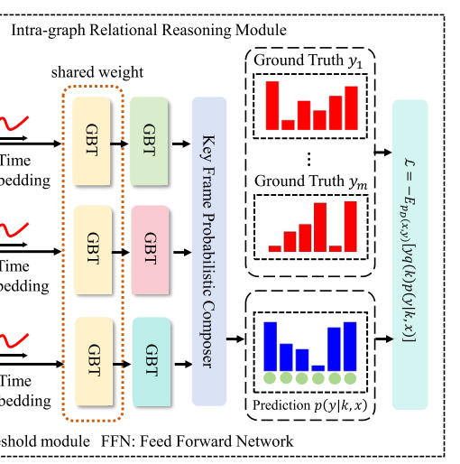
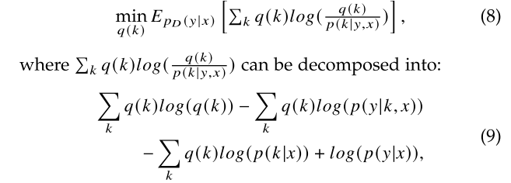
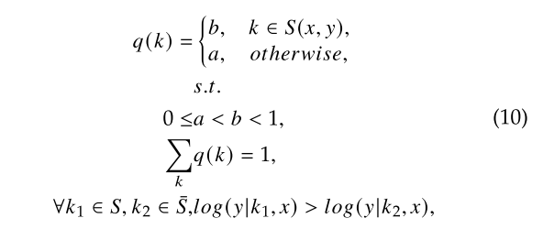
ATAI
Advanced Technique of Artificial Intelligence
ATAI
ChongqingUniversity _{AdvancedTechniqueof}
of Technology Artificial Intelligence
Chongqing University of
Technology
Chongqing University ^{ATAI}
_{of Technology} Advanced Techniqueof
Artificial Intelligence
Method
Chongqing University of Technology
Chongqing University of Technology

Slide 7

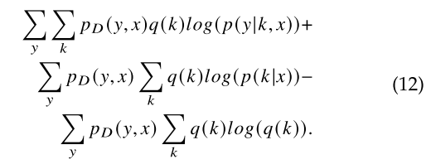

ATAI
Advanced Technique of Artificial Intelligence
ATAI
ChongqingUniversity _{AdvancedTechniqueof}
of Technology Artificial Intelligence
Chongqing University of
Technology
Chongqing University ^{ATAI}
_{of Technology} Advanced Techniqueof
Artificial Intelligence
Method
Chongqing University of Technology
Chongqing University of Technology

Slide 8
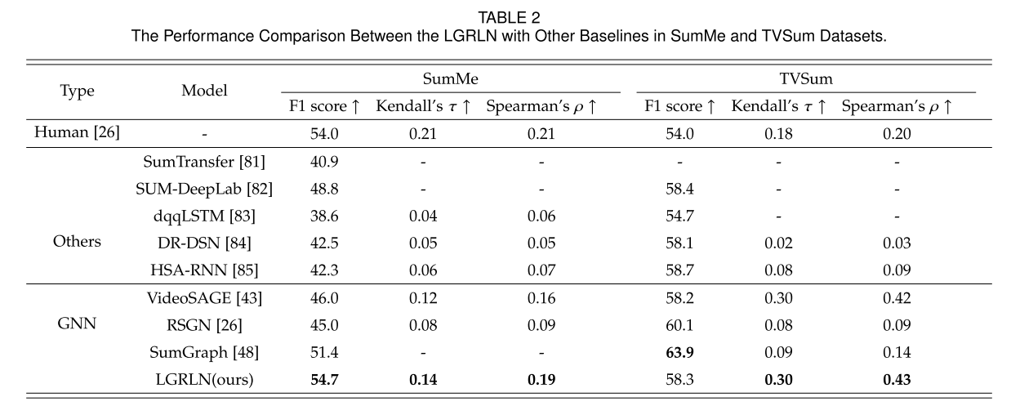
ATAI
Advanced Technique of Artificial Intelligence
ATAI
ChongqingUniversity _{AdvancedTechniqueof}
of Technology Artificial Intelligence
Chongqing University of
Technology
Chongqing University ^{ATAI}
_{of Technology} Advanced Techniqueof
Artificial Intelligence
Chongqing University of Technology
Experiments
Chongqing University of Technology

Slide 9
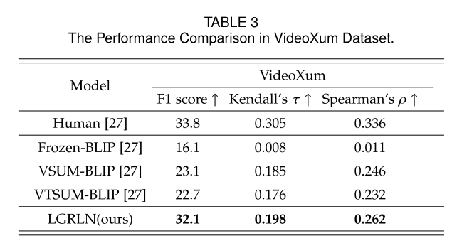
ATAI
Advanced Technique of Artificial Intelligence
ATAI
ChongqingUniversity _{AdvancedTechniqueof}
of Technology Artificial Intelligence
Chongqing University of
Technology
Chongqing University ^{ATAI}
_{of Technology} Advanced Techniqueof
Artificial Intelligence
Chongqing University of Technology
Experiments
Chongqing University of Technology

Slide 10
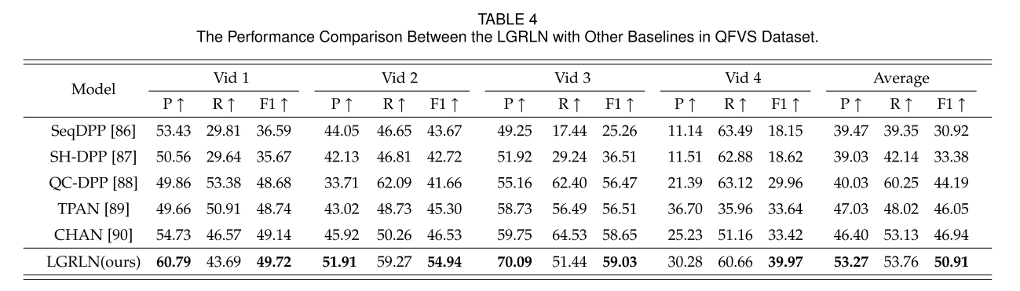
ATAI
Advanced Technique of Artificial Intelligence
ATAI
ChongqingUniversity _{AdvancedTechniqueof}
of Technology Artificial Intelligence
Chongqing University of
Technology
Chongqing University ^{ATAI}
_{of Technology} Advanced Techniqueof
Artificial Intelligence
Experiments
Chongqing University of Technology
Chongqing University of Technology

Slide 11
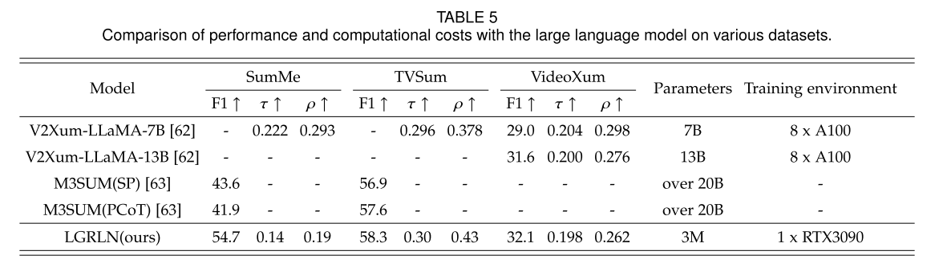
ATAI
Advanced Technique of Artificial Intelligence
ATAI
ChongqingUniversity _{AdvancedTechniqueof}
of Technology Artificial Intelligence
Chongqing University of
Technology
Chongqing University ^{ATAI}
_{of Technology} Advanced Techniqueof
Artificial Intelligence
Experiments
Chongqing University of Technology
Chongqing University of Technology

Slide 12
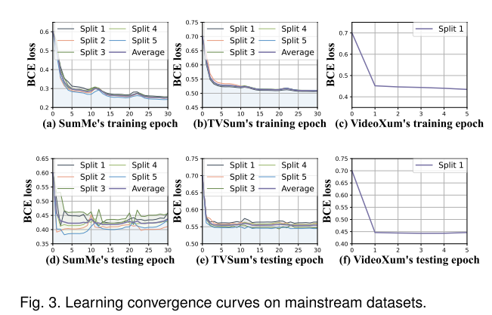
ATAI
Advanced Technique of Artificial Intelligence
ATAI
ChongqingUniversity _{AdvancedTechniqueof}
of Technology Artificial Intelligence
Chongqing University of
Technology
Chongqing University ^{ATAI}
_{of Technology} Advanced Techniqueof
Artificial Intelligence
Experiments
Chongqing University of Technology
Chongqing University of Technology

Slide 13
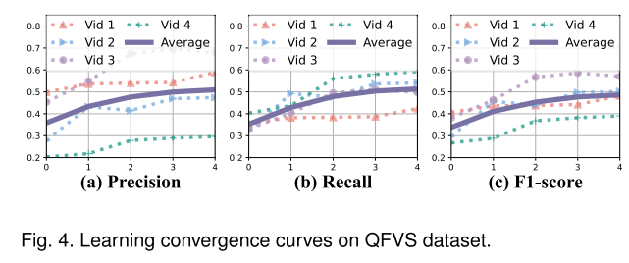
ATAI
Advanced Technique of Artificial Intelligence
ATAI
ChongqingUniversity _{AdvancedTechniqueof}
of Technology Artificial Intelligence
Chongqing University of
Technology
Chongqing University ^{ATAI}
_{of Technology} Advanced Techniqueof
Artificial Intelligence
Experiments
Chongqing University of Technology
Chongqing University of Technology

Slide 14
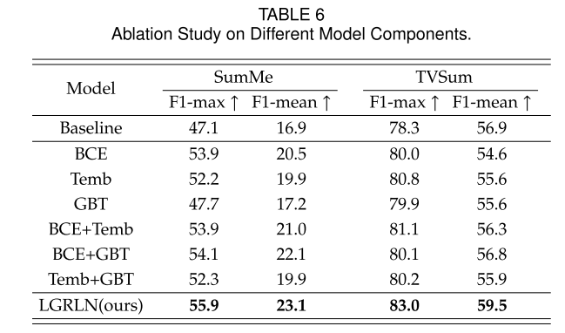
ATAI
Advanced Technique of Artificial Intelligence
ATAI
ChongqingUniversity _{AdvancedTechniqueof}
of Technology Artificial Intelligence
Chongqing University of
Technology
Chongqing University ^{ATAI}
_{of Technology} Advanced Techniqueof
Artificial Intelligence
Experiments
Chongqing University of Technology
Chongqing University of Technology

Slide 15
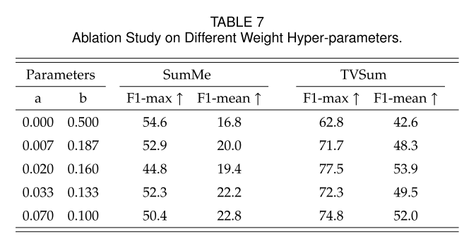
ATAI
Advanced Technique of Artificial Intelligence
ATAI
ChongqingUniversity _{AdvancedTechniqueof}
of Technology Artificial Intelligence
Chongqing University of
Technology
Chongqing University ^{ATAI}
_{of Technology} Advanced Techniqueof
Artificial Intelligence
Experiments
Chongqing University of Technology
Chongqing University of Technology

Slide 16
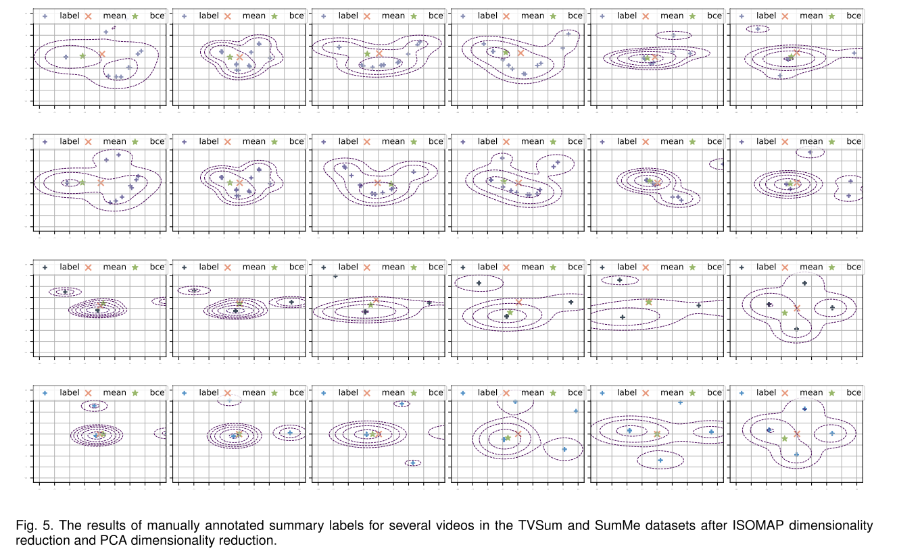
ATAI
Advanced Technique of Artificial Intelligence
ATAI
ChongqingUniversity _{AdvancedTechniqueof}
of Technology Artificial Intelligence
Chongqing University of
Technology
Chongqing University ^{ATAI}
_{of Technology} Advanced Techniqueof
Artificial Intelligence
Experiments
Chongqing University of Technology
Chongqing University of Technology
Notes:
传统方法中的简单平均和BCE加权平均，并通过主成分分析（PCA）和ISOMAP降维将高维数据映射到二维空间。
等高线表示数据的密度或概率分布。密集的区域表示数据在该区域的概率较高，稀疏的区域表示数据的概率较低。

Slide 17
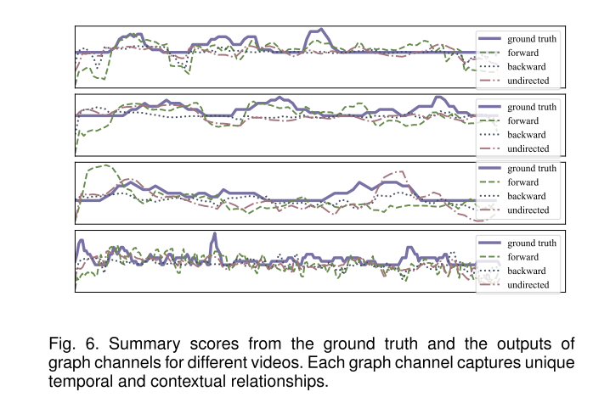
ATAI
Advanced Technique of Artificial Intelligence
ATAI
ChongqingUniversity _{AdvancedTechniqueof}
of Technology Artificial Intelligence
Chongqing University of
Technology
Chongqing University ^{ATAI}
_{of Technology} Advanced Techniqueof
Artificial Intelligence
Experiments
Chongqing University of Technology
Chongqing University of Technology

Slide 18
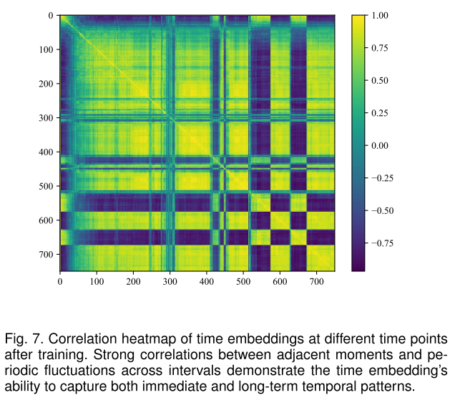
ATAI
Advanced Technique of Artificial Intelligence
ATAI
ChongqingUniversity _{AdvancedTechniqueof}
of Technology Artificial Intelligence
Chongqing University of
Technology
Chongqing University ^{ATAI}
_{of Technology} Advanced Techniqueof
Artificial Intelligence
Experiments
Chongqing University of Technology
Chongqing University of Technology

Slide 19
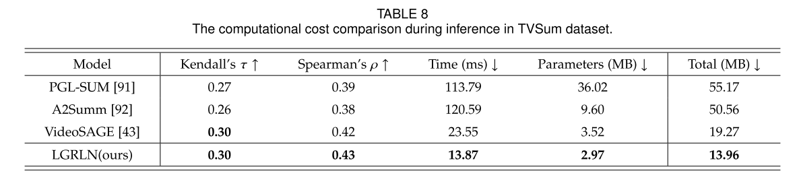
ATAI
Advanced Technique of Artificial Intelligence
ATAI
ChongqingUniversity _{AdvancedTechniqueof}
of Technology Artificial Intelligence
Chongqing University of
Technology
Chongqing University ^{ATAI}
_{of Technology} Advanced Techniqueof
Artificial Intelligence
Experiments
Chongqing University of Technology
Chongqing University of Technology

Slide 20
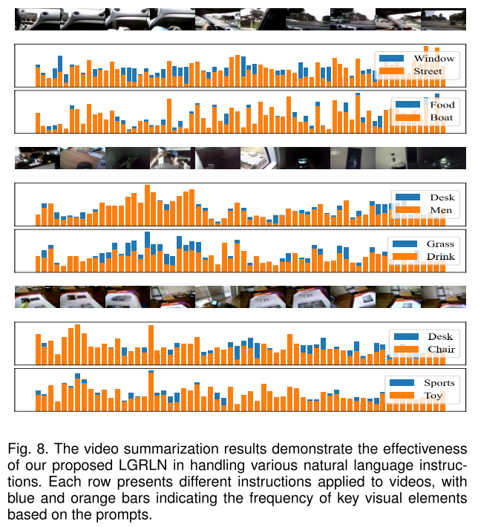
ATAI
Advanced Technique of Artificial Intelligence
ATAI
ChongqingUniversity _{AdvancedTechniqueof}
of Technology Artificial Intelligence
Chongqing University of
Technology
Chongqing University ^{ATAI}
_{of Technology} Advanced Techniqueof
Artificial Intelligence
Experiments
Chongqing University of Technology
Chongqing University of Technology

Slide 21


ATAI
Advanced Technique of Artificial Intelligence
ATAI
ChongqingUniversity _{AdvancedTechniqueof}
of Technology Artificial Intelligence
Chongqing University of
Technology
Chongqing University ^{ATAI}
_{of Technology} Advanced Techniqueof
Artificial Intelligence
Chongqing University of Technology
Chongqing University of Technology
Thanks!

