Slide 1




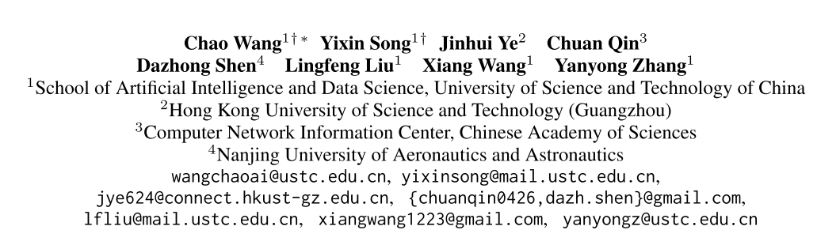





ATAI
Advanced Technique of Artificial Intelligence
ATAI
ChongqingUniversity _{AdvancedTechniqueof}
of Technology Artificial Intelligence
Chongqing University of
Technology
Chongqing University ^{ATAI}
_{of Technology} Advanced Techniqueof
Artificial Intelligence
Chongqing University of Technology
Chongqing University of Technology
FACE: A General Framework for Mapping
Collaborative Filtering Embeddings into LLM Tokens
Code : https://github.com/YixinRoll/FACE.
—— NeurIPS’2025
2025.11.07. • ChongQing
Reported by YaoYao Zhang
1

Slide 2
ATAI
Advanced Technique of Artificial Intelligence
ATAI
ChongqingUniversity _{AdvancedTechniqueof}
of Technology Artificial Intelligence
Chongqing University of
Technology
Chongqing University ^{ATAI}
_{of Technology} Advanced Techniqueof
Artificial Intelligence
Chongqing University of Technology
Chongqing University of Technology
Motivation
i) LLMs struggle to interpret the latent, non-semantic embeddings produced by CF approaches, limiting recommendation effectiveness and further applications.
ii)CF embeddings often combine multiple types of user preferences (or item features) into a single entangled vector, making it difficult to separate and interpret a user’s preferences across different aspects.

Slide 3
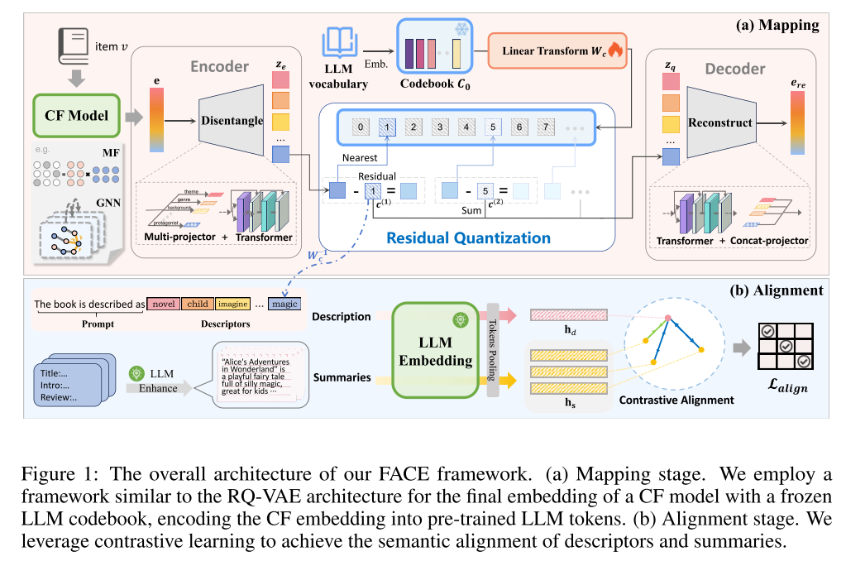
ATAI
Advanced Technique of Artificial Intelligence
ATAI
ChongqingUniversity _{AdvancedTechniqueof}
of Technology Artificial Intelligence
Chongqing University of
Technology
Chongqing University ^{ATAI}
_{of Technology} Advanced Techniqueof
Artificial Intelligence
Chongqing University of Technology
Chongqing University of Technology

Slide 4

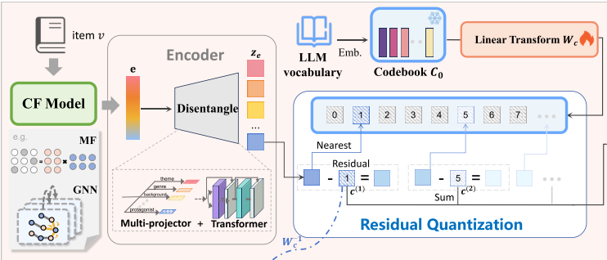
ATAI
Advanced Technique of Artificial Intelligence
ATAI
ChongqingUniversity _{AdvancedTechniqueof}
of Technology Artificial Intelligence
Chongqing University of
Technology
Chongqing University ^{ATAI}
_{of Technology} Advanced Techniqueof
Artificial Intelligence
Chongqing University of Technology
Chongqing University of Technology

Slide 5
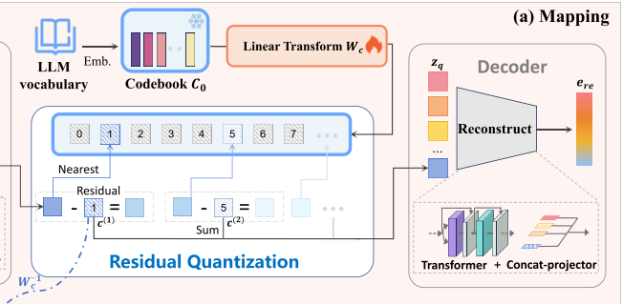
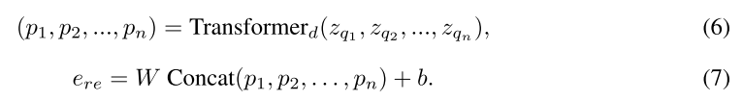
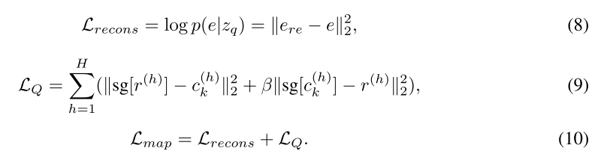
ATAI
Advanced Technique of Artificial Intelligence
ATAI
ChongqingUniversity _{AdvancedTechniqueof}
of Technology Artificial Intelligence
Chongqing University of
Technology
Chongqing University ^{ATAI}
_{of Technology} Advanced Techniqueof
Artificial Intelligence
Chongqing University of Technology
Chongqing University of Technology
Method

Slide 6
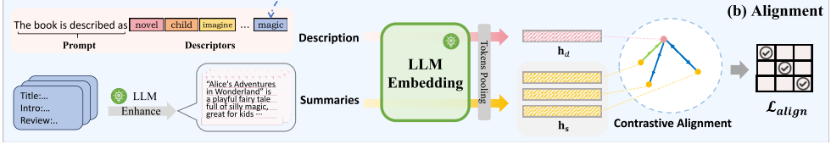




ATAI
Advanced Technique of Artificial Intelligence
ATAI
ChongqingUniversity _{AdvancedTechniqueof}
of Technology Artificial Intelligence
Chongqing University of
Technology
Chongqing University ^{ATAI}
_{of Technology} Advanced Techniqueof
Artificial Intelligence
Method
Chongqing University of Technology
Chongqing University of Technology

Slide 7
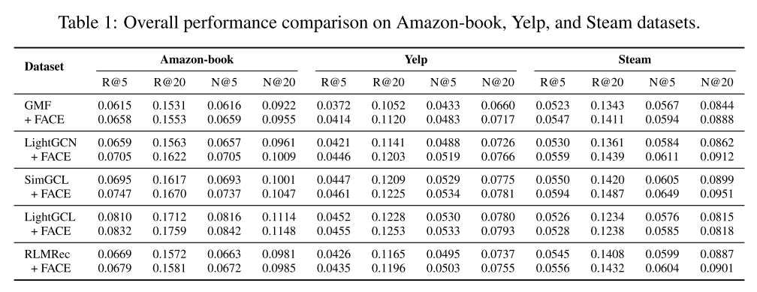
ATAI
Advanced Technique of Artificial Intelligence
ATAI
ChongqingUniversity _{AdvancedTechniqueof}
of Technology Artificial Intelligence
Chongqing University of
Technology
Chongqing University ^{ATAI}
_{of Technology} Advanced Techniqueof
Artificial Intelligence
Method
Chongqing University of Technology
Chongqing University of Technology

Slide 8
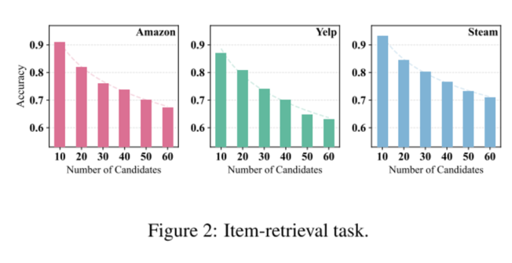
ATAI
Advanced Technique of Artificial Intelligence
ATAI
ChongqingUniversity _{AdvancedTechniqueof}
of Technology Artificial Intelligence
Chongqing University of
Technology
Chongqing University ^{ATAI}
_{of Technology} Advanced Techniqueof
Artificial Intelligence
Method
Chongqing University of Technology
Chongqing University of Technology

Slide 9
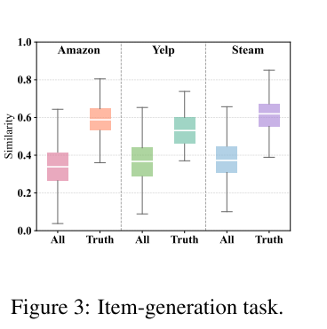
ATAI
Advanced Technique of Artificial Intelligence
ATAI
ChongqingUniversity _{AdvancedTechniqueof}
of Technology Artificial Intelligence
Chongqing University of
Technology
Chongqing University ^{ATAI}
_{of Technology} Advanced Techniqueof
Artificial Intelligence
Method
Chongqing University of Technology
Chongqing University of Technology

Slide 10
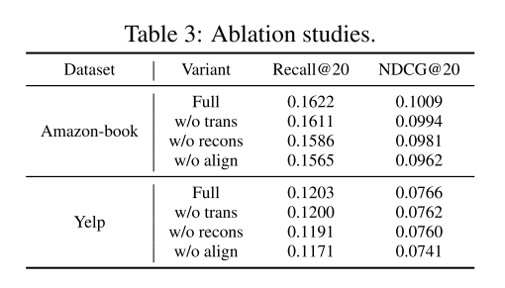
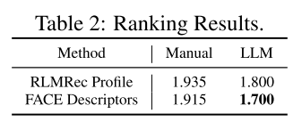
ATAI
Advanced Technique of Artificial Intelligence
ATAI
ChongqingUniversity _{AdvancedTechniqueof}
of Technology Artificial Intelligence
Chongqing University of
Technology
Chongqing University ^{ATAI}
_{of Technology} Advanced Techniqueof
Artificial Intelligence
Method
Chongqing University of Technology
Chongqing University of Technology

Slide 11
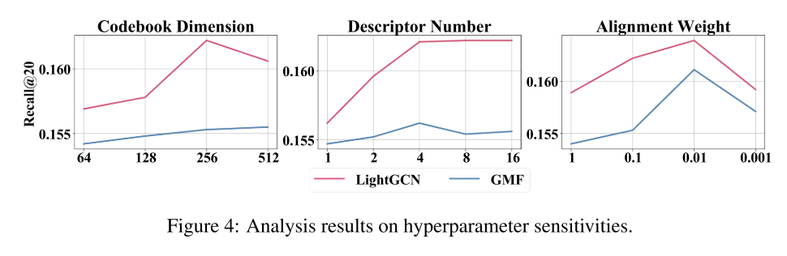
ATAI
Advanced Technique of Artificial Intelligence
ATAI
ChongqingUniversity _{AdvancedTechniqueof}
of Technology Artificial Intelligence
Chongqing University of
Technology
Chongqing University ^{ATAI}
_{of Technology} Advanced Techniqueof
Artificial Intelligence
Method
Chongqing University of Technology
Chongqing University of Technology

Slide 12
ATAI
Advanced Technique of Artificial Intelligence
ATAI
ChongqingUniversity _{AdvancedTechniqueof}
of Technology Artificial Intelligence
Chongqing University of
Technology
Chongqing University ^{ATAI}
_{of Technology} Advanced Techniqueof
Artificial Intelligence
Chongqing University of Technology
Chongqing University of Technology
Thanks!

