Slide 1




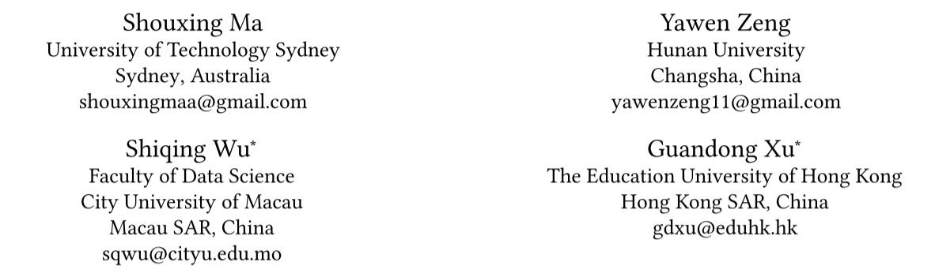



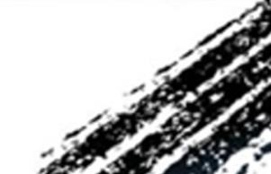

ATAI
Advanced Technique of Artificial Intelligence
ATAI
ChongqingUniversity _{AdvancedTechniqueof}
of Technology Artificial Intelligence
Chongqing University of
Technology
Chongqing University ^{ATAI}
_{of Technology} Advanced Techniqueof
Artificial Intelligence
Chongqing University of Technology
Chongqing University of Technology
Refining Contrastive Learning and Homography Relations for
Multi-Modal Recommendation
Code : https://github.com/MrShouxingMa/REARM
—— MM2025
2025.9.29. • ChongQing
Reported by Jing Li
1

Slide 2
ATAI
Advanced Technique of Artificial Intelligence
ATAI
ChongqingUniversity _{AdvancedTechniqueof}
of Technology Artificial Intelligence
Chongqing University of
Technology
Chongqing University ^{ATAI}
_{of Technology} Advanced Techniqueof
Artificial Intelligence
Chongqing University of Technology
Chongqing University of Technology
Motivation
Simple multi-modal featurecontrasts fail to produce effective representations, causing noisy modal-shared features and loss of valuable information in modal-unique features.
The lack of exploration of the homograph re-lations between user interests and item co-occurrence results in incomplete mining of user-item interplay.

Slide 3
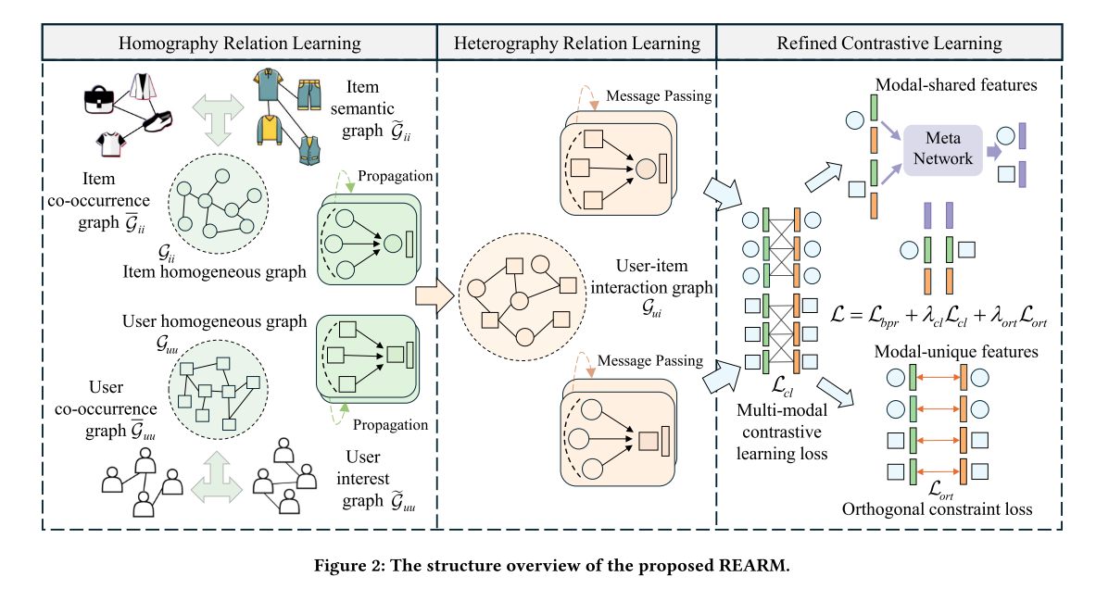
ATAI
Advanced Technique of Artificial Intelligence
ATAI
ChongqingUniversity _{AdvancedTechniqueof}
of Technology Artificial Intelligence
Chongqing University of
Technology
Chongqing University ^{ATAI}
_{of Technology} Advanced Techniqueof
Artificial Intelligence
Chongqing University of Technology
Chongqing University of Technology

Slide 4



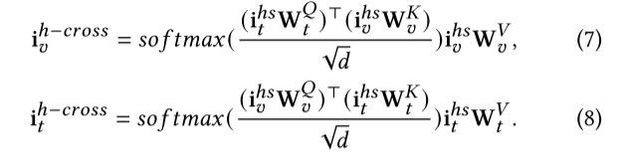



ATAI
Advanced Technique of Artificial Intelligence
ATAI
ChongqingUniversity _{AdvancedTechniqueof}
of Technology Artificial Intelligence
Chongqing University of
Technology
Chongqing University ^{ATAI}
_{of Technology} Advanced Techniqueof
Artificial Intelligence
Chongqing University of Technology
Chongqing University of Technology

Slide 5


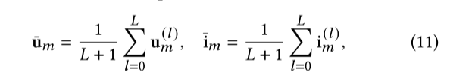




ATAI
Advanced Technique of Artificial Intelligence
ATAI
ChongqingUniversity _{AdvancedTechniqueof}
of Technology Artificial Intelligence
Chongqing University of
Technology
Chongqing University ^{ATAI}
_{of Technology} Advanced Techniqueof
Artificial Intelligence
Chongqing University of Technology
Chongqing University of Technology
Method

Slide 6

ATAI
Advanced Technique of Artificial Intelligence
ATAI
ChongqingUniversity _{AdvancedTechniqueof}
of Technology Artificial Intelligence
Chongqing University of
Technology
Chongqing University ^{ATAI}
_{of Technology} Advanced Techniqueof
Artificial Intelligence
Method
Chongqing University of Technology
Chongqing University of Technology

Slide 7
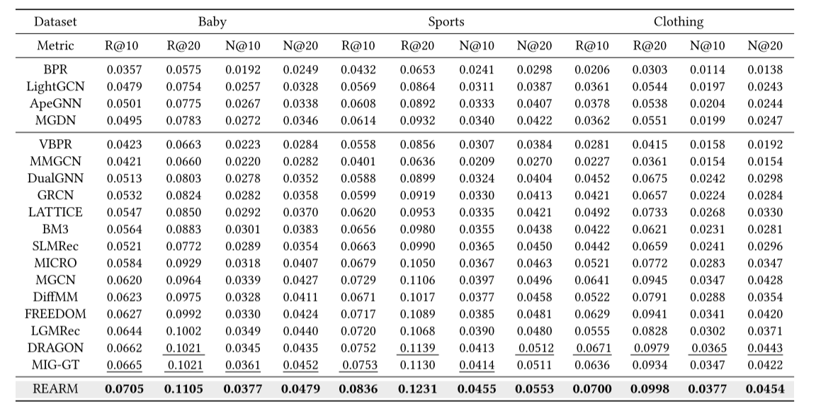
ATAI
Advanced Technique of Artificial Intelligence
ATAI
ChongqingUniversity _{AdvancedTechniqueof}
of Technology Artificial Intelligence
Chongqing University of
Technology
Chongqing University ^{ATAI}
_{of Technology} Advanced Techniqueof
Artificial Intelligence
Method
Chongqing University of Technology
Chongqing University of Technology

Slide 8
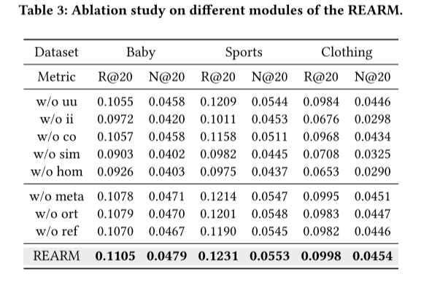
ATAI
Advanced Technique of Artificial Intelligence
ATAI
ChongqingUniversity _{AdvancedTechniqueof}
of Technology Artificial Intelligence
Chongqing University of
Technology
Chongqing University ^{ATAI}
_{of Technology} Advanced Techniqueof
Artificial Intelligence
Method
Chongqing University of Technology
Chongqing University of Technology

Slide 9
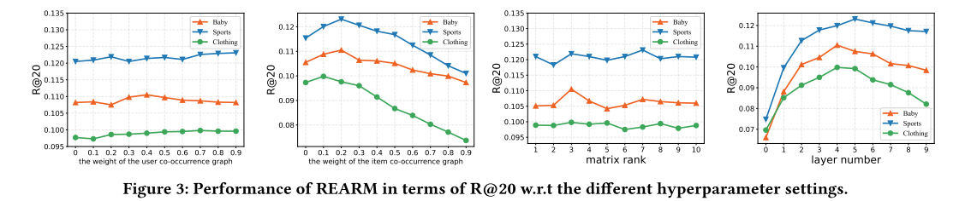
ATAI
Advanced Technique of Artificial Intelligence
ATAI
ChongqingUniversity _{AdvancedTechniqueof}
of Technology Artificial Intelligence
Chongqing University of
Technology
Chongqing University ^{ATAI}
_{of Technology} Advanced Techniqueof
Artificial Intelligence
Method
Chongqing University of Technology
Chongqing University of Technology

Slide 10
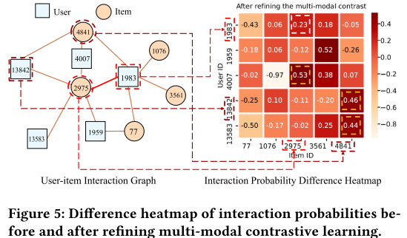
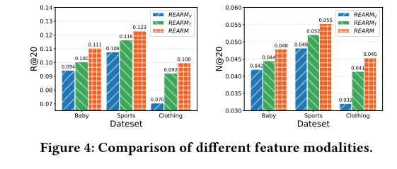
ATAI
Advanced Technique of Artificial Intelligence
ATAI
ChongqingUniversity _{AdvancedTechniqueof}
of Technology Artificial Intelligence
Chongqing University of
Technology
Chongqing University ^{ATAI}
_{of Technology} Advanced Techniqueof
Artificial Intelligence
Method
Chongqing University of Technology
Chongqing University of Technology

Slide 11
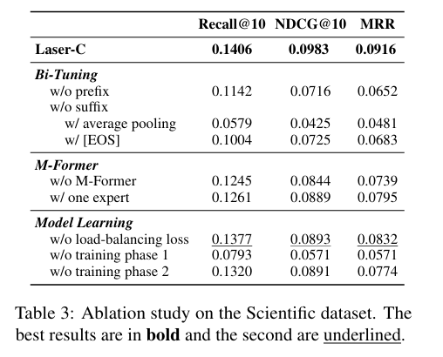
ATAI
Advanced Technique of Artificial Intelligence
ATAI
ChongqingUniversity _{AdvancedTechniqueof}
of Technology Artificial Intelligence
Chongqing University of
Technology
Chongqing University ^{ATAI}
_{of Technology} Advanced Techniqueof
Artificial Intelligence
Chongqing University of Technology
Experiments
Chongqing University of Technology

Slide 12
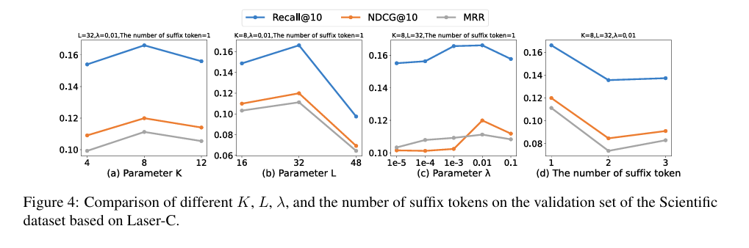
ATAI
Advanced Technique of Artificial Intelligence
ATAI
ChongqingUniversity _{AdvancedTechniqueof}
of Technology Artificial Intelligence
Chongqing University of
Technology
Chongqing University ^{ATAI}
_{of Technology} Advanced Techniqueof
Artificial Intelligence
Chongqing University of Technology
Chongqing University of Technology

Slide 13
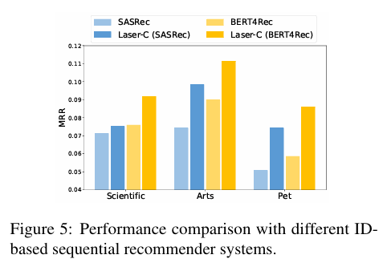
ATAI
Advanced Technique of Artificial Intelligence
ATAI
ChongqingUniversity _{AdvancedTechniqueof}
of Technology Artificial Intelligence
Chongqing University of
Technology
Chongqing University ^{ATAI}
_{of Technology} Advanced Techniqueof
Artificial Intelligence
Chongqing University of Technology
Chongqing University of Technology

Slide 14
ATAI
Advanced Technique of Artificial Intelligence
ATAI
ChongqingUniversity _{AdvancedTechniqueof}
of Technology Artificial Intelligence
Chongqing University of
Technology
Chongqing University ^{ATAI}
_{of Technology} Advanced Techniqueof
Artificial Intelligence
Chongqing University of Technology
Chongqing University of Technology
Thanks!

