Slide 1









Chongqing University of Technology
ATAI
Advanced Technique of Artificial Intelligence
A Capsule Network for Recommendation and Explaining What
You Like and Dislike
SIGIR ’19, July 21–25, 2019, Paris,France
Ankang Zuo
617075878@qq.com

Slide 2
本文结构
1 Introduction
2 Related Work
3 The Proposed Model
4 Experiments
5 Conclusion

Slide 3
Introduction
用户评论包含丰富的语义，以满足用户对项目特征的偏好。最近，许多基于深度学习的解决方案已经被提出，利用评论推荐。
然而，根据用户持有的观点和程度，仍然很难理解用户是否喜欢或不喜欢项目的某一方面。
在这里，我们考虑由用户持有的一对观点和项目的一个方面作为一个逻辑单元（胶囊网络）。
通过从评论中发现信息逻辑单元来推理评级行为，并解决其相应的情绪，可以提供更好的评级预测和解释。

Slide 4
为什么用胶囊网络
在传统卷积神经网络中，卷积层的输出为神经元加权求和的结果，因此是标量。在胶囊网络中，每个值使用向量表示，即胶囊不仅可以表示物体的特征，也可以表示物体的方向、位置等状态。

Slide 5
Introduction
本文所提出的CARP(a capsule network based model for rating prediction with user reviews)由两部分构成：
viewpoint and aspect extraction
sentiment capsules

Slide 6
A sentiment capsules include a positive capsule and a negative capsule.
Note that no human labeling or external NLP tool is required to aid the training of CARP.

Slide 7
本文做的主要工作如下：
Deep learning model for rating prediction and explanation.considering user viewpoints, item aspects and sentiments.
A capsule-based architecture routing by Bi-Agreement, a new iterative dynamic routing process for capsule networks.
A multi-task learning process by a rating score.
On seven real-world datasets results performance robustness and explanation at fine-grained level.

Slide 8
本文方法相对之前方法的优势在于：
They are incapable of telling whether a user likes or dislikes an aspect of an item according to what viewpoint the user holds and to what extent. In this work, the proposed CARP can be seen as a preliminary step to fill in the missing part.

Slide 9
本文上下文编码描述如下：
Context Encoding. Given a user document D_{u} = (w1,w2, ...,wl) where l is the document length in number of words, we first project each word to its embedding representation: D_{u} = (e1, ..., el). Here,ej ∈ R^{d} is the embedding vector for word at the j-th position, and d is the embedding size.
ReLU (i.e., Rectified Linear Unit) as the activation function.

Slide 10
Self-Attention. Intuitively, not all words in the document are important for each viewpoint. To identify which features carried by c_{j} are relevant to each viewpoint, we leverage a viewpoint-specific gating mechanism:
s_{u,x,j} = c_{j} ⊙ σ(W_{x,1}c_{j} + W_{x,2}q_{u,x} + b_{x} ) (1)
where W_{x,1}, W_{x,2} ∈ R^{n×n} and b_{x} ∈ R^{n} are transform matrices and bias vector respectively for the x-th viewpoint, σ is the sigmoid activation and ⊙ is the element-wise product operation, q_{u,x} is the embedding of x-th viewpoint shared for all users, which is learned by model optimization.

Slide 11
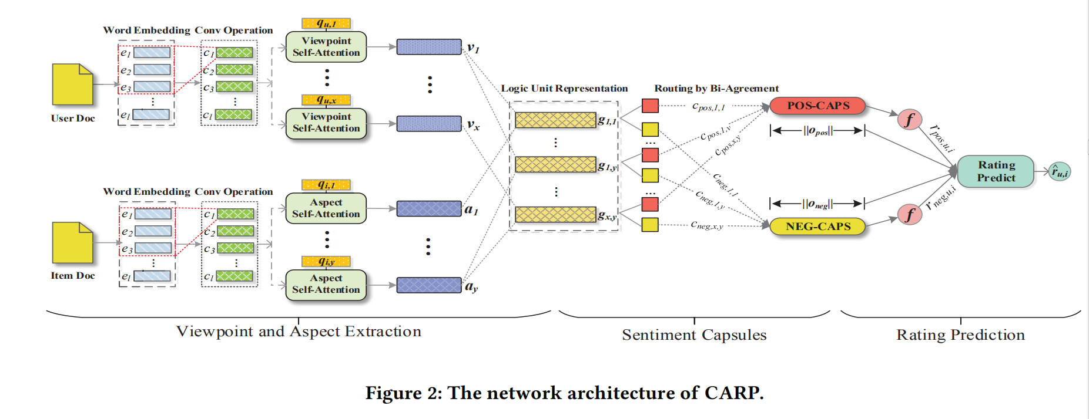
CARP网络结构图

Slide 12
逻辑单元的定义如下
Logic Unit Representation.
Given the x-th viewpoint v_{u,x} of user u and y-th aspect a_{i,y} of item i, the representation g_{x,y} of the corresponding logic unit g_{x,y} is derived as follows:
g_{x,y} = [(v_{u,x} - a_{i,y} ) ⊕ (v_{u,x} ⊙ a_{i,y} )] (3)
Where ⊕ is the vector concatenation operation.

Slide 13

情感胶囊网络构成及表示如下：
In each sentiment capsule,the latent sentiment features are derived for each logic unit as t_{s,x,y} = W_{s,x,y}g_{x,y}, where s ∈ S and S = {pos, neg} refers to the two sentiments, W_{s,x,y} ∈ R^{k×2k} is the weight matrix, and t_{s,x,y} is the latent feature vector for logic unit g_{x,y}.
Then, the capsule with sentiment s takes all feature vectors.
{t_{s,x,y} |x,y ∈ 1...M} as input and derive its output vector via an iterative dynamic routing process.

Slide 14

Squashing function transforms s_{s,u,i} into o_{s,u,i} whose length falls in the range of (0, 1).

Slide 15


Slide 16

现有路由协议的缺陷在于：
As used in original capsule architecture, the core step is to iteratively calculate an agreement score b_{s,x,y} indicating the relatedness between t_{s,x,y} and other feature vectors inside the same sentiment capsule.
Based on Equation 6, a non-informative logic unit would still pose a large blur to hurt the sentiment abstraction ability of the capsules.

Slide 17
现有路由协议的缺陷在于：
The larger weight inevitably makes a lot of noise towards the first sentiment capsule, which causes a large adverse influence in later iterations.
In this sense, CARP fails to uncover the reasoning process as well as to guarantee semantic explanation. For this reason, we introduce Routing by Bi-Agreement.

Slide 18
Routing by Bi-Agreement.
Let ¬s denote the opposite sentiment compared to sentiments, an appropriate dynamic routing process for our task should hold the following three properties: (1) Given b_{s,x,y} is relative larger inside the capsule and b_{s,x,y} > b_{¬s,x,y} ,the value of c_{s,x,y} should be larger as well; (2) Given b_{s,x,y} is relative larger inside the capsule but b_{s,x,y} < b_{¬s,x,y} , the value of c_{s,x,y} should be small; (3) Given b_{s,x,y} is relative smaller inside the capsule, the value of c_{s,x,y} should be smaller also.
RBiA is devised to derive coupling coefficient c_{s,x,y} by considering the relative magnitudes of b_{s,x,y} in both inter-capsule and intra-capsule views together.

Slide 19
Routing by Bi-Agreement.
RBiA is devised to derive coupling coefficient c_{s,x,y} by considering the relative magnitudes of b_{s,x,y} in both inter-capsule and intra-capsule views together.

Slide 20
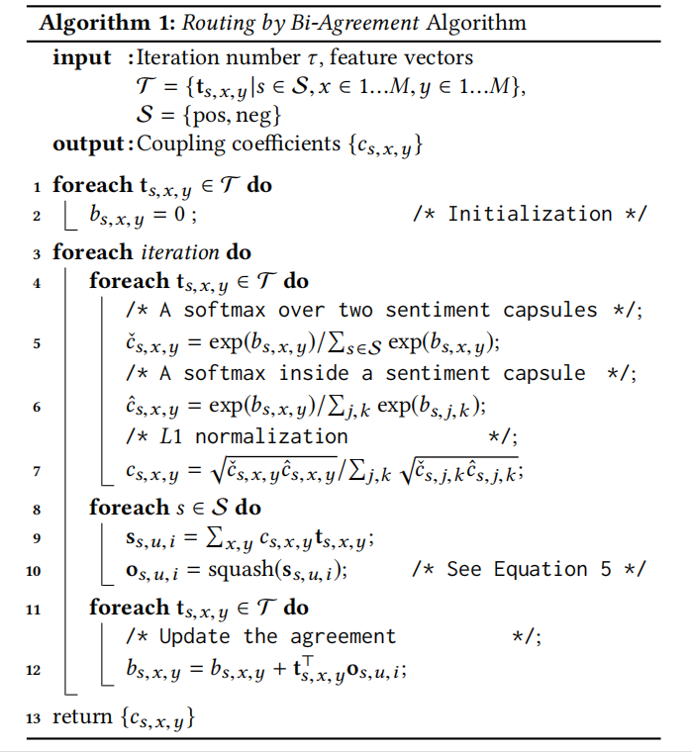
算法流程如下
At first, RBiA assigns the same initial agreement for each logic unit over the two sentiment capsules (Lines 1-2).
Then, we calculate a candidate coupling coefficient cˇ_{s,x,y} based on the inter-capsule comparison (Line 5). On the other hand, another candidate coupling coefficient cˆ_{s,x,y} is calculated similarly, but by comparing b_{s,x,y} in an intra-capsule view (Line 6). We calculate coupling cofficient c_{s,x,y} by performing L1 normalization over the
geometric mean of cˇ_{s,x,y} and cˆ_{s,x,y} inside each sentiment capsule(Line 7).

Slide 21
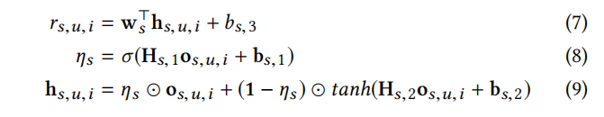
Rating Prediction and Optimization
Given the output o_{s,u,i}, we calculate rating r_{s,u,i} user u would give for item i with sentiments as follows:
Where w_{s} is the regression weight vector, b_{s,3} is a bias term, H_{s,1}, H_{s,2} ∈ R^{k×k}
Are transform matrices, b_{s,1,} b_{s,2} ∈ R^{k} are the bias vectors, and 1 is the vector with all elements being 1.

Slide 22


Rating Prediction and Optimization
By further considering the user and item biases, the overall rating score is then calculated as follows:
Where rˆ_{u,i} is the predicted rating score, b_{u} and b_{i} are the corresponding bias for user u and item i respectively, and function
Is a variant of the sigmoid function, producing a value within the target rating range of [1,C].

Slide 23


多任务学习目标函数
Multi-task Learning. For model optimization, we use Mean Square Error (MSE) as the objective to guide the parameter learning:
By matching the observed rating scores alone, the training of CARP would easily strap into a local optimum, which may not correctly reflect the fine-grained sentiments.Therefore, we introduce a sub-task to enhance the capacity of sentiment analysis in CARP.
When rating r_{u,i} > π, s_{u,i} = pos; otherwise, s_{u,i} = neg. That is, we can split O into two disjoint subsets O_{pos} and O_{neg}. And π is a predefined threshold.We then utilize a sentiment analysis task as another objective function:

Slide 24
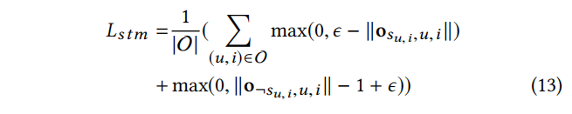
为解决数据不平衡问题，上述函数需改造
We need to consider the data imbalance issue. That is, the number of the user-item pairs with a lower rating score is significantly less than the couterpart (i.e., |O_{pos}| ≫ |One_{neg}|). This imbalance problem hurts the model from identifying the negative sentiment.
To recruite more supervision regarding the negative sentiment to alleviate this problem, weexploit a mutual exclusion principle as follows:
In Equation 13, each user-item pair should also meet the condition ∥o¬s_{u,i},u,i∥ ≤ 1 - ϵ.In other words, the feedbacks regarding both the positive and negative sentiments are provided by each user-item pair.

Slide 25

Considering both two objectives, the final objective for CARP is a linear fusion of Lsqr and Lstm:
where λ is a tunable parameter controling the importance of each subtask.

Slide 26
实验数据集
数据集准备时的配置及处理：
Datasets. In our experiment, we use seven datasets from three sources: Amazon-5cores, Yelp, and the RateBeer website.
Each user and item has at least 5 reviews.
Yelp spanning from 2016 to 2017 as the final dataset, denoted as Yelp16-17.
We randomly build the training set and testing set in the ratio 80 : 20. Moreover, 10% records in the training set are randomly selected as the validation set for hyper-parameter selection. Note that at least one interaction for each user/item is included in the training set.

Slide 27
实验比较
We compare the proposed CARP against the conventional baseline and recently proposed state-of-the-art rating prediction methods:
(a) probabilistic matrix factorization that leverages only rating scores, PMF.
(b) latent topic and shallow embedding learning models with reviews, RBLT and CMLE.
(c) deep learning based solutions with reviews, DeepCoNN,D-Attn,TransNet, TARMF MPCN and ANR.

Slide 28
超参数设置如下
Hyper-parameter Settings. We apply grid search to tune the hyper-parameters for all the methods based on the setting strategies reported in their papers. The final performances of all methods are reported over 5 runs. The latent dimension size is optimized from{25, 50, 100, 150, 200, 300}. The word embeddings are learned from scratch. The dimension size of word embedding is set to 300 (i.e.d = 300).
For other bigger datasets ,the batch size is set to 200. The number of convolution filters is set to 50 for convolution based methods (including CARP, n = 50).
For CARP, window size is c = 3, the iteration number τ is set to 3 for Routing by Bi-Agreement, the number of viewpoints or aspects for each user/item is set to be 5 (i.e., M = 5), and λ is 0.5. learning rate to 0.001 for model training.

Slide 29
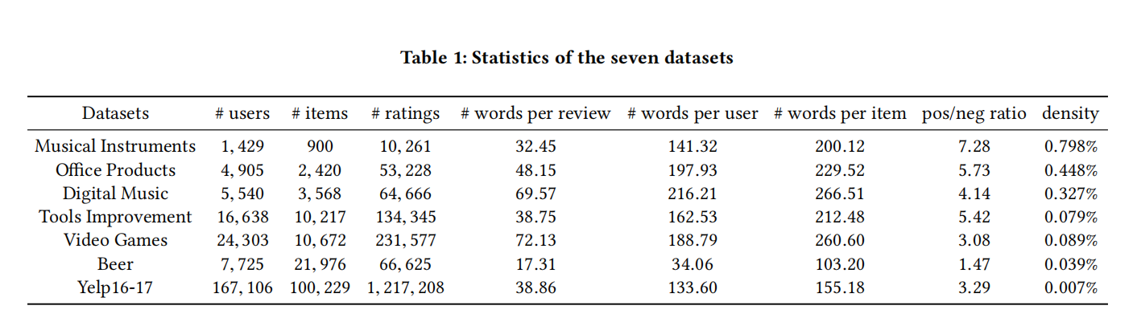
数据集统计信息如下
其中Density计算方式为ratings/(users*items)

Slide 30
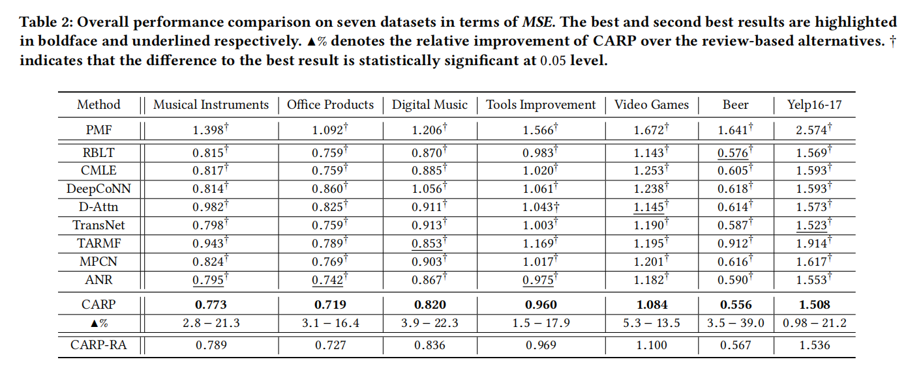
几种方法效果（MSE）对比如下：

Slide 31
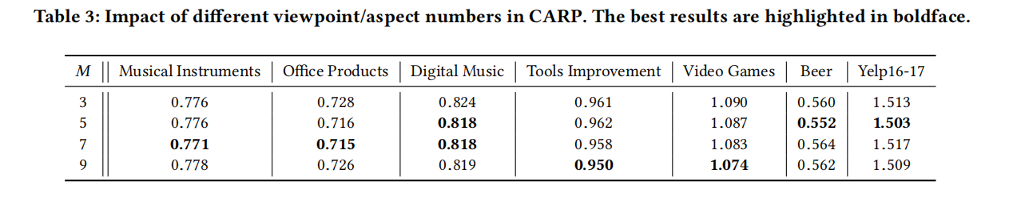
Impact of different viewpoint/aspect numbers in CARP.

Slide 32
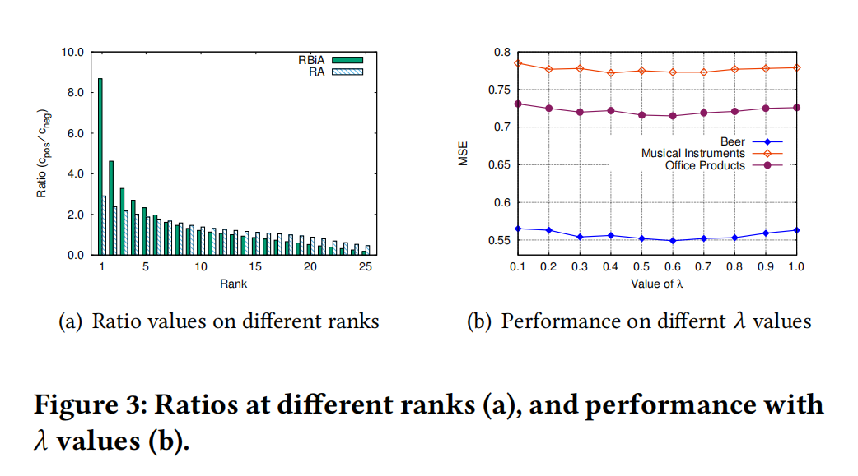
不同位次下比列（正负之比）以及不同λ值的影响

Slide 33
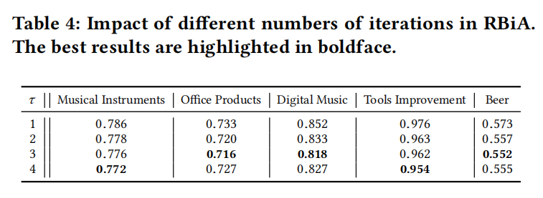
不同迭代次数对RBIA的影响

Slide 34
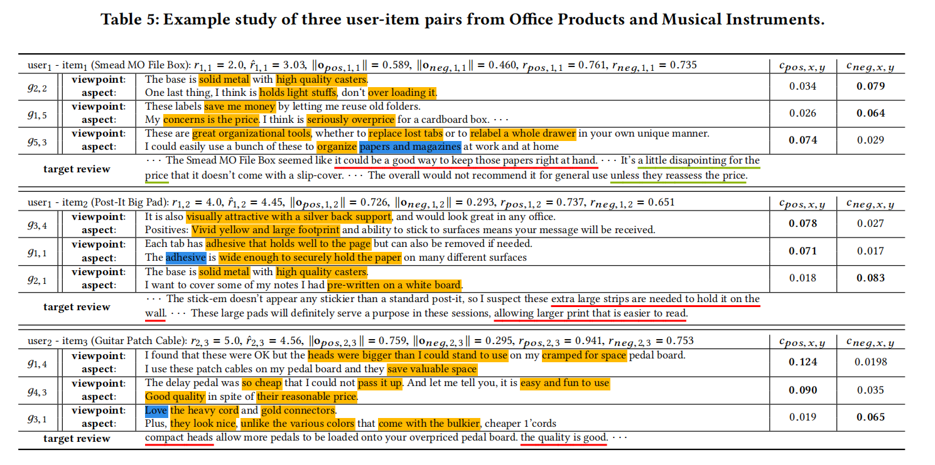
来自Office产品和乐器的三个用户项目对的示例研究

Slide 35
Analysis of CARP
We further investigate the impact of the parameter settings (i.e.,τ , M, λ) to the performance of CARP on the validation set.
Impact of Dynamic Routing. We investigate the impact of τ in the dynamic routing of CARP It is clear that more than two iterations leads to better prediction accuracy. The optimal performance is obtained by performing either 3 or 4 iterations.
Impact of M Value. The M value specifies the number of viewpoints/aspects extracted for each user/item respectively. Here, we report the performance patterns of CARP by tuning M amongst{3, 5, 7, 9}. As shown in Table 3, the optimal M value is not consistent across the datasets. It seems that M = 5or7 is desired in more datasets.
Impact of Multi-task Learning. Parameter λ controls the tradeoff in the multi-task learning setting of CARP. we also introduce a mutual exclusion principle in the multi-task learning process.

Slide 36
Explainability Analysis
Recall that CARP has encoded contextual information to represent each word. To better visualize a viewpoint (an aspect), we retrieve the top-K phrases whose weight is the sum of the weights of the constituent words in the convolutional window. Finally, we pick the sentences containing these informative phrases to represent the corresponding viewpoint/aspect. Here, we choose K = 30. We randomly sample three user-item pairs from two datasets.
Overall, our results demonstrate that CARP is superior in rating prediction and facilitates explanation with causes and effects at a finer level of granularity.

Slide 37
CONCLUSION
基于胶囊网络的推荐和解释模型可以看作是对特定人类活动进行推理的一步。我们的大量实验证明 通过对细粒度层次上的因果关系建模，得到了更好的推荐性能和理解。
实际上，根据用户的观点、项目方面和情感对评级行为进行推理，可以在电子商务中获得更多的好处，包括跨域推荐、用户概要分析和 面向用户的评审总结。我们将在未来探索这些可能性。

Slide 38
THANKS!

