Slide 1









Chongqing University of Technology
ATAI
Advanced Technique of Artificial Intelligence
Chongqing University of Technology
Heterogeneous Graph Attention Networks for Semi-supervised Short Text Classification
Ling Zhu

Slide 2
Outline
Introduction
Motivation
Approach
Experiments
Conclusion

Slide 3
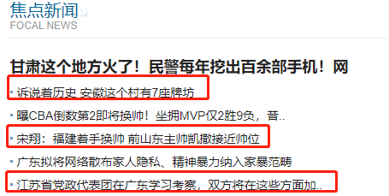
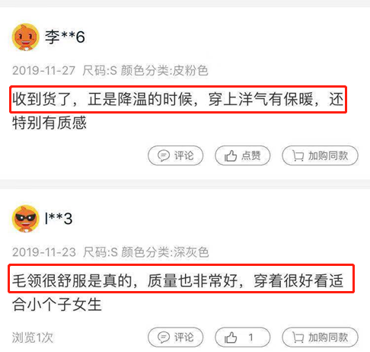
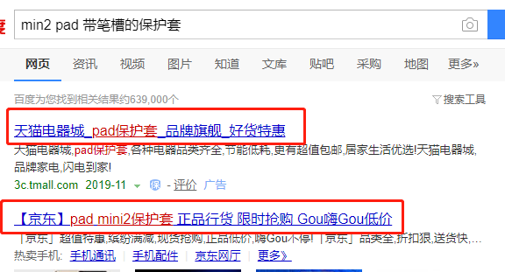
Introduction
News tagging
Sentiment analysis
Application
Query intent classification
News categorization

Slide 4
Motivation
1.the sparsity and ambiguity short text
2.The labeled data is scarce
Notes:
1.Most existing studies focus on long texts and achieve unsatisfactory performance on short texts
2.Sparsity at multiple granularity levels and reduce the weights of noisy information
2. The current method performs poorly on short text classification
the sparsity and limited labeled data
add additional information-entity,but unable to consider the relational data(entity-entity)

Slide 5
Approach
incorporate any additional information(entity,topic)
capture the rich relations among the texts and the additional information
1.(HIN)Heterogeneous information network
2.(HGAT)Heterogeneous Graph Attention networks
learn the importance of different neighbor nodes
the importance of different node (information) types to a current node

Slide 6
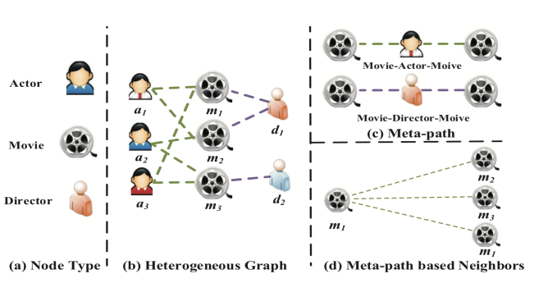
Approach
(HIN)Heterogeneous information network
Figure 1: An illustrative example of a heterogeneous graph
(IMDB)
Notes:
Three types of nodes (i.e., actor, movie, director).
(b) A heterogenous graph IMDB consists three types of nodes
and two types of connections.
(c) Two meta-paths involved in
IMDB (i.e., Moive-Actor-Moive and Movie-Director-Movie). (d)
Moive m1 and its meta-path based neighbors (i.e., m1, m2 and
m3).

Slide 7
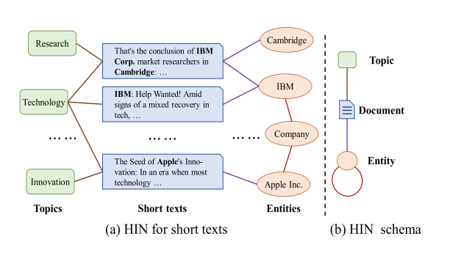
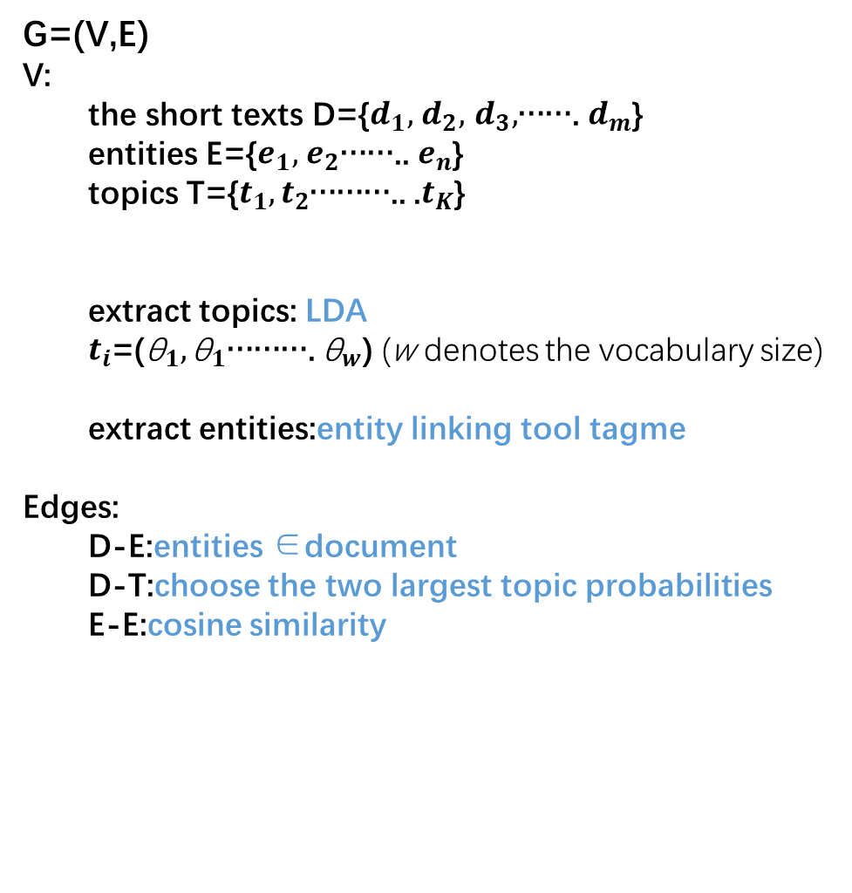
Approach
(HIN)Heterogeneous information network
G=(V,E)
V:
  the short texts D={$d_{1},$ $d_{2},$ $d_{3},$……. $d_{m}$}
  entities E={$e_{1},$ $e_{2}$…….. $e_{n}$}
  topics T={$t_{1},t_{2}$……….. .$t_{K}$}
  extract topics: LDA
  $t_{i}$=(${\text{θ}}_{1},{\text{θ}}_{1}$………. ${\text{θ}}_{w}$) (w denotes the vocabulary size)
  extract entities:entity linking tool tagme
Edges:
  D-E:entities ∈document
  D-T:choose the two largest topic probabilities
  E-E:cosine similarity
Figure 2: An example of HIN for short texts on AGNews.
Notes:
Edges:
Topic-Document:document is belong to topic
Document-entity:entity is belong to document
Entity-entity:cosine similarity

Slide 8
Approach
Document Embedding
Extract document feature using tfidf
Topic Embedding
The word distribution is used to represent the topic(LDA)
inputs
entity Embedding
{Based on the Wikipedia corpus get entity embedding,
Tfidf vector of its wikipedia description text}
adjacency matrix A

Slide 9
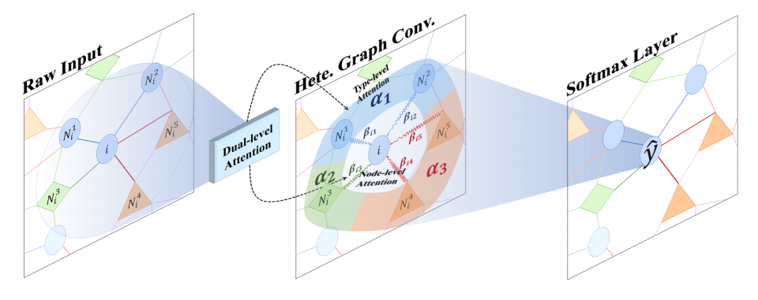
Approach
(HGAT)Heterogeneous Graph Attention networks
Figure 3: Illustration of our model HGAT

Slide 10




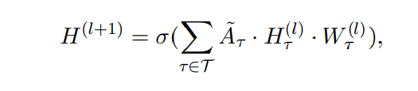




Approach
Heterogeneous Graph Convolution
A: adjacency matrix
GCN
HIN
={${\text{τ}}_{1}$, ${\text{τ}}_{2}$, ${\text{τ}}_{3}$} express different types of nodes
the submatrix of
Consider the fusion of multiple heterogeneous relationships

Slide 11



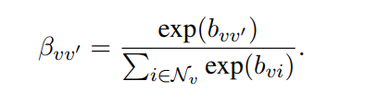
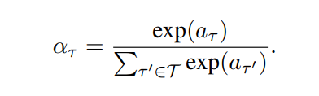
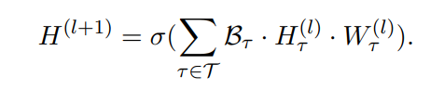
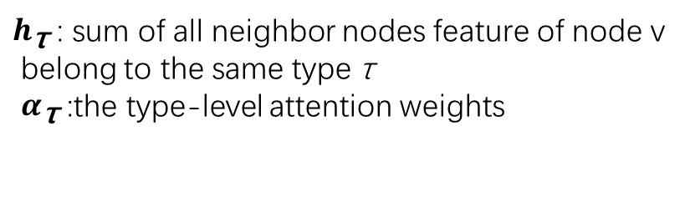
Approach
Dual-level Attention Mechanism
Type-level Attention
Node-level Attention
$h_{\text{τ}}$ : sum of all neighbor nodes feature of node v
belong to the same type τ
$α_{\text{τ}}$ :the type-level attention weights

Slide 12
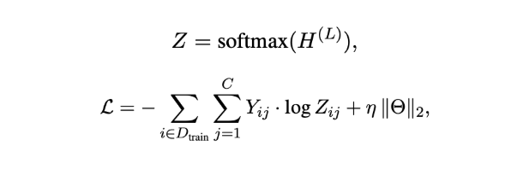
Approach
Model Training

Slide 13
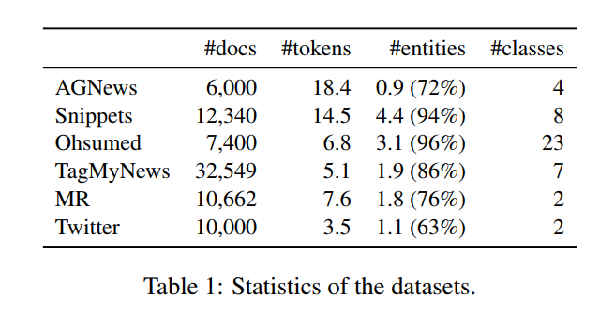
Experiments

Slide 14
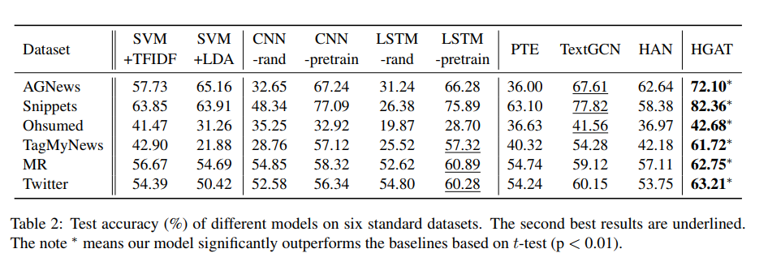
Experiments
Notes:
ASGCN-DT:在依赖树上是有方向的，ASGCN-DG在依赖树上是无方向的，它们之间唯一的区别在于邻接矩阵不同，ASGCN-DT的邻接矩阵会比较稀疏一点

Slide 15
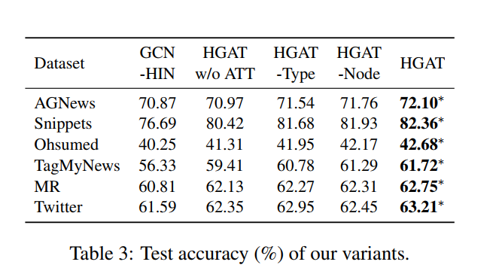
Experiments

Slide 16
Conclusion
propose a novel heterogeneous graph neural network based method for semisupervised short text classification
we first present a flexible HIN framework for modeling the short texts
propose a novel model HGAT to embed the HIN based on a dual-level attention mechanism including node-level and type-level attentions

Slide 17
Thanks

