Slide 1
Neural Demographic Prediction using Search Query
—— WSDM，2019
Explainer: Qing Zeng

Slide 2
OUTLINE
01
Background
Motivation
02
03
Approach
Experiment
04
Result
05

Slide 3
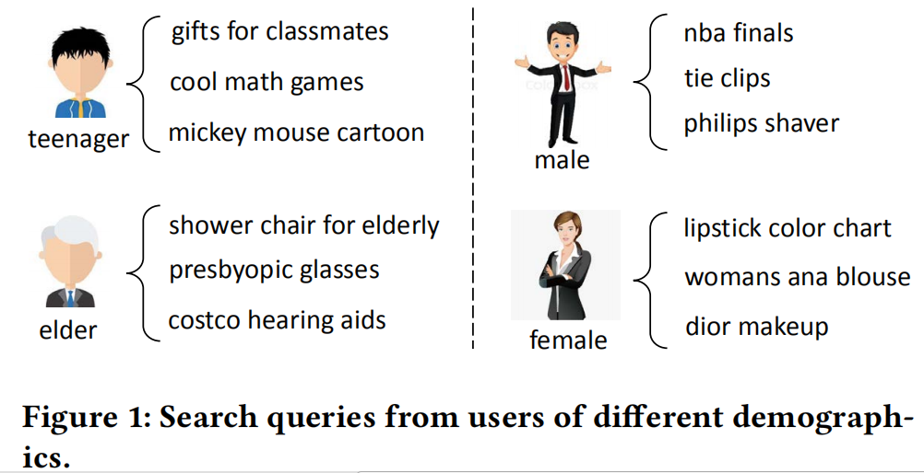
Background
  Demographics of online users such as age and gender play an important role in personalized web applications.

Slide 4
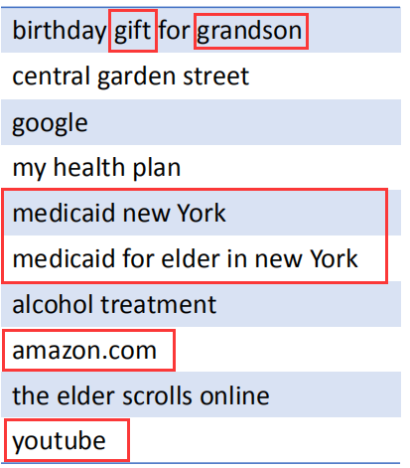
Motivation
1. Not all search queries are useful for demographic prediction, and many queries are irrelevant and even noisy.
2. Neighbouring search queries may have relatedness with each other.
3. Different words in the same query may have different importance for demographic prediction.

Slide 5
Pre-Approach
Several deep learning based methods have been proposed for demographic prediction：
1. Zhang et al. used LSTM to predict the genders and ages of social media users based on their microblogging messages.Besides the original messages, they also incorporated the retweeted messages（转发）, the comments from others and the comments to others,to learn unified user representations.（2016）
2. Wang et al.proposed a CNN based method to simultaneously predict the ages and genders of social media users using their messages.（2016）
3. Farnadi et al.proposed a multimodal fusion model to incorporate the texts, images and user relations to predict the ages and genders of Facebook users.（2018）

Slide 6
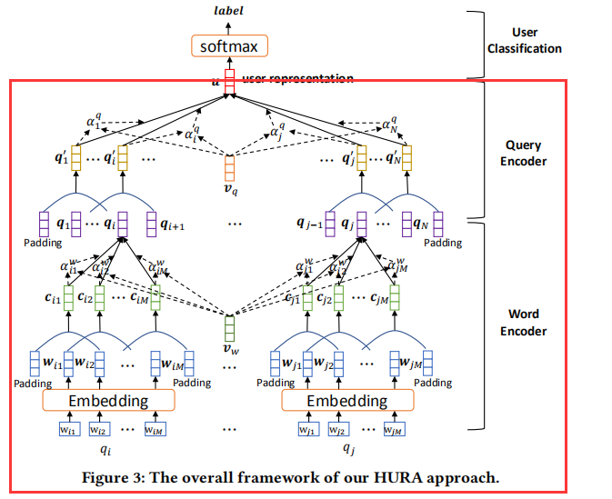
Approach
user
representation

Slide 7
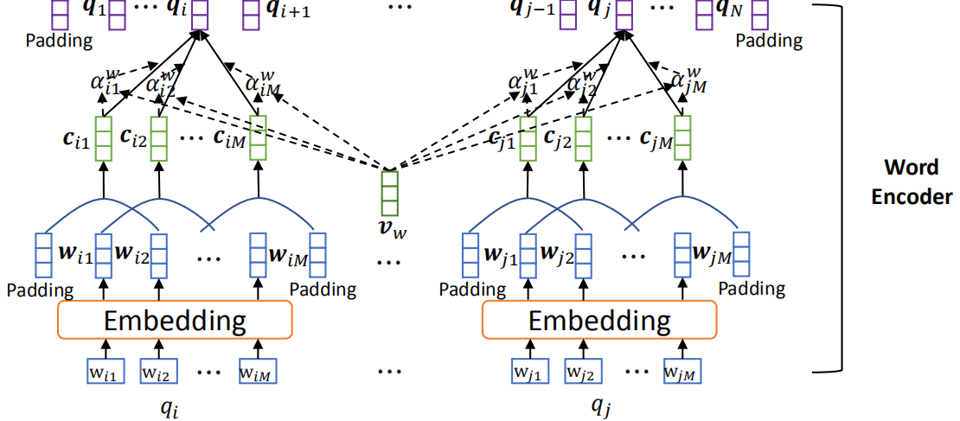
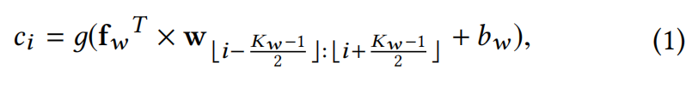
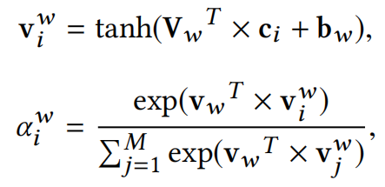
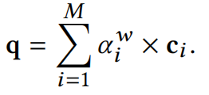
Word Encoder

Slide 8
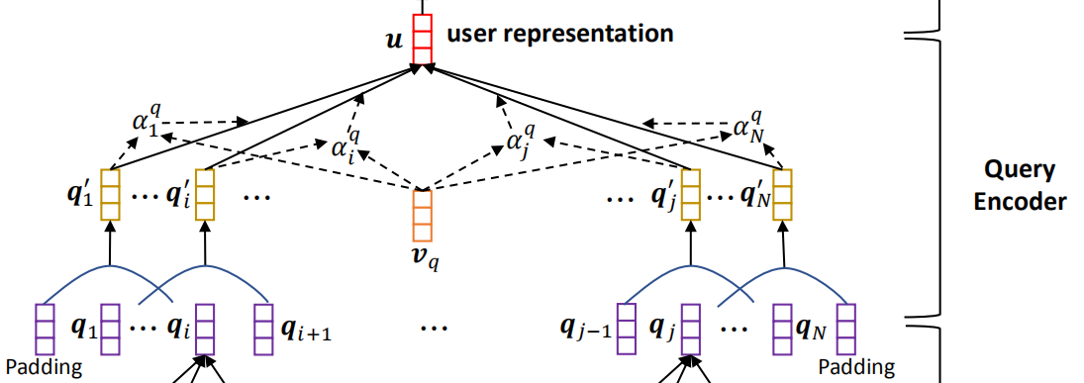


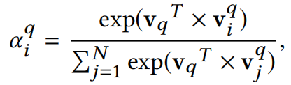
Query Encoder

Slide 9
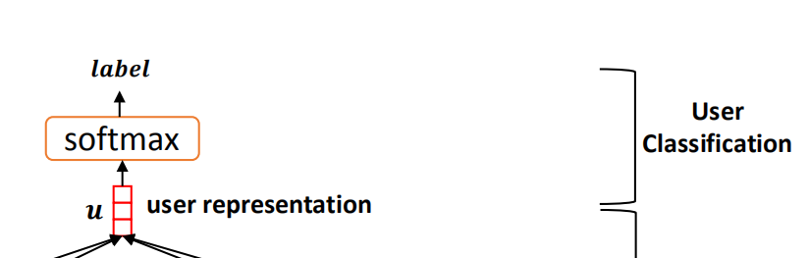

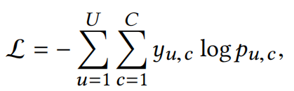
User Classification

Slide 10
Experiment-Dataset
1. We randomly sampled 25,000 users from a commercial search engine and the age categories of these users are included in their profiles. We also downloaded the search queries of these users in 6 months, ranging from October 1, 2017 to March 31, 2018.
2. We also randomly sampled 25,000 users from a commercial search engine whose gender information is available and downloaded their search queries in the same way as the Age dataset. There are 13,349 male users and 11,651 female users in this dataset.

Slide 11
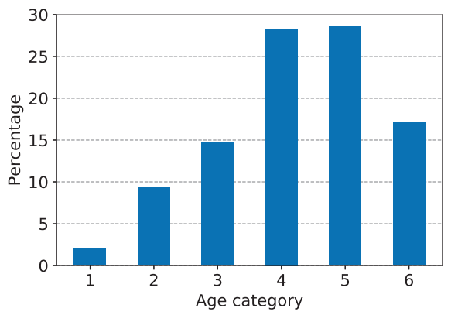
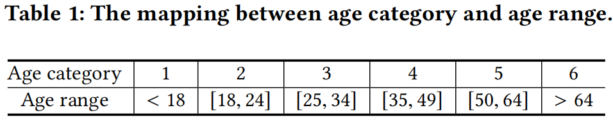
Experiment-Dataset

Slide 12
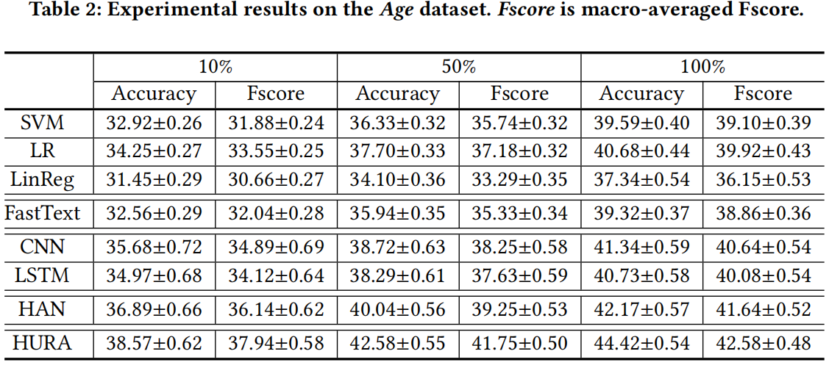
Result

Slide 13
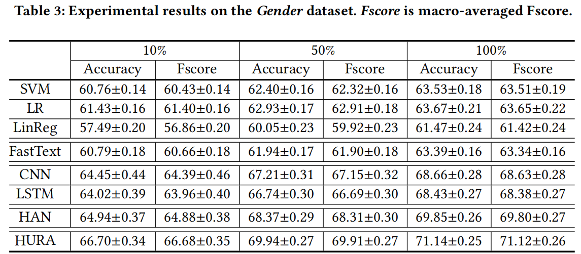
Result

Slide 14
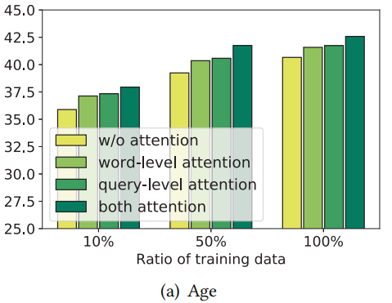
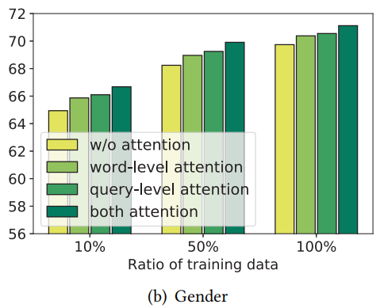
Result
The effectiveness of word-level and query-level attention networks for our HURA approach.

Slide 15
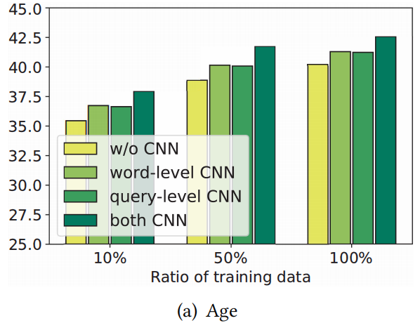
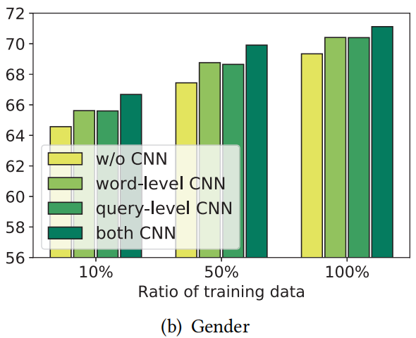
Result
The effectiveness of word-level and query-level CNN networks for our HURA approach.

Slide 16
THANK YOU

