Slide 1
Progressive Self-Supervised
Attention Learning for Aspect-Level Sentiment Analysis
学生：瞿春霞
ACL-2019

Slide 2
outline
Motivation
Background
Approach

Slide 3
Motivation
A major drawback:
Excessively focus on a few frequent words with sentiment polarities, while ignoring infrequent ones.
Notes:
有个缺陷:过于关注高频词,很少低频词

Slide 4
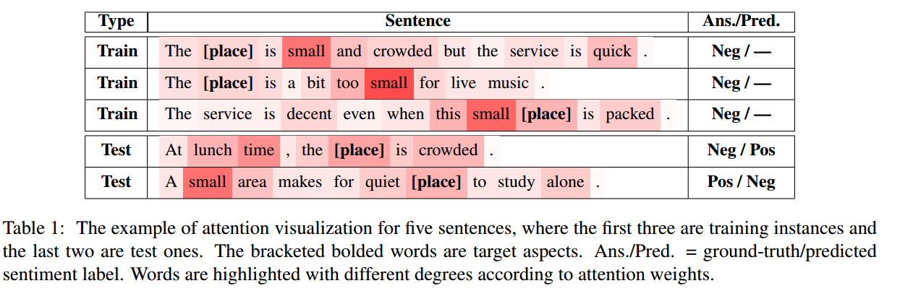
target aspect
Notes:
Target aspect是place，context word “small”
Crowded是表达消极的情感是没有捕捉到的
Test2中small与给定的target aspect是没有关系的
Small频繁与消极情感出现,attention将含small的句子与消极情绪直接联系起来
Crowded被部分忽略,而被排除在否定性词汇之外

Slide 5
What is solution?
Supervised attention
In this paper , author propose a novel progressive self-supervised attention learning approach for neural ASC models.
Notes:
解决方法:监督注意机制
本文作者提出的是渐进的自我监督注意学习方法

Slide 6
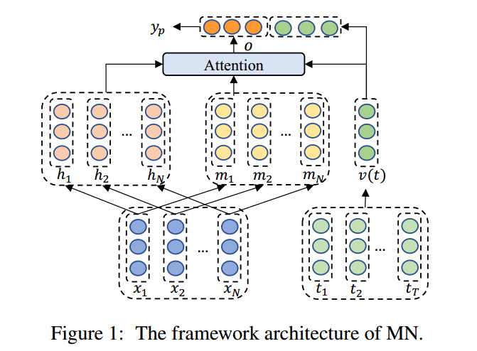
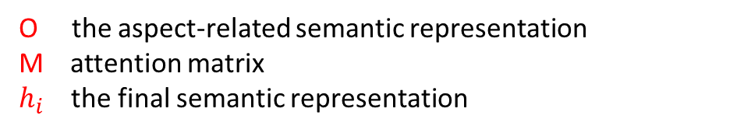


Background
$v\left(t\right)$ final vector representation
$$ο=\sum_{i}{softmax\left(v_{t}^{T}Mm_{i}\right)h_{i}}$$
O the aspect-related semantic representation
M attention matrix
$h_{i}$ the final semantic representation
Notes:
V(t)：the averaged aspect embedding of its words

Slide 7
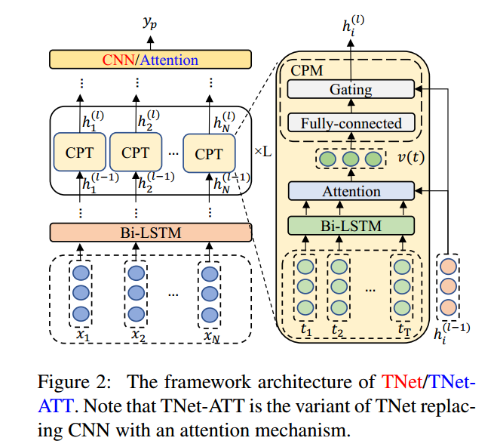

$h^{\left(0\right)}\left(x\right)$ the contextualized word representations
$$h^{\left(l+1\right)}\left(x\right)=CPT\left(h^{l}\left(x\right)\right)$$
CPT:Context-Preserving Transformation
CPM:Context-Preserving Mechanism

Slide 8
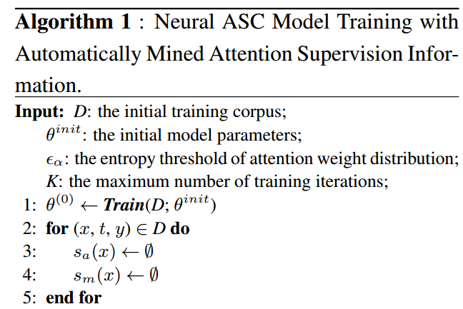

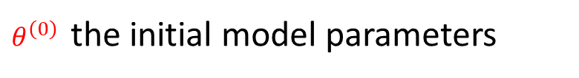
Approach
$θ^{\left(0\right)}$ the initial model parameters
$s_{a}\left(x\right)$ context words with active effects
$s_{m}\left(x\right)$ context words with misleading effects
Notes:
第一步,使用初始的训练集进行模型训练,得到参数$θ^{\left(0\right)}$

Slide 9
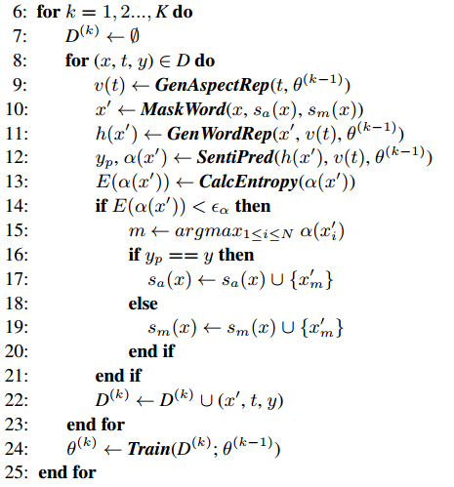
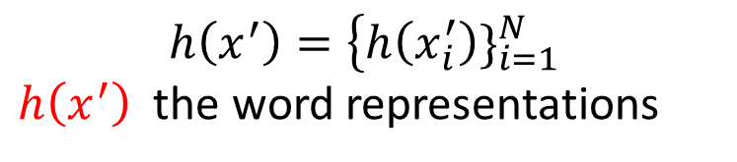


$$v\left(t\right) the aspect representation$$
$$x^{′} new sentence$$
$$h\left(x^{′}\right)=\left\{h\left(x_{i}^{′}\right)\}_{i=1}^{N} \right.$$
$h\left(x^{′}\right)$ the word representations
Notes:
第二步,进行K次迭代

Slide 10
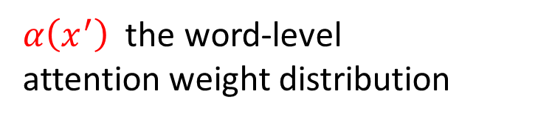
$α\left(x^{′}\right)$ the word-level
attention weight distribution
Notes:
第二步,进行K次迭代

Slide 11
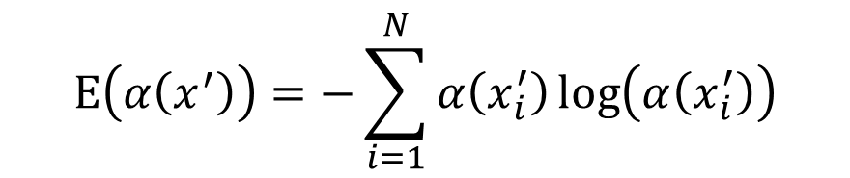
$$Ε\left(α\left(x^{′}\right)\right)=−\sum_{i=1}^{N}{α\left(x_{i}^{′}\right)\log\left(α\left(x_{i}^{′}\right)\right)}$$
Notes:
第二步,进行K次迭代

Slide 12
Notes:
第二步,进行K次迭代

Slide 13
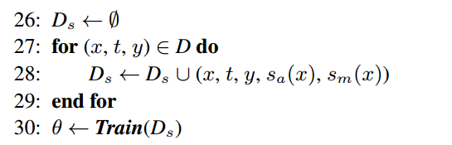

$$D_{s} final training corpus with attention$$
$$supervision information$$

Slide 14
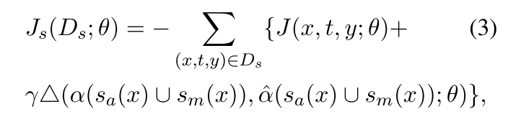
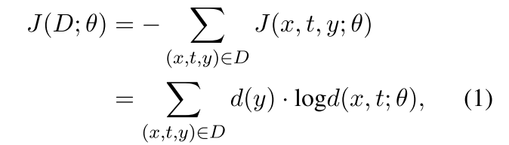

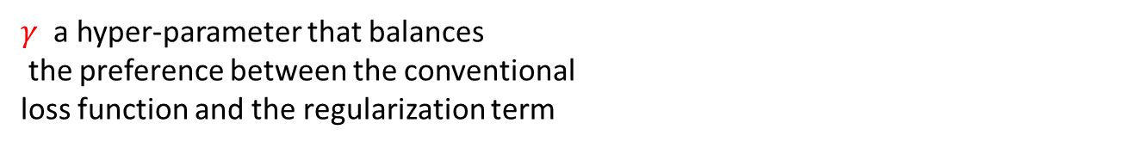
Model training with attention supervision information
soft attention regularizer
$γ$ a hyper-parameter that balances
the preference between the conventional
loss function and the regularization term
:Euclidean Distance style loss

Slide 15
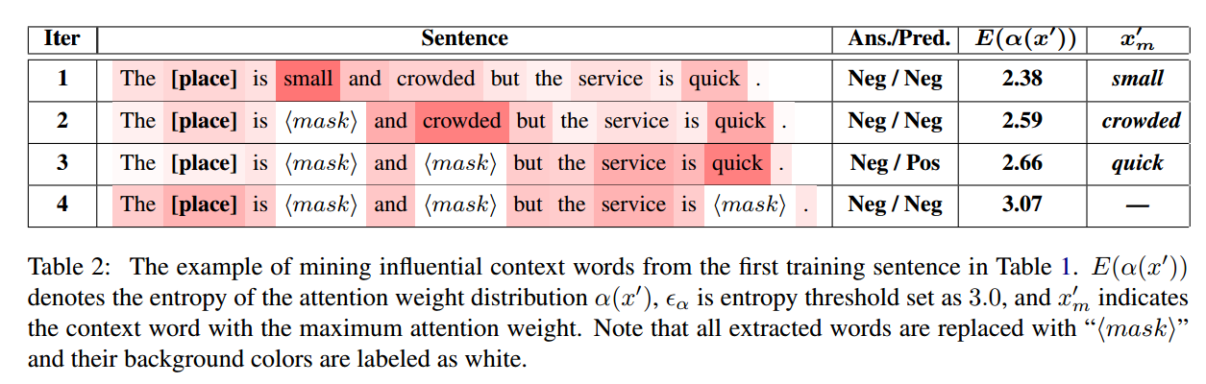

Slide 16
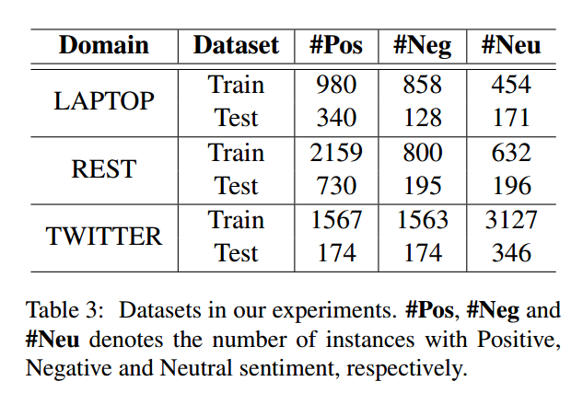
Experiments

Slide 17
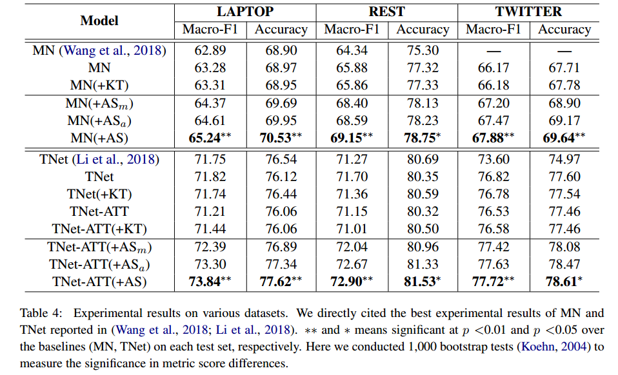

Slide 18
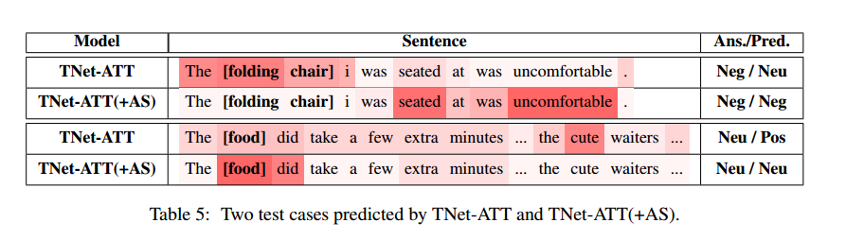

Slide 19
Thank you!

