Slide 1
KGAT : Knowledge Graph Attention Network for Recommendation
Wang, Xiang, et al. “KGAT: Knowledge Graph Attention Network for Recommendation.” KDD ’19 Proceedings of the 25th ACM SIGKDD International Conference on Knowledge Discovery & Data Mining, 2019, pp. 950–958.
Reported by Ding Nan

Slide 2
Outline
Introduction
Task formulation
Methodology
Experiments
Conclusion and future work

Slide 3
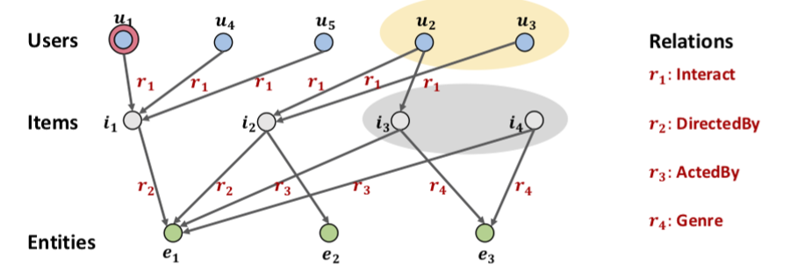

Introduction

Slide 4
Task formulation
User-Item Bipartite Graph
Knowledge Graph.
Item-entity :
Collaborative Knowledge Graph
Input: G
Output:

Slide 5
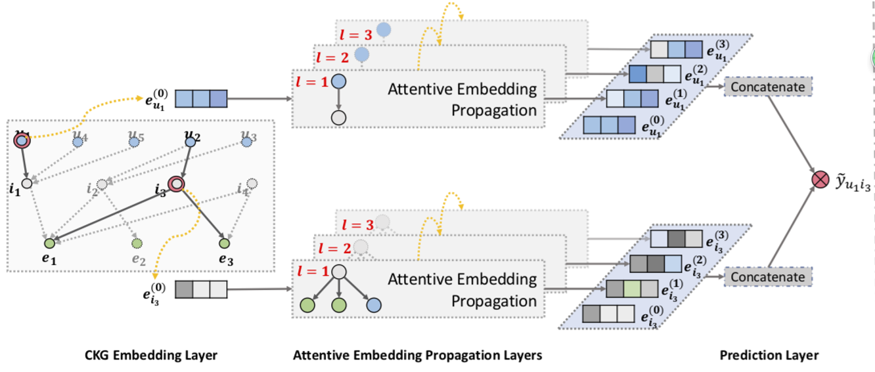
Methodology

Slide 6
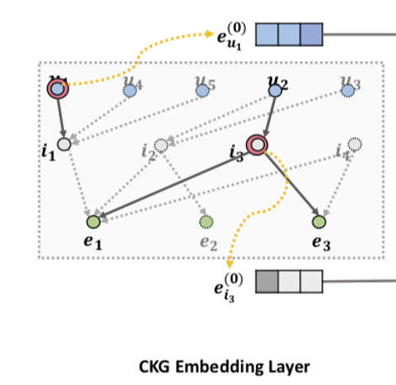
Embedding Layer
TransR:
Score:
Pairwise ranking loss:

Slide 7
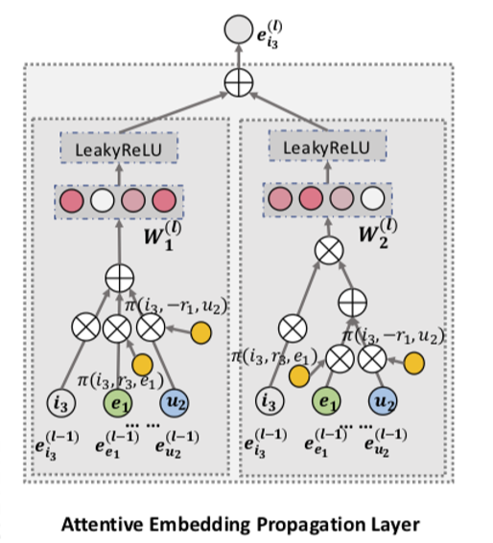
Attentive Embedding Propagation Layer
Information Propagation:
Knowledge-aware attention:

Slide 8





Attentive Embedding Propagation Layer
Information Aggregation:
GCN Aggregator
GraphSage Aggregator
Bi-Interaction Aggregator

Slide 9






Prediction Layer
Users:
Items:
Match score:
Optimization
Loss function:

Slide 10
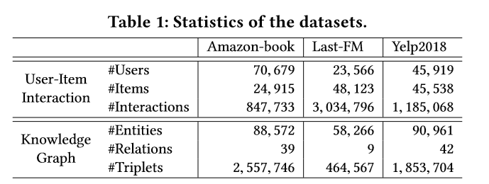
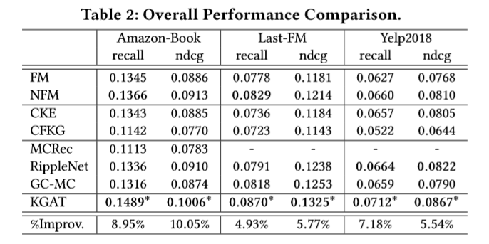
Experiments

Slide 11
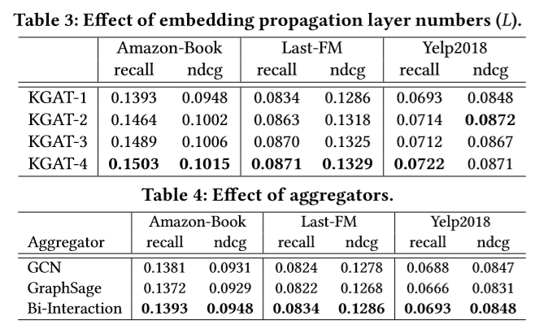
Experiments

Slide 12
Conclusion and future work
Devised a new framework KGAT , which explicitly models the high order connectivities in CKG in an end-to-end fashion.
Extensive experiments on three real-world datasets demonstrate the rationality and effectiveness of KGAT.
By integrating social network with CKG, we can investigate how social influence affects the recommendation.

Slide 13
Thanks！

