Slide 1


Coherent Comment Generation for Chinese Articles with a
Graph-to-Sequence Model
2019 Association for Computational Linguistics
Reporter:Zhi Chen

Slide 2
01
Introduction
02
Graph-to-Sequence Model
CONTENTS
03
Experiment
04
Result
05
Conclusion

Slide 3
Introduction
Online news platform is now a popular way for people to get information, where users also make comments or read comments made by others.
Automatically generate article commenting is helpful in encouraging user engagement and interaction on online news platforms.

Slide 4
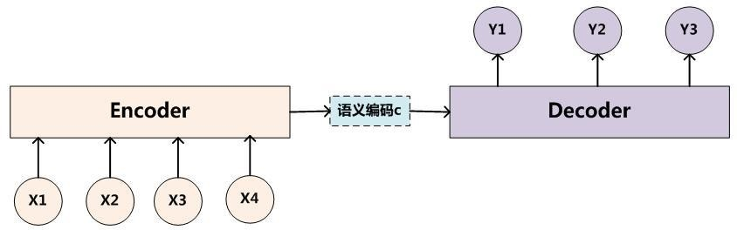
Introduction
The sequence to sequence model is a kind of End-to-End algorithm framework
Seq2Seq is generally implemented through the Encoder-Decoder framework
Encoder encodes the input sequence into a fixed-length vector, and Decoder converts the previously generated fixed vector into an output sequence.
[note] picture come from network

Slide 5
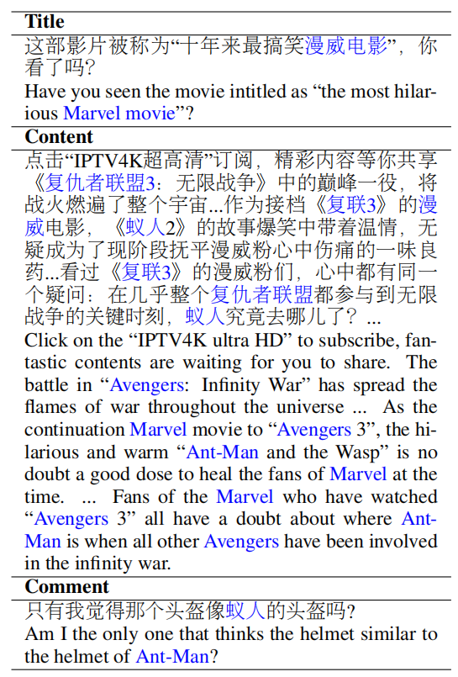

Introduction
sequence-to-sequence models achieve great success in different scenarios like machine translation and summarization , comment generation has several nontrivial challenges:
① The news articles can be very long.
②News headlines uses hyperbolic expressions that are semantically different from the content of the article.
③Users focus on different aspects (topics) of the news when making comments.

Slide 6
Introduction
This paper propose a graph-to-sequence model that generates comments
The contributions as follows:
①Propose to represent the article with a topic interaction graph
②Propose a graph-to-sequence model that generates comments based on the topic interaction graph
③ Collect and release a large scale (200,000) article-comment corpus

Slide 7
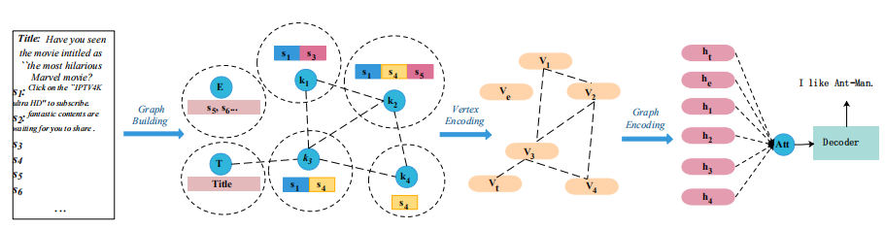
Graph-to-Sequence Model
Encoder-Decoder Framework：
Article text
Interaction graph
Hidden vectors
Comment sequence

Slide 8
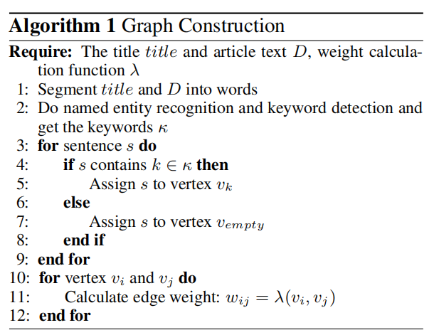
Graph Building

Slide 9
Vertex Encoder
Embedding
word embedding & positional embedding
Vertex Encoder
Self-Attention
Multi-Head Self-Attention

Slide 10
Graph Encoder
Adjacency Matrix
Diagonal Matrix
Identity Matrix
Laplacian matrix
Laernable Weight Matrix
Add one feed forward layer to the final output
of the GCN. g^{K} is the output of the last layer of
GCN.
To avoid the over-smoothing problem of GCN

Slide 11
Decoder
initial state t0 and the output of the GCN <g0,g1,...,gn>
gj卷积之后的第j个表示
Decoder
y1,y2,...,ym
？？？？
Context vector
yi是图当中的关键词和实体组成的空间还是一个更大的词空间？？？？
Adopt copy mechanism by merging the predicted word token probability distribution with the attention distribution.

Slide 12
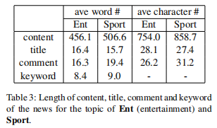
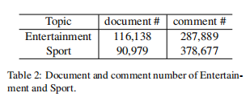
Experiment-Corpus
Collect news and comments from Tencent Kuaibao, select the news from two most popular topics Entertainment and Sport.
The length of news content is too large for traditional sequence-to-sequence model.

Slide 13
Evaluation Metrics
1. Coherence: This metric evaluates how Coherent (consistent) is the comment to the news document.
2. Informativeness: This metric evaluates how much concrete information the comment contains.
3. Fluency: This metric evaluates whether the sentence is fluent.
Ask three raters to evaluate the generated comments of different models .
Use spearman’s rank score to measure the correlation between raters.
The p-values are all below 1e-50. Spearman’s rank of around 0.6.

Slide 14
Baseline
1. Seq2seq:Three kinds of input, the title (T), the content (C) and the title together with the content (TC).
2. Self-attention:Two kinds of input, the bag of words (B) and the keywords (K).
3. Hierarchical-Attention

Slide 15
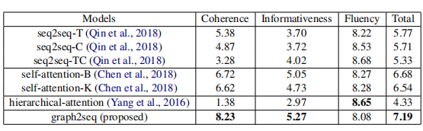
Results
1. graph2seq receives much higher scores in coherence.
2. other baseline models tend to generate general comments such as “I still think I like him”
3. self-attention based models receive higher coherence score

Slide 16
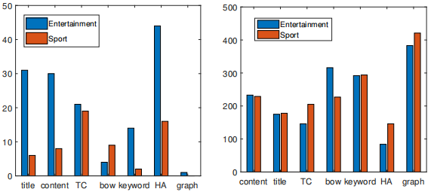
Results
general comments
( the lower the better)
unique words
( the higher the better)
1.graph2seq model can generate comments with the most information because it can capture the plot of the article.
2.Models with higher coherence score tend to be more informative.
The number of general comments is loosely negatively correlated to the informative score, especially in entertainment topic.

Slide 17
Results
Reason:similar structure of decoder between different models.(RNN+Attention)
1.The generated comment is against the world knowledge; “ 大餐是个好演员 ”.
2.The model can not distinguish between similar characters; “鹿晗是谁？我只认识鹿晗 ”.
3. The model sometimes repeatedly generates the same names.

Slide 18
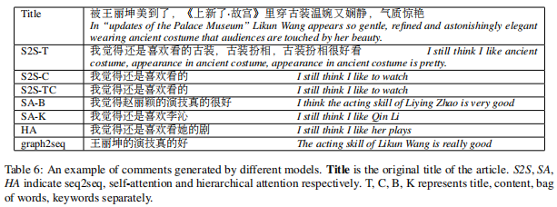
Case study

Slide 19
Conclusion
1.Propose to automatically generate comment of articles with a graph-to-sequence
model.
2.Model can better understand the structure of the article.
3.Experiment results show that model can generate more coherent and infomative comments.
4.We observe that there are still some comments conflicting with the world knowledge.
5.In the future, we would like to explore how to introduce external knowledge into the graph to make the generated comments more logical.

Slide 20
thank you!

Slide 21
Experiment-Settings
Batch-size = 32
Embeddings-size = 128
Use 1-layer convolution in GCN
For all the RNN based encoders, use bidirectional LSTM, hidden size = 128.
Vocavulary-size = 60,000
The sentences are truncated to 100 words.
The maximum length for generating is set to 32
For multi-head attention, we use 4 heads.
Dropout rate = 0.1
For RNN encoder, RNN decoder and multi-layer self-attention, use a layer number of 2.
Initial learning rate is set to 0.0005

