Slide 1
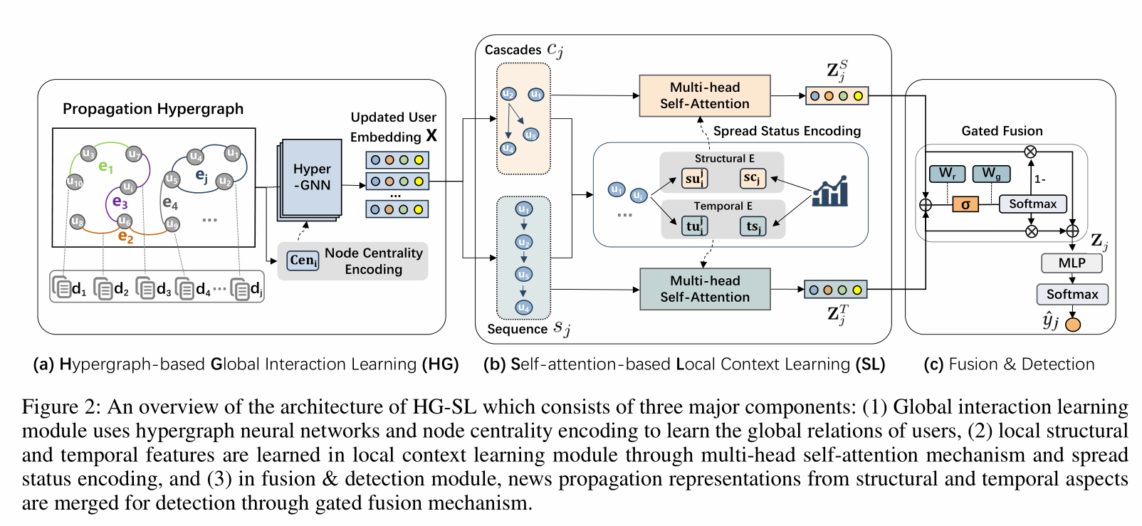
2023_AAAI_Jointly Learning of Global and Local User Spreading Behavior for Fake News Early Detection

Slide 2
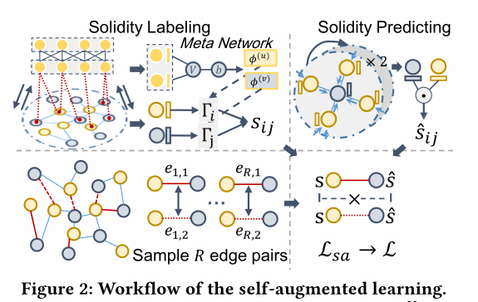
2022_KDD_Self-Supervised Hypergraph Transformer for Recommender Systems

Slide 3
2022_KDD_Multi-Behavior Hypergraph-Enhanced Transformer for Sequential Recommendation

Slide 4
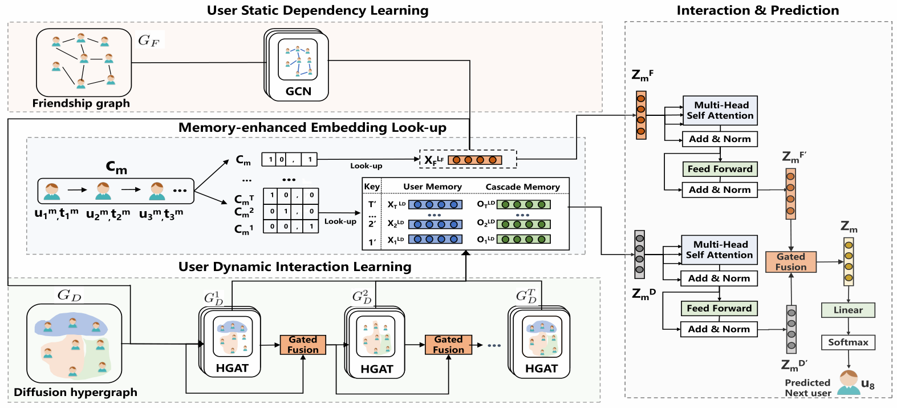
2022_AAAI_Memory-enhanced Sequential Hypergraph Attention Network for Information Diffusion Prediction
Notes:
基于时间戳划分为T个子集来构建扩散超图

