Slide 1
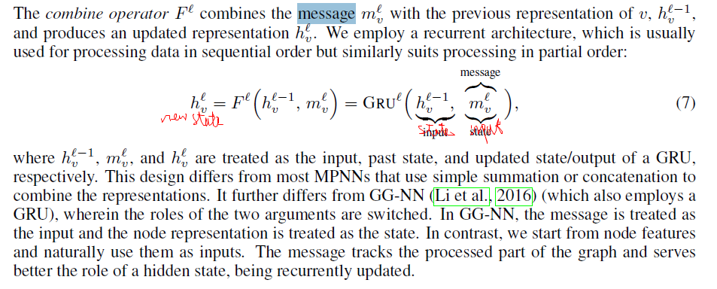
new state
state
input(x)
2021_ICLR_DAGNN_Directed Acyclic Graph Neural Networks

Slide 2
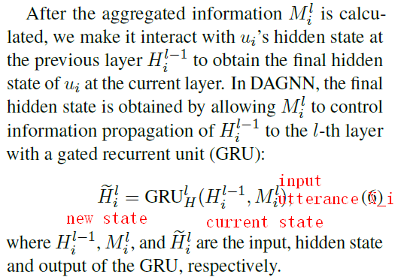
2021_ACL_DAG-ERC_Directed Acyclic Graph Network for Conversational Emotion Recognition

Slide 3
2019_AAAI_DialogueRNN_An Attentive RNN for Emotion Detection in Conversations

