Slide 1




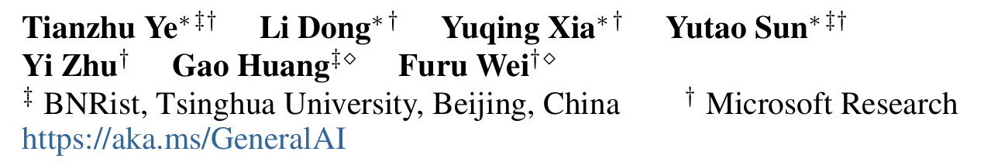





ATAI
Advanced Technique of Artificial Intelligence
ATAI
ChongqingUniversity _{AdvancedTechniqueof}
of Technology Artificial Intelligence
Chongqing University of
Technology
Chongqing University ^{ATAI}
_{of Technology} Advanced Techniqueof
Artificial Intelligence
Chongqing University of Technology
Chongqing University of Technology
Differential Transformer
Code : https://aka.ms/Diff-Transformer.
—— ICLR’2025
Reported by Yang Jiang
1

Slide 2
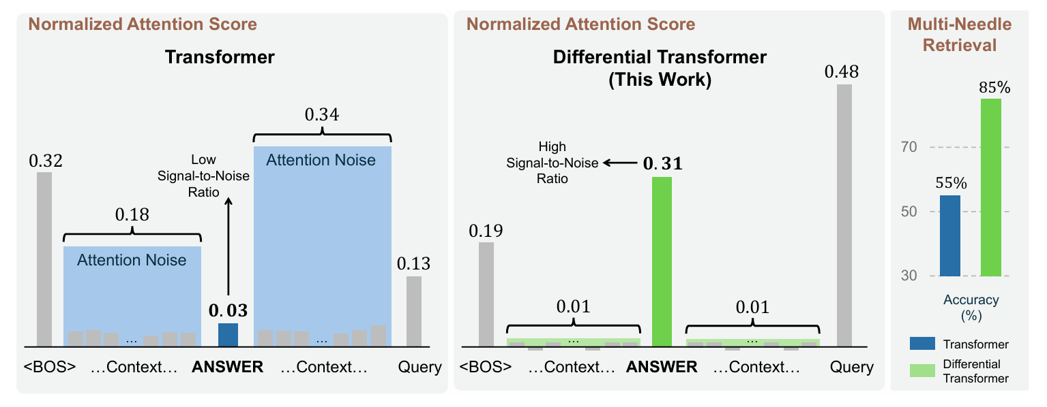
ATAI
Advanced Technique of Artificial Intelligence
ATAI
ChongqingUniversity _{AdvancedTechniqueof}
of Technology Artificial Intelligence
Chongqing University of
Technology
Chongqing University ^{ATAI}
_{of Technology} Advanced Techniqueof
Artificial Intelligence
Chongqing University of Technology
Chongqing University of Technology
Introduction
Transformer tends to overallocate attention to irrelevant context.

Slide 3
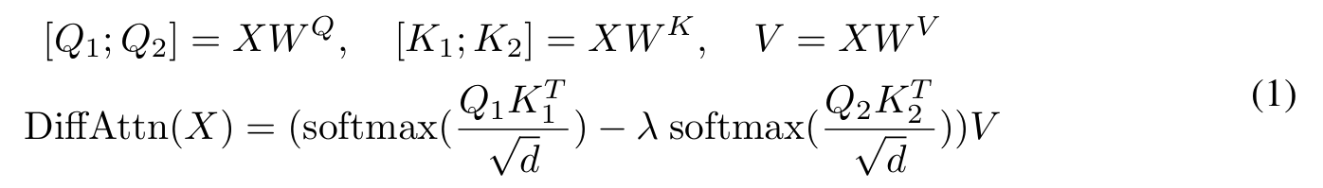
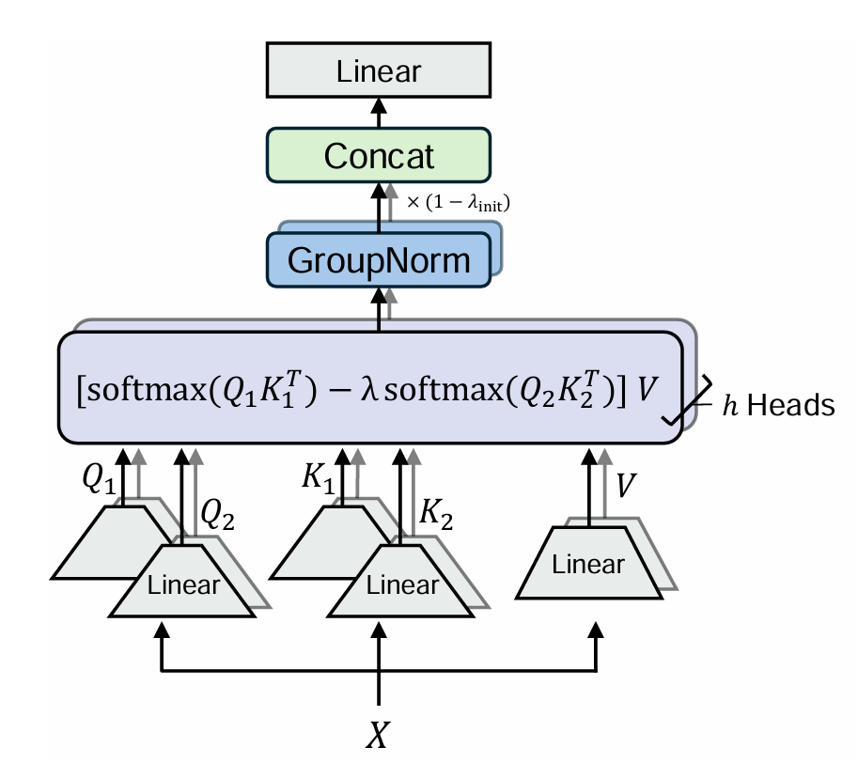

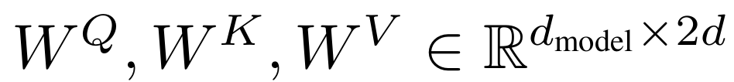

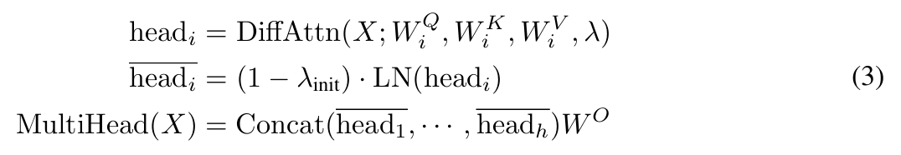
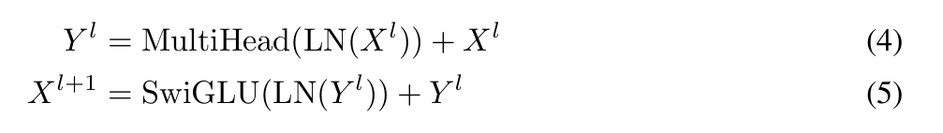
ATAI
Advanced Technique of Artificial Intelligence
ATAI
ChongqingUniversity _{AdvancedTechniqueof}
of Technology Artificial Intelligence
Chongqing University of
Technology
Chongqing University ^{ATAI}
_{of Technology} Advanced Techniqueof
Artificial Intelligence
Chongqing University of Technology
Chongqing University of Technology
Overview

Slide 4
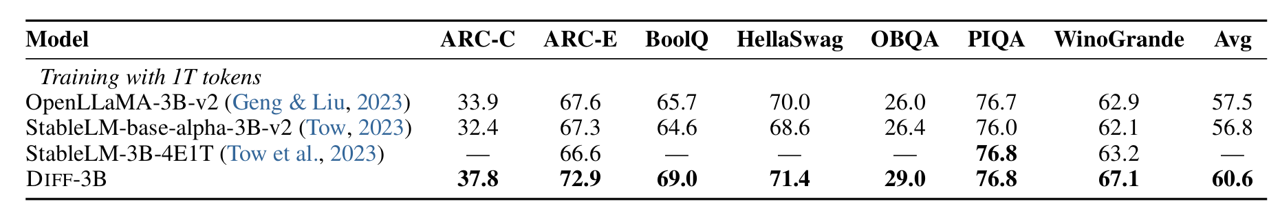
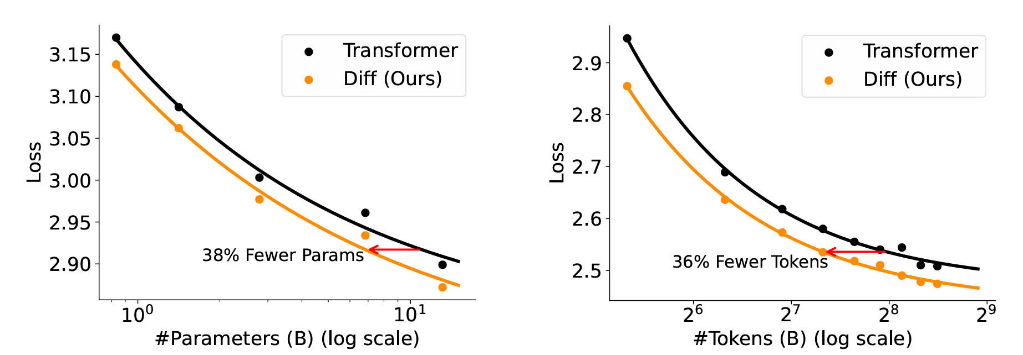
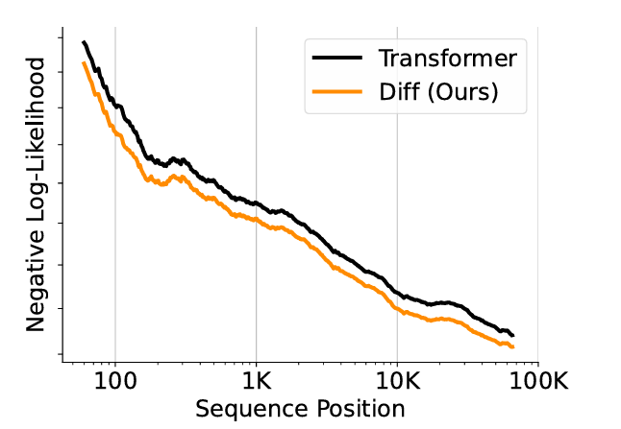
ATAI
Advanced Technique of Artificial Intelligence
ATAI
ChongqingUniversity _{AdvancedTechniqueof}
of Technology Artificial Intelligence
Chongqing University of
Technology
Chongqing University ^{ATAI}
_{of Technology} Advanced Techniqueof
Artificial Intelligence
Chongqing University of Technology
Chongqing University of Technology
Experiments

Slide 5
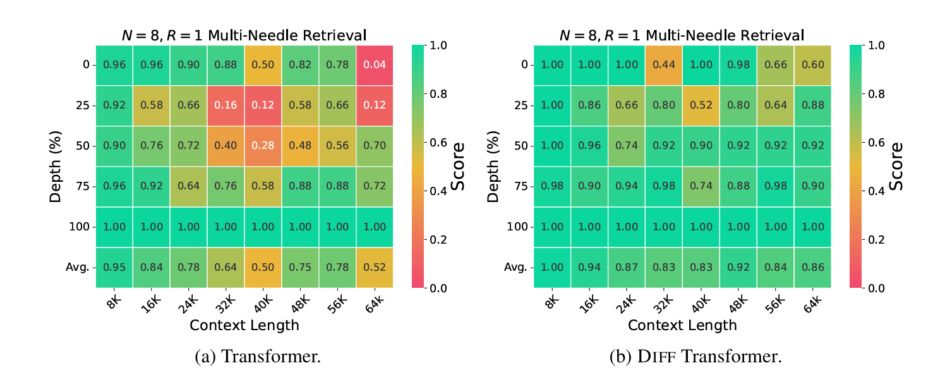
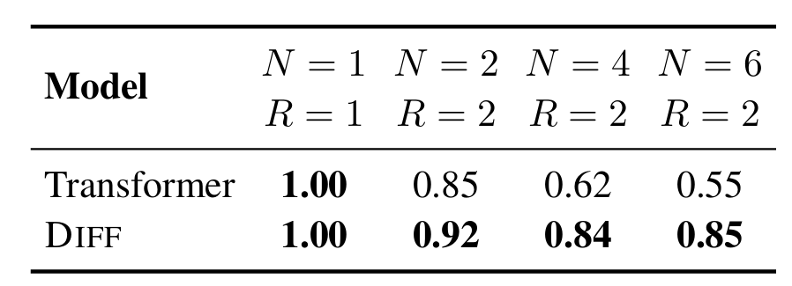
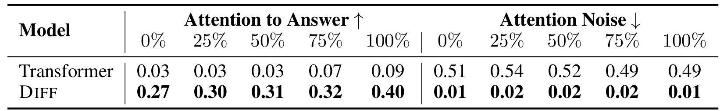
ATAI
Advanced Technique of Artificial Intelligence
ATAI
ChongqingUniversity _{AdvancedTechniqueof}
of Technology Artificial Intelligence
Chongqing University of
Technology
Chongqing University ^{ATAI}
_{of Technology} Advanced Techniqueof
Artificial Intelligence
Chongqing University of Technology
Chongqing University of Technology
Experiments

Slide 6
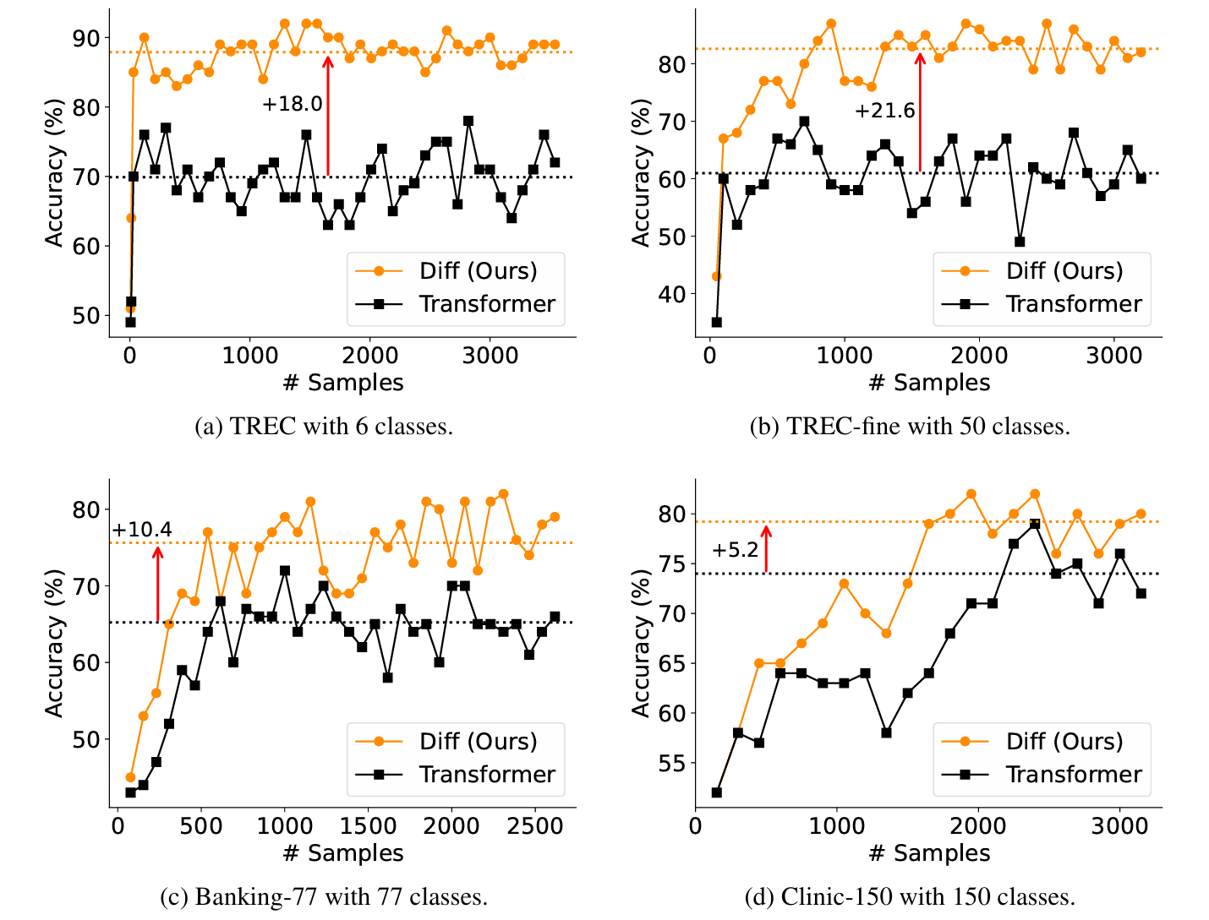
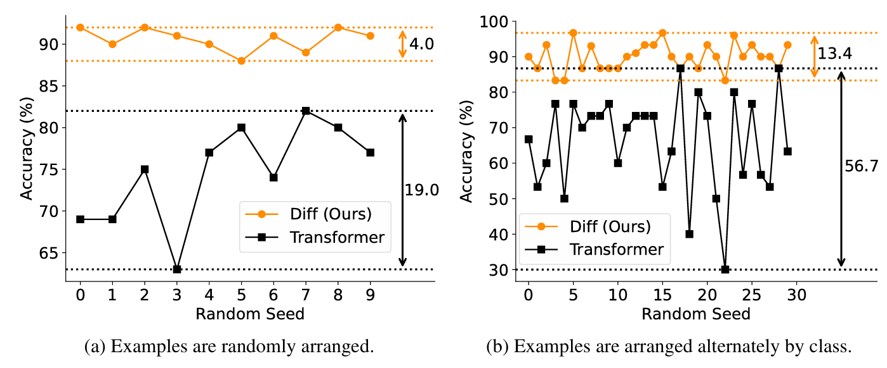
ATAI
Advanced Technique of Artificial Intelligence
ATAI
ChongqingUniversity _{AdvancedTechniqueof}
of Technology Artificial Intelligence
Chongqing University of
Technology
Chongqing University ^{ATAI}
_{of Technology} Advanced Techniqueof
Artificial Intelligence
Chongqing University of Technology
Chongqing University of Technology
Experiments

Slide 7
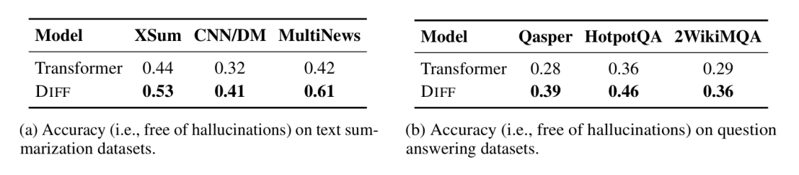
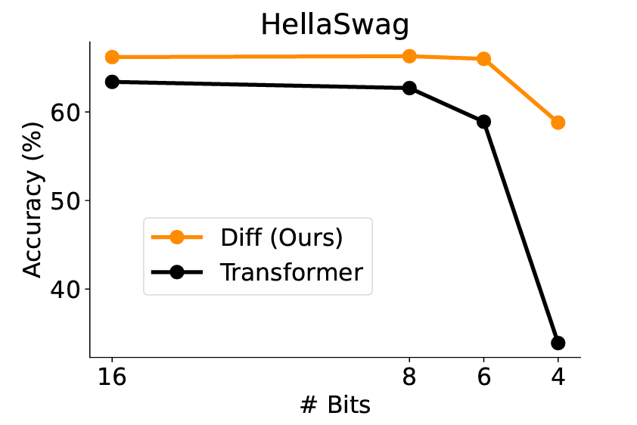
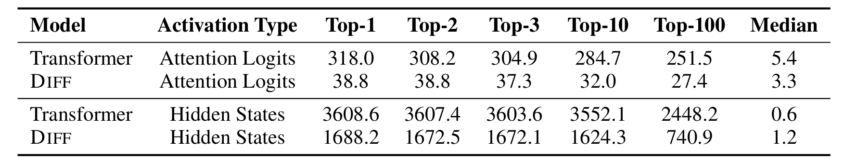
ATAI
Advanced Technique of Artificial Intelligence
ATAI
ChongqingUniversity _{AdvancedTechniqueof}
of Technology Artificial Intelligence
Chongqing University of
Technology
Chongqing University ^{ATAI}
_{of Technology} Advanced Techniqueof
Artificial Intelligence
Chongqing University of Technology
Chongqing University of Technology
Experiments

Slide 8
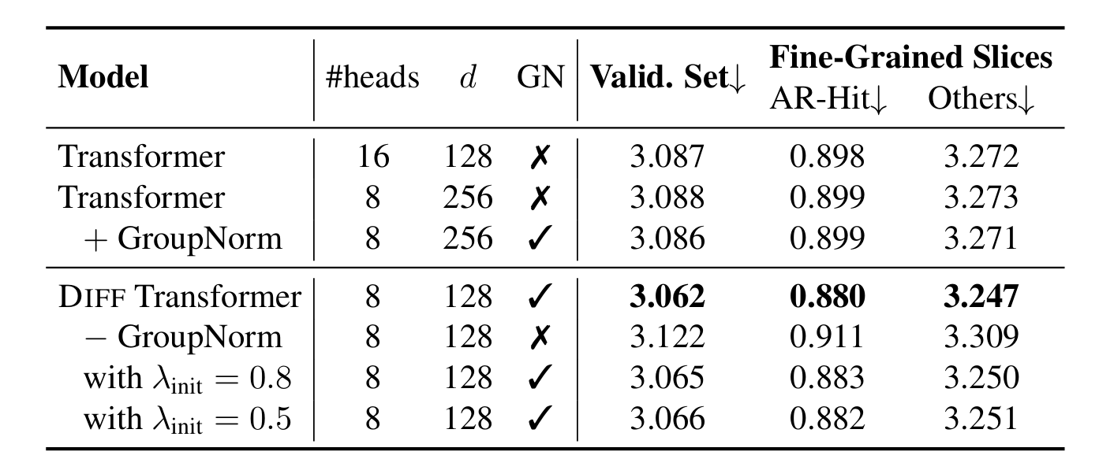
ATAI
Advanced Technique of Artificial Intelligence
ATAI
ChongqingUniversity _{AdvancedTechniqueof}
of Technology Artificial Intelligence
Chongqing University of
Technology
Chongqing University ^{ATAI}
_{of Technology} Advanced Techniqueof
Artificial Intelligence
Chongqing University of Technology
Chongqing University of Technology
Experiments

Slide 9


ATAI
Advanced Technique of Artificial Intelligence
ATAI
ChongqingUniversity _{AdvancedTechniqueof}
of Technology Artificial Intelligence
Chongqing University of
Technology
Chongqing University ^{ATAI}
_{of Technology} Advanced Techniqueof
Artificial Intelligence
Chongqing University of Technology
Chongqing University of Technology
Thanks!

