Slide 1
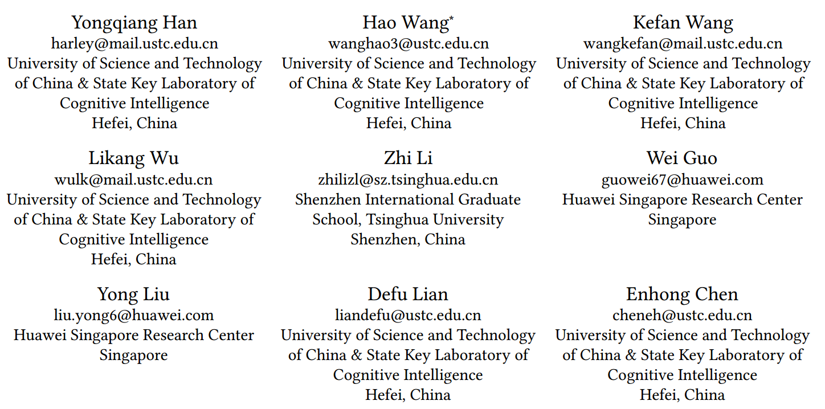
ATAI
Advanced Techniqueof Artificial Intelligence
ATAI
ChongqingUniversity _{AdvancedTechniqueof}
of Technology Artificial Intelligence
Chongqing University of
Technology
Chongqing University ^{ATAI}
_{of Technology} Advanced Techniqueof
Artificial Intelligence
Chongqing University of Technology
Chongqing University of Technology
Efficient Noise-Decoupling for Multi-Behavior Sequential
Recommendation
code:no
—— WWW 2024
Reported by ZhenDong Huang
1

Slide 2
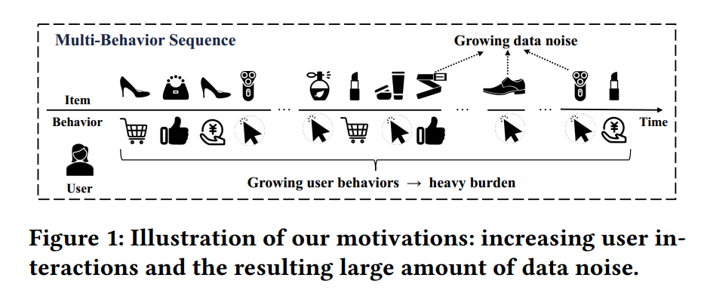
ATAI
AdvancedTechniqueof
Artificial Intelligence
ATAI
ChongqingUniversity _{AdvancedTechniqueof}
of Technology Artificial Intelligence
ChongqingUniversity of Technology
Motivation
1.Although the incorporationof multi-behavior information can further effectively explore userbehavior patterns and multidimensional user interest, some behavior data will also bring inevitable noise to the modeling of userinterests
2.To begin with, the trade-off between capturing complex patternsin longer multi-behavior sequences and maintaining a manageable model size is a non-trivial problem
3.Then, noise signals are prevalent and highly coupled with user preference signals in behavior
sequences

Slide 3
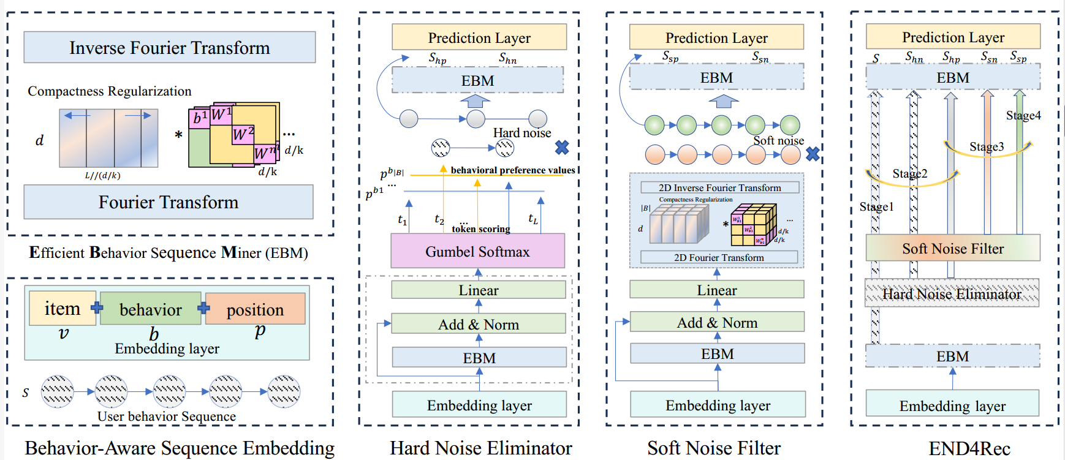
ChongqingUniversity of Technology
ATAI
AdvancedTechniqueof
Artificial Intelligence
ATAI
ChongqingUniversity _{AdvancedTechniqueof}
of Technology Artificial Intelligence
Overview

Slide 4
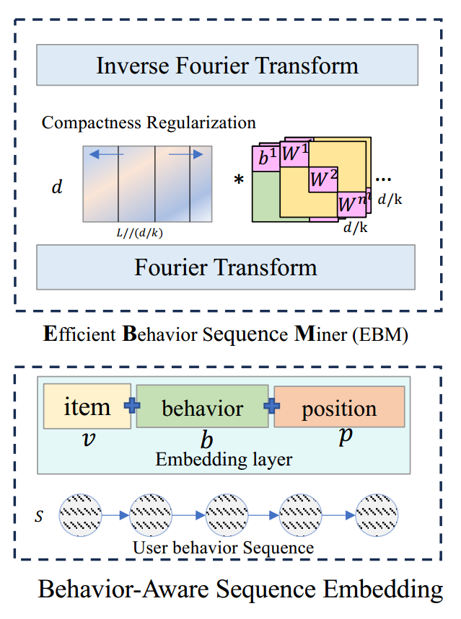
ChongqingUniversity of Technology
ATAI
AdvancedTechniqueof
Artificial Intelligence
ATAI
ChongqingUniversity _{AdvancedTechniqueof}
of Technology Artificial Intelligence
Method

Slide 5
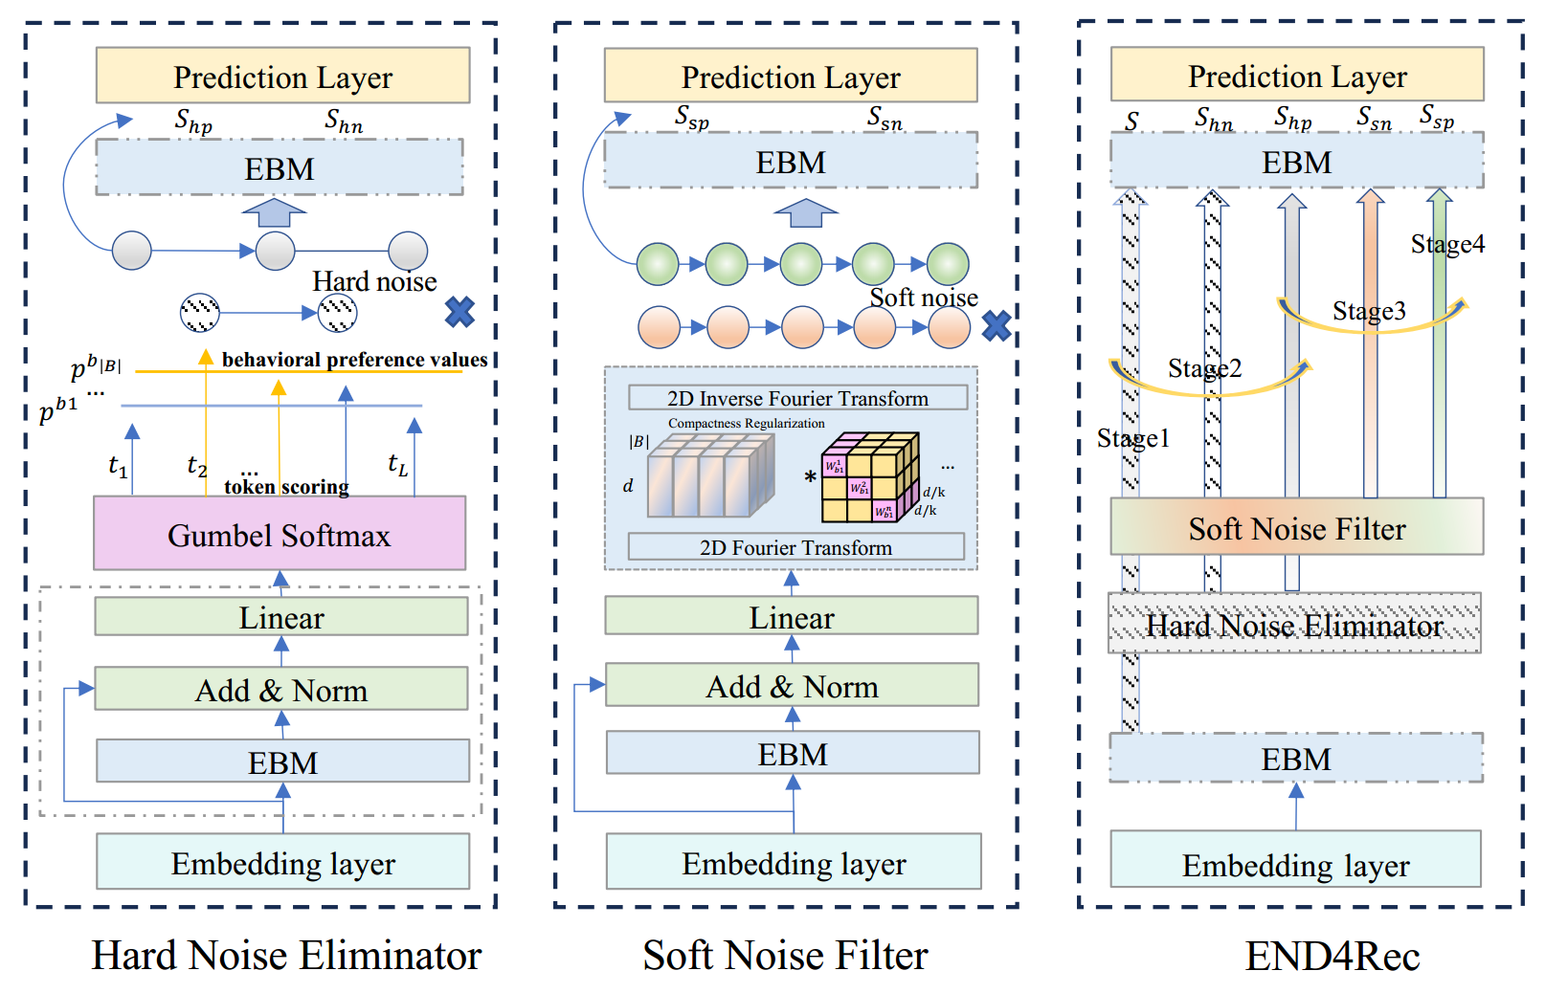
ChongqingUniversity of Technology
ATAI
AdvancedTechniqueof
Artificial Intelligence
ATAI
ChongqingUniversity _{AdvancedTechniqueof}
of Technology Artificial Intelligence
Method

Slide 6
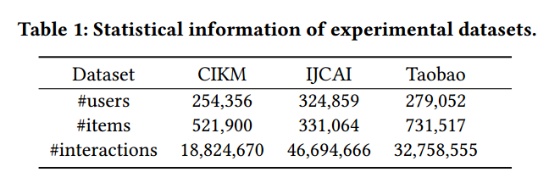
ATAI
AdvancedTechniqueof
Artificial Intelligence
ATAI
ChongqingUniversity _{AdvancedTechniqueof}
of Technology Artificial Intelligence
ChongqingUniversity of Technology
Experiments

Slide 7
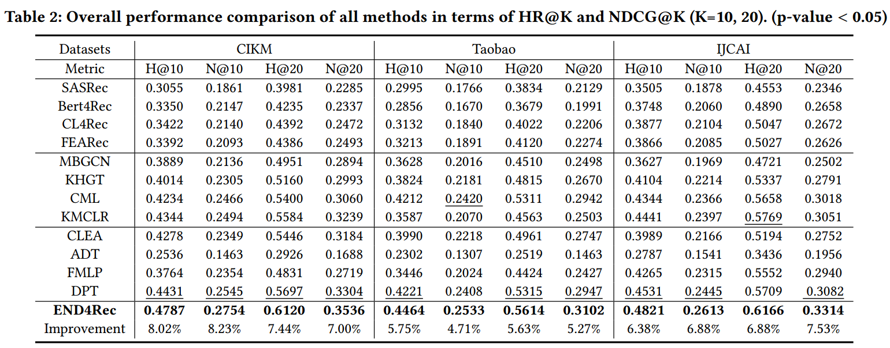
ATAI
AdvancedTechniqueof
Artificial Intelligence
ATAI
ChongqingUniversity _{AdvancedTechniqueof}
of Technology Artificial Intelligence
ChongqingUniversity of Technology
Experiments

Slide 8
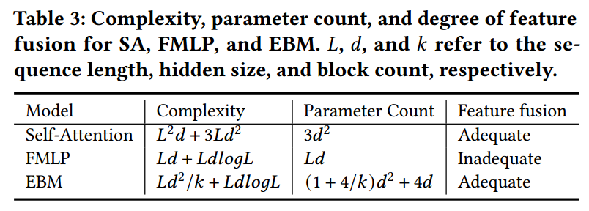
ATAI
AdvancedTechniqueof
Artificial Intelligence
ATAI
ChongqingUniversity _{AdvancedTechniqueof}
of Technology Artificial Intelligence
ChongqingUniversity of Technology
Experiments

Slide 9
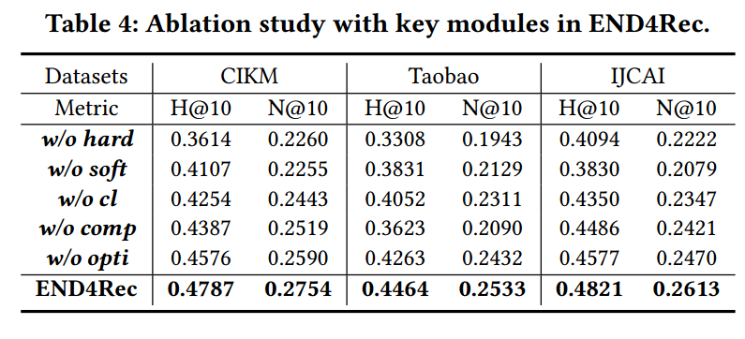
ChongqingUniversity of Technology
ATAI
AdvancedTechniqueof
Artificial Intelligence
ATAI
ChongqingUniversity _{AdvancedTechniqueof}
of Technology Artificial Intelligence
Experiments

Slide 10
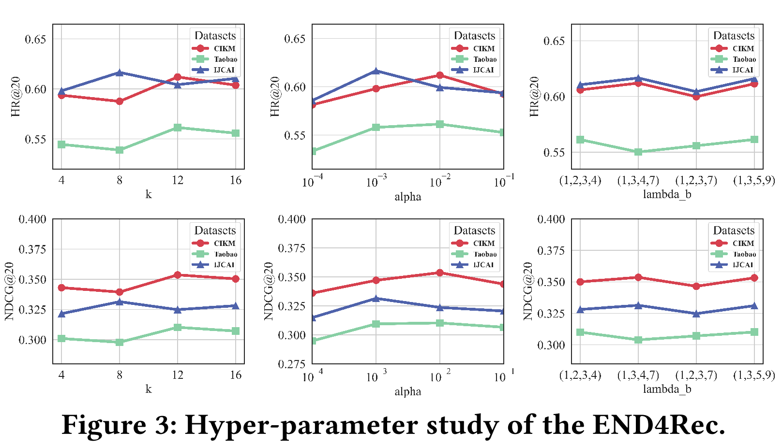
ChongqingUniversity of Technology
ATAI
AdvancedTechniqueof
Artificial Intelligence
ATAI
ChongqingUniversity _{AdvancedTechniqueof}
of Technology Artificial Intelligence
Experiments

Slide 11
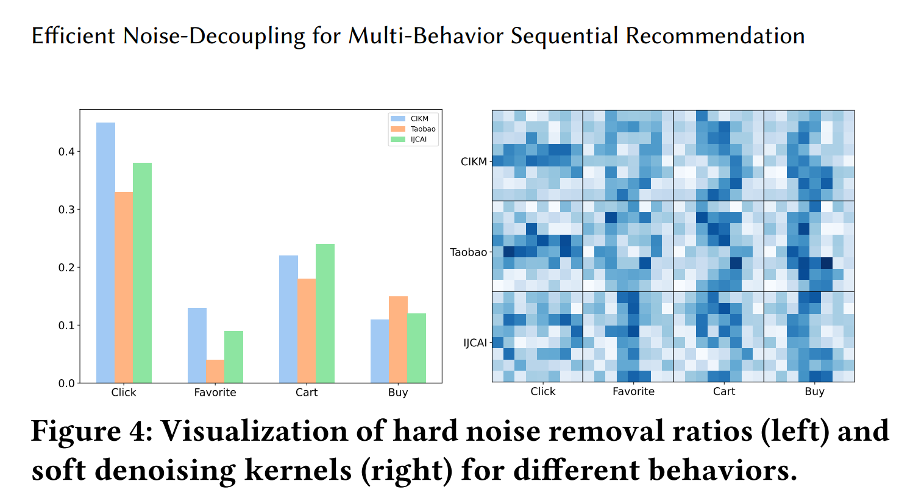
ChongqingUniversity of Technology
ATAI
AdvancedTechniqueof
Artificial Intelligence
ATAI
ChongqingUniversity _{AdvancedTechniqueof}
of Technology Artificial Intelligence
Experiments

Slide 12
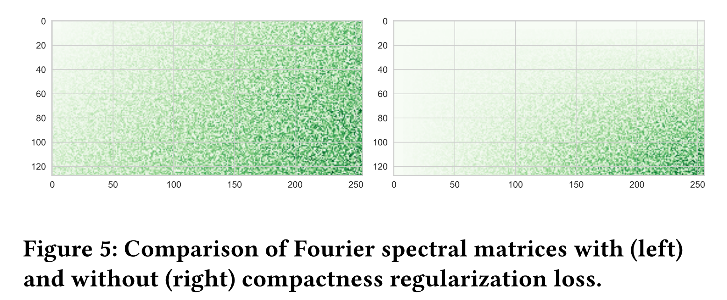
ChongqingUniversity of Technology
ATAI
AdvancedTechniqueof
Artificial Intelligence
ATAI
ChongqingUniversity _{AdvancedTechniqueof}
of Technology Artificial Intelligence
Experiments

Slide 13
ChongqingUniversity of Technology
ATAI
AdvancedTechniqueof
Artificial Intelligence
ATAI
ChongqingUniversity _{AdvancedTechniqueof}
of Technology Artificial Intelligence
Thanks!

