Slide 1
Chongqing University of Technology
ATAI
Advanced Technique of Artificial Intelligence
Chongqing University of Technology
MEDA: Meta-Learning with Data Augmentation for Few-Shot Text Classification（IJCAI 2021）
Pengfei Sun
Nanjing University
Yawen Ouyang
Nanjing University
Wenming Zhang
Nanjing University
Reported by Ting Wang
2021.09.22

Slide 2
Chongqing University of Technology
ATAI
Advanced Technique of Artificial Intelligence
Chongqing University of Technology
1. Innovation
2. Method
3. Experiments
4. Conclusion

Slide 3
Innovation
1. We propose a novel data augmentation method named ball generator to increase the number of shots for novel classes.
2. We propose a novel framework Meta-Learning with Data Augmentation (MEDA) for few-shot text classification, which jointly optimizes the ball generator and the meta-learner.
3. Experiments on two benchmark datasets demonstrate the effectiveness and superiority of the model.

Slide 4
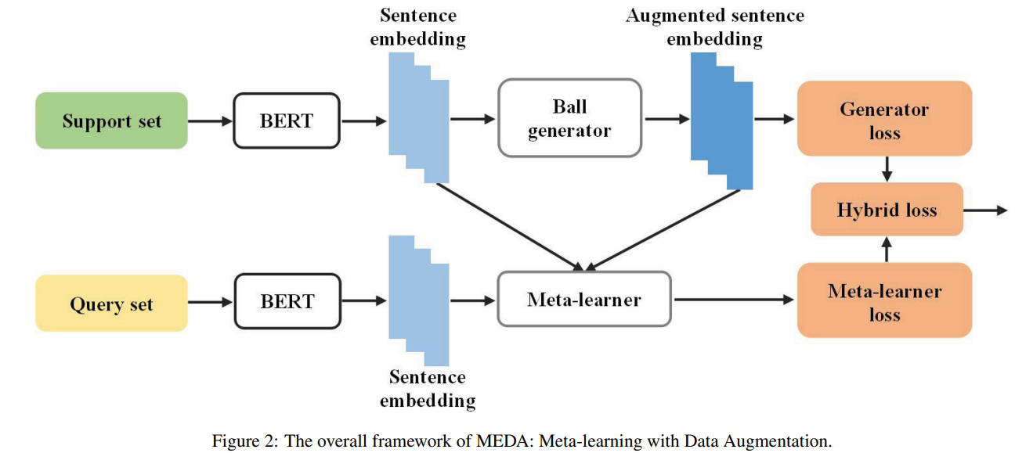
Approach

Slide 5
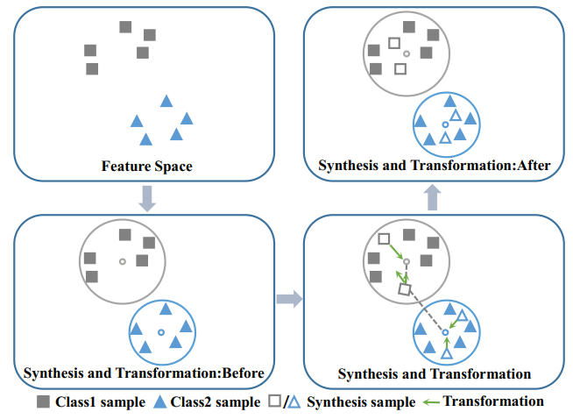
Approach
Ball Generator
Ball:
（1）
Augmented sample:
（2）
Transformation module:
（3）
Augmented sample set :
（4）
Original sample set :
（5）
Sample set :
（6）
（7）
（8）

Slide 6
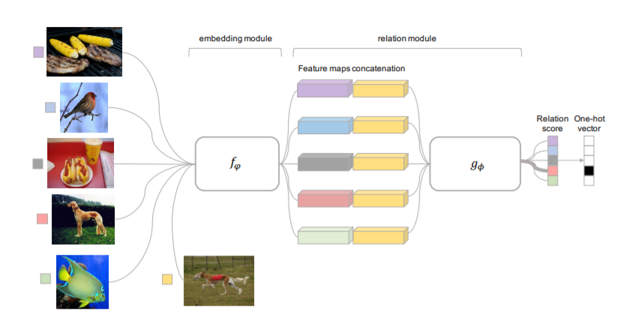
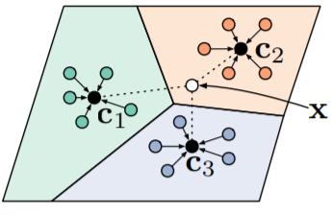
Approach
Meta-learner
Relation Networks(RN)
Prototypical Networks(PN)
Embedding:
Prototype:
Relation:

Slide 7
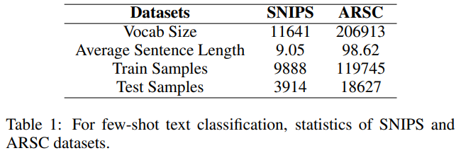
Experiments
SNIPS: SNIPS is a personal voice assistant dataset which is collected in a crowd sourced fashion. We divide the original 7 intents into 5 intents as Ctrain and 2 intents (AddToPlaylist, RateBook) as Ctest. The Ctrain and Ctest are used as training set and test set respectively.
ARSC: Consists of English reviews of 23 types of products on Amazon.Following the experiment setting of Yu (2018), we creat a 12-way 5-shot text classification task on this dataset.
Dataset：
https://github.com/Gorov/DiverseFewShot Amazon

Slide 8
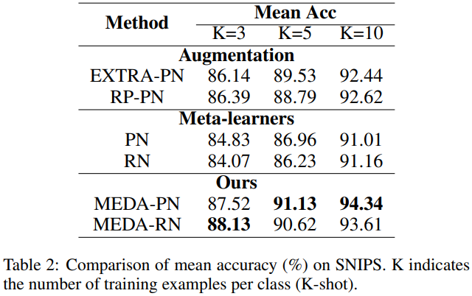
Experiments

Slide 9
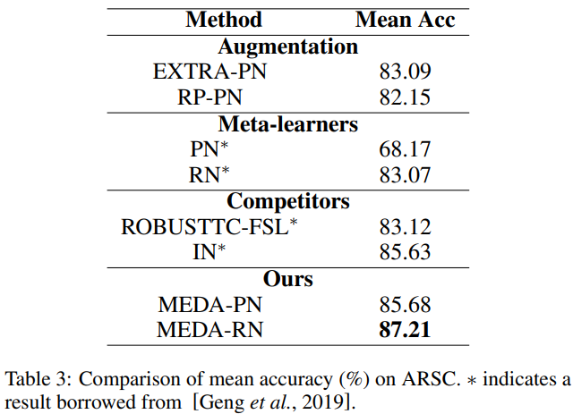
Experiments

Slide 10
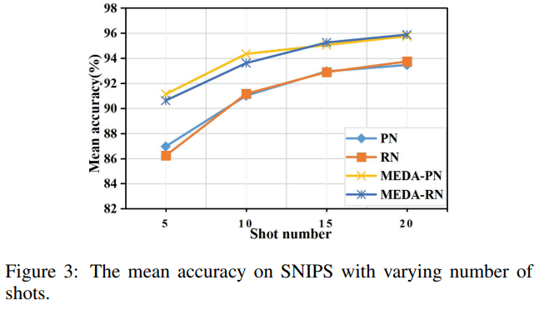
Experiments

Slide 11
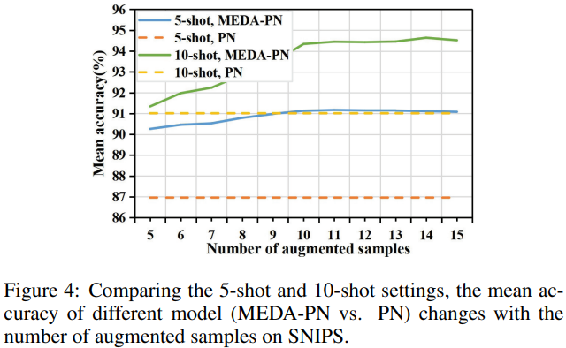
Experiments

Slide 12
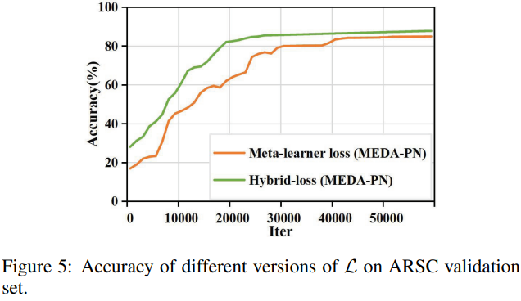
Experiments

Slide 13
Thanks!

