Slide 1






Self-Supervised Graph Co-Training for Session-based Recommendation
2021.11.15 • ChongQing
Reported by Gu Tang

Slide 2
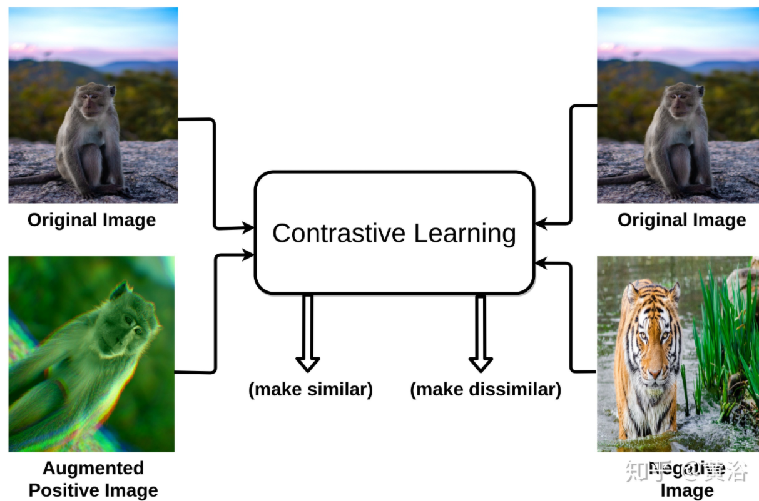
Introduction

Slide 3
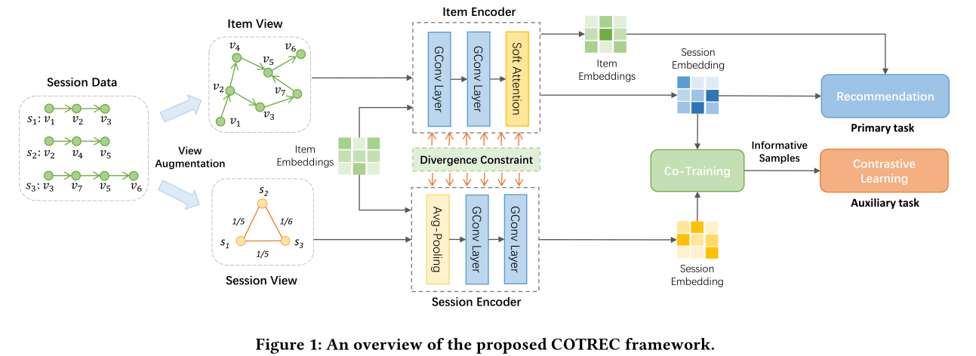
Method

Slide 4
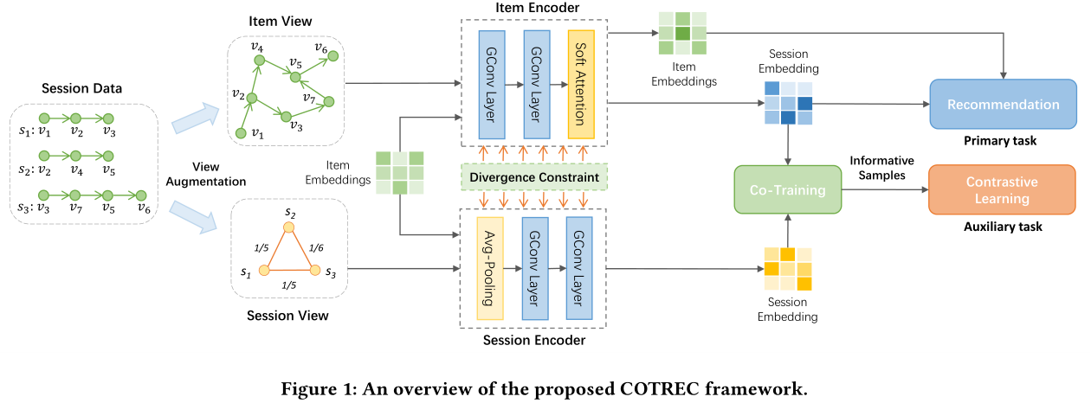
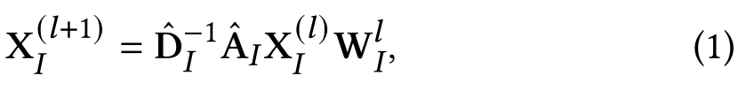


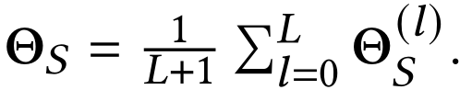


Method

Slide 5
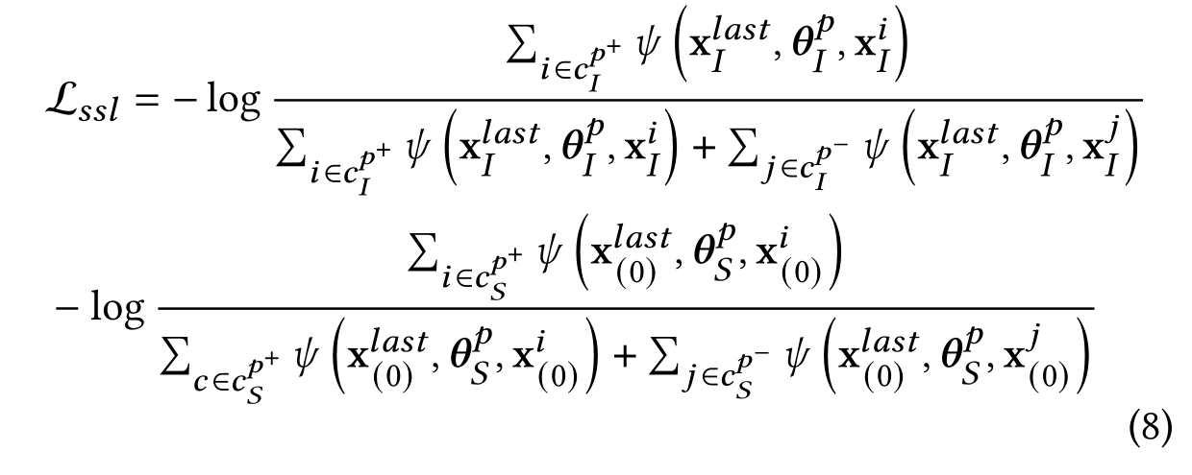
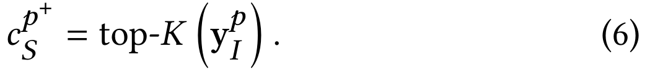


Method

Slide 6
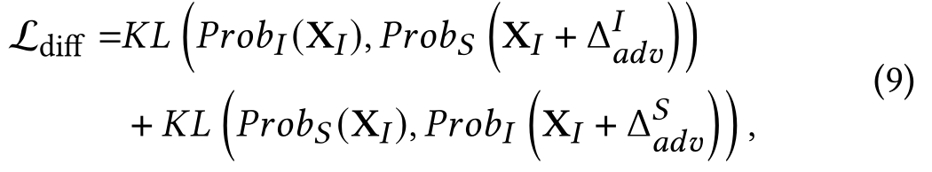
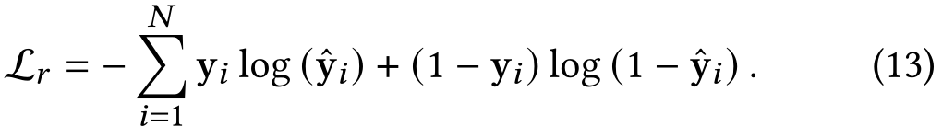
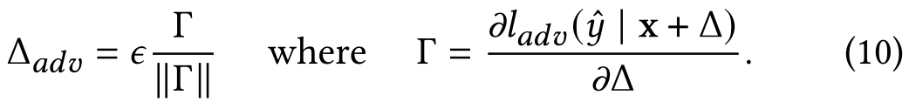
Method

Slide 7
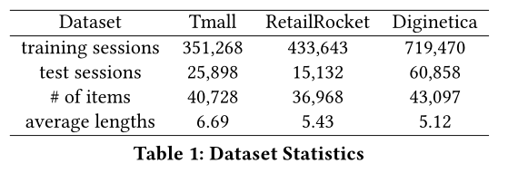
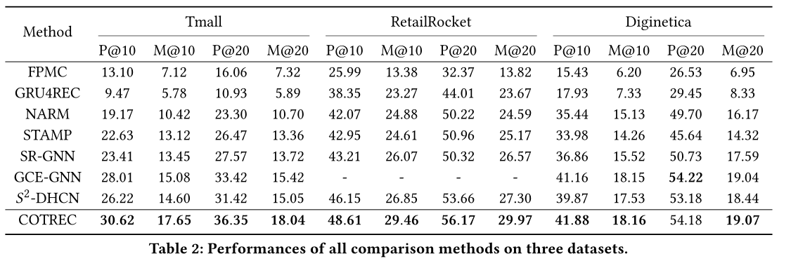
Experiment

Slide 8
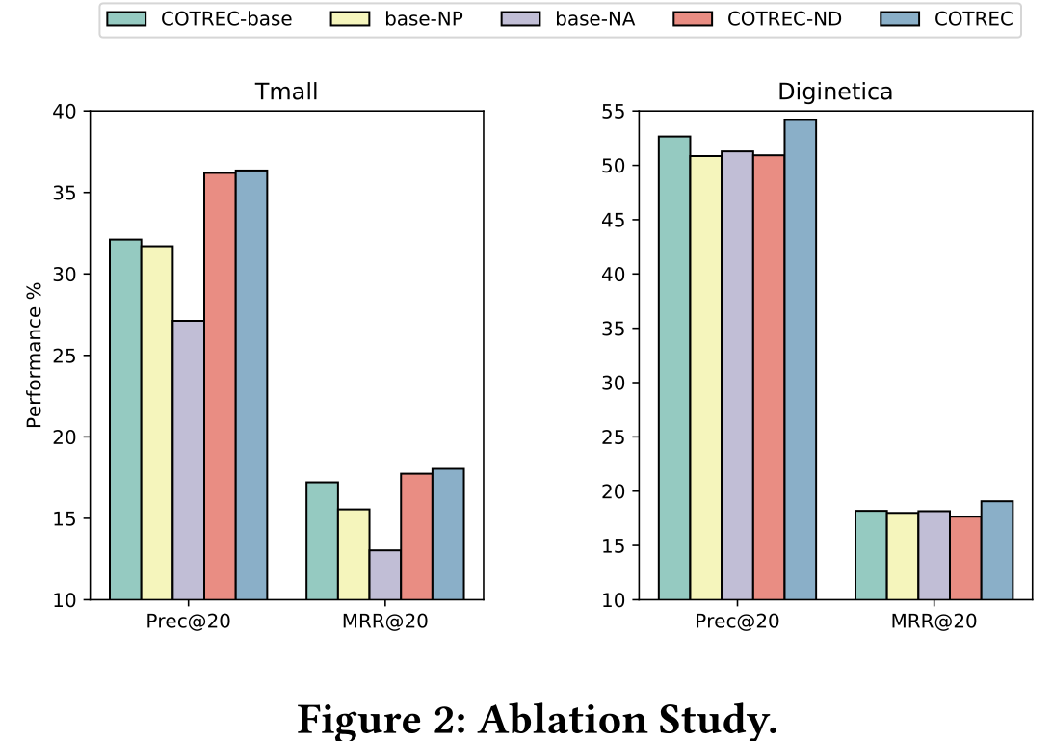
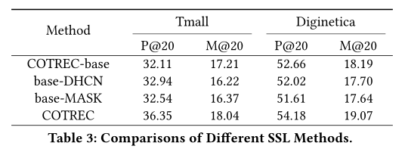
Experiments
Notes:
COTREC-base, base-NP, base-NA, COTRECND,
and we compare the four variants with the complete COTREC
model on Tmall and Diginetica. In COTREC-base, we only use the
item view to model session data, removing the session view and
the self-supervised graph co-training. In base-NP, we remove the
reversed position embeddings. base-NA means that we remove the
soft-attention mechanism and replace it with averaging item representations
as the representation of each session. In COTREC-ND,
we only use self-supervised co-training without the divergence
constraint.

Slide 9
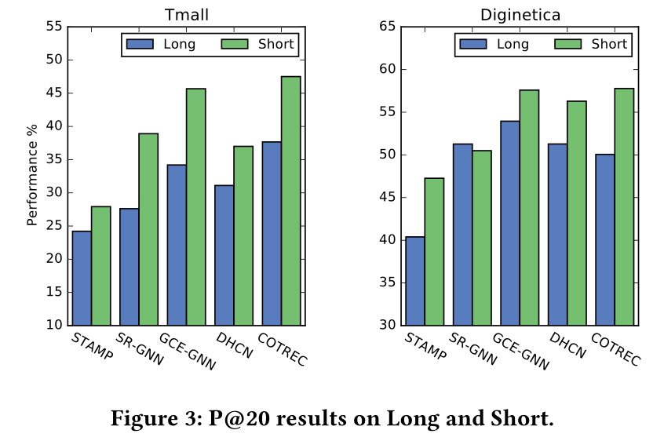
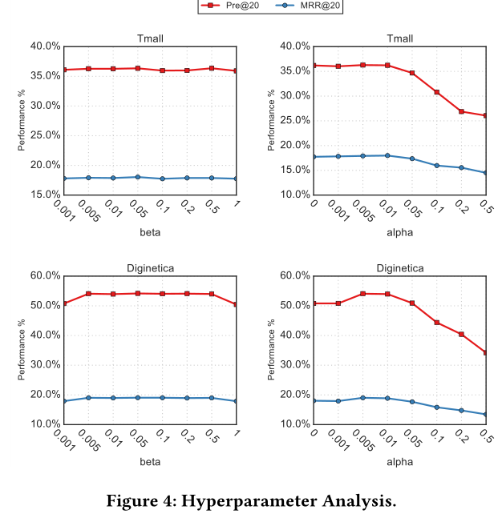
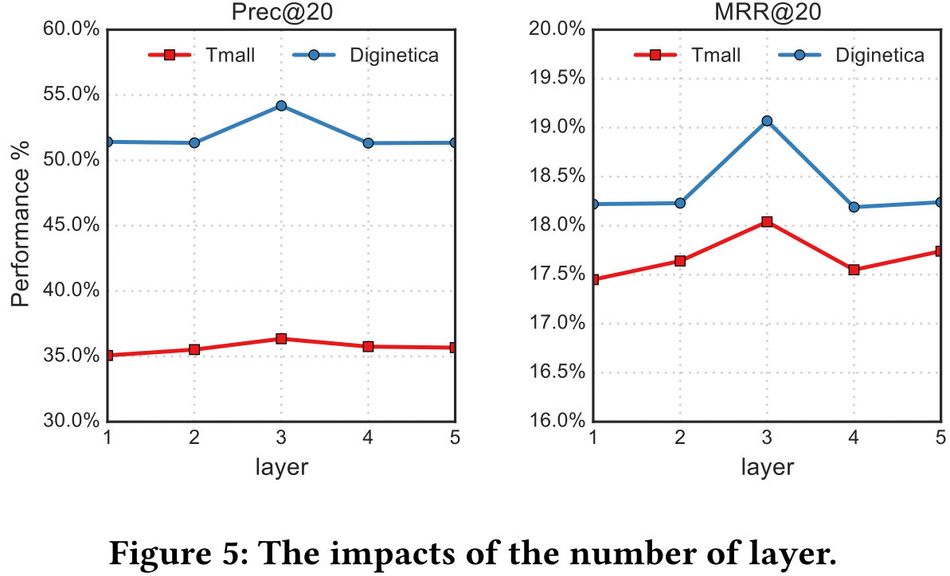
Experiments

Slide 10
Thanks

