Slide 1
DA-GCN: A Domain-aware Attentive Graph Convolution Network for Shared-account Cross-domain Sequential Recommendation
WWW 2021
Code:None
2021.07.13 • ChongQing
Reported by Gu Tang

Slide 2
Introduction
Cross-domain sequential recommendation (CSR) is a recommendation task that aims to recommend the next item by leveraging historical user interactions from multiple domains. Nowadays, as users need to register on different platforms to access services in specific areas, such as music subscriptions and food delivery, corporate social responsibility is gaining huge research attention. In this work, we studied corporate social responsibility in an emerging but challenging scenario, where multiple individual users share an account, and their interactions are recorded in multiple domains. Therefore, in this case, it is more challenging to generate accurate recommendations because the interests of different users are mixed in the interaction sequence. In addition, although in a single user scenario, data from two domains may help discover her/his preferences, the existence of a shared account will amplify the noise in the interactive data and hinder the accuracy of sequential recommendation. Previous work has used RNN to capture this cross-domain sequence relationship. This article explicitly constructs a graph to display the display structure information of the two domains of the learning link.

Slide 3
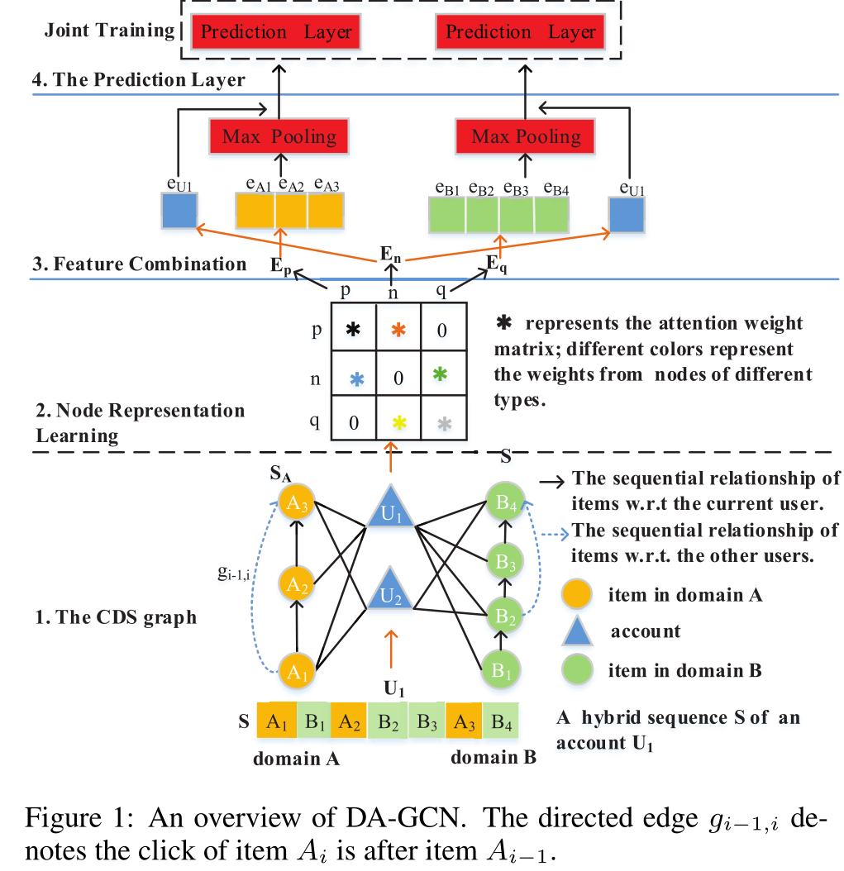
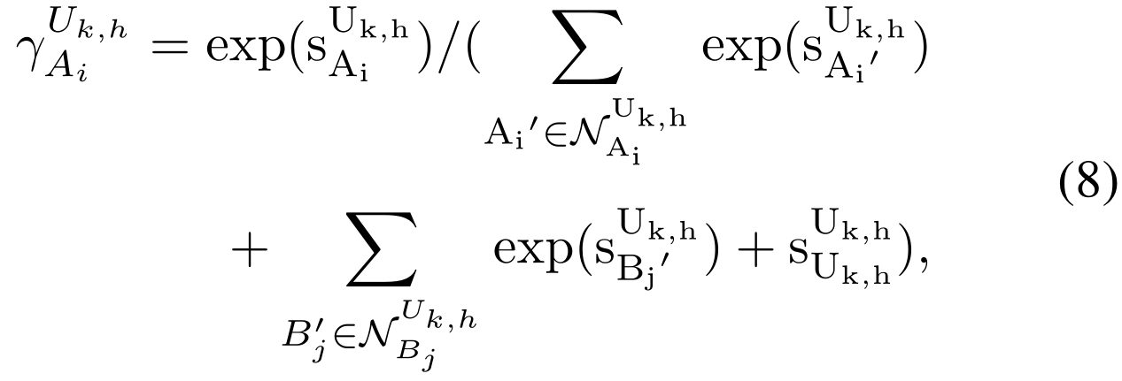
Method

Slide 4
Method

Slide 5
Method

Slide 6
Method

Slide 7
Method

Slide 8
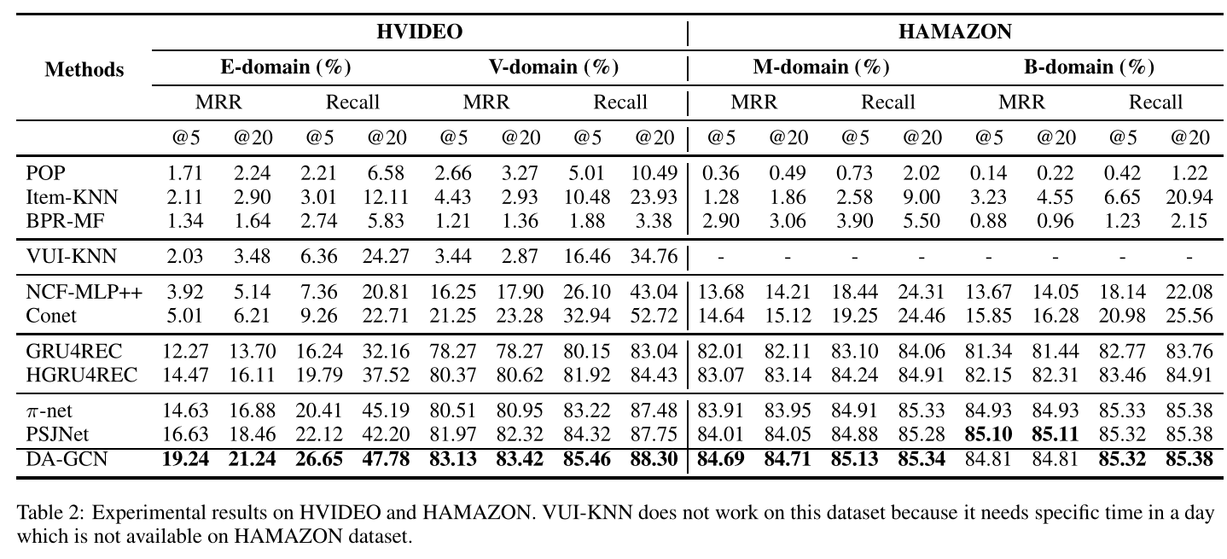
Experiments

Slide 9
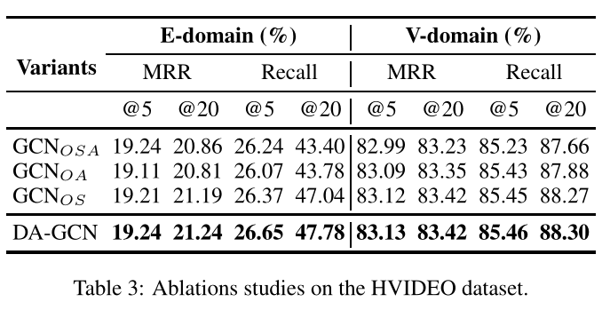
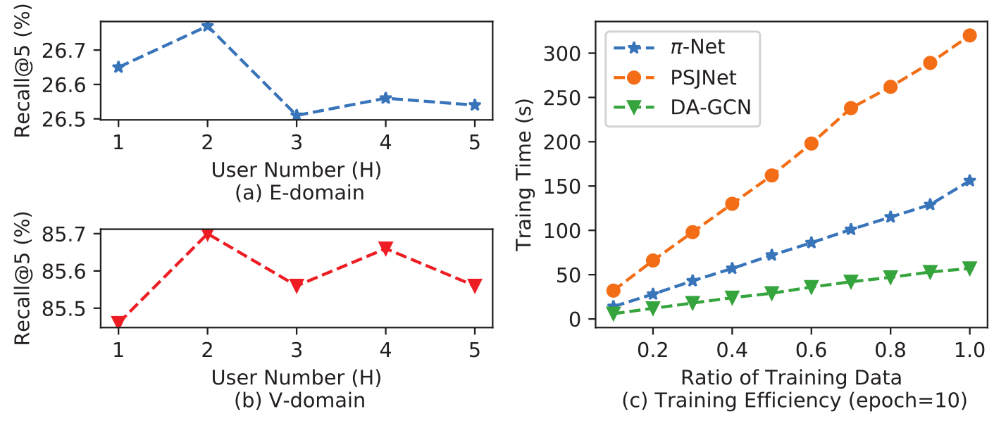
Experiments

Slide 10
Thanks

