Slide 1
Chongqing University of Technology
ATAI
Advanced Technique of Artificial Intelligence
Chongqing University of Technology
t https://
github.com/thunlp/ERICA.
ERICA: Improving Entity and Relation Understanding for
Pre-trained Language Models via Contrastive Learning
https://github.com/thunlp/ERICA.
（ACL-2021)
Reported by Jia Wang
Notes:
通过对比学习改善预训练语言模型的实体和关系理解

Slide 2
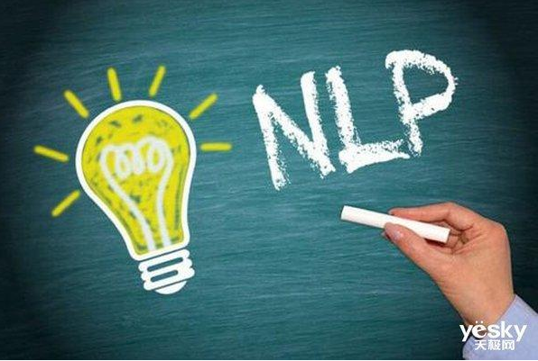
Chongqing University of Technology
ATAI
Advanced Technique of Artificial Intelligence
Chongqing University of Technology
1. Introduction
2. Approach
3. Experiments
4. Conclusion

Slide 3
Introduction
• conventional pre-training objectives do not explicitly model relational facts, which frequently distribute in text and are crucial for understanding the whole text.
• they mainly focus on within-sentence relations in isolation, ignoring the understanding of entities, and the interactions among multiple entities at document level, whose relation understanding involves complex reasoning patterns.
• In this paper, we propose ERICA, a novel framework to improve PLMs’ capability of Entity and RelatIon understanding via ContrAstive learning, aiming to better capture in-text relational facts by considering the interactions among entities and relations comprehensively.
• We conduct experiments on a suite of language understanding tasks, including relation extraction, entity typing and question answering.
Notes:
这篇文章认为以后的知识驱动的预训练语言模型过于关注于对Entity和Relation单独的建模，并未考虑两者之间的复杂交互，故而无法较好的理解文本中真正的知识信息。为解决这一问题，本文提出两个基于对比学习的任务，即Entity Discrimination和Relation Discrimination。

Slide 4
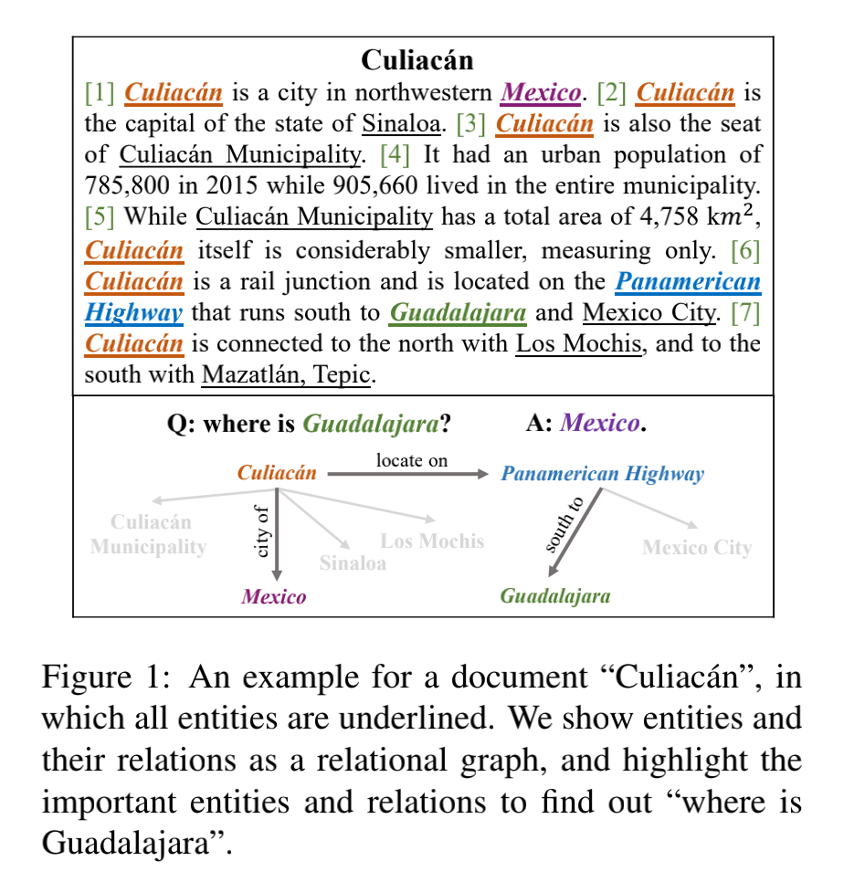
Approach
Notations
the distant supervision from an external KG
Notes:
ERICA接受了大规模的无标签训练，利用外部知识图谱K的远程监督

Slide 5
Approach
Entity & Relation Representation

Slide 6
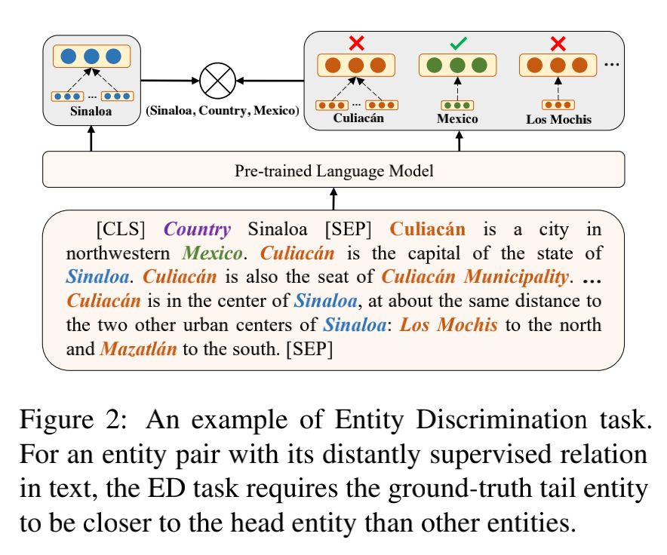
Approach
Entity Discrimination Task
The goal of entity discrimination task is equivalent to maximizing the posterior：
=“relation_name entity_mention[SEP] ”
we empiri-cally find directly optimizing the posterior cannotwell consider the relations among entities. Hence,we borrow the idea of contrastive learning and push the representations of positive pair closer than negative pairs.
Notes:
实体识别任务的目的是在给定一个头部实体和一个关系的情况下，推断出文档中的尾部实体。
对于entity discrimination任务，模型将头实体和关系拼接到一起，并和包含尾实体的文档相拼接，以输入给BERT。对于这个输入，尾实体作为正例，而文档中的其他实体则作为负例，可以进行对比学习。
我们的经验发现，直接优化后验模型并不能很好地考虑实体之间的关系。因此，我们借用对比学习

Slide 7
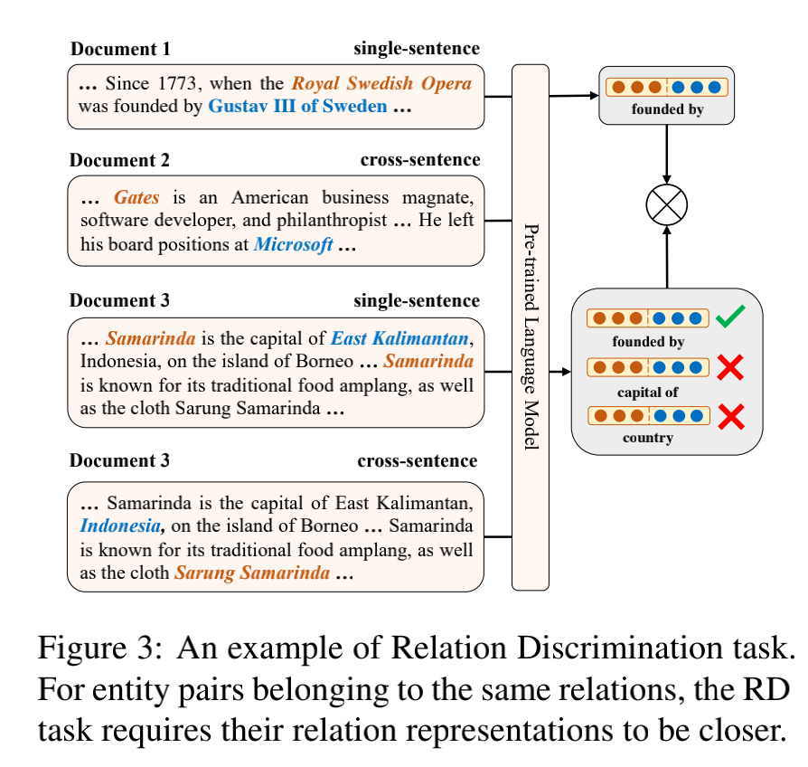
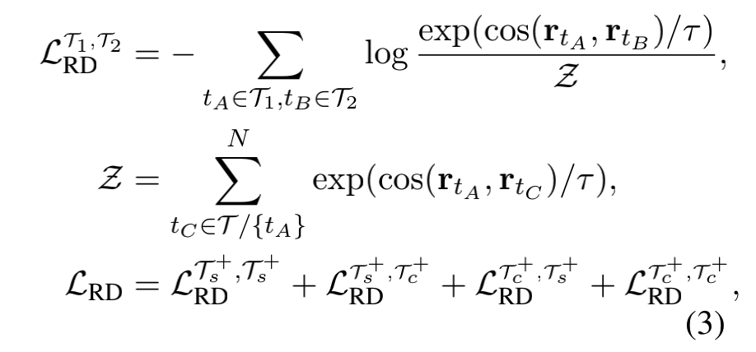
Approach
Relation Discrimination Task
Notes:
关系辨别任务旨在区分两个关系在语义上是否紧密。与现有的关系增强型PLMs相比，本文采用文档级而非句子级的远程监控，进一步使PLMs理解现实场景中复杂的推理链，从而提高了PLMs对关系的理解。
对于relation discrimination任务，模型考虑不同文档中相同relation对应的entity直接的关系，这里我们把包含同样relation的triple所在的两个文档作为正例，而不同relation的作为负例，也采用对比学习进行训练。最终本文采用一个多任务学习的框架，加入MLM来进一步增强整个模型的效果。该方法在许多文档理解任务上均取得了很好的效果。

Slide 8
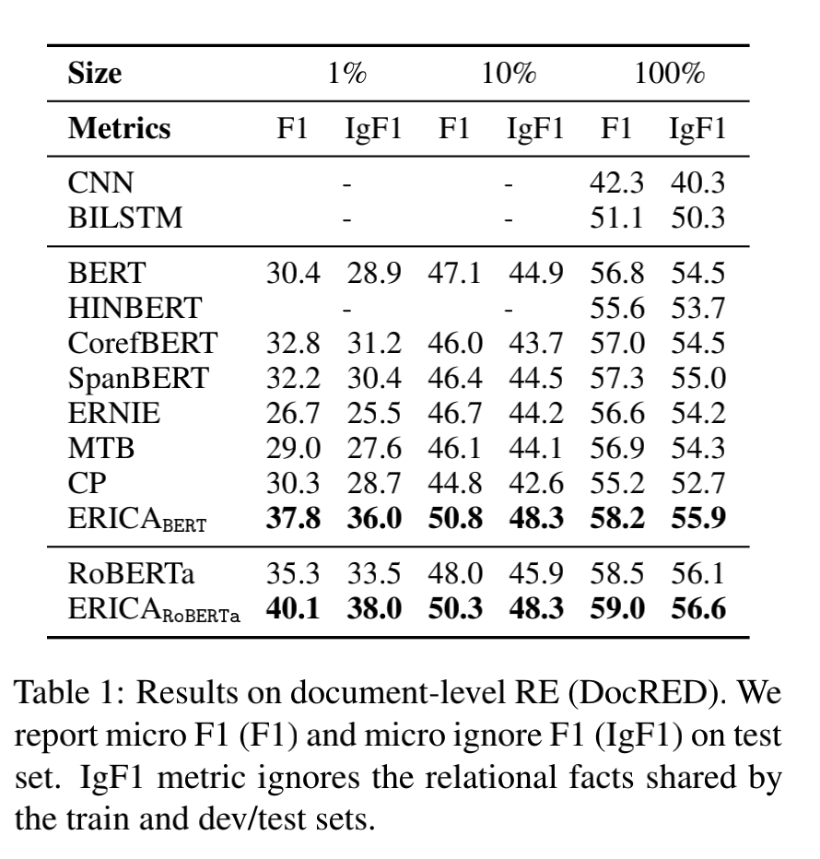
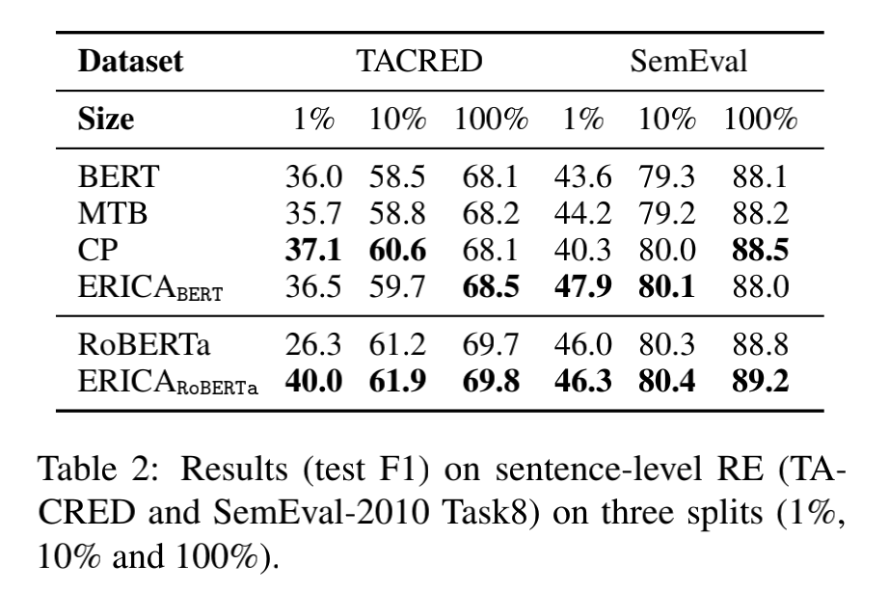
Experiments
Notes:
Document-level RE（1） Sentence-level RE（2）（ Relation Extraction）

Slide 9
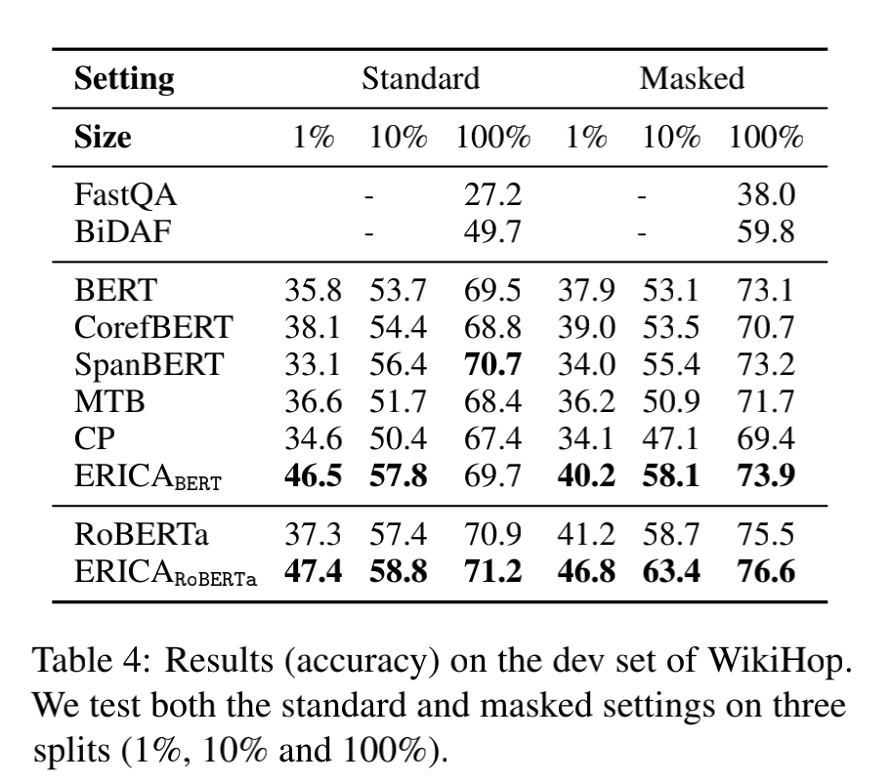
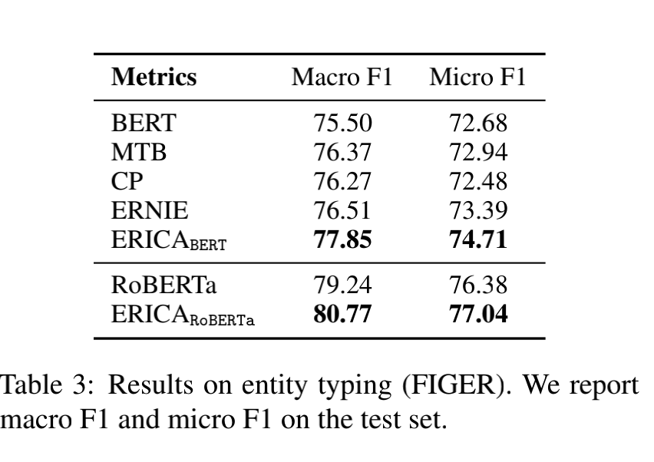
Experiments
Notes:
Entity Typing（3） Multi-choice QA（4）

Slide 10
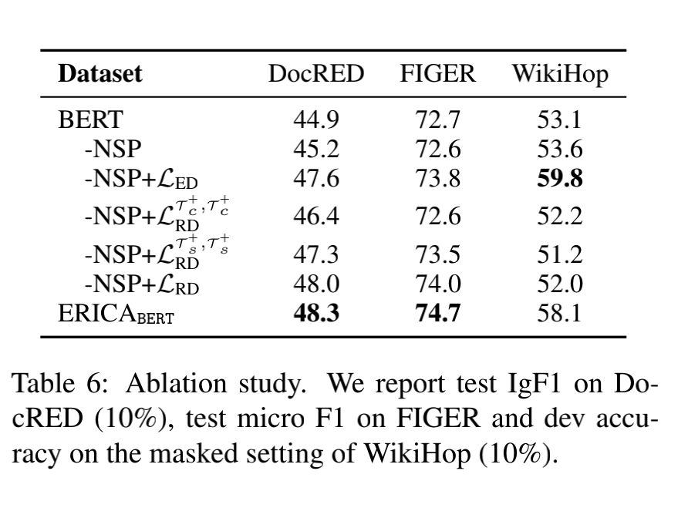
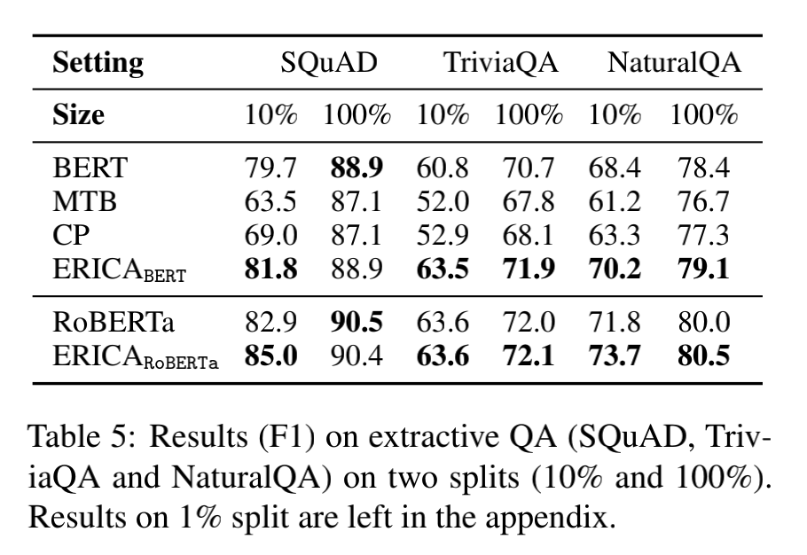
Experiments
Notes:
Extractive QA（5）

Slide 11
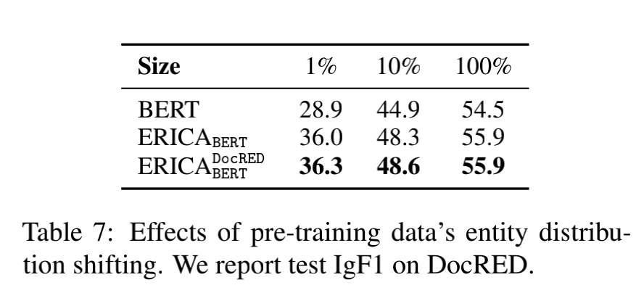
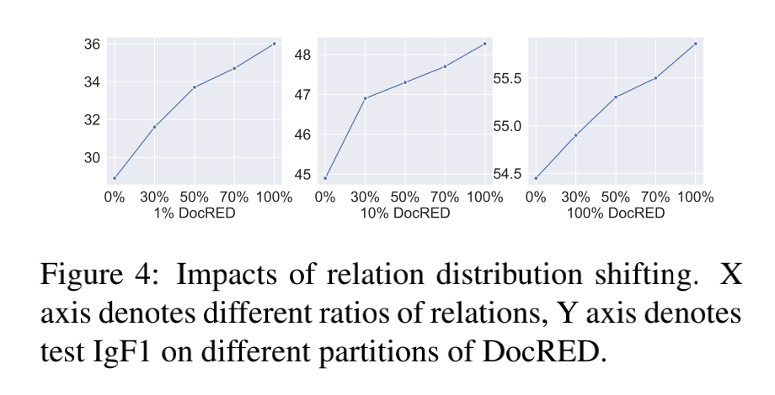
Experiments
Notes:
我们调查两个域位转移因素：实体分配和关系分配，以探讨它们如何影响 ERICA 的性能（7）

Slide 12
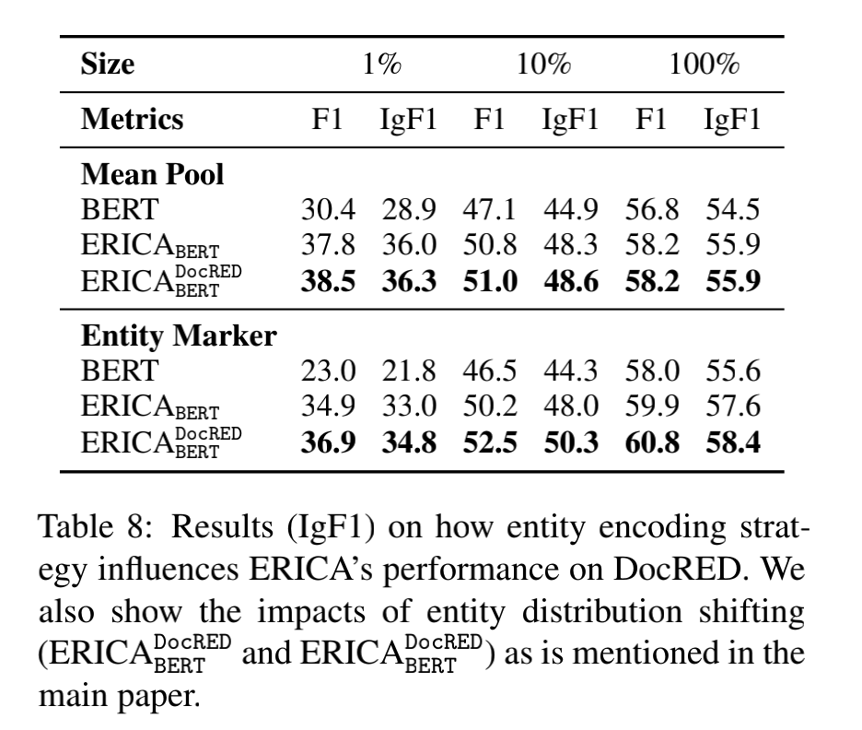
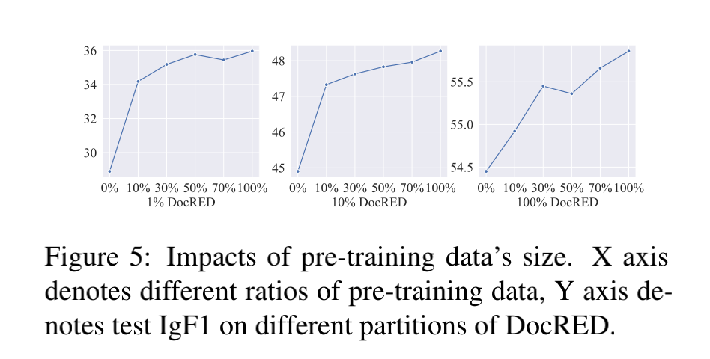
Experiments

Slide 13
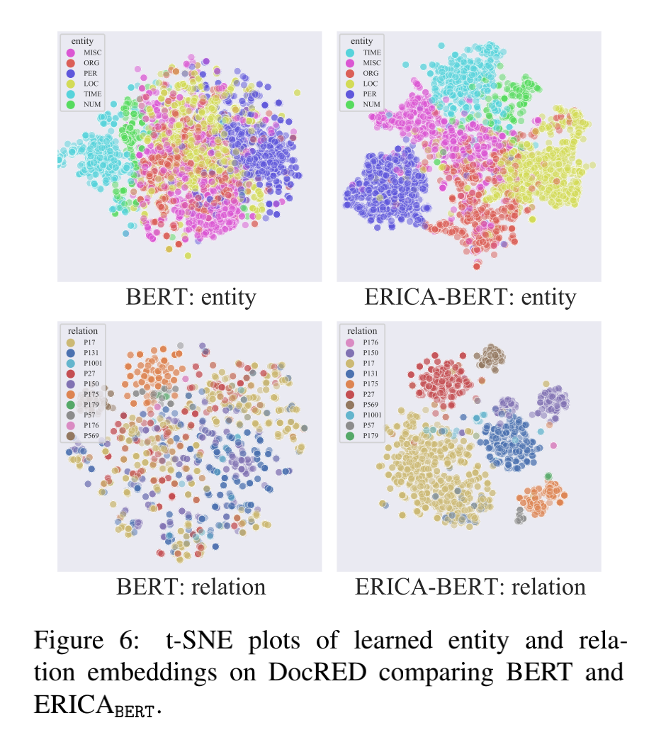
Experiments

Slide 14
Conclusion
In this paper, we present ERICA, a general framework for PLMs to improve entity and relation understanding via contrastive learning. We demonstrate the effectiveness of our method on several language understanding tasks, including relation extraction, entity typing and question answering. The experimental results show that ERICA outperforms all baselines, especially under low-resource
settings, which means ERICA helps PLMs better capture the in-text relational facts and synthesize information about entities and their relations.

Slide 15
Thanks

