Slide 1
ATAI
Advanced Technique of Artificial Intelligence
Chongqing University of Technology
Few-shot Learning summary
Reported by TingWang

Slide 2
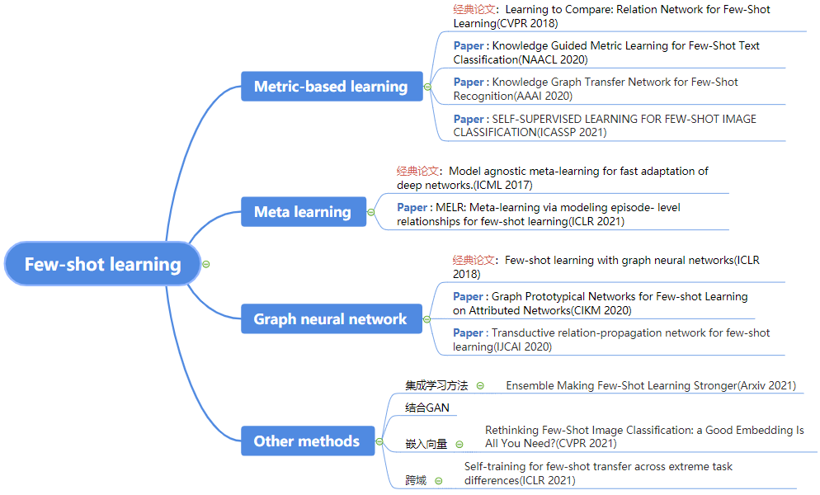
Introduction_Method

Slide 3
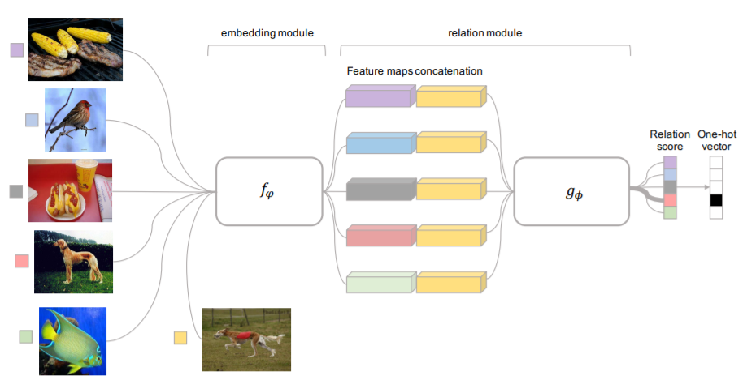
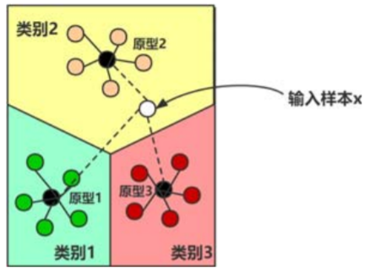
Introduction_Method
Metric Based:
paper: Learning to Compare: Relation Network for Few-Shot Learning(CVPR2018)

Slide 4
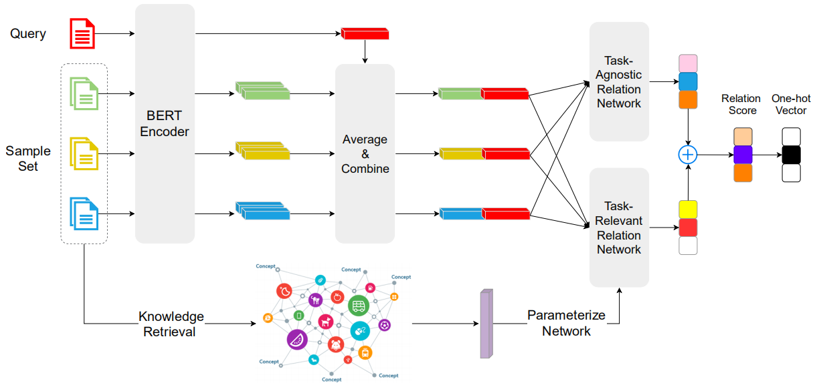
Introduction_Method
Paper : Knowledge Guided Metric Learning for Few-Shot Text Classification(NAACL 2020)

Slide 5
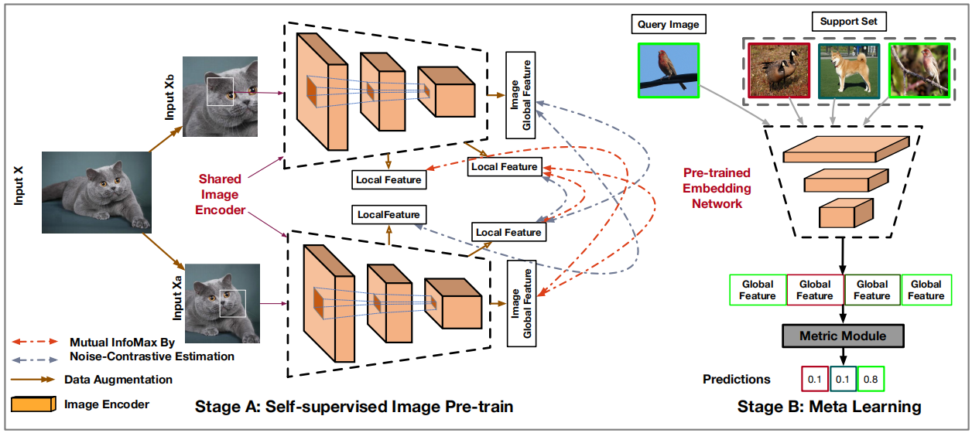
Introduction_Method
Paper : SELF-SUPERVISED LEARNING FOR FEW-SHOT IMAGE CLASSIFICATION (ICASSP 2021)
Code: https://github.com/phecy/SSL-FEW-SHOT

Slide 6
Introduction_Method

Slide 7
Introduction_Method
Episodic training:
Support set
Query set
meta task1:
meta-train:
meta task2:
meta task3:
Meta学习器
meta task4:
meta-test:
meta task5:

Slide 8
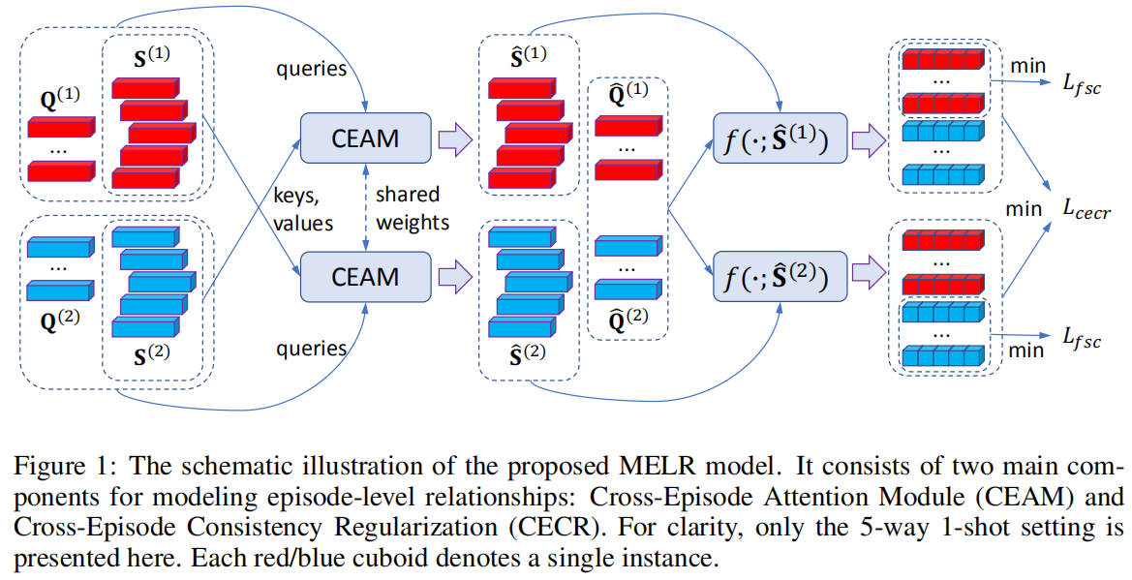
Introduction_Method
Paper : Meta-learning via modeling episode- level relationships for few-shot learning(ICLR 2021)

Slide 9
Introduction_Method

Slide 10
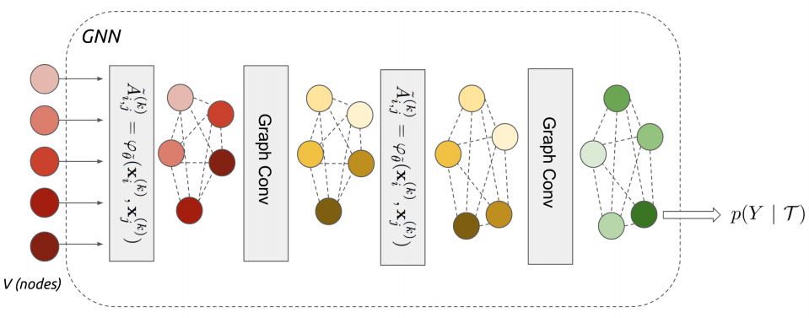
Introduction_Method
Graph neural network:
paper: FEW-SHOT LEARNING WITH GRAPH NEURAL NETWORKS（ICLR2018）

Slide 11
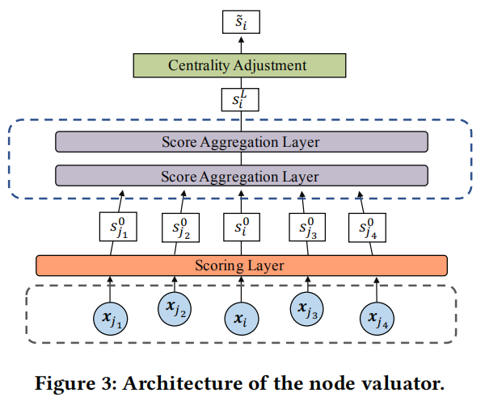
Introduction_Method
Paper : Graph Prototypical Networks for Few-shot Learning on Attributed Networks (CIKM 2020)
Code : https://github.com/kaize0409/GPN_Few-shot

Slide 12
Introduction_Method

Slide 13
THANKS

