Slide 1
Exploring Periodicity and Interactivity in Multi-Interest Framework for Sequential Recommendation
IJCAI 2021
Code:None
2021.07.24 • ChongQing
Reported by Gu Tang

Slide 2
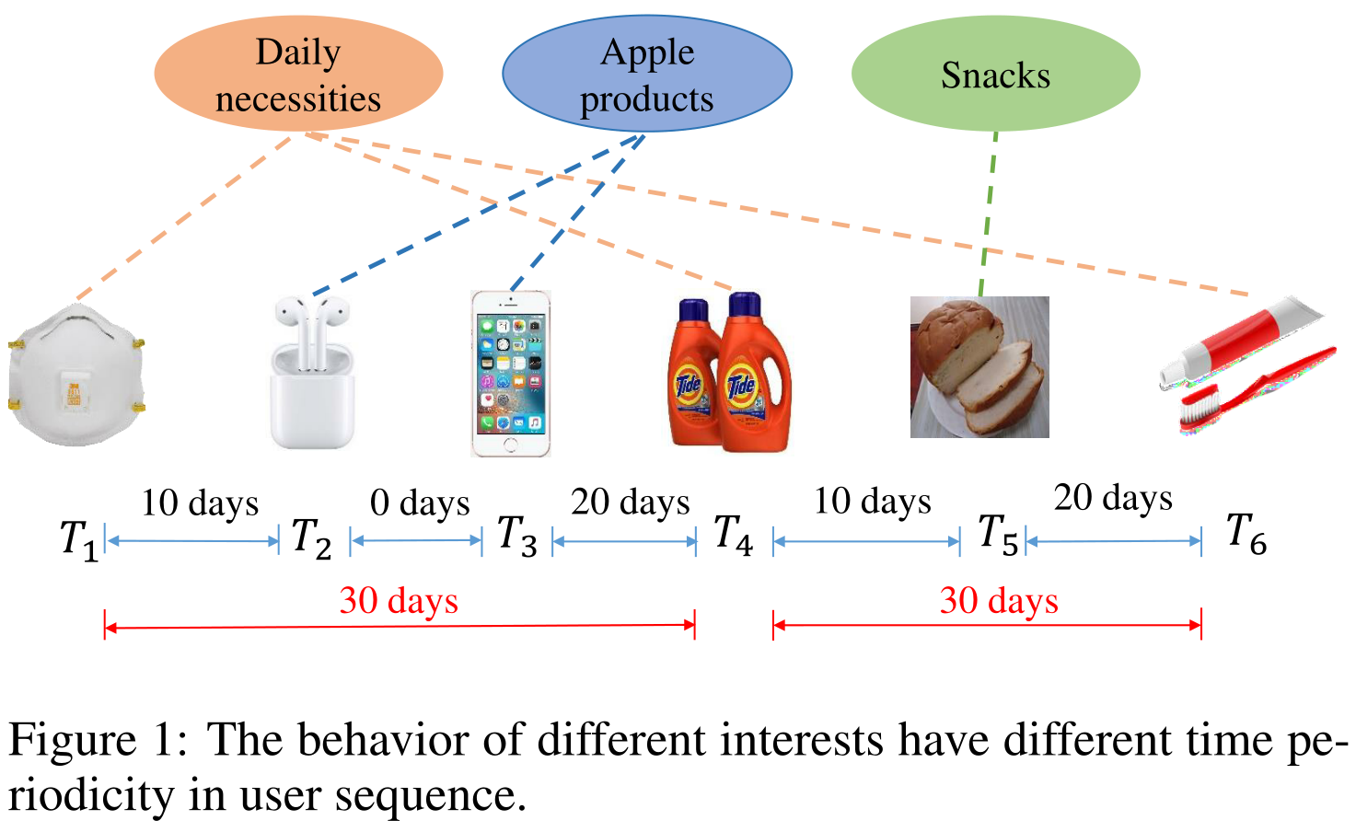
Introduction

Slide 3
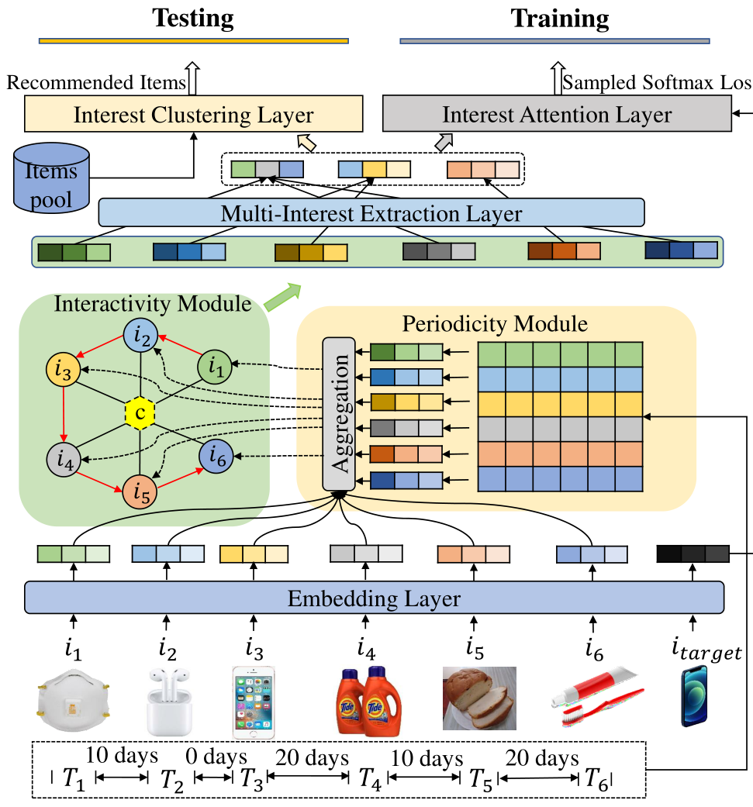
Method

Slide 4
Method

Slide 5
Method

Slide 6
Experiments

Slide 7
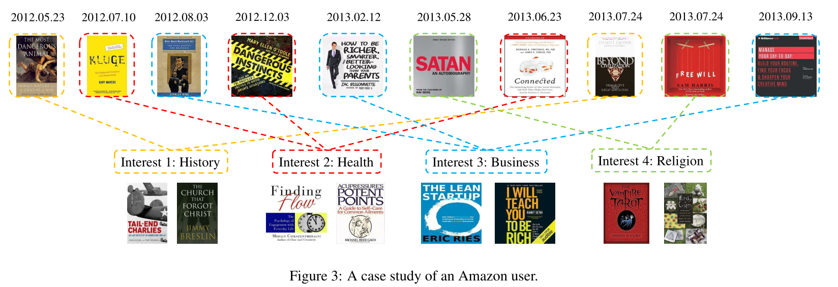
Experiments

Slide 8
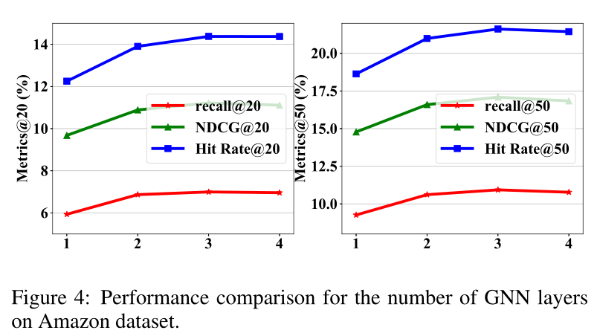
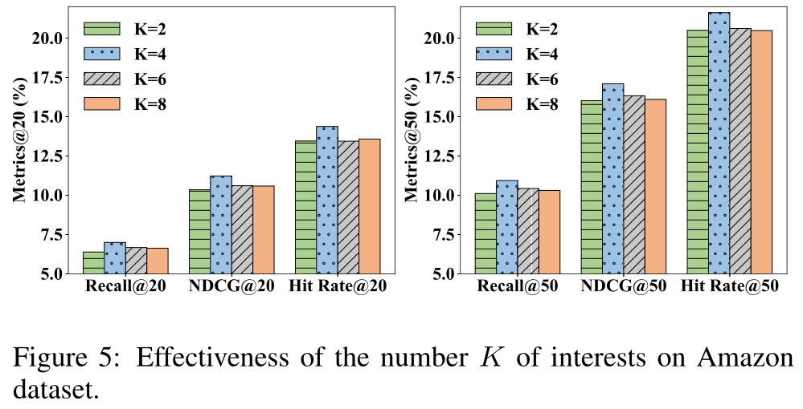
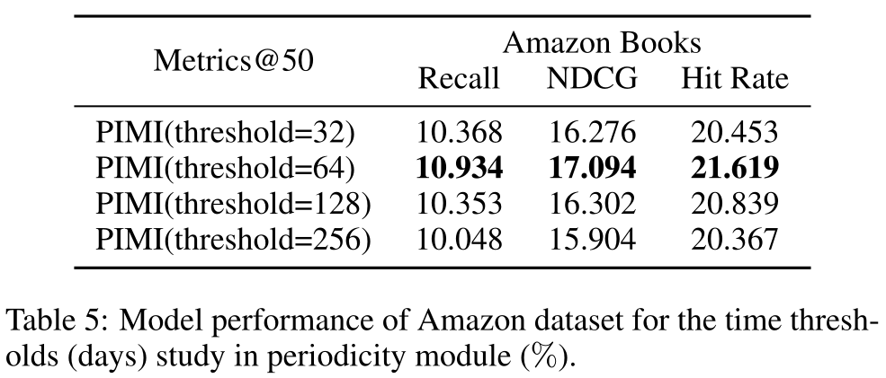
Experiments

Slide 9
Thanks

