Slide 1
Chongqing University of Technology
ATAI
Advanced Technique of Artificial Intelligence
Chongqing University of Technology
Jointly Non-Sampling Learning for Knowledge Graph Enhanced Recommendation
(SIGIR-2020)
github：https://github.com/chenchongthu/JNSKR
Reported by Ting Wang
2020.06.26 • ChongQing

Slide 2
Chongqing University of Technology
ATAI
Advanced Technique of Artificial Intelligence
Chongqing University of Technology
1. Introduction
2. Innovation
3. Method
4. Experiments
5. Conclusion

Slide 3
Introduction
Solve the problem of lacking negative feedback：
1.Negative sampling strategy
2.Non-Sampling strategy

Slide 4
Introduction
The problem with the current method:
1. The methods(CNN,GNN,GAN,GCN)with complex network structures have a substantial number of parameters, and require expensive computations.
2.The performance of negative sampling is not robust as it is highly sensitive to the sampling distribution and the number of negative samples.
3.Sampling is biased, making it difficult to converge to the same loss with all training examples, regardless of how many update steps have been taken.

Slide 5
Introduction
Matrix Factorization (MF)：
(1)
传统的非采样学习Loss function:
(2)
复杂度：O(|U||V|d) d:embeddng size
论文:Collaborative filtering for implicit feedback datasets.(ICDM 2008). 地址：http://yifanhu.net/PUB/cf.pdf

Slide 6
Innovation
1.Derive an efficient optimization method to learn from the whole knowledge graph with a controllable time complexity.
2. This is the first non-sampling learning method for KG enhanced recommendation.

Slide 7
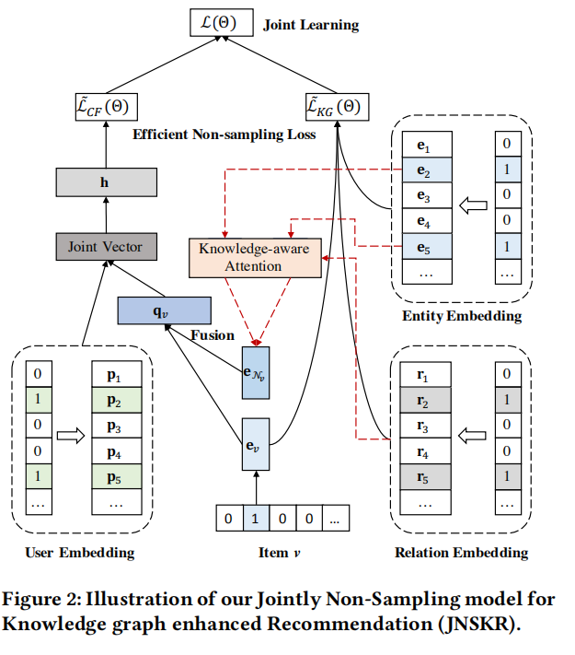
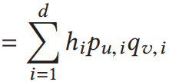
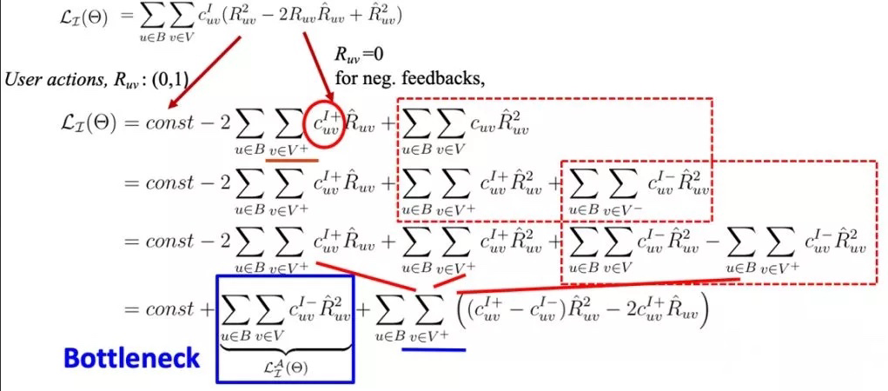
Approach
Scoring Function：
（1）
Loss Function：
（2）
复杂度：
论文：Efficient Neural Matrix Factorization without Sampling for Recommendation (TOIS2020)
地址：https://github.com/chenchongthu/ENMF

Slide 8
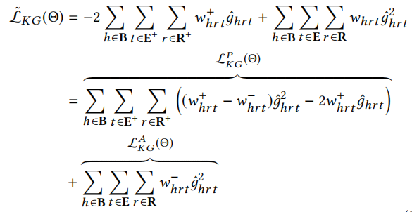
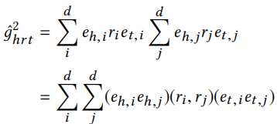
Approach
Knowledge Graph Embedding：
（3）
Loss Function:
Scoring:
（4）
（5）

Slide 9
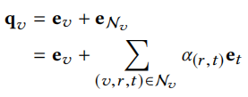
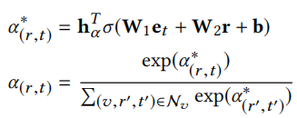
Approach
User-Item Preference Modeling：
（6）
N_{v} ：the neighbored knowledge triplets of v
（7）
（8）
（9）
（10）

Slide 10
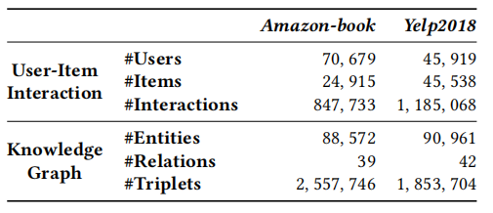
Experiments
Dataset:
Yelp2018: https://www.yelp.com/dataset/challenge
Amazon-book: http://jmcauley.ucsd.edu/data/amazon

Slide 11
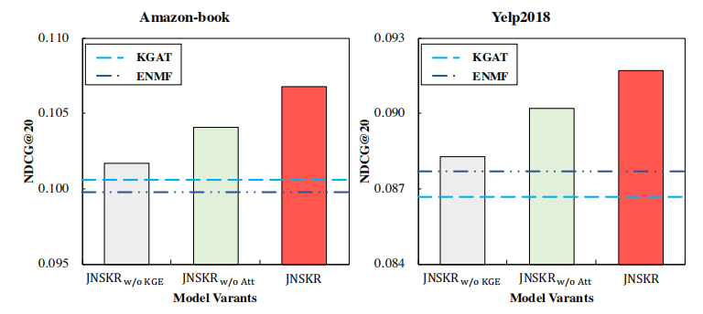
Experiments
Effect of Knowledge Graph Embedding and Attention Mechanism:
Figure 3: Performance of variants of JNSKR on Amazon-book and Yelp2018 datasets. The two dotted lines represent the results of KGAT (KG enhanced method) and ENMF (plainCF method) respectively, which are added as baselines.

Slide 12
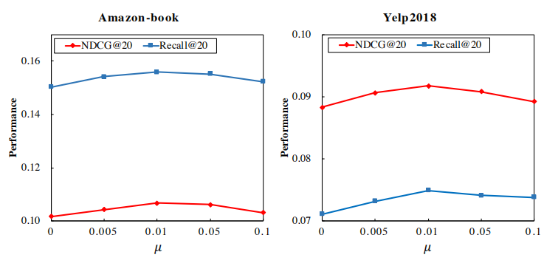
Experiments
Effect of Joint Learning.:
Figure 4: Effect of µ on Amazon-book and Yelp2018 datasets

Slide 13
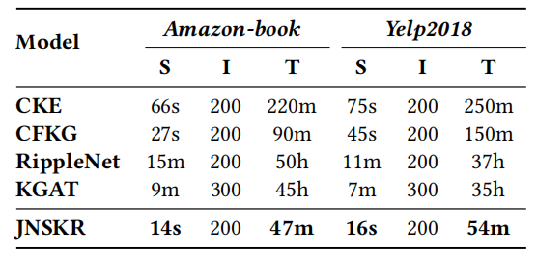
Experiments
Efficiency study:
Figure 5: Comparisons of runtime (second/minute/hour
[s/m/h]). “S”, “I”, and “T” represent the training time for a
single iteration, the number of iterations to converge, and
the total training time, respectively.

Slide 14
Conclusion
We first design a new efficient non-sampling loss for knowledge graph embedding learning, whose complexity is reduced significantly.We then aggregate an item’s surrounding entities with attention mechanisms to help learn accurate user preference over items.The proposed JNSKR consistently and significantly outperforms the state-of-the-art recommendation models in terms of both recommendation performance and training efficiency.

Slide 15
Thanks!

