Slide 1




Chongqing University of Technology
ATAI
Advanced Technique of Artificial Intelligence
Chongqing University of Technology
A Knowledge-Aware Attentional Reasoning Network for Recommendation
Qiannan Zhu, et al(AAAI 2020)
Reported by Ziteng Wu

Slide 2
Chongqing University of Technology
ATAI
Advanced Technique of Artificial Intelligence
Chongqing University of Technology
1. Introduction
2. Method
3. Experiments

Slide 3
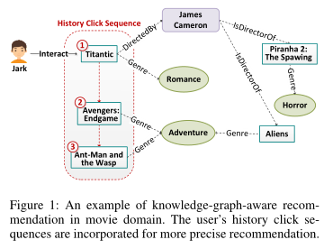
Introduction
reasoning path
(Jark,Interact,Titantic)→(Titantic,Directedby,James Cameron)→(James Cameron,isDirectorof,Piranha 2)
without considering user's clicked sequences
(James Cameron,isDirectorof,Piranha 2) or
(James Cameron,isDirectorof,Aliens)
considering user's clicked sequences
Titantic→Avengers→Ant-Man and Wasp
(Adventure,Genre,Aliens) > (Horror,Genre,Piranha 2)
Adventure
Notes:
之前的知识感知推荐都是通过推理用户-电影之间的路径来预测用户对候选集的点击率，忽略了用户的历史点击序列，而用户的历史点击序列能反映出用户最近一段时间的历史兴趣。

Slide 4
Introduction
This paper proposes a knowledge-aware attentional reasoning network KARN that incorporates the users’ clicked history sequences and path connectivity between users and items for recommendation.
Notes:
本文提出了一种基于知识感知的注意力推理网络KARN，该网络融合了用户的历史点击序列和用户与推荐项目之间的路径连通性。提出的KARN不仅开发了一个基于注意力机制的RNN，可以从用户点击的历史序列中捕捉用户的历史兴趣；而且还开发了一个层次化的注意力神经网络来推理用户和项目之间的路径，从而推断出用户对项目的潜在意图。之后基于用户的历史兴趣和潜在意图，KARN预测用户对候选项的点击概率。

Slide 5
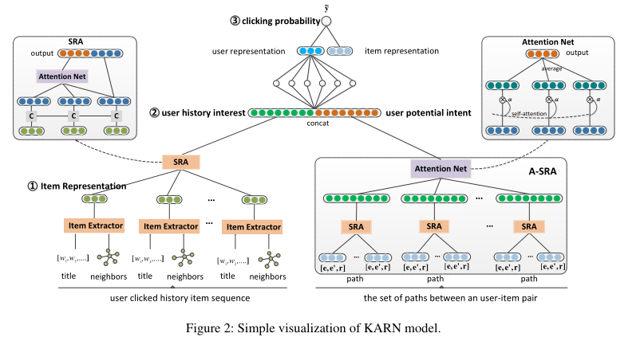
Method

Slide 6
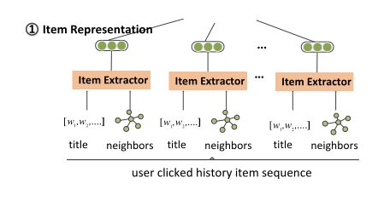


Method
CNN:
local maxpooling
textual knowledge
contextual knowledge

Slide 7
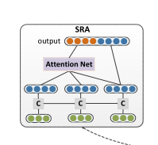


Method

Slide 8
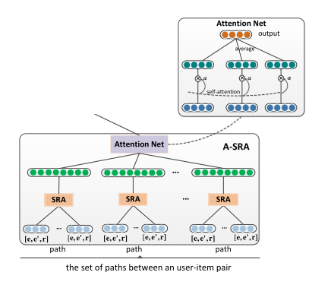
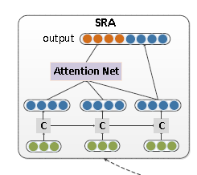

Method
jark,Interact,Titantic,DirectedBy,James Cameron,isDirectorof,
Piranha 2
(Titantic,item,Directedby)

Slide 9
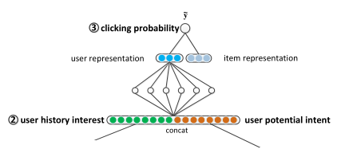


Method

Slide 10
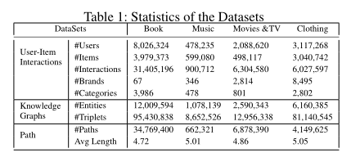
Experiments
Dataset

Slide 11
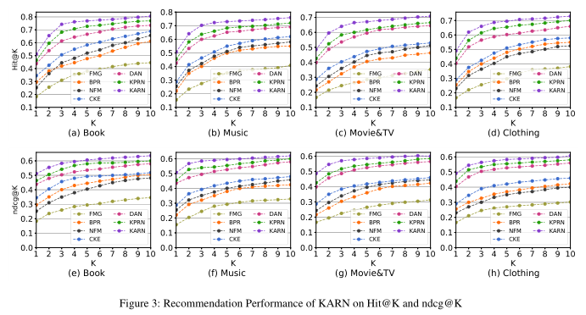
Experiments
Compare with baselines

Slide 12
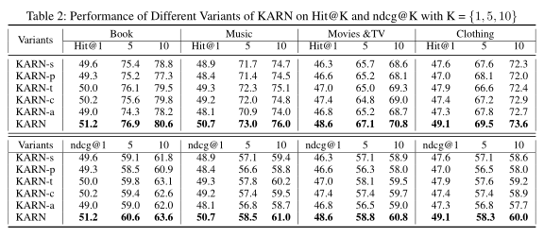
Experiments
Discussion on Different KARN Variants

Slide 13
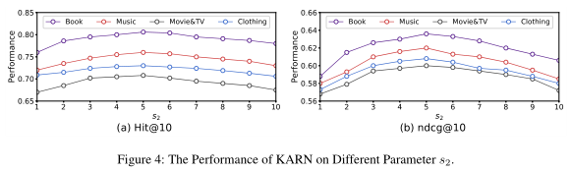
Experiments
Effect of Different Multi-Aspects s₂

Slide 14
Thanks

