Slide 1
Chongqing University of Technology
ATAI
Advanced Technique of Artificial Intelligence
Chongqing University of Technology
K-BERT Enabling Language Representation with Knowledge Graph
——AAAI 2020
2020.10.01 • ChongQing
Reported by Sijin Liu

Slide 2
Chongqing University of Technology
ATAI
Advanced Technique of Artificial Intelligence
Chongqing University of Technology
1.Introduction
2.Method
3.Experiments
4.Conclusion

Slide 3
Introduction
BERT：
Unsupervised pre-trained Language Representation (LR)models like BERT (Devlin et al. 2018) have achieved promising results in multiple NLP tasks. These models are pre-trained over large-scale open-domain corpora to obtain general language represent ations and then fine-tuned in specific downstream tasks for absorbing specific-domain knowledge. However, due to the domain-discrepancy between pre-training and fine-tuning, these models do not perform well on knowledge-driven tasks.
pre-train a model emphasizing domain-specific
Publicly-provided models, like BERT, and XLNet，pre-trained over open-domain corpora
pre-training is time-consuming and computationally expensive, making it unacceptable to most users.

Slide 4
Introduction
Knowledge Graph：
Two challenges:
Heterogeneous Embedding Space (HES)
the embedding vectors of words in text and entities in KG are obtained in separate ways, making their vector-space inconsistent;
1.KGs in many fields is structured data;
2.equip the model with domain knowledge, while reducing the cost of pre-training on a large scale.
3.models posses greater interpretability, for the injected knowledge is manually editable.
Knowledge Noise (KN)
Too much knowledge incorporation may divert the sentence from its correct meaning.

Slide 5
Introduction
K-BERT
Knowledge-enabled Bidirectional Encoder Representation from Transformers
1. This paper proposes a knowledge-enabled LR model, namely K-BERT, which is compatible with BERT and can incorporate domain knowledge without HES and KN issues;
2. K-BERT can easily inject domain knowledge into the models by equipped with a KG without pre-training
3. With the delicate injection of KG, K-BERT significantly outperforms BERT not only on domain-specific tasks, but also plenty of those in the open-domain

Slide 6
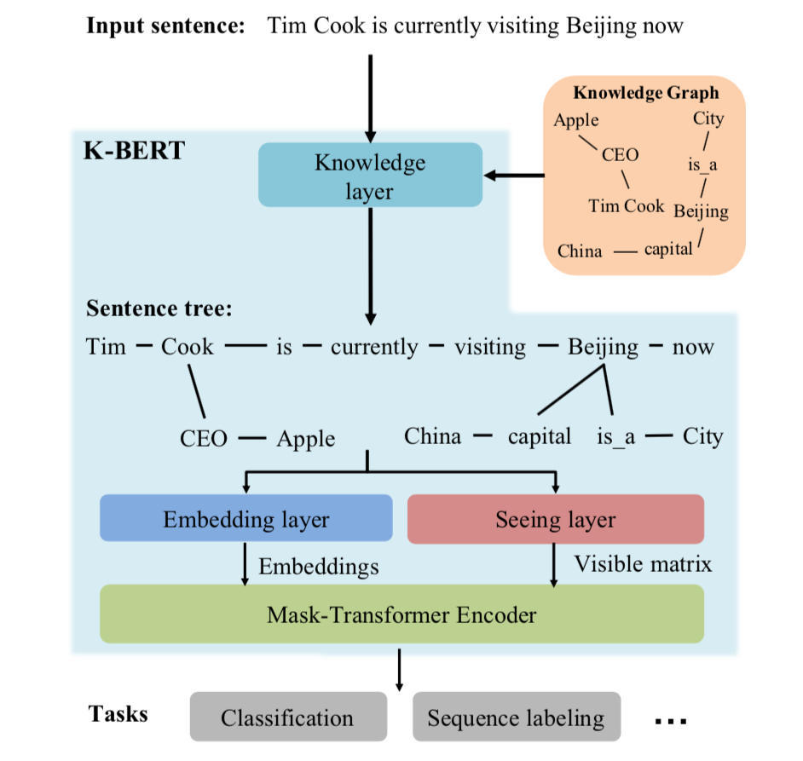
Method
表示一句话，n 表示语句长度，对于英文是词级别的，对于中文是字级别的；
：字典，所有的 ；
：知识图谱，是所有三元组的集合；
：一个三元组，

Slide 7
Method
Knowledge layer
1) sentence knowledge injection
2) sentence tree conversion.
知识查询 (K-Query)
all the entity names involved in the sentence s are selected out to query their corresponding triples from
given an input sentence
and a KG , KL outputs a sentence tree
其中，

Slide 8
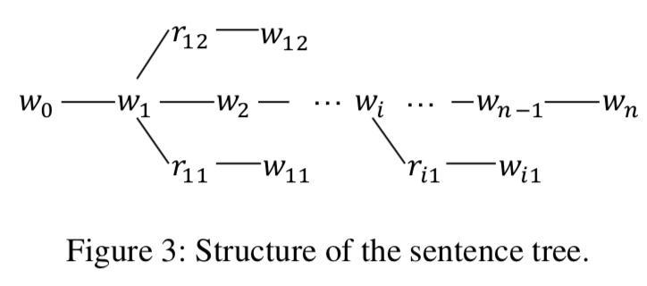
Method
Knowledge layer
知识注入 (K-Inject)
K-Inject injects the queried E into the sentence s by stitching the triples in E to their corresponding position, and generates a sentence tree t

Slide 9
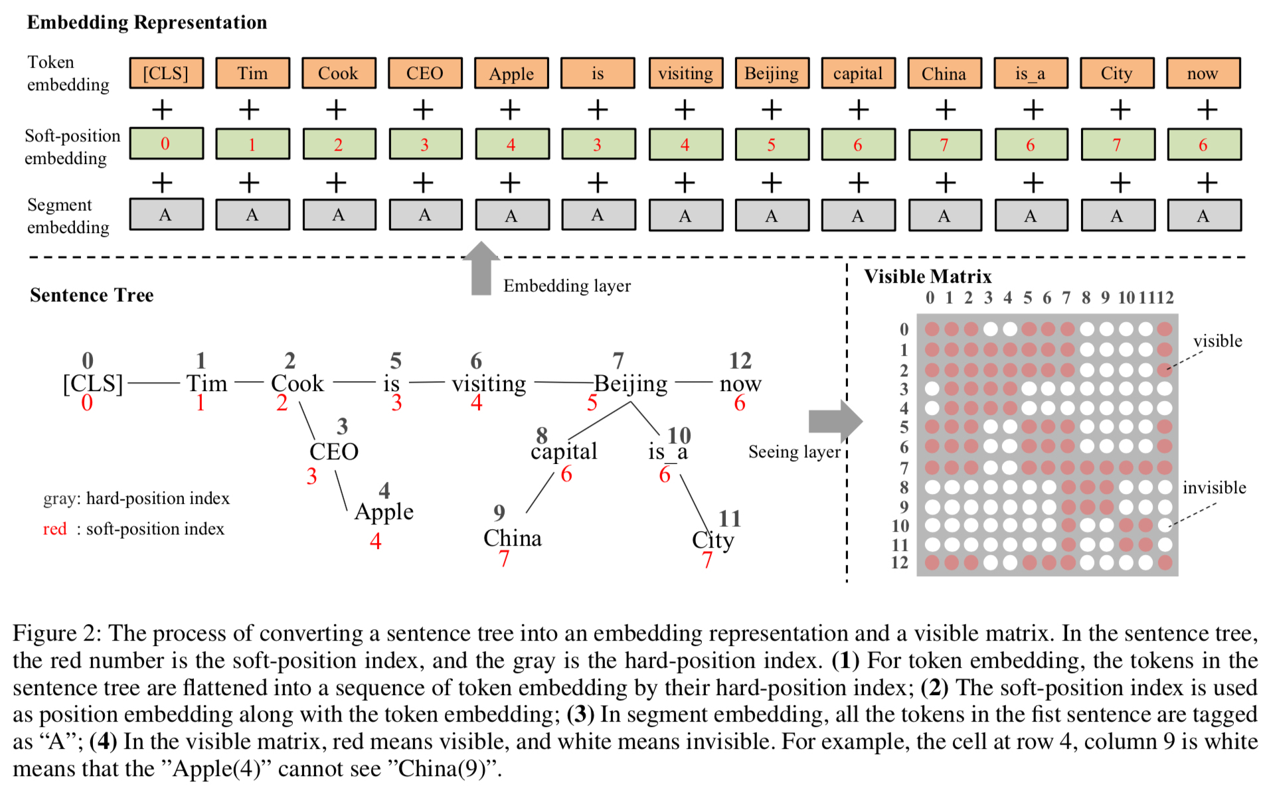
Method
Embedding layer
Embedding layer(EL)的作用是将句子树转换成嵌入表达。和BERT一样，K-BERT的嵌入表示包括三部分：token embedding, position embedding 和 segment embedding。关键是如何将句子树转换成一个序列，同时保留它的结构信息。

Slide 10
Method
Seeing layer
matrix is defined as (3),
(3)
表示两个词在同一支路上； 表示两个词不在同一支路上。 i和j 是hard-position index.

Slide 11
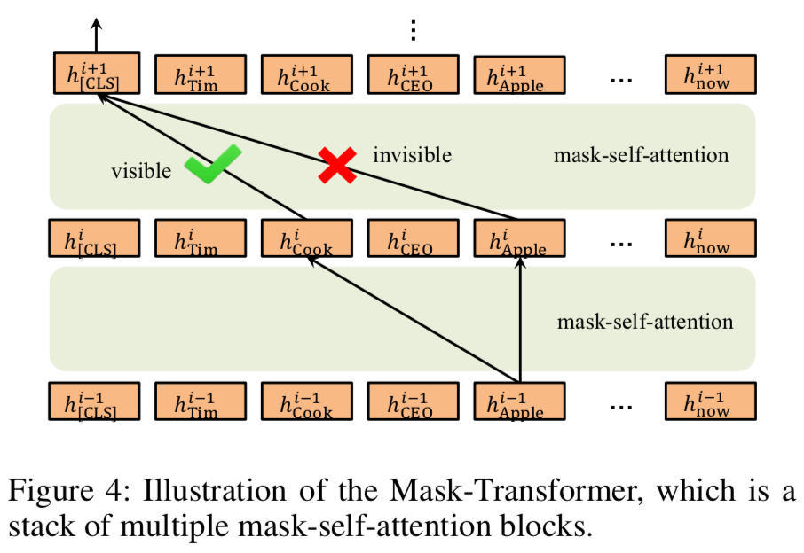
Method
Mask-Transformer
L —— mask-self-attention块的个数；
H —— hidden size
A —— mask-self-attention header的个数
如果 对 不可见，则 ，从而注意力 .
Mask-Self-Attention
是需要学习的模型参数；
：隐状态的第 i 个mask-self-attention块；
：缩放因子；
：visible matrix；

Slide 12
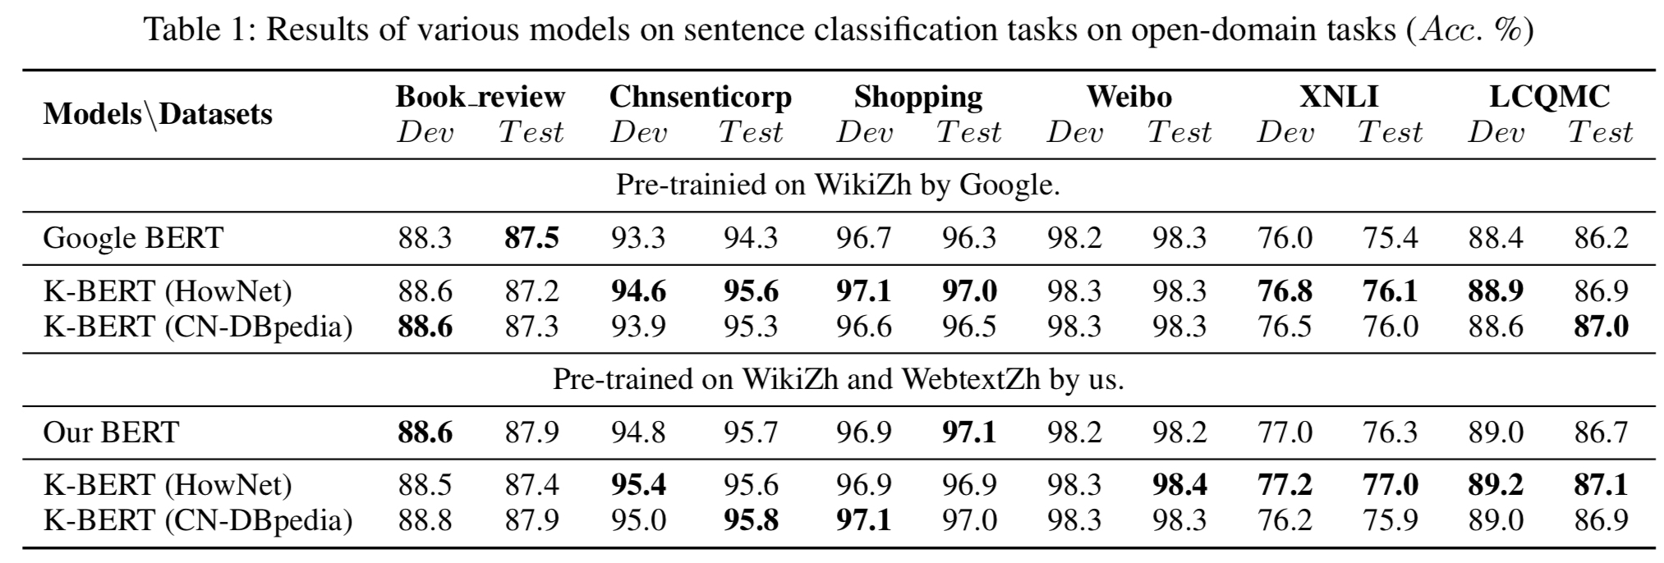
Experiments
在开放域的8个中文NLP任务上对Google BERT和K-BERT做了比较，结果如下表：
说明：为了反应KG和RL(Representation Language)模型之间的角色关系，作者在训练X-BERT时保持与BERT的参数一致。在训练K-BERT时并不会加入KG。因为KG会将相关的两个实体绑定在一起，从而训练时被掩码的两个词意思相近或相等，从而导致语义损失。KG是在接下游任务微调时或推理时加入的。

Slide 13
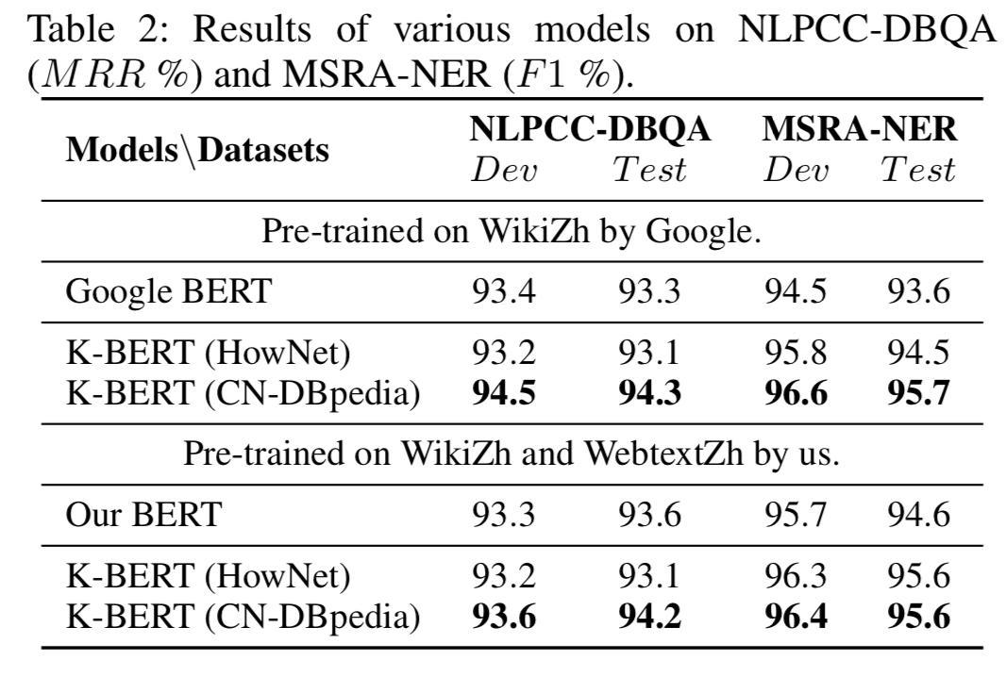
Experiments

Slide 14
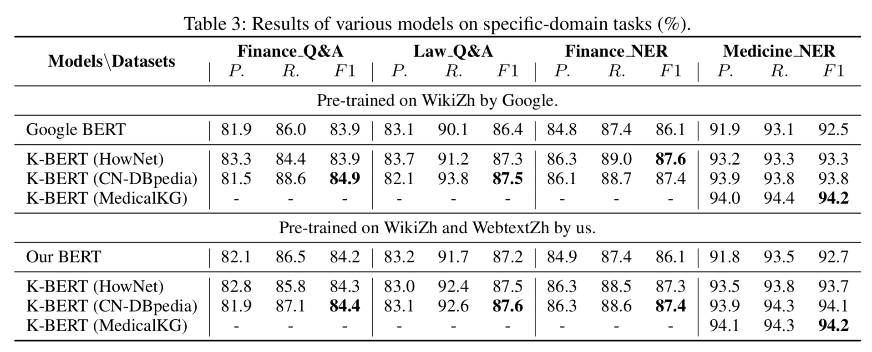
Experiments
在金融、法律和医学领域的NLP任务做了测试，见下表：

Slide 15
Experiments
w/o soft-position: 微调时使用hard-position，而不是soft-position;
w/o visible matrix：所有token之间都是可见的。

Slide 16
Summary
In this paper, the authors propose K-BERT to enable language representation with knowledge graphs, achieving the capability of commonsense or domain knowledge. Despite the challenges of HES and KN, our investigation reveals promising results on twelve open-/specific- domain NLP tasks. Empirical results demonstrate that KG is especially helpful for knowledge-driven specific-domain tasks and can be used to solve problems that require domain experts. Besides, K-BERT is compatible with the model parameters of BERT, which means that users can directly adopt the available pre-trained BERT parameters (e.g., Google BERT, Baidu-ERNIE, etc.) on K-BERT without pre-training by themselves.

Slide 17
Thank you!

