Slide 1
GraLSP:
Graph Neural Networks with Local Structural Patterns
Zhuomin Chen
2020.05.24
AAAI 2020

Slide 2
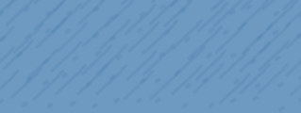


Chongqing University of Technology
ATAI
Advanced Technique of Artificial Intelligence
Chongqing University of Technology
1.Introduction
2.Conclusion
3.Model
4.Experiment and Result
5. Model Analysis

Slide 3
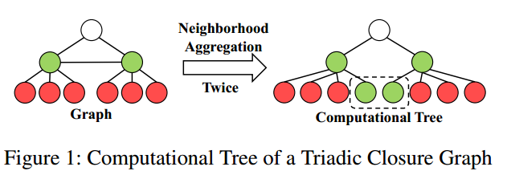
Introduction

Slide 4
Contributions
Analyze the neighborhood aggregation scheme and conclude that common GNNs suffer from defects in identifying some common structural patterns.
Propose that random walks can be used to capture structural patterns with analyses on them.
Propose a novel neighborhood aggregation scheme that combines the structural and node properties through adaptive receptive radius, attention and amplification.
Carry out extensive experiments with their results showing that our model, incorporating structural patterns into GNNs, attains satisfactory performances.

Slide 5
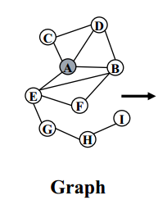



Model(1)

Slide 6
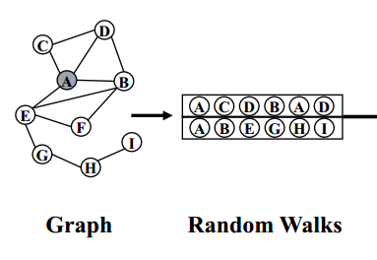
Model(2)

Slide 7
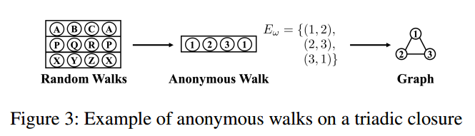

Model(3)

Slide 8
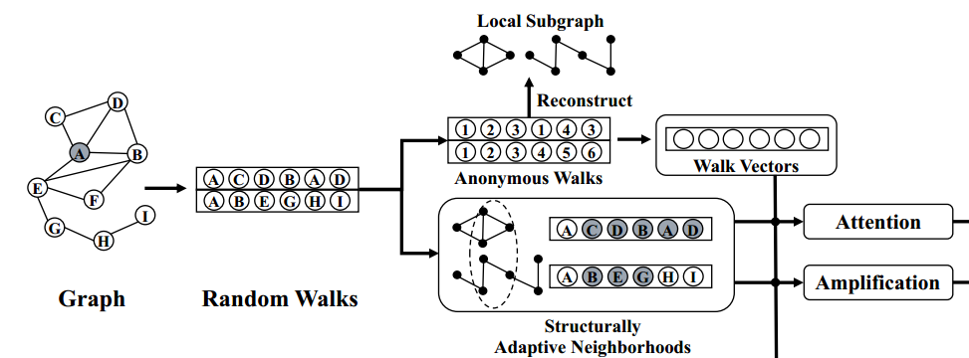


Model(4)

Slide 9
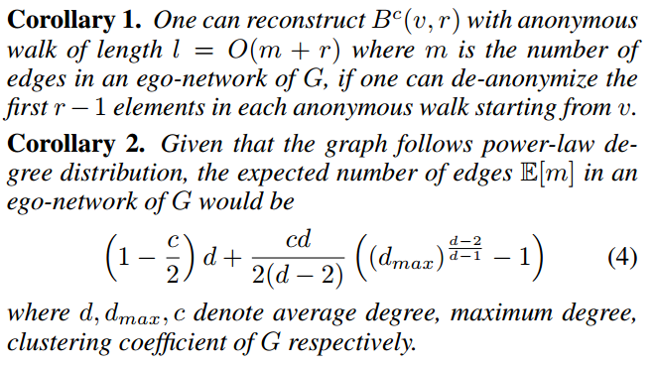

Model(4)

Slide 10
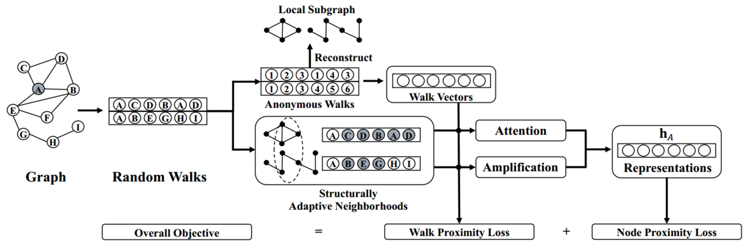





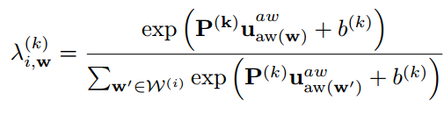


Model(5)

Slide 11




Model(6)

Slide 12
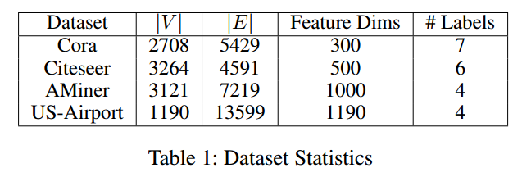
Experiment and Result(1)

Slide 13
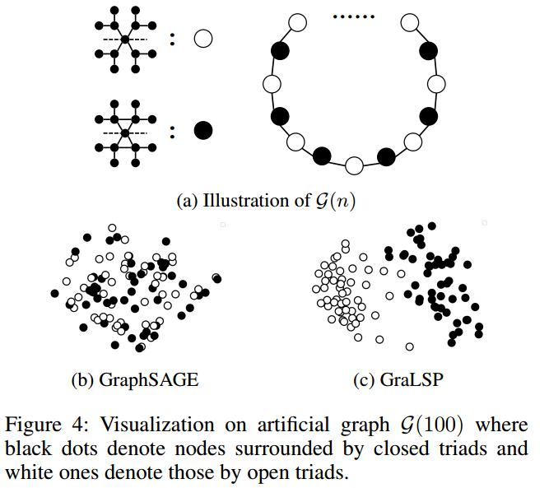
Experiment and Result(2)

Slide 14
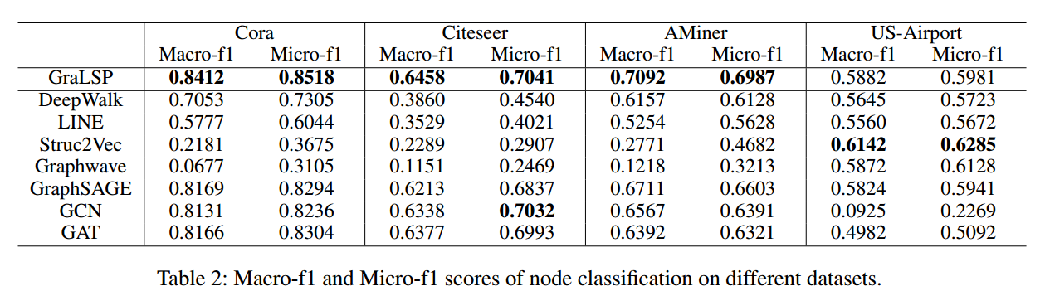
Experiment and Result(3)

Slide 15
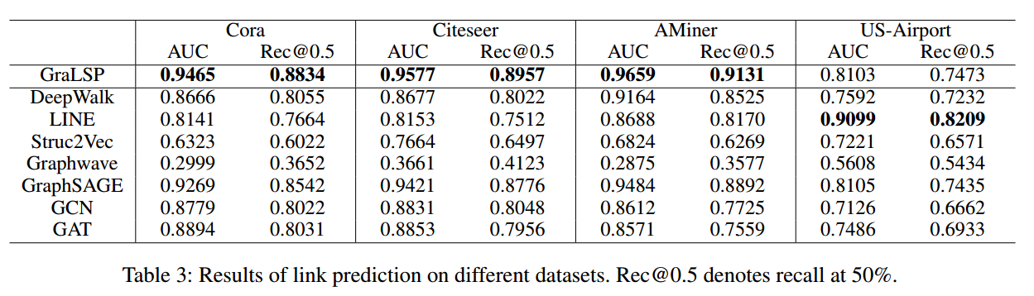
Experiment and Result(4)

Slide 16
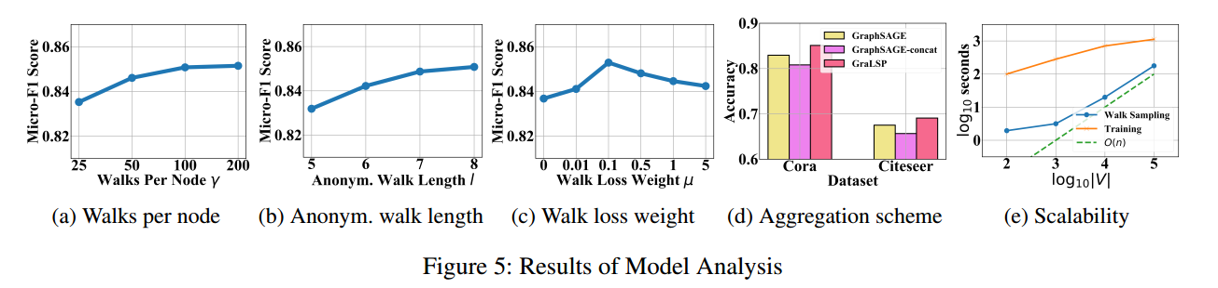
Model Analysis(1)

Slide 17
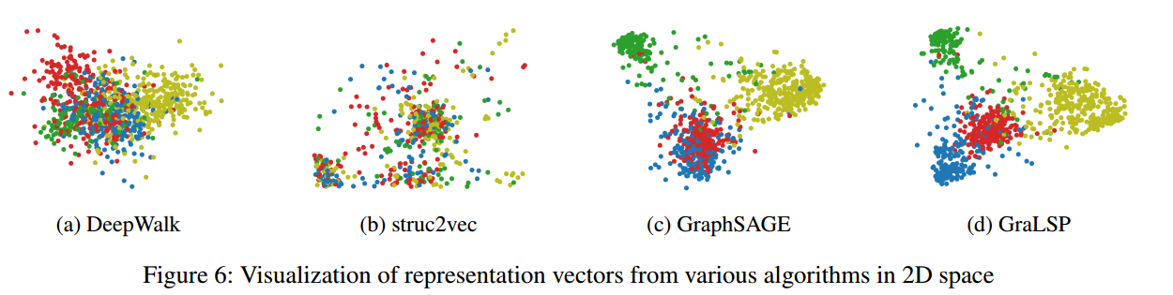
Model Analysis(2)

