Slide 1
VGCN-BERT: Augmenting BERT with Graph Embedding for Text Classiﬁcation
汇报人：TangGu
时间：2020.4.28

Slide 2
1
Background
GCN benefits:
1.It's a good way to aggregate long-distance information
2.it can learn the node feature information and structure information end-to-end at the same time, which is the best choice for graph data learning task at present
3.GCN has a wide range of applicability and can be applied to nodes and graphs of any topological structure
GCN disadvantages:
GAT
1.The original GCN training is full batch, which is difficult to be extended to large-scale network, and the convergence is slow
Solution way
Graph-SAGE
2.Text GCN can't get the order characteristics of document words

Slide 3
Backgroud
A
Doc_1
Doc_2
word_1
word_2
word_3
Doc_1
1 | 0 | 0.1 | 0.2 | 0.3
0 | 1 | 0.4 | 0.5 | 0.6
0.1 | 0.4 | 1 | 0.7 | 0.8
0.2 | 0.5 | 0.7 | 1 | 0.9
0.3 | 0.6 | 0.8 | 0.9 | 1
The last disadvantage of demo:
Doc_2
node_vec=[[1.0,2.0,3.0,4.0,5.0],
[1.1,2.1,3.1,4.1,5.1],
[1.2,2.2,3.2,4.2,5.2],
[1.3,2.3,3.3,4.3,5.3].
[1.4,2.4,3.4,4.4,5.4]]
node_vec_1=[[1.0,2.0,3.0,4.0,5.0],
[1.1,2.1,3.1,4.1,5.1],
[1.4,2.4,3.4,4.4,5.4],
[1.3,2.3,3.3,4.3,5.3]. [1.2,2.2,3.2,4.2,5.2],
word_1
word_2
word_3
A_1
If we want to get Doc_1_vec:
Doc_1
Doc_2
word_3
word_2
word_1
Doc_1
1 | 0 | 0.3 | 0.2 | 0.1
0 | 1 | 0.6 | 0.5 | 0.4
0.3 | 0.6 | 1 | 0.9 | 0.8
0.2 | 0.5 | 0.9 | 1 | 0.7
0.1 | 0.4 | 0.8 | 0.7 | 1
A . node_vec
Doc_1_vec = [1.8,3.4,5.0,6.6,8.2]
Doc_2
A _1. node_vec_1
Doc_1_vec = [1.8,3.4,5.0,6.6,8.2]
word_3
word_2
word_1

Slide 4
VGCN
VGCN:
The graph of VGCN is constructed on the basis of dictionary, which is essentially an isomorphic graph
Build_graph:vocabulary graph is constructed using normalized point-wise mutual information (NPMI):
For a single convolutional layer of GCN, the new representation is calculated as follows:
A$∈n∗n ,$n = vocab_size
X = [batch_size,vocab_size]
x ˜ A extracts the part of vocabulary graph relevant to the input sentence x
W holds the weights of the hidden state vector for the single document

Slide 5
Integrating VGCN into BERT
Muitly-Head self-attention
Note:Graph embedding is a single doc embedding

Slide 6
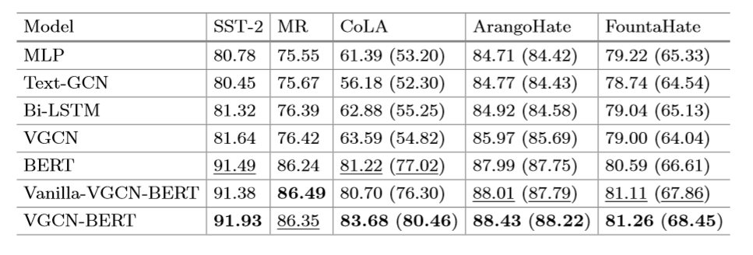
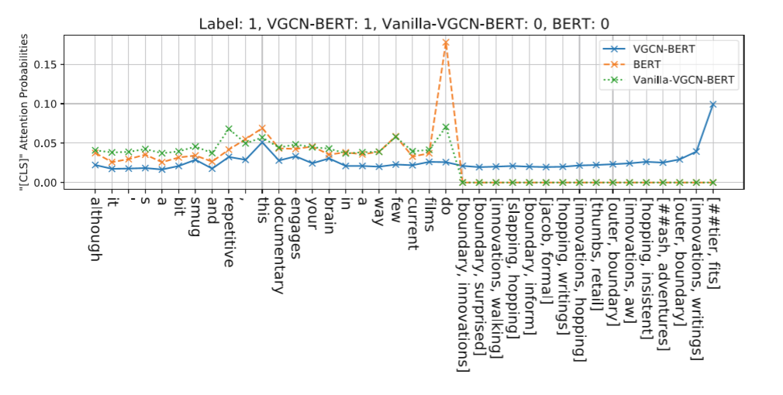
Experiments and results

Slide 7
THANGKS!

