Slide 1
Chongqing University of Technology
ATAI
Advanced Technique of Artificial Intelligence
Chongqing University of Technology
ASAP: Adaptive Structure Aware Pooling for Learning Hierarchical Graph Representations（AAAI 2020）
Zhanwang Peng

Slide 2
Outline
Introduction
Approach
Experiments
Conclusion

Slide 3
Introduction
Problem Statement：
$x_{i}$ is d-dimensional feature representation of $v_{i}$

Slide 4
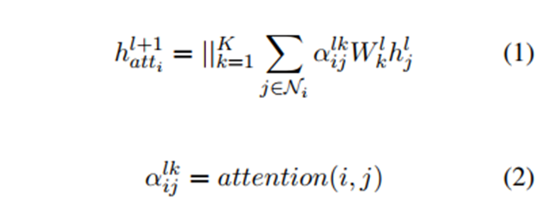
Introduction
Self-Attention:
朱玲

Slide 5
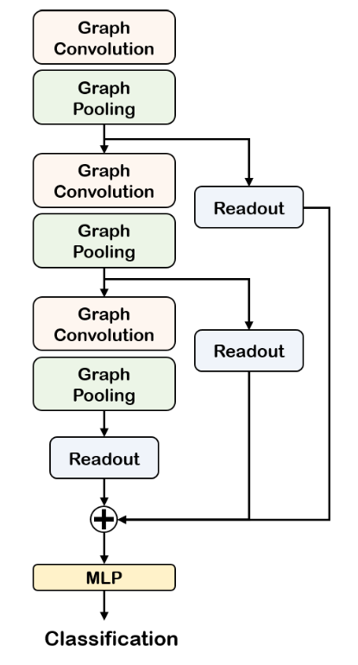
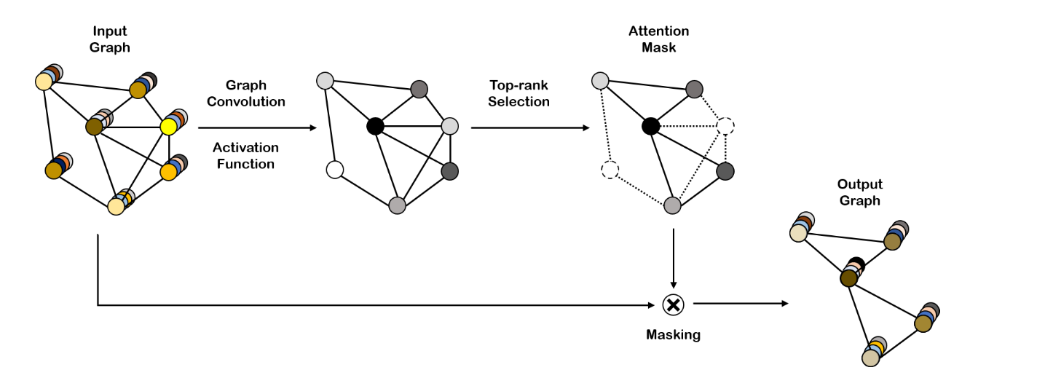
Introduction
论文：Self-Attention Graph Pooling（ICML2019）

Slide 6
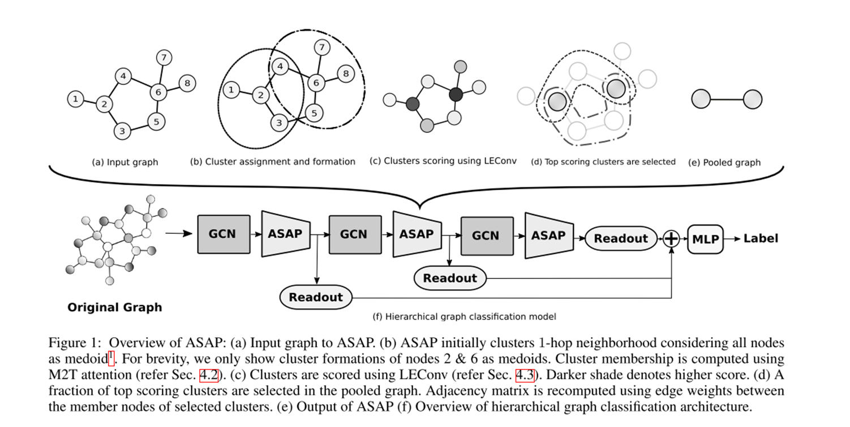
Approach
Readout is a concatenation of the mean and max of the node representations

Slide 7
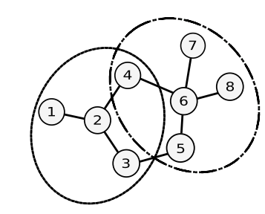
Approach
Cluster Assignment:
:
the cluster assignment matrix:

Slide 8
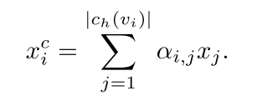
Approach
first create a master query:
which is representative of all the nodes within a cluster
$x_{j}^{′}$ is obtained after passing $x_{j}$ through a separate GCN
In this work we experiment with max master function defined as:

Slide 9
Approach

Slide 10
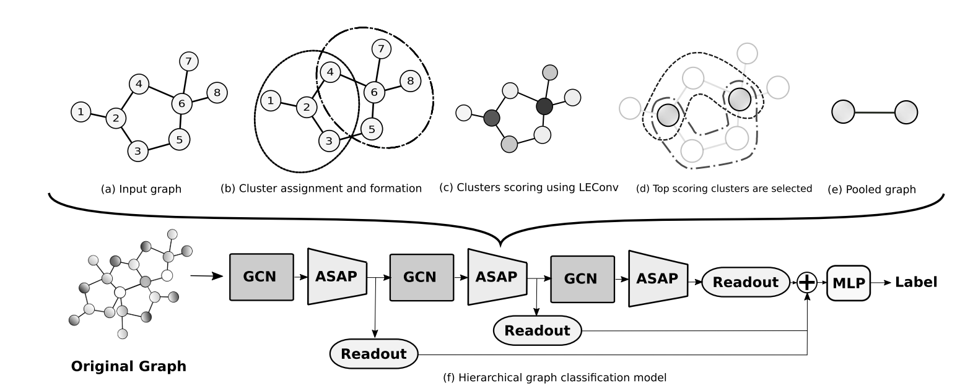
Approach

Slide 11
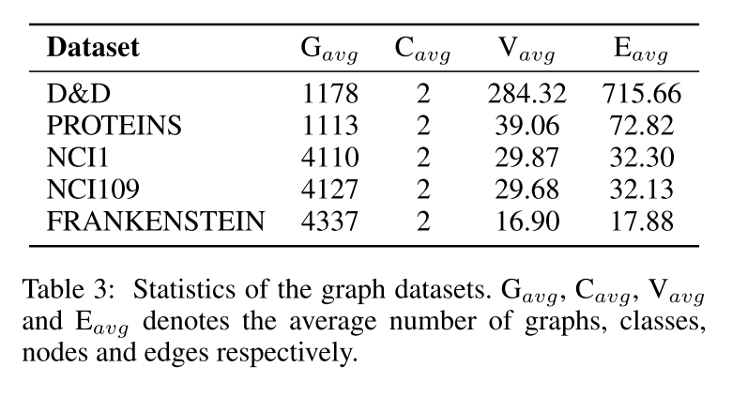
Experiments

Slide 12
Experiments

Slide 13
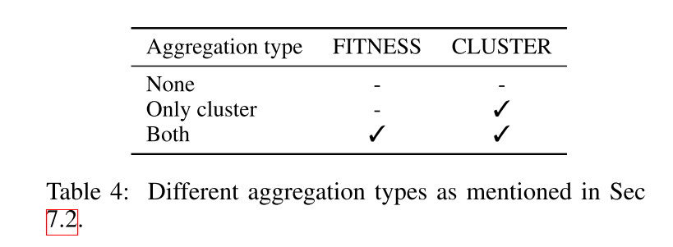
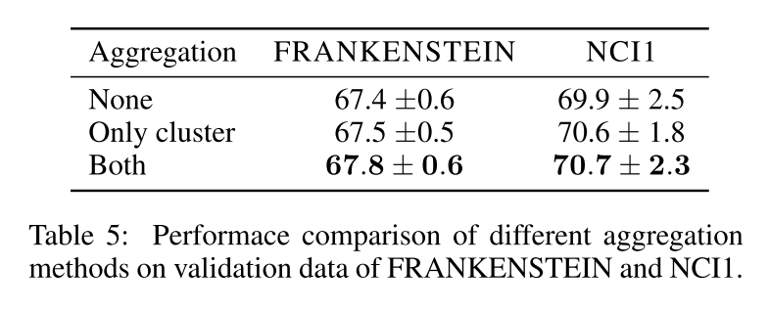
Experiments

Slide 14
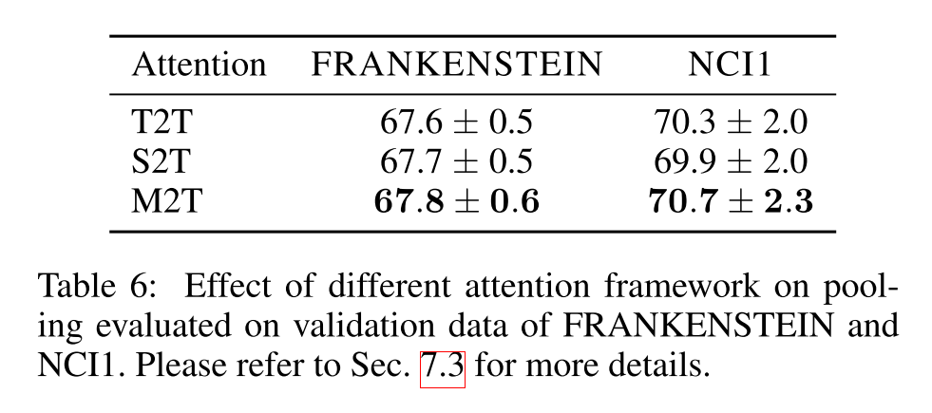
Experiments

Slide 15
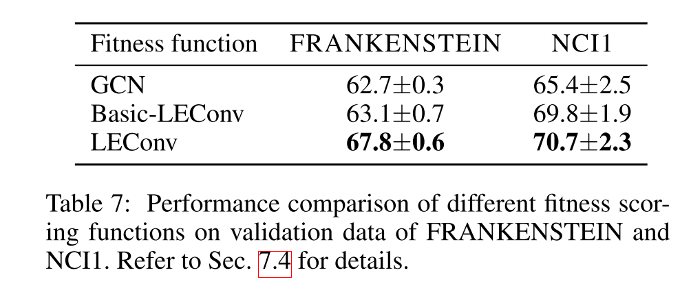
Experiments

Slide 16
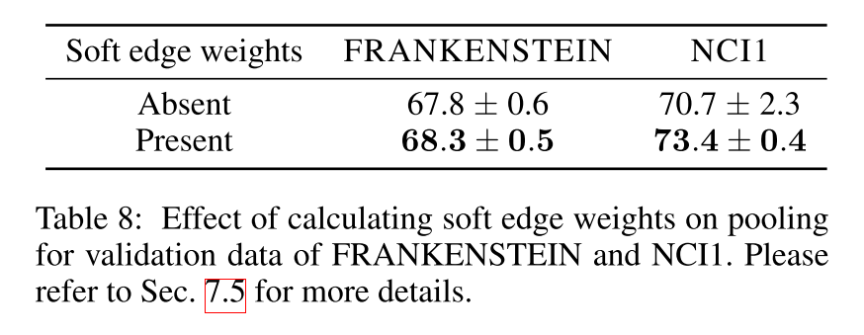
Experiments

Slide 17
Conclusion
ASAP clusters local subgraphs hierarchically which helps it to effectively learn the rich information present in the graph structure.
ASAP also calculates sparse edge weights for the selected clusters and is able to capture the edge connectivity information efficiently while being scalable to large graphs.

Slide 18
Thanks

