Slide 1
KERL: A Knowledge-Guided Reinforcement Learning Model for Sequential Recommendation
汇报人：Gu Tang
时间：2020.12.20
Conference：SIGIR_2020
Github:https://github.com/fanyubupt/KERL

Slide 2
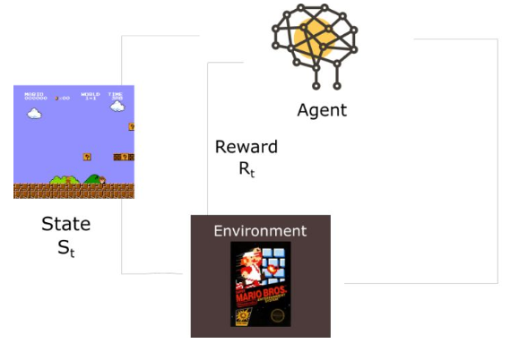
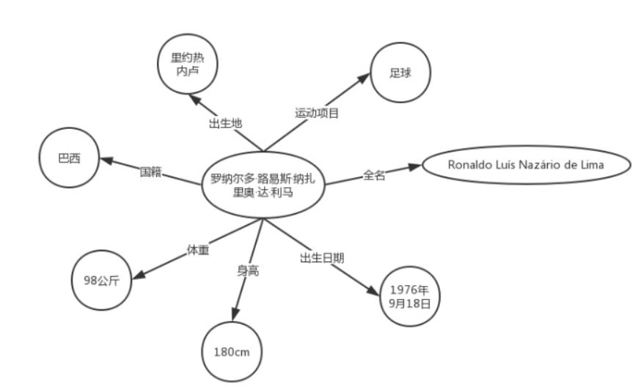
Motivations
Previous studies have used maximum likelihood estimation (MLE) to fit the observation interaction sequence step by step, which does not describe the long-term or overall effectiveness of optimization objectives. In this paper, knowledge mapping and reinforcement learning are introduced into sequential recommendation
Sequence recommendations

Slide 3
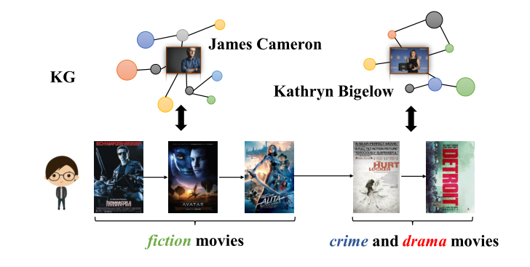
Model Architecture
In the past, the recommendation based on kg can't deal with the situation that the user's intention is elegant

Slide 4
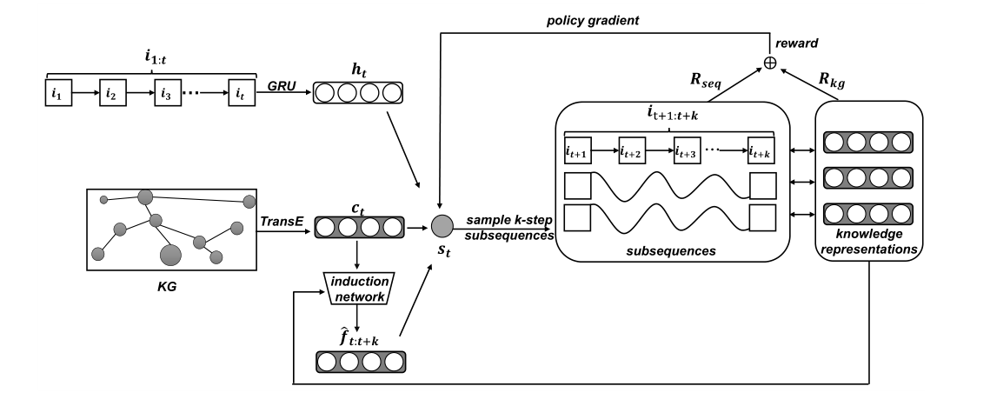
Model Architecture

Slide 5
CoSan Prepare-data

Slide 6
model

Slide 7
model

Slide 8
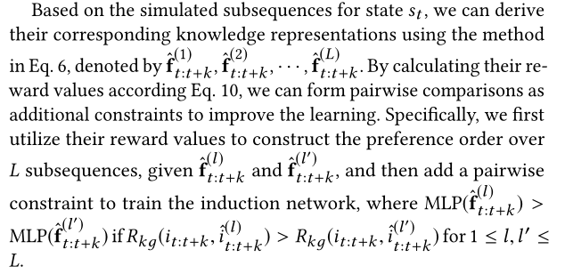
model

Slide 9
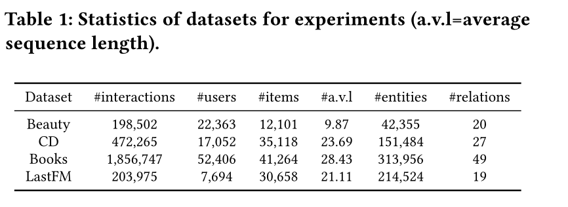
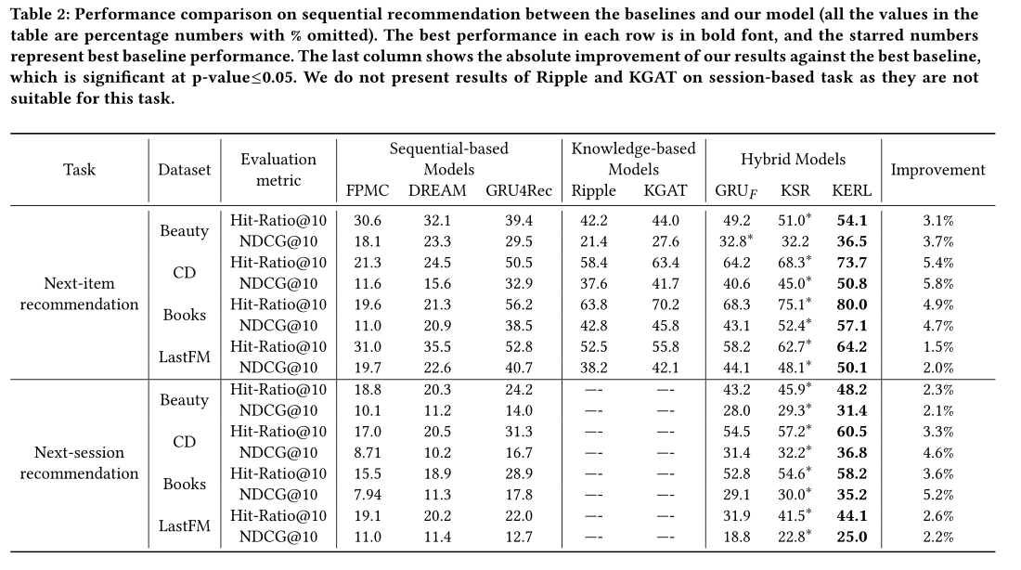
Experiment

Slide 10
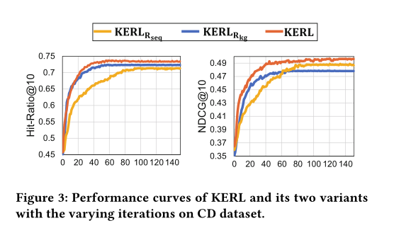
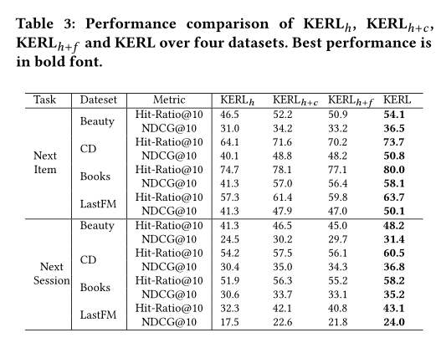
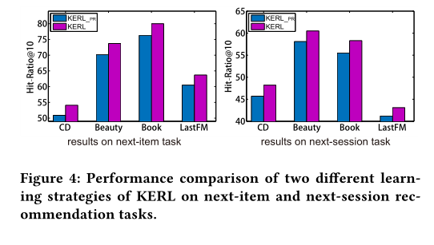
Experiment

Slide 11
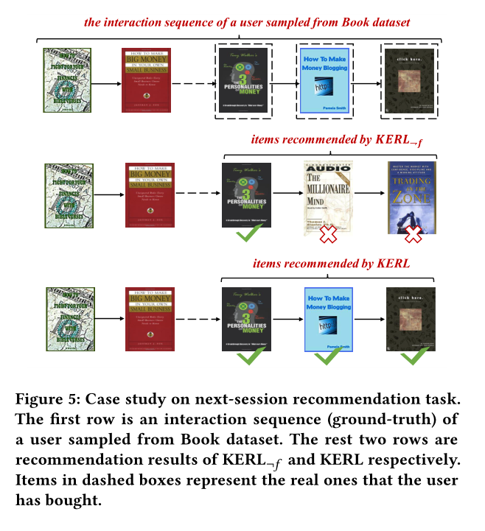
Experiment-case study

Slide 12
THANGKS!

