Slide 1
Policy-GNN: Aggregation Optimization for Graph Neural Networks
KDD_2020
Code：https://github.com/lhenry15/Policy-GNN
2020.12.20 • ChongQing
Reported by Chenghong Li

Slide 2
1. Introduction
2. Method
3. Experiments
4. Conclusion

Slide 3
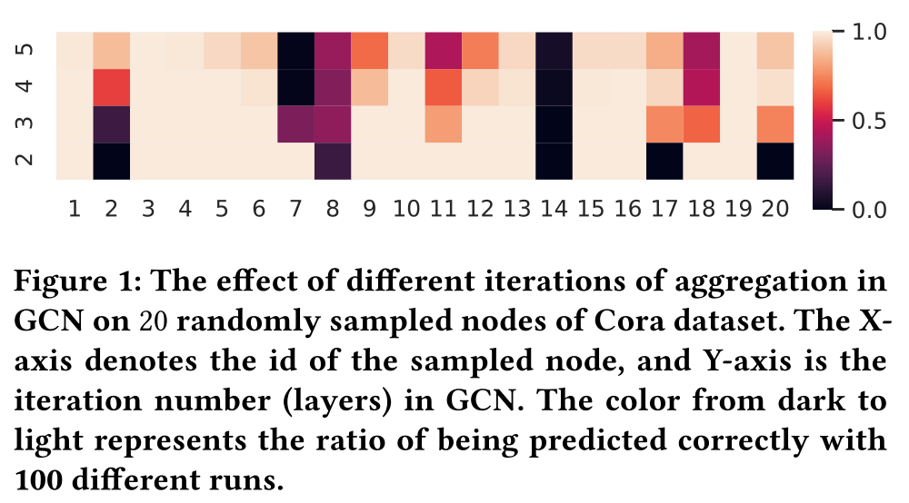
Introduction
Introducing diverse aggregation to the nodes can significantly boost the performance of GNNs.
We propose Policy-GNN, a meta-policy framework to model the complex aggregation strategy.
We formulate the graph representation learning as a Markov decision process (MDP).
Solving Markov Decision Process with Deep-Q Learning (DQN).

Slide 4
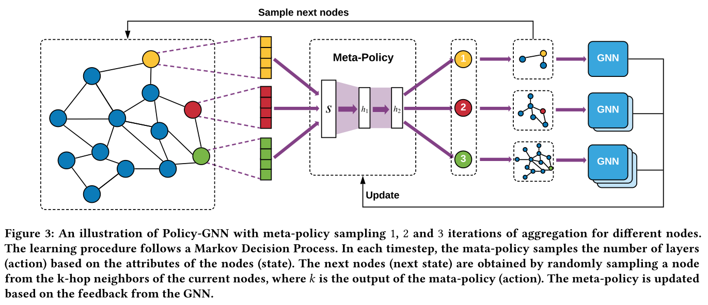
Method

Slide 5
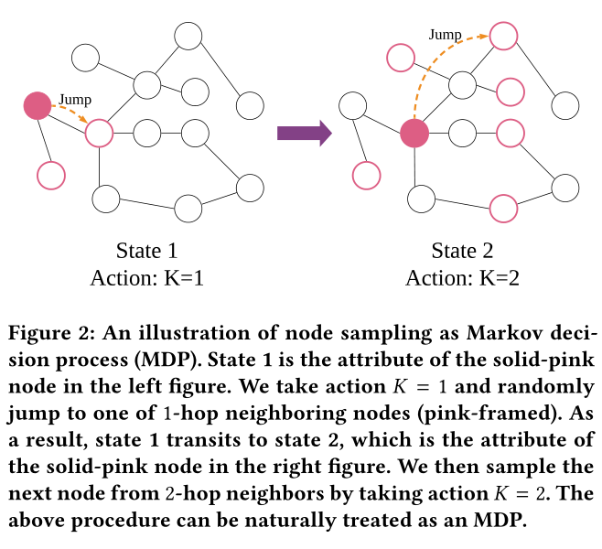
Method

Slide 6
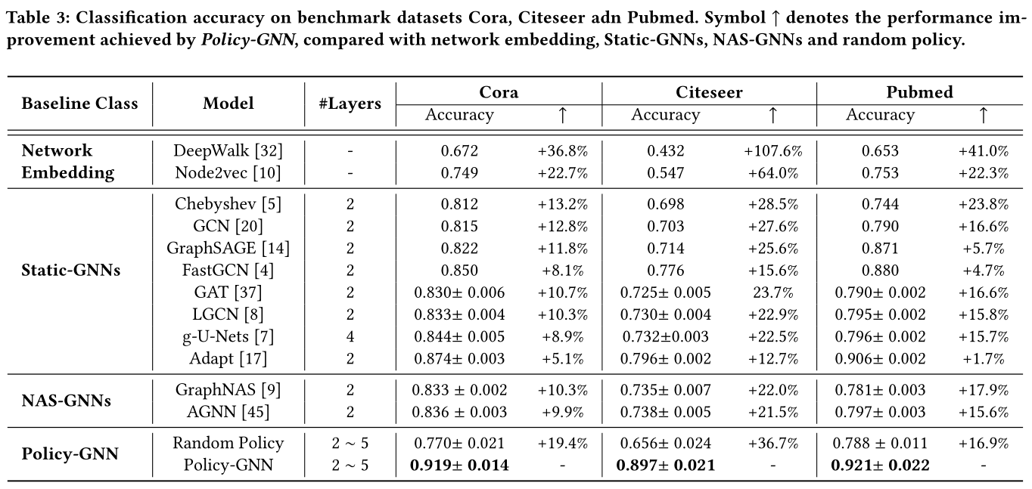
Experiments

Slide 7
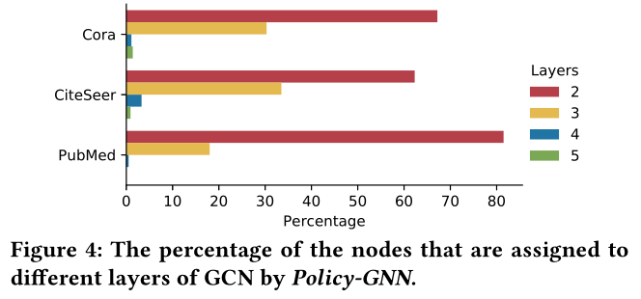
Experiments

Slide 8
Conclusion
Policy-GNN, a meta-policy framework that adaptively learns an aggregation policy to sample diverse iterations of aggregations for different nodes.
Policy-GNN formulates the graph representation learning problem as a Markov decision process and employs deep reinforcement learning with a tailored reward function to train the meta-policy.

Slide 9
THANKS

