Slide 1









Chongqing University of Technology
ATAI
Advanced Technique of Artificial Intelligence
Chongqing University of Technology
Neural News Recommendation with Attentive Multi-View Learning
International Joint Conference on Artificial Intelligence (IJCAI-2019)
Reported by Ting Wang

Slide 2
Chongqing University of Technology
ATAI
Advanced Technique of Artificial Intelligence
Chongqing University of Technology
1.Introduction
2.Method
3.Experiments
4.Conclusion

Slide 3
Introduction
Background:
Existing news recommendation methods usually learn these representations based on single news information.

Slide 4
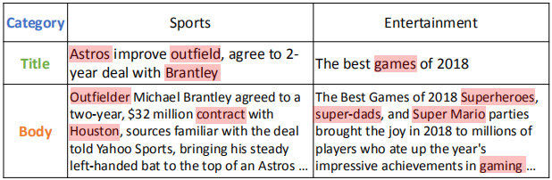
Introduction
Motivation:
1.A news article usually contains different kinds of information.
2.Different kinds of news information have different characteristics.
3.Different words in the same news may have different importance.

Slide 5
Introduction
Contribution:
1.An attentive multi-view learning model
2.Apply word-level and view-level attention mechanism to news encoder to select important words and views.

Slide 6
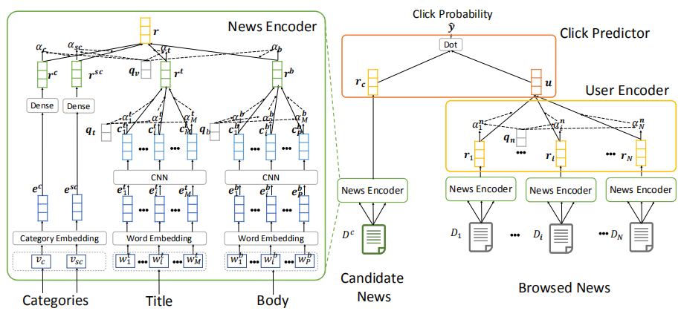
Method

Slide 7
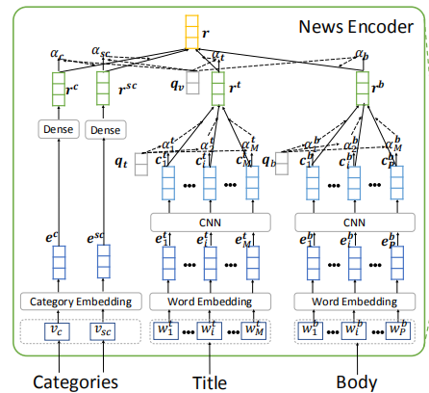






Method
view-level
word-level

Slide 8
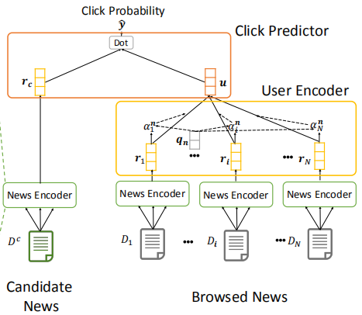



Method

Slide 9
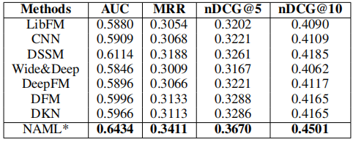
Experiments

Slide 10
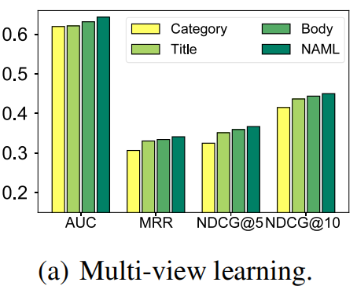
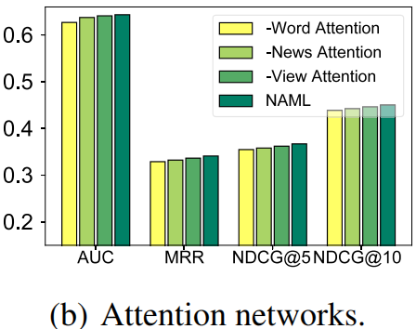
Conclusion
The effectiveness of the multi-view learning framework and the attention networks in our approach

Slide 11
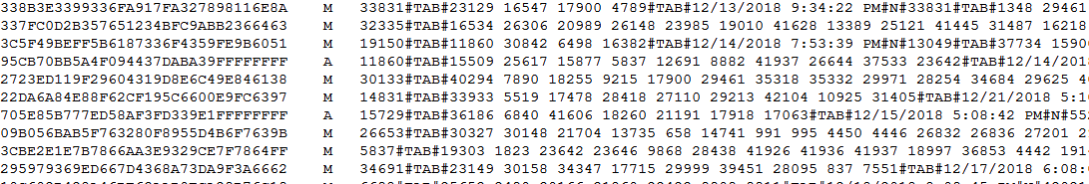
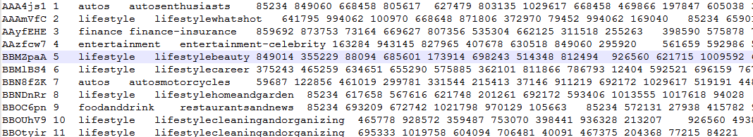
Data:

Slide 12
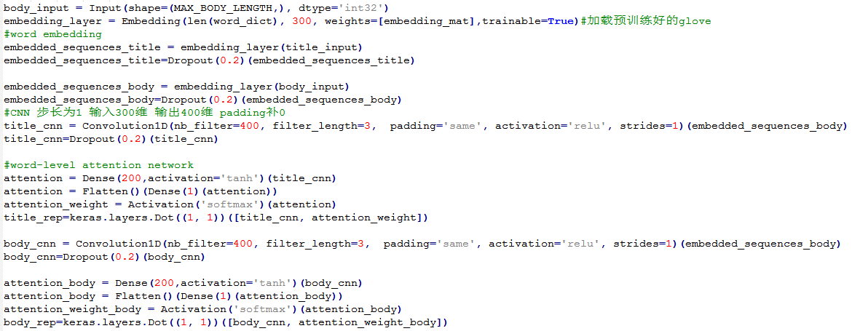
News encoder-title/body:

Slide 13
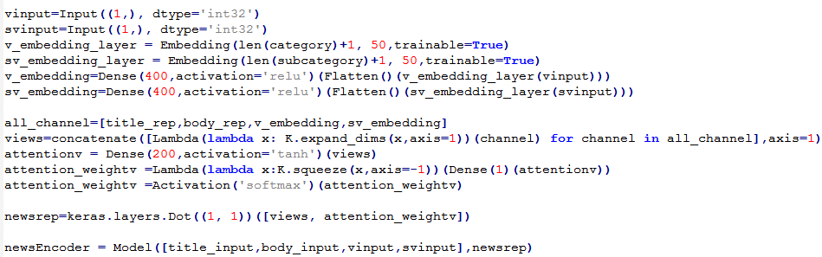
News encoder-category/subcategory:

Slide 14
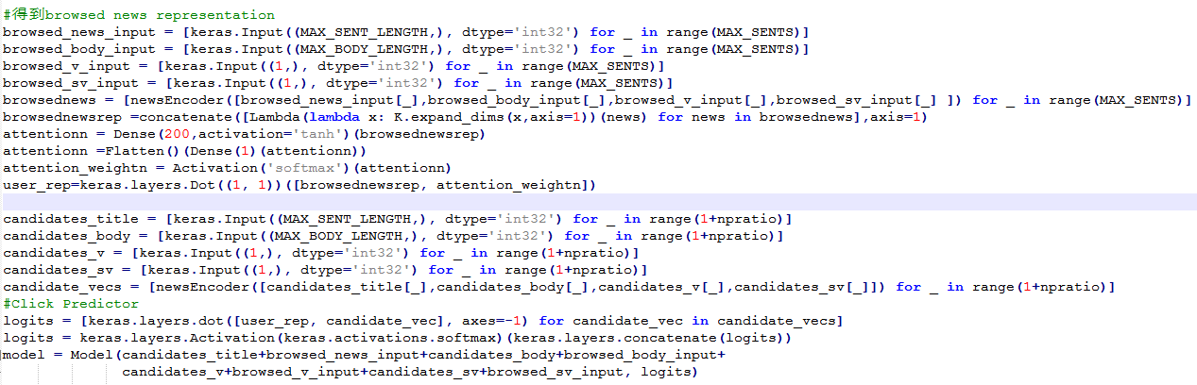
Browsed News:

Slide 15
Thank you!

