Slide 1
Emotion-Cause Pair Extraction: A New Task to Emotion Analysis in Texts

Slide 2
Contents
Background
Problem Definition
Approach
Experiments

Slide 3
Background
Two shortcomings:
The emotion must be annotated before cause extraction
Ignores the fact that they are mutually indicative
The main contributions:
Emotion-cause pair extraction(ECPE)
A two-step framework
Construct a corpus suitable for the ECPE task

Slide 4
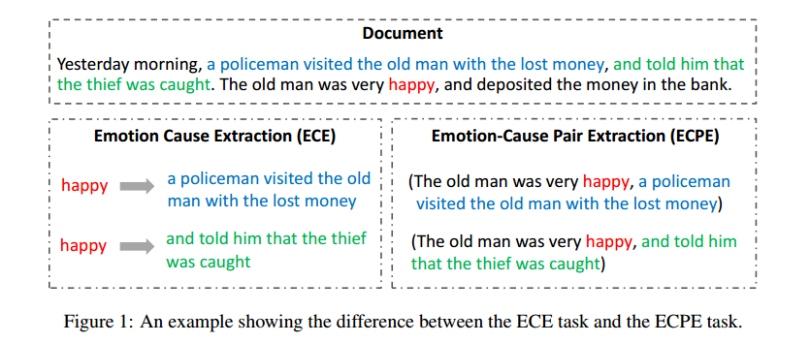
Problem Definition

Slide 5
Approach
Step1 Individual Emotion and Cause Extraction
Step2 Emotion-Cause Pairing and Filtering

Slide 6
Step1 Individual Emotion and Cause Extraction

Slide 8
Experiments

