Slide 1
Context-aware Embedding for Targeted Aspect-based Sentiment Analysis
Reporter:彭展望

Slide 2
Outline
Background
Motivation
Method
Experiment
Conclusion

Slide 3
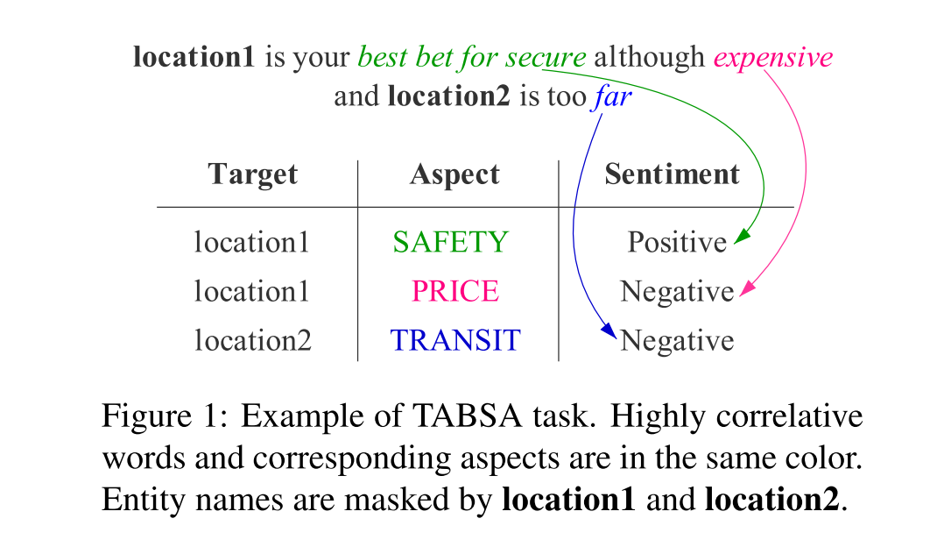
Background

Slide 4
Motivation
Solve the following problems:
Existing methods tend to get out of context when representing targets and aspects.
The target and aspect have overlapping association mappings in the context.

Slide 5
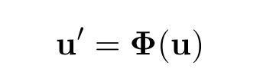
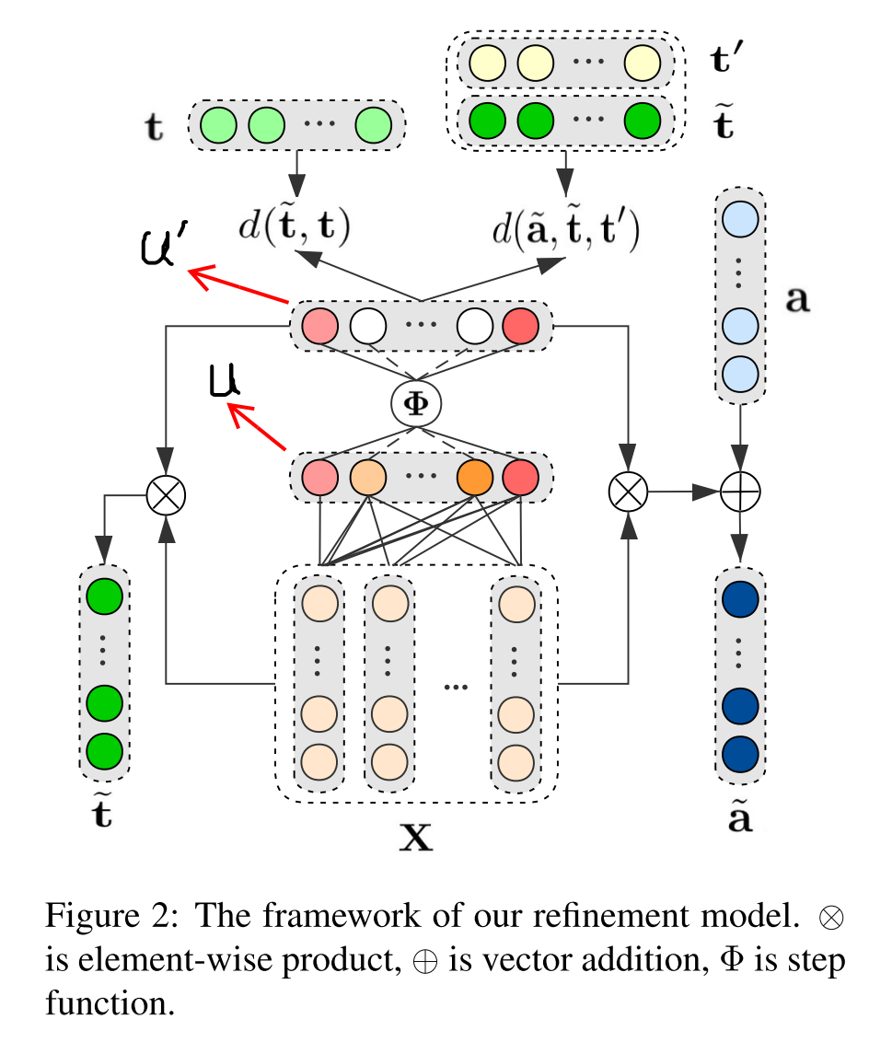

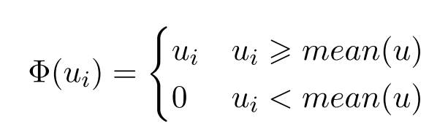


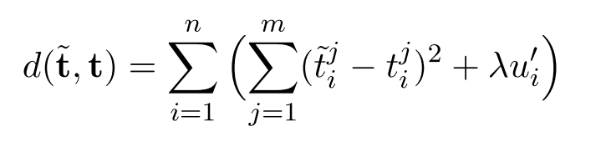
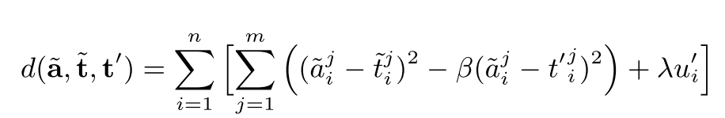
Method

Slide 6
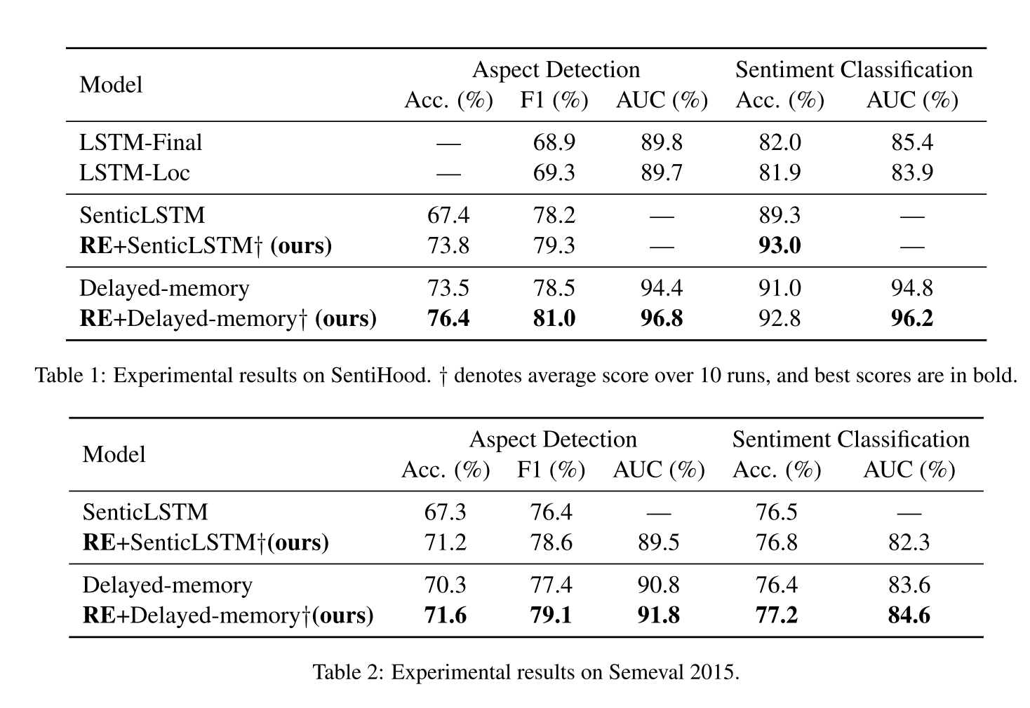
Experiment

Slide 7
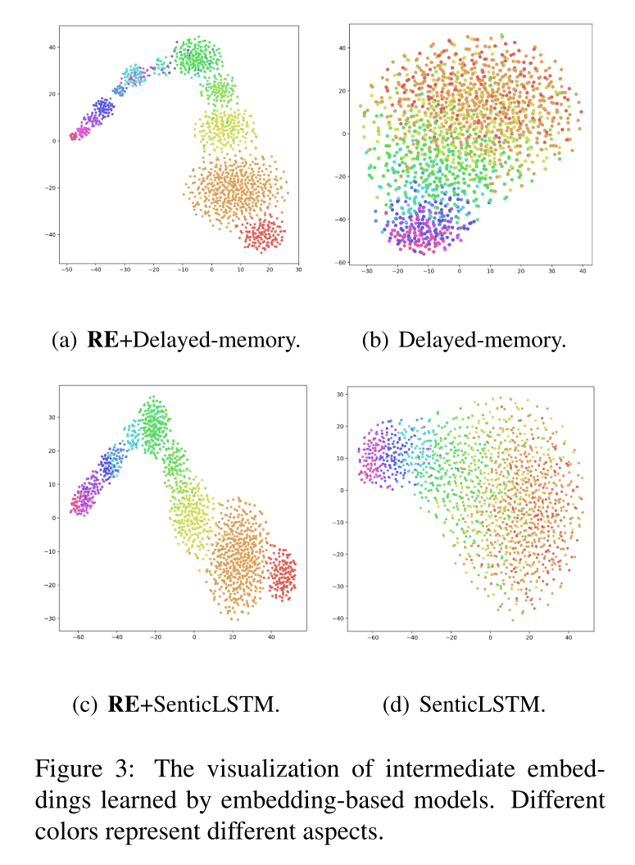
Experiment

Slide 8
Conclusion
Experiment results on SentiHood and Semeval 2015 show that the method can be directly incorporated into embedding-based TABSA models and achieve state-of-the-art performance.

