Slide 1
Chongqing University of Technology
ATAI
Advanced Technique of Artificial Intelligence
Chongqing University of Technology
Collaborative Sampling in Generative Adversarial Networks (AAAI-2020)
Yuejiang Liu, Parth Kothari, Alexandre Alahi
2020.12.17
Reported by Zhang Yin
Code&dataset:https://github.com/vita-epfl/collaborative-gan-sampling

Slide 2
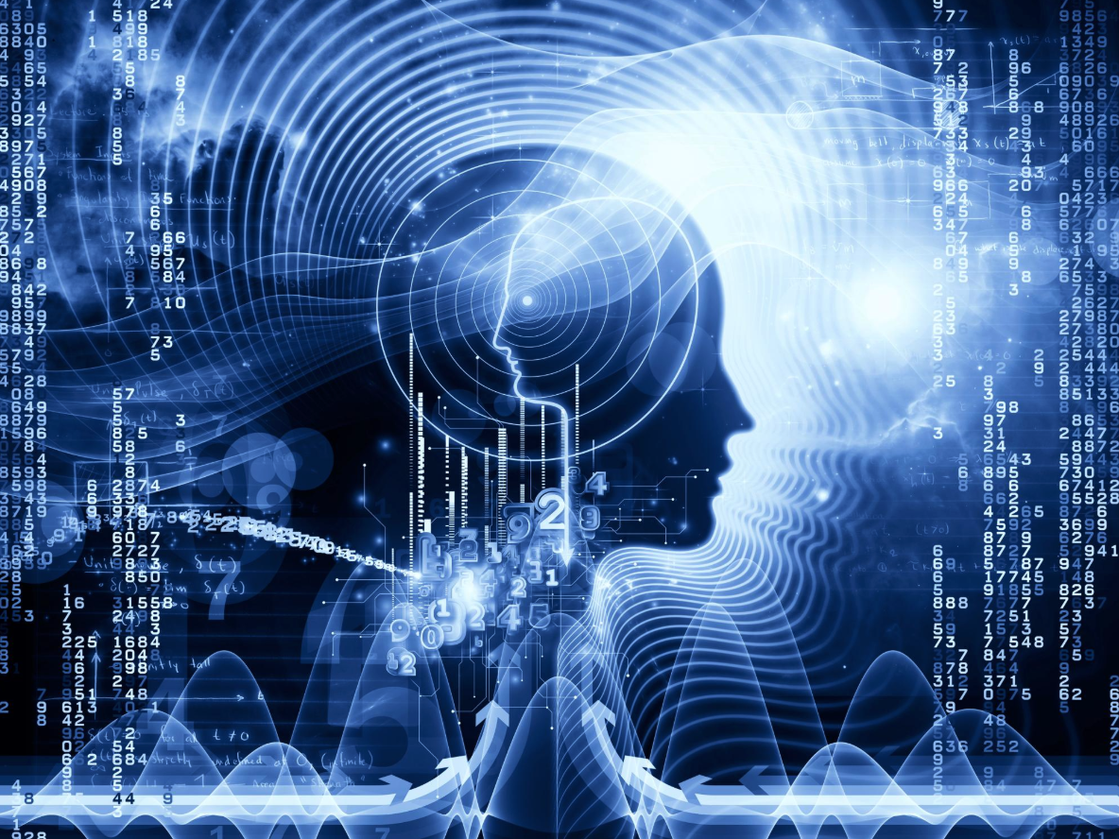
Chongqing University of Technology
ATAI
Advanced Technique of Artificial Intelligence
Chongqing University of Technology
1.Introduction
2.Method
3.Experiments
4.Conclusion

Slide 3
Introduction

Slide 4
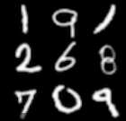
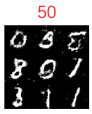
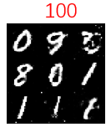
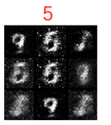
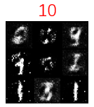
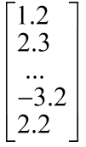
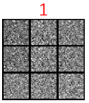
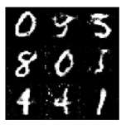
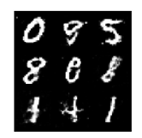
Introduction
Generative Adversarial Networks (GANs) consist of two neural networks, namely the Generator G and the Discriminator D, trained together.
Z =
Real
D
Discriminator
Real
Fake
G
Generator
Fake
120 150

Slide 5
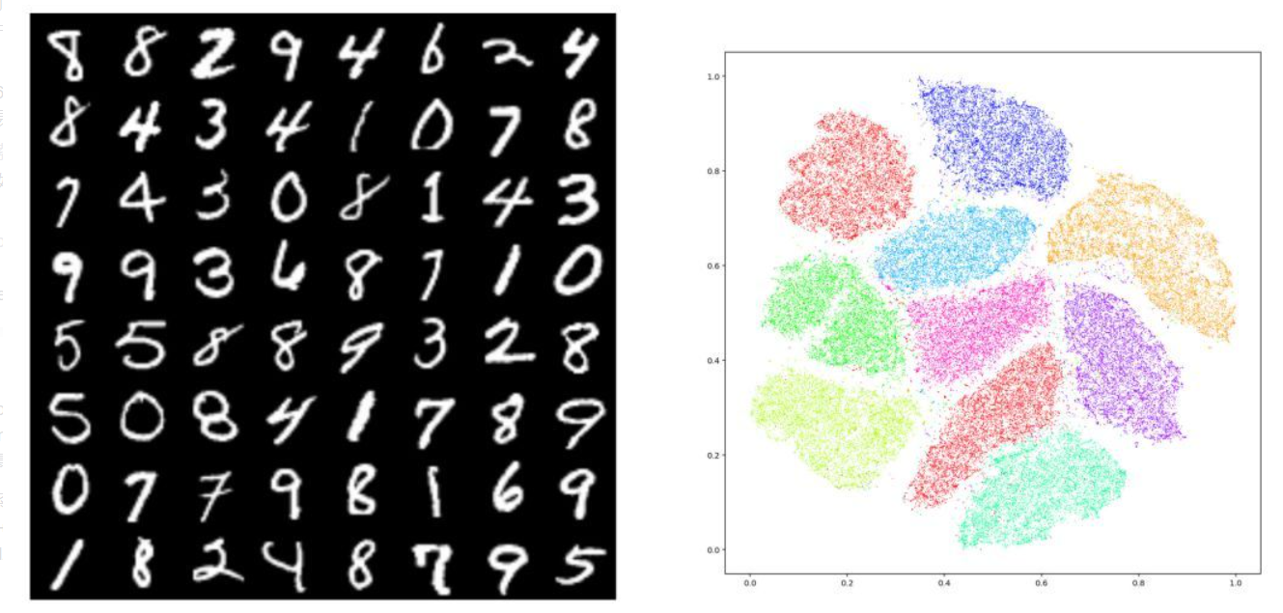
Unstable of Gan
Mode collapse of Generator
The disappearance of the Generator gradient.
G and D are difficult to converge at the same time.

Slide 6
Method
1.Collaborative Sampling
2. Discriminator Shaping

Slide 7
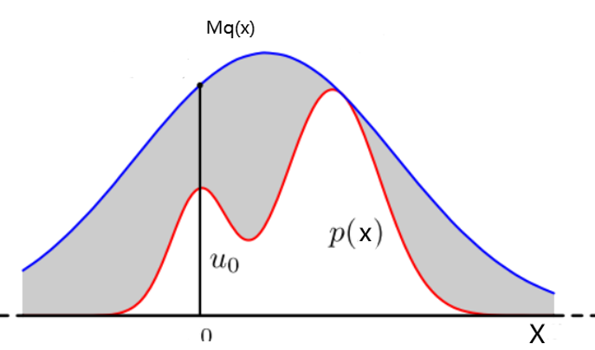
Method
Monte Carlo Method
Target p(x), proposal distribution q(x)
accept-reject:
(3)Sophisticated MC: leverage informed local moves to explore the important regions of p(x) gradient-based Markov transition T(x → y), in the form of ∇ log p(x).
p(x)T(x→y)=p(y)T(y→x)

Slide 8
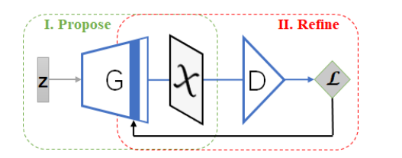
Method
Collaborative Sampling
Figure 1 Generator and the Discriminator for collaborative sampling : Once training completes,
(I) The fixed generator proposes samples. (II) the discriminator provides gradients, back to a particular layer of the generator.

Slide 9
Method
Collaborative Sampling
λ is the stepsize,

Slide 10
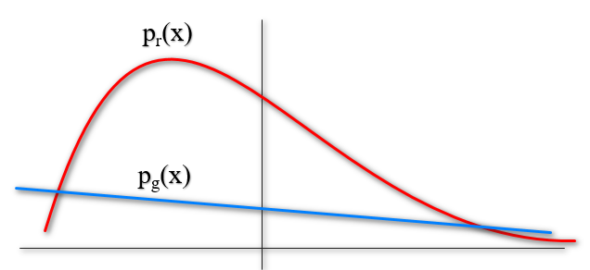
Method
Discriminator Shaping
In the standard GAN training.Discriminator prone to overfitting and less robust in unexplored regions.
When p_{g} fails to provide good coverage of the target p_{r}, the density ratio p_{r}(x)/p_{g}(x) grows.
As a consequence, the discriminator obtained from standard training may misclassify a poorly refined sample as real and fail to suggest further improvements.

Slide 11
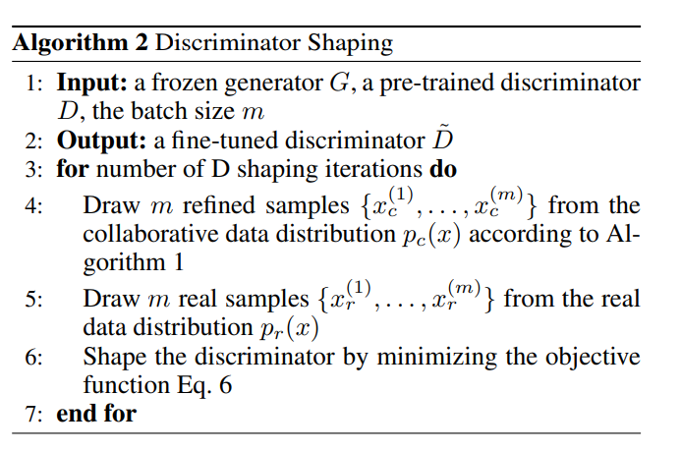
Method
Discriminator Shaping

Slide 12
Experiments

Slide 13
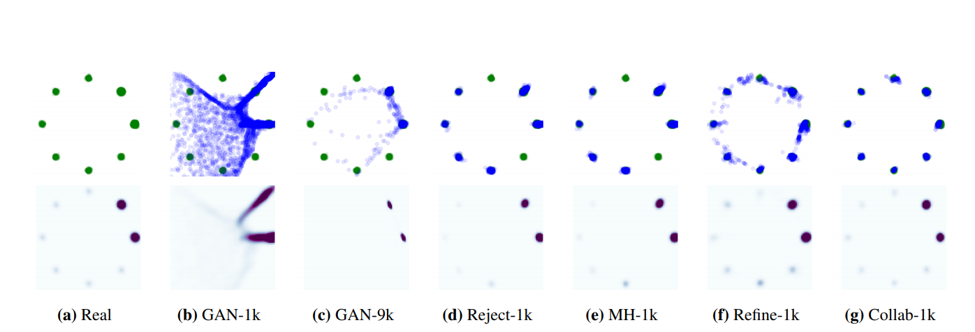
Experiment
Synthetic Data
We first evaluate our collaborative sampling scheme on a synthetic 2D dataset, which comprises of an imbalanced mixture of 8 Gaussians. 90% of the real samples are drawn from two Gaussian components while the rest 10% are drawn from the other six. We use a standard fully-connected MLP with 6 hidden layers and 64 hidden units per layer to model the generator and the discriminator. We shape the discriminator for 5k additional iterations after terminating the standard GAN training and conduct a maximum 50 sample refinement steps in the data space with a step size of 0.1. For fair comparison, we set the hyperparameter γ in the rejection sampling method (Azadi et al. 2019) to 1.0 and the MC iteration number k in the Metropolis-Hasting method (Turner et al. 2019) to 20. In addition, for fairness with regards to our discriminator shaping, we train the discriminator for 5k additional iterations before running these accept-reject methods.

Slide 14
Experiment
Figure 4: Quantitative results on the imbalanced mixture of eight Gaussians. Evaluated on 10000 samples. (a) Proportion of good samples. Higher is better. (b) KL divergence between the categorical distribution of real samples and that of good generated samples. Lower is better. (c) JS divergence between the augmented categorical distribution of real samples and that of all generated samples. Lower is better. (d) The scores of diagnostic metrics and the performance gain from the rejection step at different stages of the discriminator.

Slide 15
Experiment
In addition to the Z-statistic promoted in (Turner et al. 2019), we also take the expected calibration error (ECE) (Naeini, Cooper, and Hauskrecht 2015), another popular metric for neural network calibration (Guo et al. 2017) into comparison. It is visually apparent that the evolvement of the Z-statistic is dramatically different from the other metrics. More detailed correlation coefficients between the diagnostic metrics and then performance gains from the rejection step are summarized in Table 1. Compared with the Z-statistic and ECE, the Brier Score exhibits a significantly stronger correlation with the performance gains, which validates the effectiveness of the Brier Score for discriminator diagnosis.

Slide 16
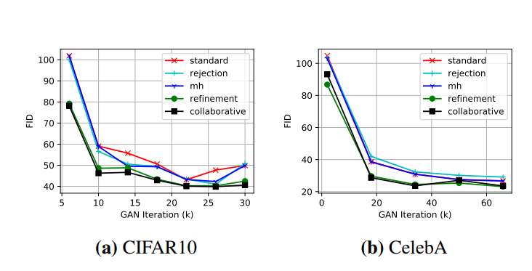
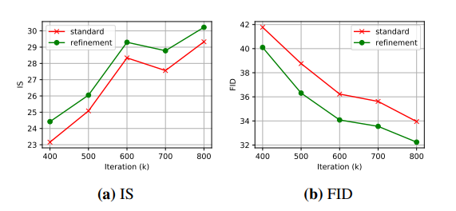
Experiment
Image Generation
We next demonstrate the efficacy of our method in image generation tasks. In our experiments, we use the standard DCGAN for modelling the CIFAR10 and the CelebA datasets, and the SAGAN for modelling ImageNet at 128 × 128 resolution.
Figure 6: Quantitative comparison between our collaborative
sampling scheme and baseline sampling methods for DCGAN
on CIFAR10 and CelebA. Lower is better for FID.
Figure 7: Quantitative comparison between our collaborative
sampling scheme and the standard sampling for SAGAN on
ImageNet .Higher is better for IS and lower is better for FID.

Slide 17
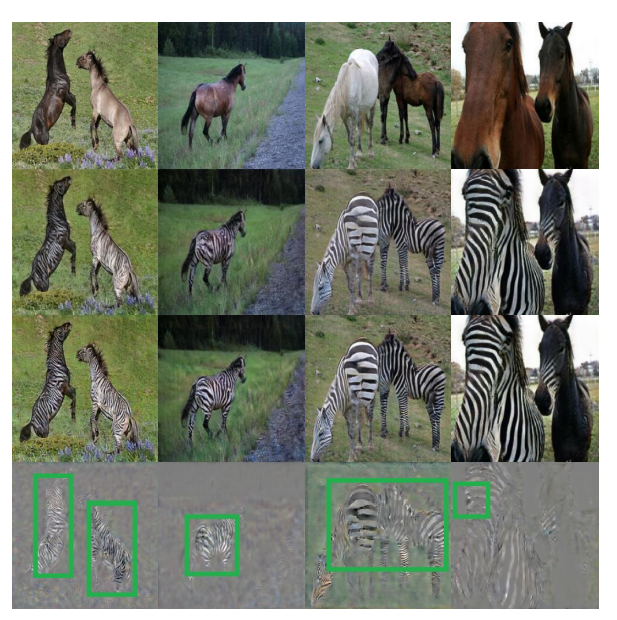
Experiment
Image Generation
We next evaluate our collaborative sampling scheme with CycleGAN ,a popular method for imageto-image translation. To improve the image quality, we perform a maximum of 100 refinement steps.
Figure 8: Results of our collaborative sampling scheme
in CycleGAN for unpaired image-to-image translationat
256 × 256 resolution. The real horse images (top) are
translated into synthetic zebra images (second row),which
are further refined by our method (third row). The differences
between the translated and refined images are concentrated
on zebra patterns (bottom).

Slide 18
Conclusion
This paper presents a novel collaborative sampling scheme for using GANs at test time. Rather than disregarding the discriminator, they propose to continue using the gradients provided by a shaped discriminator to refine the generated samples. This is advantageous when the model distribution does not match the real data distribution. It is also highly valuable for applications where sample quality matters or the rejection sampling approach is not admissible. Orthogonal to existing techniques in GAN training, the method offers an additional degree of freedom to improve the generated samples empowered by the discriminator.

Slide 19
Chongqing University of Technology
ATAI
Advanced Technique of Artificial Intelligence
Chongqing University of Technology
Thank you!

