Slide 1
A Girl Has A Name: Detecting Authorship Obfuscation
Asad Mahmood Zubair Shafiq Padmini Srinivasan
Speaker: Zhang Yaohong
2020.11.8

Slide 2
Content
1
Introduction
2
Related Work
3
Proposed Approach
4
Experimental Setup
5
Results
6
Conclusion

Slide 3
1
Introduction
Authorship attribution
identify the author of a text using stylometric techniques designed to capitalize on differences in the writing style of different authors
authorship attribution methods can now identify authors with impressive accuracy
pose a threat to privacy-conscious users such as journalists and activists who may wish to publish anonymously

Slide 4
1
Introduction
Authorship obfuscation
a protective countermeasure, aims to evade authorship attribution by obfuscating the writing style in a text
automated authorship obfuscation methods can evade attribution while preserving semantics, but do not consider the adversarial threat model where the adversary is “obfuscation aware”
in addition to evading attribution and preserving semantics, it is important that authorship obfuscation methods are “stealthy” – i.e., they need to hide the fact that text was obfuscated

Slide 5
Authorship Obfuscation
2
Related Work
instructed users to manually obfuscate text such as by imitating the writing style of someone else
presented a rule-based obfuscation approach to adapt the style of a text towards the “average style” of the text corpus
proposed search and model based approaches for authorship obfuscation

Slide 6
Obfuscation Detection
2
Related Work
Prior work has successfully used stylometric analysis to detect manual authorship obfuscation, do not accurately detect more advanced automated authorship obfuscation methods
a classifier based on a language model can accurately detect synthetic text generated by the same language model
mingled in unpredictable proportions and ways with the author’s original writing style, the detection of obfuscated text different and potentially more challenging than synthetic text detection

Slide 7
intuition
3
Proposed Approach
exploit the differences in text smoothness between human written and obfuscated texts.
Detector Architectures
Figure 1: Pipeline for obfuscation detection

Slide 8
Word likelihood extraction
3
Proposed Approach
extract the likelihood from the language model (either as a probability or as a rank) for each word in the text given its context
GPT-2
a variation of the “transformer” architecture.
compute the conditional probability for word i as
uni-directional context
GPT-2 117M
GPT-2 345M

Slide 9
Word likelihood extraction
3
Proposed Approach
BERT
based on “Transformers”.
considers a bidirectional context
the conditional occurrence probability for word i is
using code made available by the Giant Language Model Test Room (GLTR) tool

Slide 10
Feature Representation
3
Proposed Approach
Binning based features:
aggregate this information using fixed size bins representing different likelihood ranges
create bin sizes of 0.001, 0.005 and 0.010 for probabilities
create bin sizes of 10, 50 and 100 for ranks
each bin contains the proportion of words in the document with likelihood in that range

Slide 11
Feature Representation
3
Proposed Approach
Image based features:
the word likelihood values received from language models are in essence signals
explore a transfer learning approach wherein use the VGG-19 classifier4 trained for image classification on ImageNet dataset
sort the extracted likelihood values for the text in descending order and then plot these values saving it as an image.
extract the document’s 6 representation from the last flatten layer of VGG-19

Slide 12
Classification
3
Proposed Approach
Support Vector Machine (SVM)
Random Forest Classifier (RFC)
K Nearest Neighbor (KNN)
Artificial Neural Network (ANN)
Gaussian Naive Bayes (GNB)

Slide 13
Authorship Obfuscation Approaches
4
Experimental Setup
Document Simplification(DS-PAN17)
1) If the number of contractions in the document is greater than the number of expansions, then replace all contractions with expansions otherwise replace all expansions with contractions.
2) Simplify by removing parenthetical texts that do not contain any named entity, discourse markers or appositions.
3) Replace words with synonyms that haven’t been already used in the text

Slide 14
Authorship Obfuscation Approaches
4
Experimental Setup
Style Neutralization(SN-PAN16)
calculate the average values for the whole corpus for stylometric features
calculate the values of same stylomteric features for the input document
using text transformation move the document’s stylometric feature values towards the corpus averages
MUTANT-X
uses a genetic algorithm (GAs) in combination with an authorship attribution system to identify words
MUTANT-X embeddingCNN: built using a deep learning based authorship attribution system

Slide 15
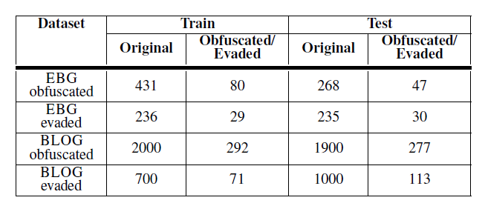
Data
4
Experimental Setup
Table 1: Number of original and obfuscated/evaded documents in train and test sets of each of the four datasets
EBG: use the Extended Brennan Greenstadt corpus
BLOG: use the Blog authorship corpus

Slide 16
Obfuscation Detection Methods
4
Experimental Setup
propose a total of 160 distinct architectures, testing these for each of the four datasets, conduct a total of 640 distinct obfuscation detection experiments
GLTR: a tool to help humans distinguish between original and machine generated synthetic text, uses pre-trained language models to extract word likelihoods
Character trigrams + KNN: preprocess each document by unifying case and separating punctuation, represent each document using character trigrams, the classification is performed using KNN with normalized cosine distance.
Writeprints + SVM: uses stylometric features to perform spun document detection, linear SVM to be working better than the polynomial one

Slide 17
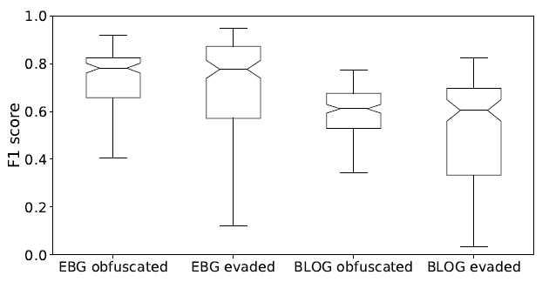
5
Results
Summary trends: 25% of all 160 architectures achieve F1 score greater than 0.76, 50% achieve F1 score greater than 0.72 and a high 75% of them were able to achieve F1 score greater than 0.52
Figure 2: Notched box plots for obfuscation detection F1 scores using all 160 architectures for each dataset.

Slide 18
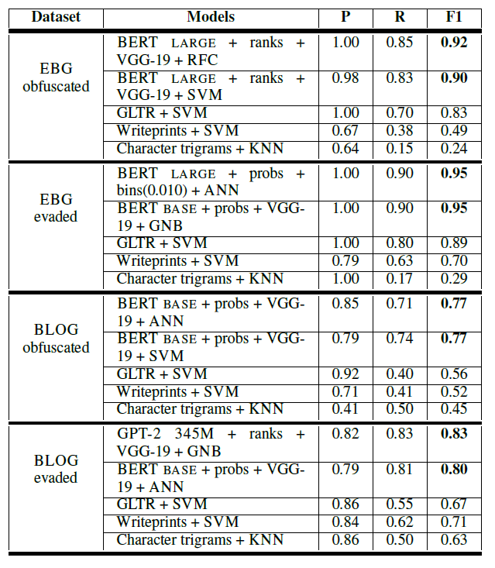
5
Results
Table 2: Obfuscation detection results (P: precision, R: recall, F1: F1 score)

Slide 19
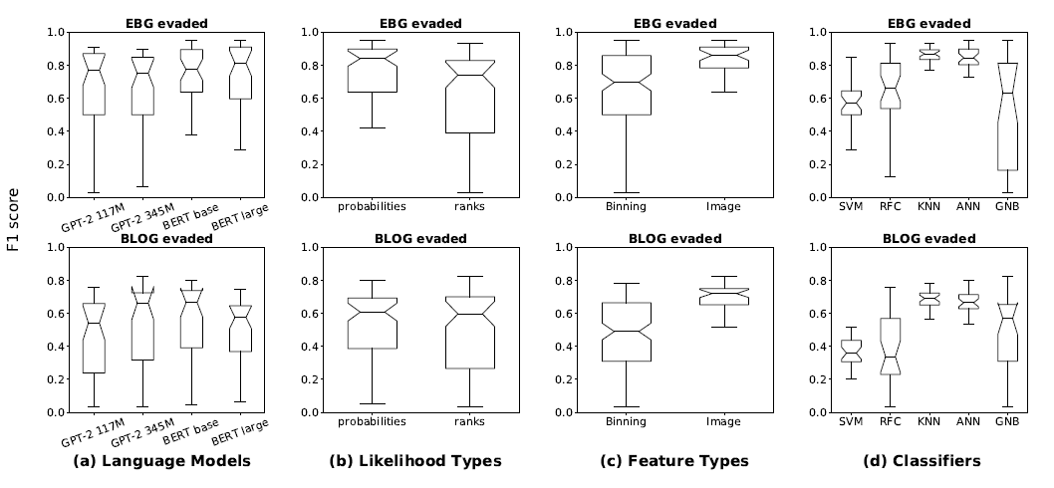
5
Results
Figure 3: Notched box plots of F1 scores for all dimensions across the two evaded datasets. For each dataset every notched boxplot in (a) is generated from 40 experiments (experiments correspond to architectures), (b) is generated from 80 experiments, (c) is generated from 120 experiments for binning and 40 for image whereas (d) is generated from 32 different experimental combinations.

Slide 20
5
Results
Dimension 1: Language model & output type
BERT shows greater consistency in F1 score (box size) than GPT-2 in both datasets, the bidirectional nature of BERT helps in capturing context and consequently smoothness better than GPT-2 which is uni-directional
Dimension 2: Feature type
image based features exhibit strikingly greater stability in F1 scores than binning based features
Dimension 3: Classifier
KNN and ANN achieve relatively high and stable performance is in their nature of being able to adapt to diverse and complex feature spaces

Slide 21
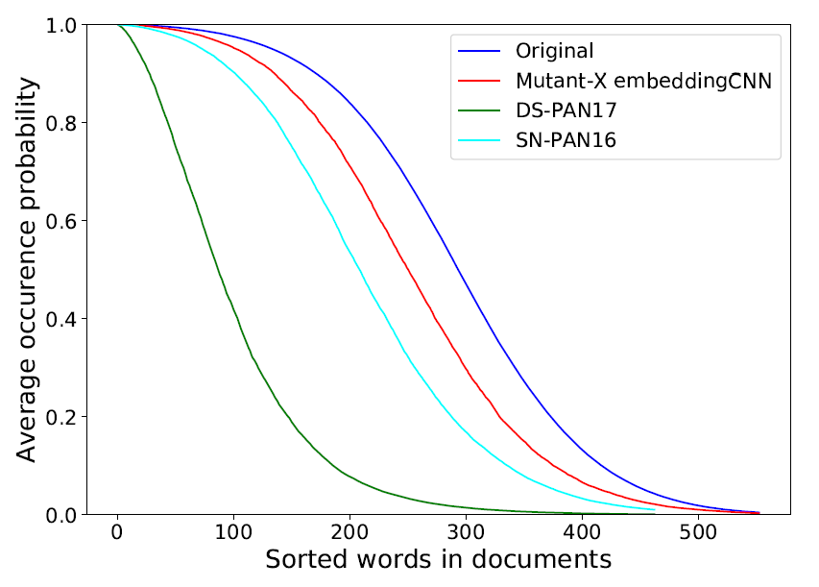
5
Results
Figure 4: Comparison between different obfuscators and original documents on the basis of average sorted probabilities extracted by BERT BASE for EBG obfuscated dataset.

Slide 22
6
Conclusion
the state-of-the-art authorship obfuscation methods are not stealthy
the degradation in text smoothness caused by authorship obfuscators allow a detector to distinguish between obfuscated documents and original documents
point to future research opportunities to build stealthy authorship obfuscation methods
Obfuscation methods should strive to preserve text smoothness in addition to semantics

