Slide 1
Chongqing University of Technology
ATAI
Advanced Technique of Artificial Intelligence
Chongqing University of Technology
Politeness Transfer: A Tag and Generate Approach
Aman Madaan , Amrith Setlur , Tanmay Parekh , Barnabas Poczos, Graham Neubig,Yiming Yang, Ruslan Salakhutdinov, AlanW Black, Shrimai Prabhumoye
Speaker: ZhangLiang
2020.11.19
Proceedings of the 58th Annual Meeting of the Association for Computational Linguistics, pages 1869–1881
July 5 - 10, 2020. c 2020 Association for Computational Linguistics

Slide 2
Content
1 Introduction
2 Related Work
3 Task and Datasets
4 Methodology
5 Experiments and Results

Slide 3
Introduction
·Paper motivation
·Prior work on text style has not focused on politeness as a style transfer task.
·There are primarily two reasons for this complexity.
·Circumscribe the scope of politeness for the purpose of this study.

Slide 4
Introduction
·Contrast with the standard style transfer tasks.
·Propose a tag and generate pipeline.
·Evaluate on content preservation, fluency and style transfer accuracy.
·Main contribution is the design of politeness transfer task.

Slide 5
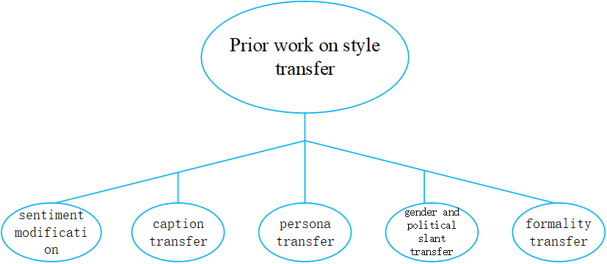
Related Work
·Prior work on style transfer

Slide 6
Related Work
·Current style transfer techniques
·Delete, Retrieve, Generate(DRG)
Advantages and disadvantages
·Improvements

Slide 7
Task and Datasets
Data Preparation
·step1: Pre-processing
·step2:Further pruning
·step3: Use a politeness classifier to assign politeness scores to these sentences and filter them into ten buckets based on the score (P0-P9; Fig. 1).

Slide 8
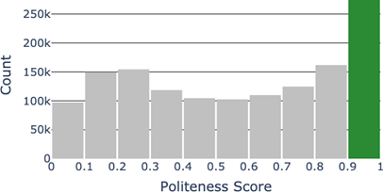
Task and Datasets
Data Preparation
Train data: P9 Test Data: all buckets
Figure 1: Distribution of Politeness Scores for the Enron Corpus

Slide 9
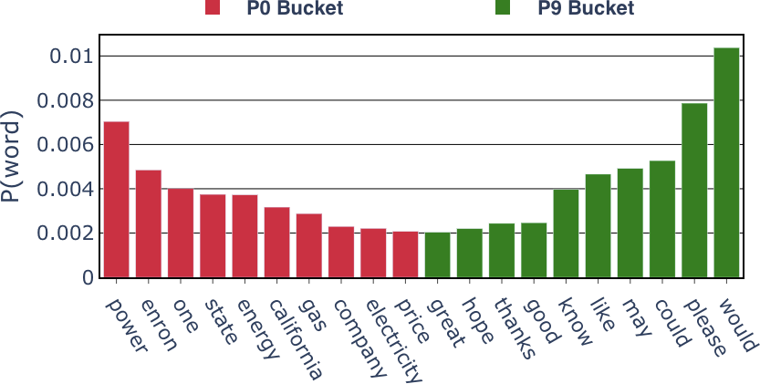
Task and Datasets
Data Preparation
Figure 2: Probability of occurrence for 10 of the most common 30 words in the P₀ and P₉ data buckets

Slide 10
Methodology
Figure 3: Our proposed approach: tag and generate. The tagger infers the interpretable style free sentence $Z(x_{i})$ for an input $x^{(1)}$ in source style $S_{1 }$The generator transforms $x_{i}^{\left(1\right)}$ into ${\hat{x}}_{i}^{(2)}$ which is in target style $S_{2}$.
$X_{1}$ = $\left\{x_{1}^{(1)},…, x_{n}^{(1)}\right\}:$samples of sentences from style $S_{1}$
$X_{2}$ = $\left\{x_{1}^{(2)},…, x_{m}^{(2)}\right\}$:samples of sentences from style $S_{2}$(target style)

Slide 11
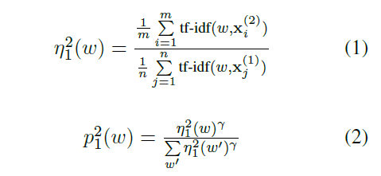
Methodology
Estimating Style Phrases
$η_{1}^{2}\left(w\right)$is the ratio of the mean tf-idfs for a given n-gram w present in both X1;X2
Further smooth and normalize $η_{1}^{2}\left(w\right)$to get $p_{1}^{2}\left(w\right)$
Estimate $Γ_{2}$

Slide 12
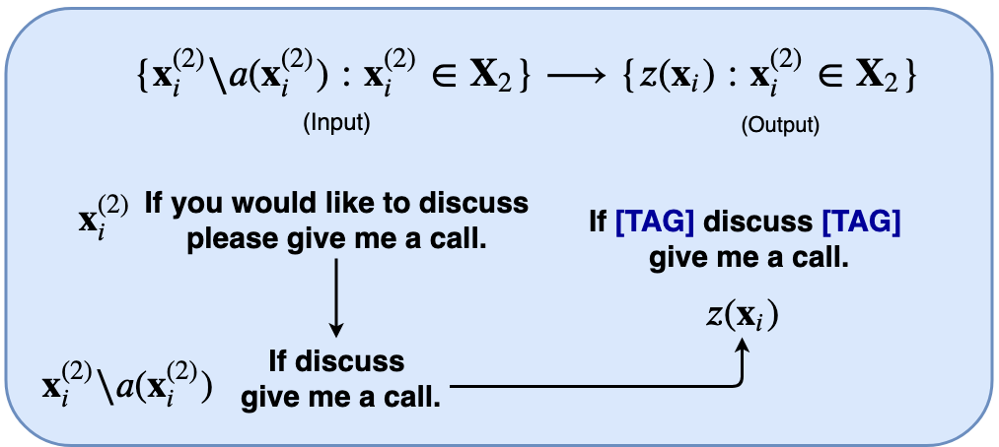
Methodology
Style Invariant Tagged Sentence
The loss for replace-tagger
The loss for add-tagger
Figure 4: Creation of training data for add-tagger.

Slide 13
Methodology
Style Targeted Generation
The loss objective (La) given by Eq. 4 is crucial for tasks like politeness transfer where one of the styles is poorly defined.

Slide 14
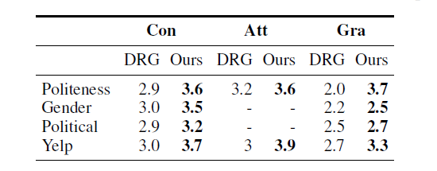
Experiments and Results
Table 3: Human evaluation on Politeness, Gender,Political and Yelp datasets.

Slide 15
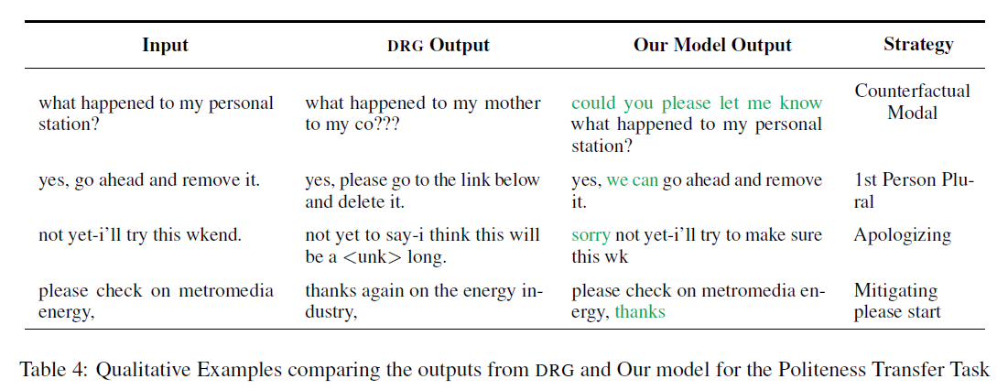
Experiments and Results

Slide 16
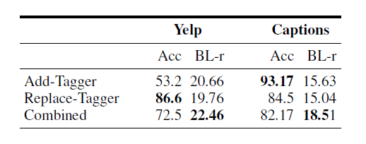
Experiments and Results
Table 5: Comparison of different tagger variants for Yelp and Captions datasets

Slide 17
Thanks

