Slide 1
Proactive Human-Machine Conversation with Explicit Conversation Goals
WenquanWu, Zhen Guo, Xiangyang Zhou, Hua Wu,
Xiyuan Zhang, Rongzhong Lian and Haifeng Wang
Baidu Inc., Beijing, China.
Speaker: Yang Junming
2020.11.26
Proceedings of the 57th Annual Meeting of the Association for Computational Linguistics, pages 3794–3804 Florence, Italy, July 28 - August 2, 2019. c 2019 Association for Computational Linguistics

Slide 2
Content
1
Introduction
2
Methods
3
Experiments
4
Case Study

Slide 3
1
Introduction
Building a human-like conversational agent is one of long-cherished goals in Artificial Intelligence (AI)
Now，endowing the agent with the ability of proactively leading the conversation (introducing a new topic or maintaining the current topic).
The Baidu Conversation Corpus (DuConv)

Slide 4
1
Introduction
Each dialog in the DuConv is created by two crowdsourced workers, Both the leader and the follwer. the leading player is assigned with an explicit goal. The conversation goal is a knowledge path comprised of two topics and structured as “[start]→ topic_a → topic_b”.

Slide 5
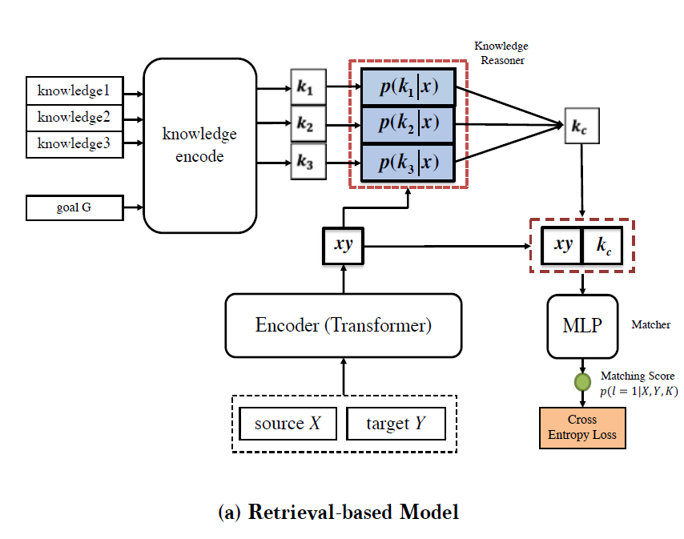
2 Methods
a retrieval-based model.
the context-response representation module (Encoder)
the knowledge representation module (Knowledge Encoder)
the knowledge reasoning module
(Knowledge Reasoner)
the matching module
(Matcher)

Slide 6
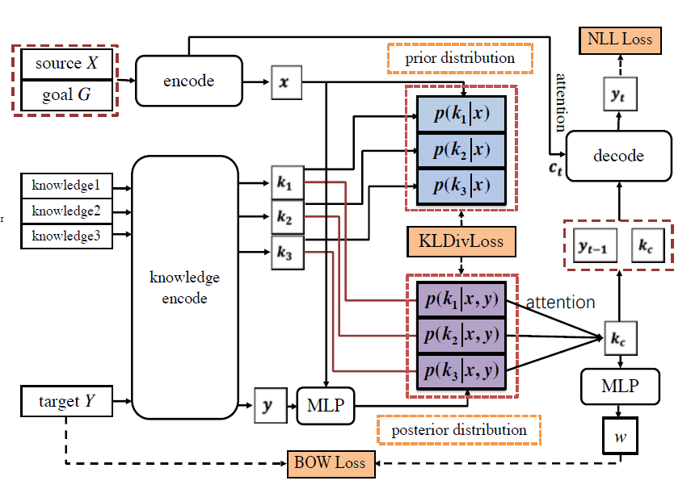
2 Methods
a generation-based model.
the Utterance Encoder
the Knowledge Encoder
the Knowledge Manager
the Decoder

Slide 7
3 Experiments
Automatic evaluation results.

Slide 8
3 Experiments
Human evaluation results： three grades: good(2), fair(1), bad(0). For goal completion, “2” means that the goal is achieved with full use of knowledge, “1” means the goal is achieved by making minor use of knowledge, and “0” means that the goal is not achieved. set the perfect grade (3) for dialogue-level coherence

Slide 9
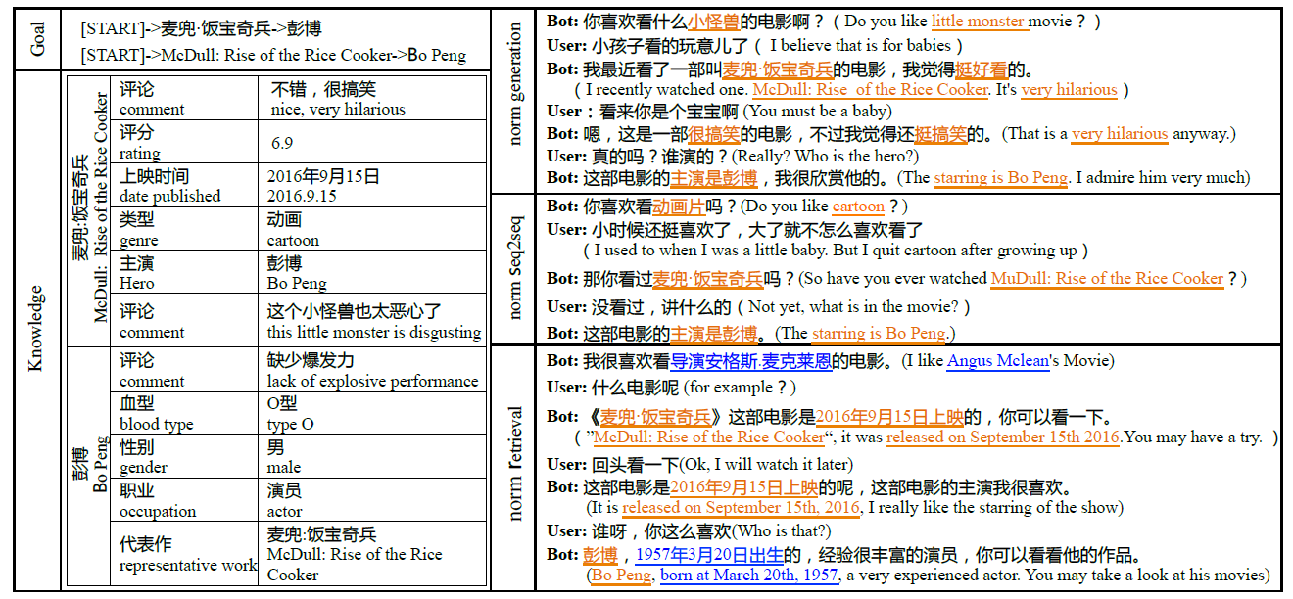
4 Case Study

