Slide 1
Learning to Identify Follow-Up Questions in Conversational Question Answering
Department of Computer Science, National University of Singapore
Speaker:王凯
From：ACL
Code and data : https:// github.com/nusnlp/LIF
Date： July 2020

Slide 2
1.Introduction
2.Task Overview
3.Method
4.Experiments Results

Slide 3
Introduction

Slide 4
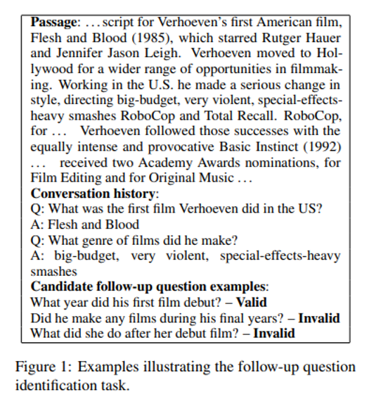
Introduction
Given a text passage as knowledge and a series of question-answer pairs as conversation history, it requires a model to identify whether a candidate follow-up question is valid or invalid. The proposed dataset requires a model to understand both topic continuity and topic shift to correctly identify a follow-up question.

Slide 5
Introduction
Propose a new task for follow-up question identification in a conversational reading comprehension setting which supports automatic evaluation.
We present a new dataset, namely LIF, which is derived from the recently released conversational QA dataset QuAC
We propose a three-way attentive pooling network which aims to capture topic shift and topic continuity for follow-up question identification. The proposed model significantly outperforms all the baseline systems.

Slide 6
Task Overview

Slide 7
Task Overview
Denote the passage as P which consists of T tokens.
The sequence of previous questions and their corresponding answers be denoted as {Q1, Q2, . . . , QM} and {A1, A2, . . . , AM}
The candidate follow-up question is denoted as C.
Denote the length of the candidate follow-up question as V
Concatenate all previous questions and their answers with special separator tokens as follows: Q1 | A1 || Q2 | A2 || . . . || QM | AM. The combined length of the previous questionanswer pairs in the conversation history is denoted as U.

Slide 8
Method

Slide 9
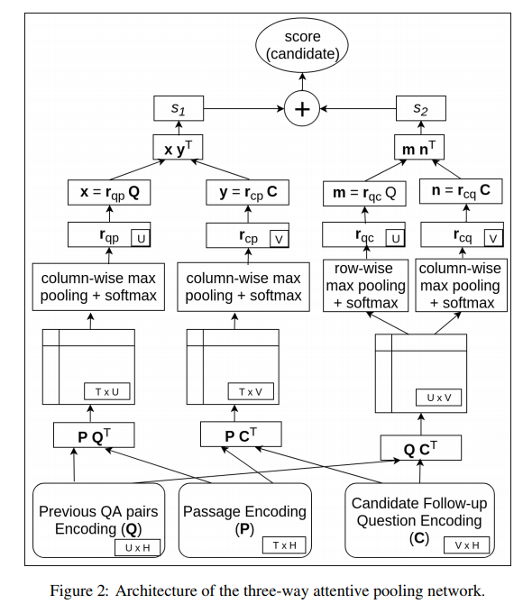
Method
Embedding
Character-level:CNN
Word-level:pre-trained vectors from GloVe
Encoding
Bid-LSTM

Slide 10
Method

Slide 11
Method
Perform column-wise max-pooling over and
is given as (1 ≤ i ≤ U):
Perform both row-wise and column-wise max-pooling over Ac,q to generate and

Slide 12
Method
Score each candidate follow-up question

Slide 13
Experiments

Slide 14
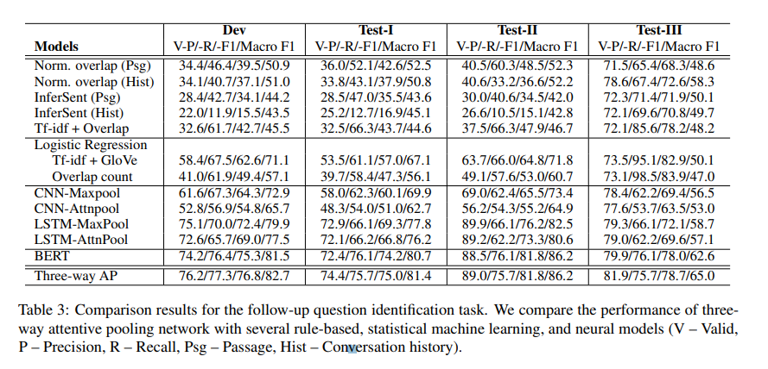
Experiments

Slide 15
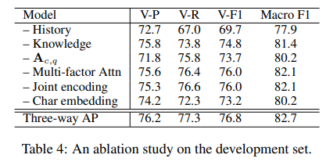
Experiments

Slide 16
THANKS！

