Slide 1
Multi-Domain Dialogue Acts and Response Co-Generation
Sun Yat-sen University Alibaba Group
-----ACL 2020
Reported by Jinghui Wang
2020.12.24

Slide 2
CONTENT
01
Motivation
02
Method
01
Motivation
Method
03
Experiments
04
Conclusion
03
Experiments
Conclusion

Slide 3
1
Motivation

Slide 4
Motivation
Existing pipeline approaches
●neglect multi-domain dialogue acts's inherent structures
●the associations between acts and responses are not taken into account for response generation

Slide 5
2
Method

Slide 6
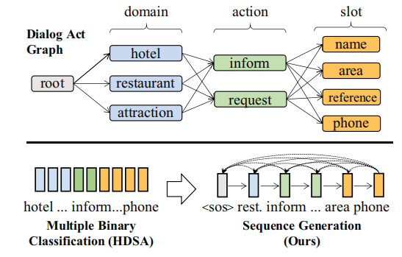
Method

Slide 7
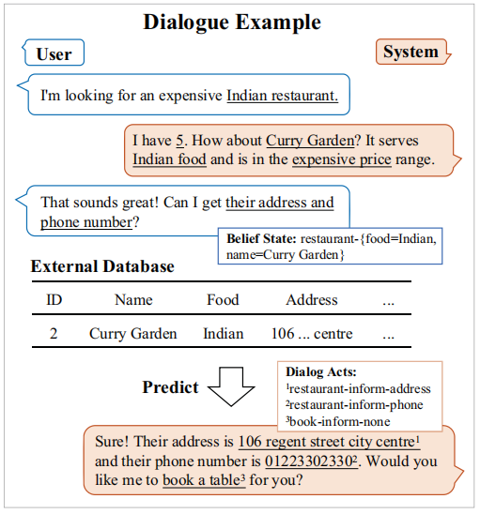
Method

Slide 8
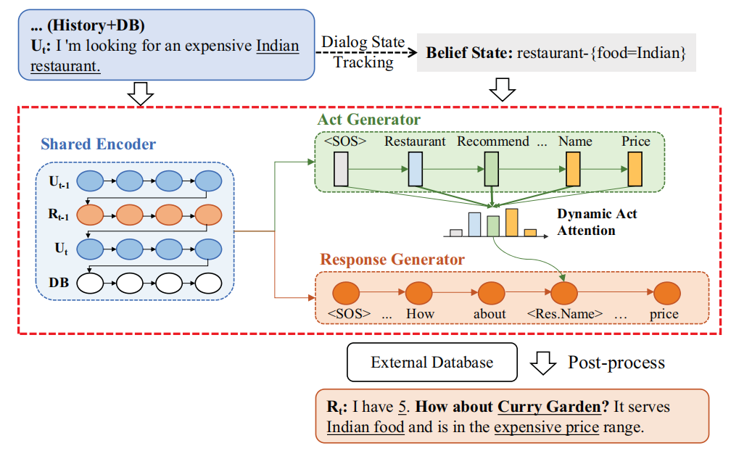
Method
MARCO

Slide 9
Method

Slide 10
Method
each act word embedding

Slide 11
Method

Slide 12
3
Experiments

Slide 13
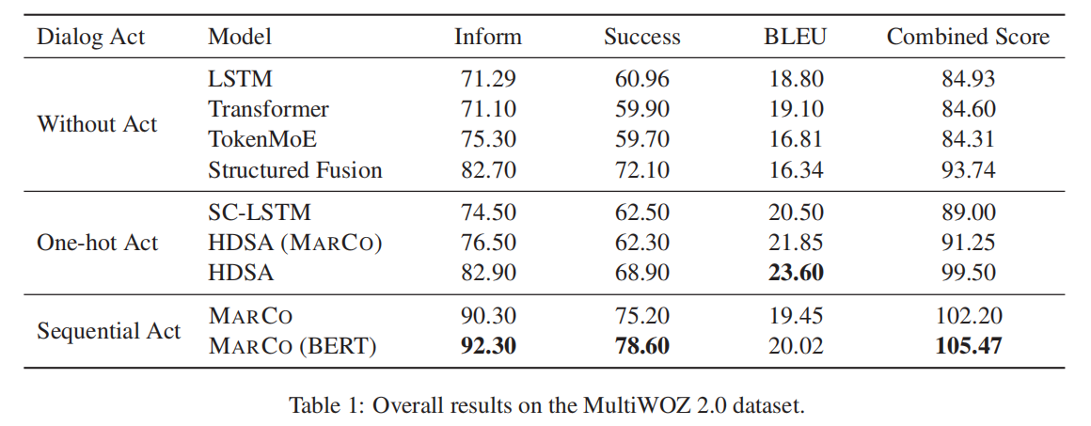
Experiments

Slide 14
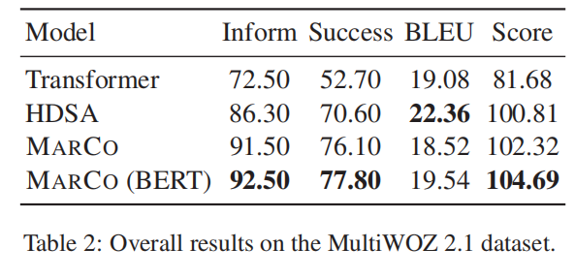
Experiments

Slide 15
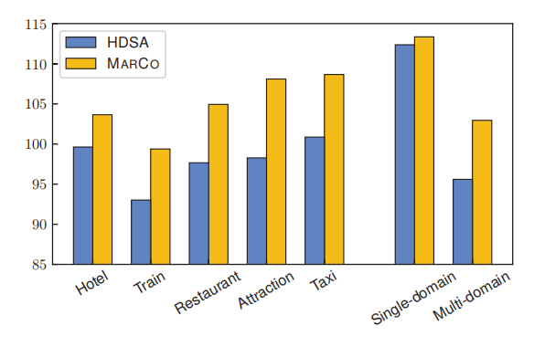
Experiments
Figure 4: Combined score of MARCO vs. HDSA across different domains.

Slide 16
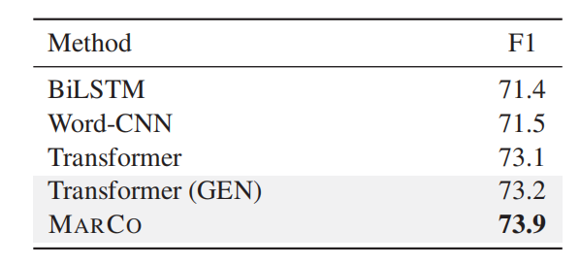
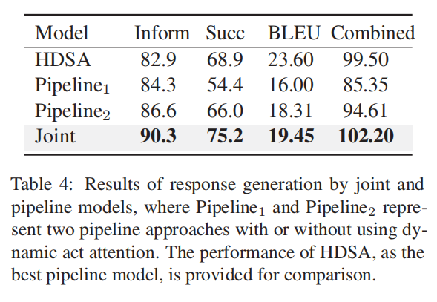
Experiments
Table 3: Results of different act generation methods
Table 4: Results of response generation models

Slide 17
Experiments
Figure 5: An illustrative example of the dynamic act attention mechanism

Slide 18
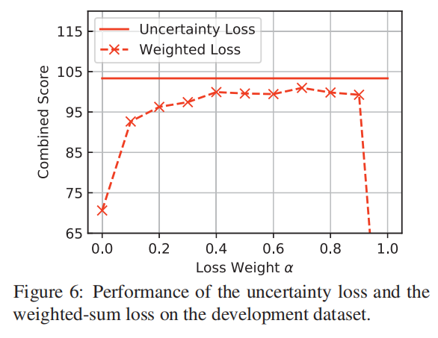
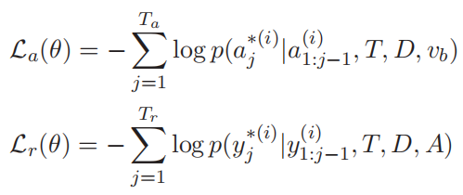
Experiments

Slide 19
4
Conclusion

Slide 20
Conclusion
♦model dialogue act prediction as a sequence generation problem
exploit act structures
♦propose a co-generation model
(generate dialogue acts and responses sequences jointly)
♦with an uncertainty loss used for adaptive weighting

Slide 21
THANKS

