Slide 1
An Effective Transition-based Model for Discontinuous NER
ACL - July 5 - 10, 2020
汇报人：吕艳娜

Slide 2
Contents
Premise
Prior Work
Model
Data sets
Baseline Models
Summary

Slide 3
premise
NER？
Xiao Ming at Chong Qing
Name
Place
continuous

Slide 4
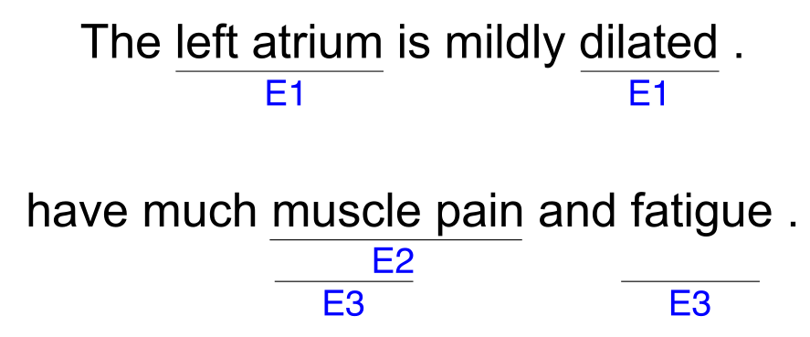
Prior Work
discontinuous
Discontinuous
(Overlop)

Slide 5
Existing methods on discontinuous NER
Token level approach
Sentence level approach
1. high time complexity
2.ambiguity

Slide 6
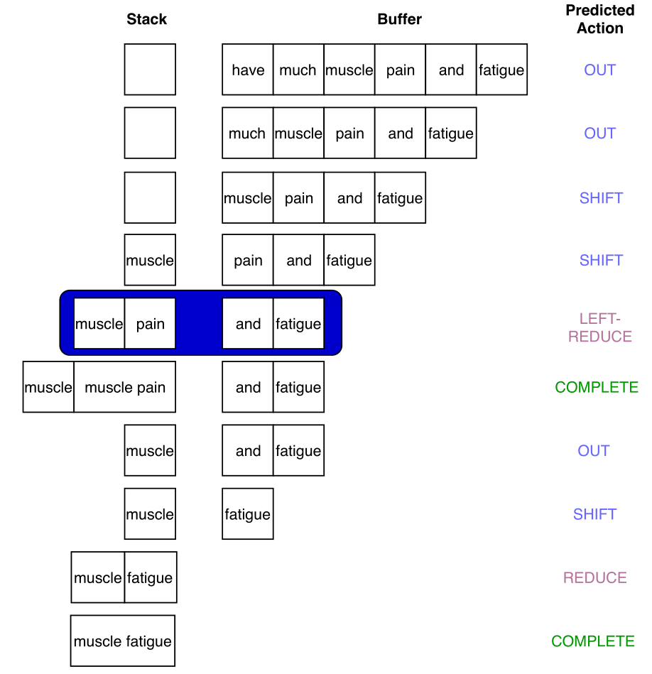
Model

Slide 7
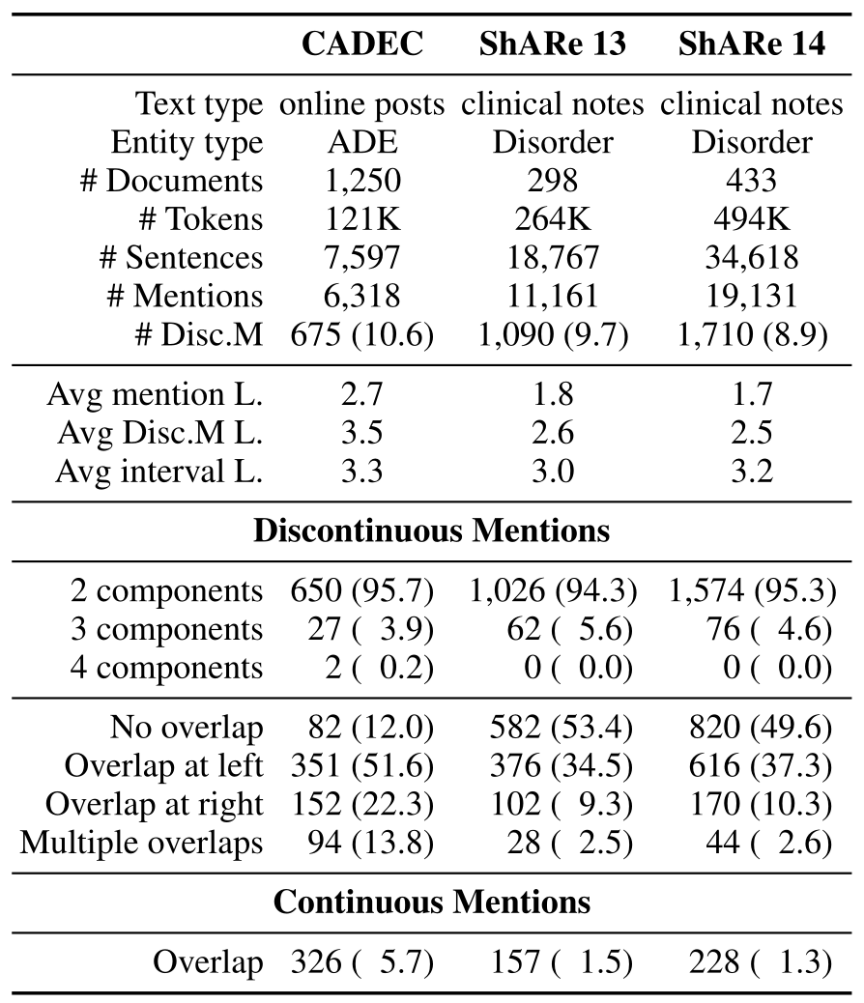
Data sets

Slide 8
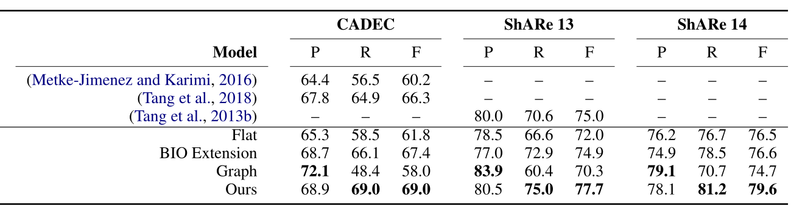
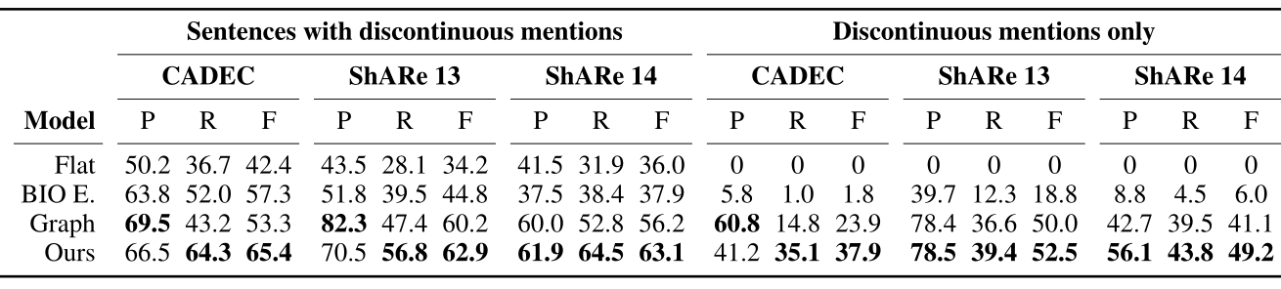
Baseline Models

Slide 9
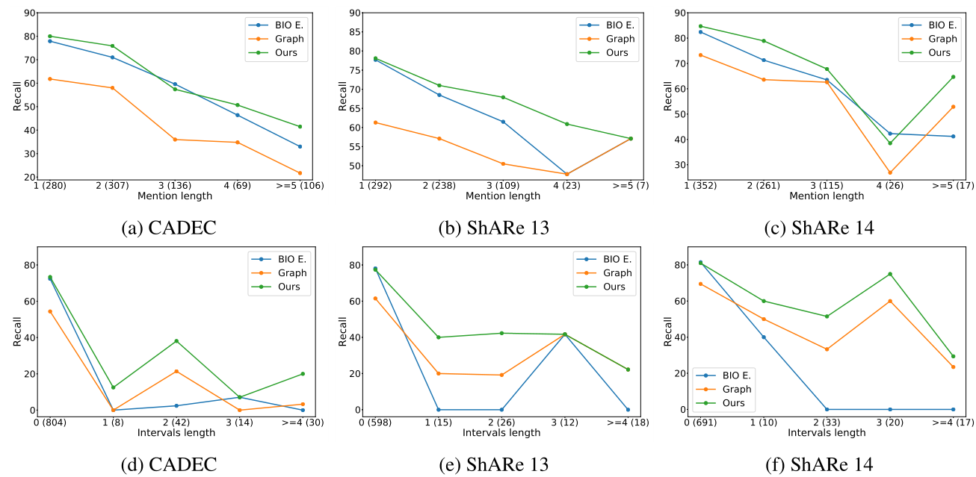
The impact of mention length and interval length on recall.

Slide 10
Discontinuous mentions(overlap)
No overlap: ‘left atrium is mildly dilated’
Left overlap: ‘muscle pain and fatigue’
Right overlap: ‘hip/leg/foot pain’
Multi-overlap: ‘Joint and Muscle Pain / Stiffness’

Slide 11
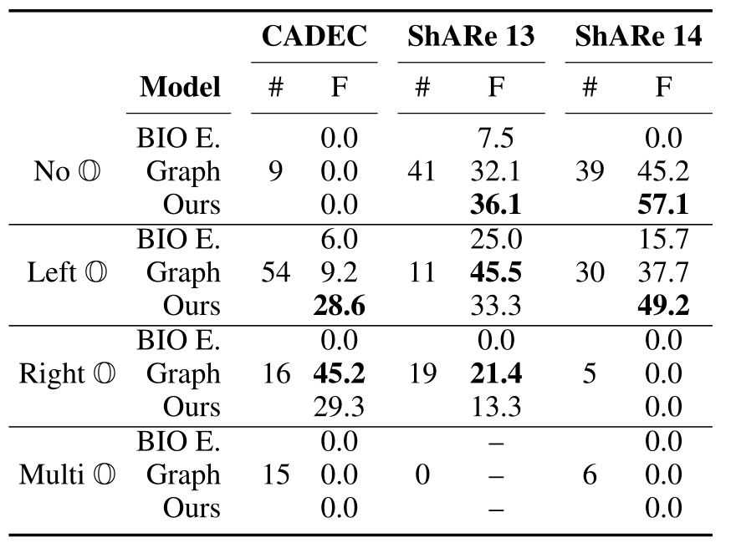

Slide 12
Summary
Advantage
Insufficient

Slide 13
Thank you

