Slide 1
Rigid Formats Controlled Text Generation
——ACL 2020
Reported by yan Liu

Slide 2
1.Introduction
2.Method
3.Experiments
4.Conclusion

Slide 3
Introduction
1.They must comply fully with the rigid predefined formats.
2.They must obey some rhyming schemes.
3.Although they are restricted to some formats, the sentence integrity must be guaranteed.

Slide 4
Method
Input: a rigid format C:
C={c0 c1 c2 c3,c0 c1 c2 c3 c4 c5.}
Output:
Y=love is not love, bends with the remover to remove.

Slide 5
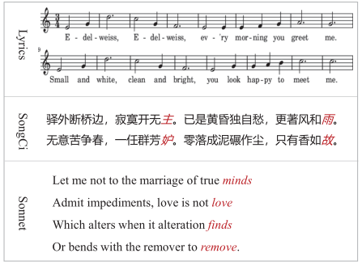
Format and Rhyme Symbols:
C={c0,c0,c0,c2,c1,</s>
c0,c0,c0,c0,c0,c2,c1,</s>,<eos>}
Intra-Position Symbols:
P={p4,p3,p2,p1,p0,</s>
p6,p5,p4,p3,p2,p1,p0,</s>,<eos>}
Segment Symbols:
S={s0,s0,s0,s0,s0,</s>
s1,s1,s1,s1,s1,s1,s1,</s>,<eos>}

Slide 6
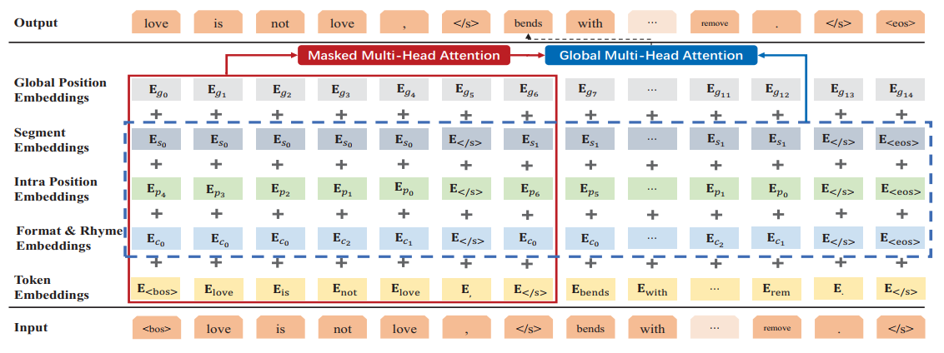

Slide 7
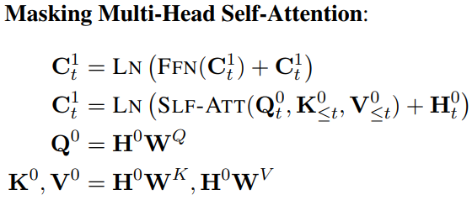
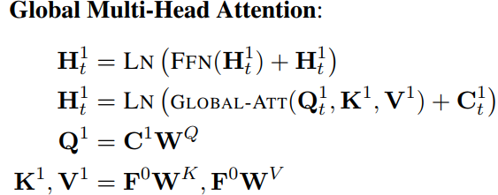

Slide 8
Recall that C can be arbitrary and flexible,thus we can rebuild a new format C’based on the generated result Y by masking partial content.
C’={c0,c0,c0,love,c1,</s>
bends,c0,c0,c0,c0,remove,c1,</s>,<eos>}

Slide 9
Experiments
SongCi and Sonnet, in Chinese and English respectively.
Besides PPL and Distinct, we also tailor-design several metrics for our task to conduct the evaluation for format, rhyme, and sentence integrity.

Slide 10
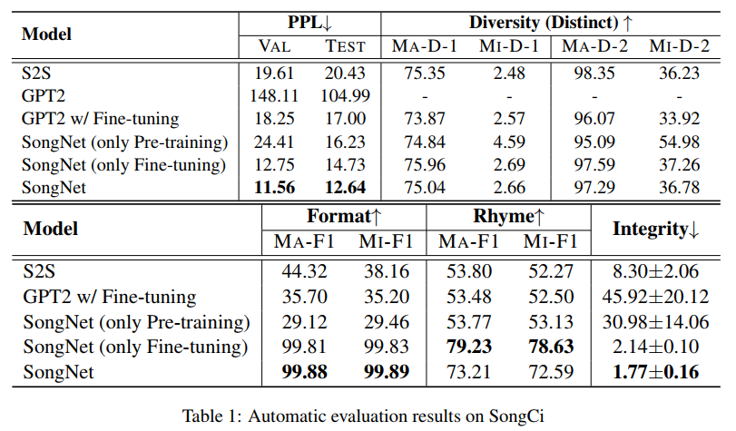

Slide 11
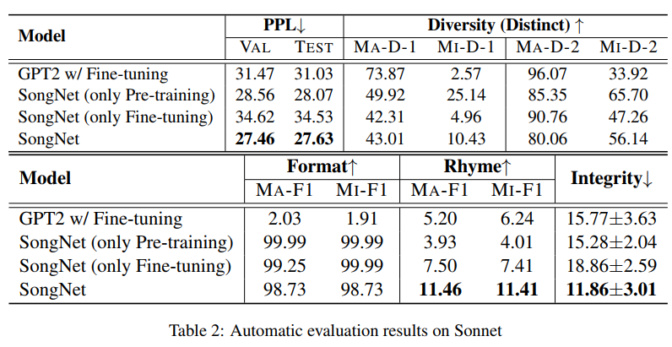

Slide 12
Another observation is that some of the results on corpus Sonnet are not as good as the results on SongCi. The main reason is that Sonnet only contains 100 samples in the training set as shown in Table. Therefore, the model cannot capture sufficient useful features especially for the rhyming issue.

Slide 14
Thank you!

