Slide 1
Chongqing University of Technology
ATAI
Advanced Technique of Artificial Intelligence
Chongqing University of Technology
A Contextualized Temporal Attention Mechanism for Sequential Recommendation
——WWW 2020
Code：https://github.com/Charleo85/seqrec
2020.10.27 • ChongQing
Reported by Sijin Liu

Slide 2
Chongqing University of Technology
ATAI
Advanced Technique of Artificial Intelligence
Chongqing University of Technology
1.Introduction
2.Method
3.Experiments
4.Conclusion

Slide 3
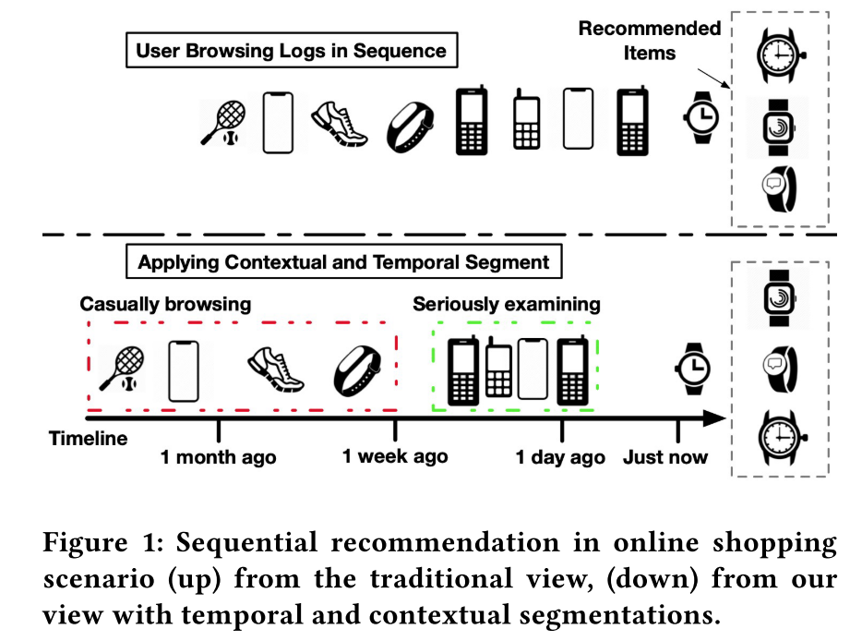
Introduction
Most existing sequential recommendation algorithms focus on transitional structure among the sequential actions, but largely ignore the temporal and context information.
The influence patterns from different segments of history reflect user interests in different ways.
By temporal segment
By contextual segment

Slide 4
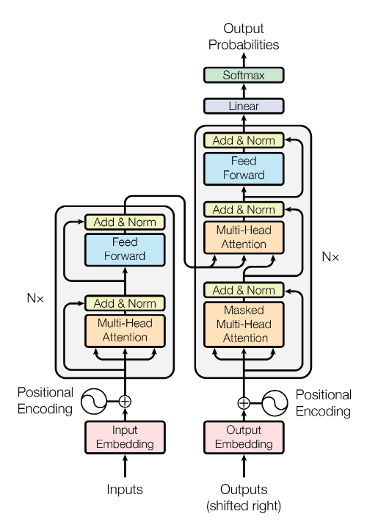
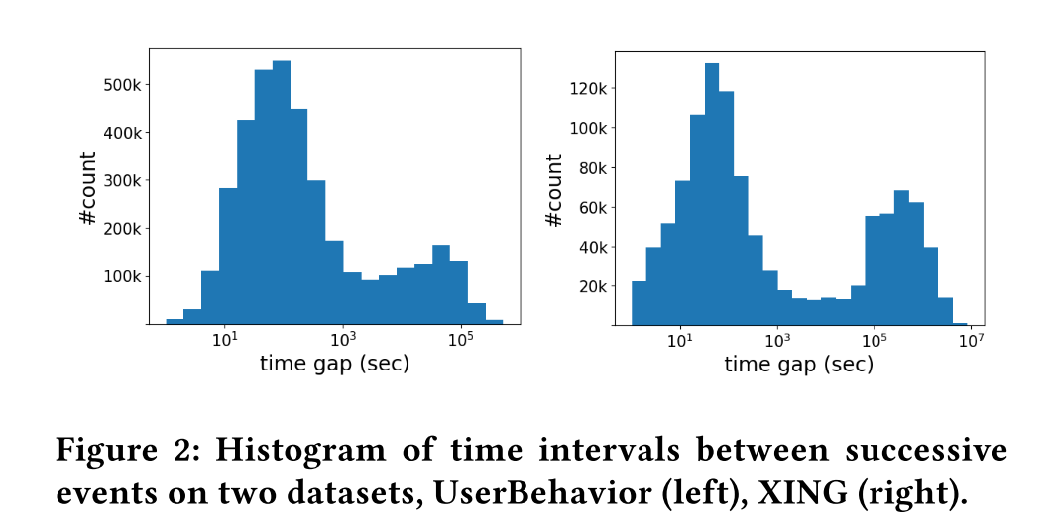
Introduction
Self-attention: there is no explicit ordering of input or segment of history modeled by self-attention mechanism.
Session: the user preference does not necessarily transit in strict accordance with the manually defined session boundaries.
2017_Attention is all you need.

Slide 5
Introduction
The Contextualized Temporal Attention Mechanism (CTA), an attention based sequential neural architecture that draws dependencies among the historical interactions not only through event correlation but also jointly on temporal and context information for sequential behavior modeling.

Slide 6
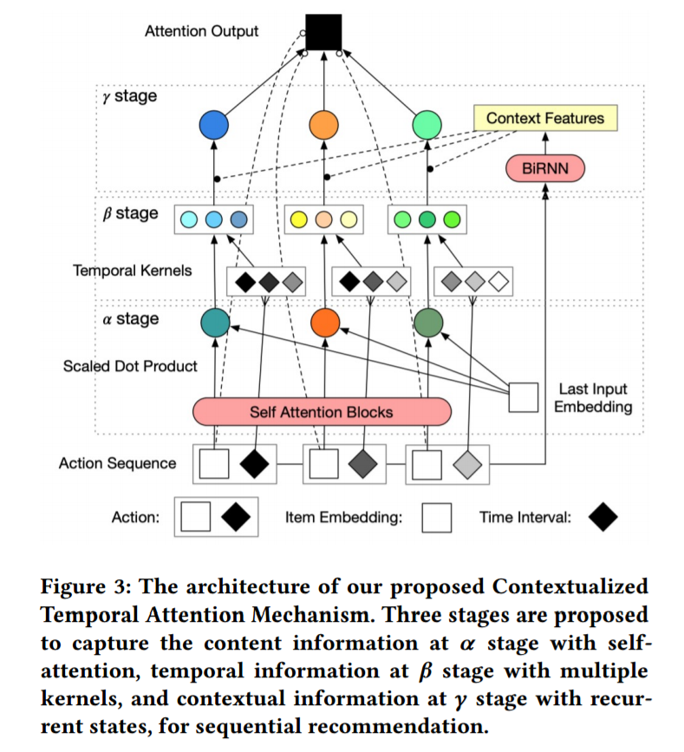
Method
item space as $ν$ of size $N$
user space as $υ$ of size $U$
a set of user behavior sequences C = ${\{S}^{1},S^{2},…, S^{u}\}$
Each $S^{u}$= {($t_{1}^{u}$, $s_{1}^{u}$) , ($t_{2}^{u}$, $s_{2}^{u}$) , . . . } is a sequence of time-item tuples , where $t_{j}^{u}$is the timestamp when item $s_{i}^{u}$ is accessed by user $u$

Slide 7
Method
$Input$：the user’s historical events of a window size $L$ in item and time pairs${\{(t_{i},s_{i})\}}_{i=1}^{L}$, the timestamp at the moment of recommendation $t_{L+1}$.
$E_{input} ∈ ℝ^{N×d_{in}}: X = [s_{1}, . . . , s_{L}]$ $·E_{input}∈ℝ^{L×d_{in}}$.
$$T = [t_{L+1}−t_{1}, . . .t_{L+1}−t_{L}] ∈ℝ^{L×1}$$
$$α = M^{α} (X) → β =M^{β}(T) →γ =M^{γ}(X, β,α)$$
The predicted representation of recommended item
$${\hat{x}}_{L+1}=F^{out}(γ^{T}· X) ∈ℝ^{d_{out}×1}$$

Slide 8
Method
$$α stage:what is the action$$
Input sequence embedding $X$, through a stack of $d_{l}$ self-attentive encoder blocks ( $d_{h}$ heads and $d_{a}$ hidden units) into representation $H^{d_{l}}$
Input $H^{j}$ → the $i$th attention head of the $j$th self attention block
where are the learnable parameters specific to $i$th head of $j$th attention block
scaling factor

Slide 9
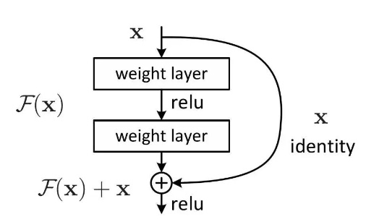
Method
$$α stage:what is the action$$
where
is the learnable parameter
where
are the learnable parameters
is softmax temperature

Slide 10
Method
$$β stage:when did it happen$$
a collection of $K$ kernel functions $φ(·) : ℝ^{L}$ → $ℝ^{L}$ with different shapes including:
exponential decay kernel, $φ \left(T\right)=ae^{−T}+ b$
logarithmic decay kernel, $φ \left(T\right)= −a\log\left(1+T\right)+b$
linear decay kernel, $φ (T) = −aT + b$
constant kernel, $φ (T) = 1$

Slide 11
Method
$$γ stage:how did it happen$$
$$C=\text{Bi}\text{−}\text{RNN}(X) ⊕C_{attr} ∈ℝ^{L×dr}$$
$$P(·|C) = softmax(F^{γ}\left(C\right))$$
$$β^{c}= β·P(·|C)$$
$$γ = softmax (αβ^{c} )$$

Slide 12
Method
The predicted representation of recommended item
$${\hat{x}}_{L+1}=F^{out}(γ^{T}· X) ∈ℝ^{d_{out}×1}$$

Slide 13
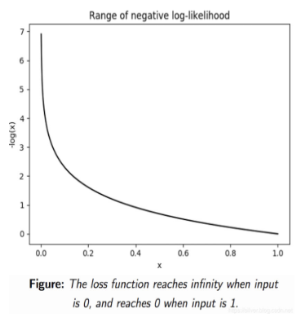
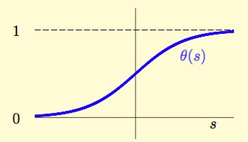
Method
Ranking-based metrics (optimize the quality of recommendation list)
Loss function for model estimation:
Negative Log-Likelihood (NLL)
(1) Bayesian Personalized Ranking (BPR) loss
(2) TOP1 Loss
{$r_{v}$} : the highest similarity scores
Negative sampling: $N_{s}$⊆ $V$, that excludes the target item $i$, i.e., $i ∉N_{s}$

Slide 14
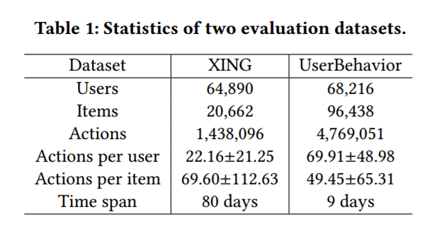
Experiments
Heuristics methods.
Session-based Models.
Temporal Models.
Sequential Models.

Slide 15
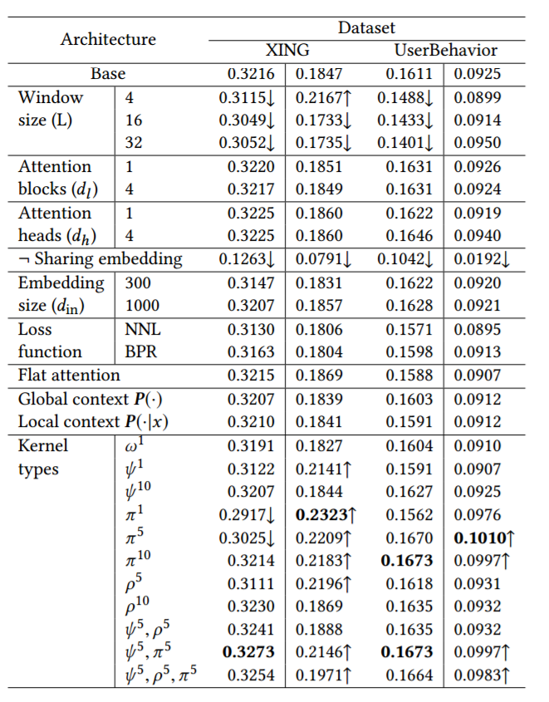
Experiments

Slide 16
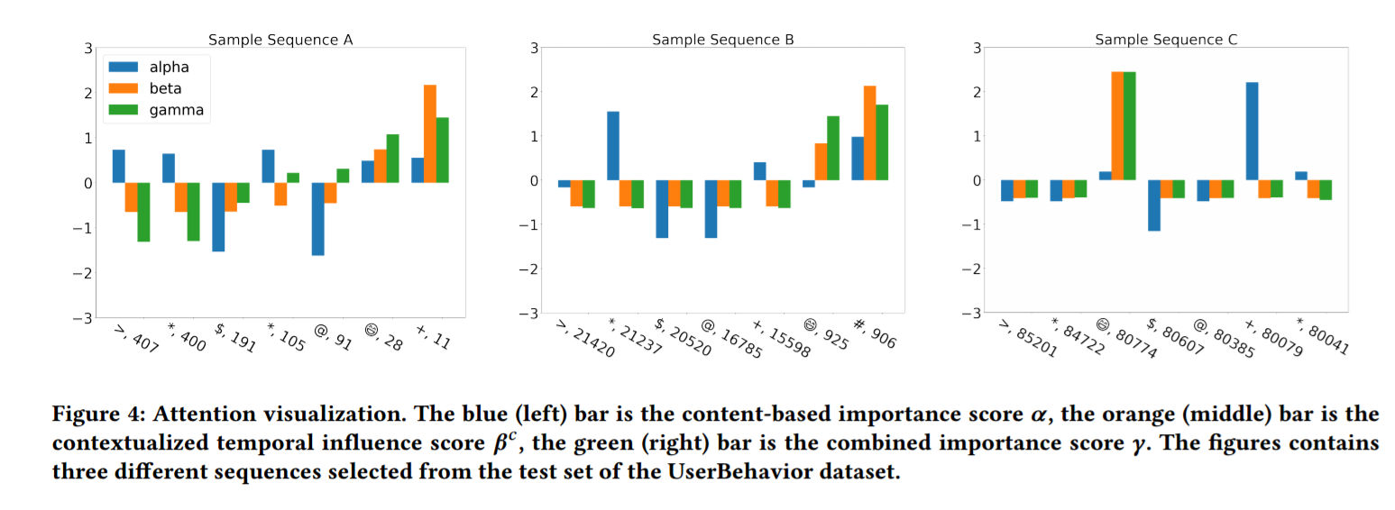
Experiments

Slide 17
Summary
This work identifies and addresses the critical problem in sequential recommendation, Déjà vu, that is the user interest based on the historical events varies over time and under different context. CTA, has the following advantages:
• Efficacy & Efficiency. Compared with the baseline work, CTA effectively improves the recommendation quality by modeling the contextualized temporal information. It also inherits the advantage of self-attention mechanism for its reduced parameters and computational efficiency, as the model can also be deployed in parallel.
• Interpretability. The model, featuring the three stage weighing mechanism, shows promising traits of interpretability.
• Customizability. The model design is flexible in many parts.

Slide 18
Thank you!

