Slide 1
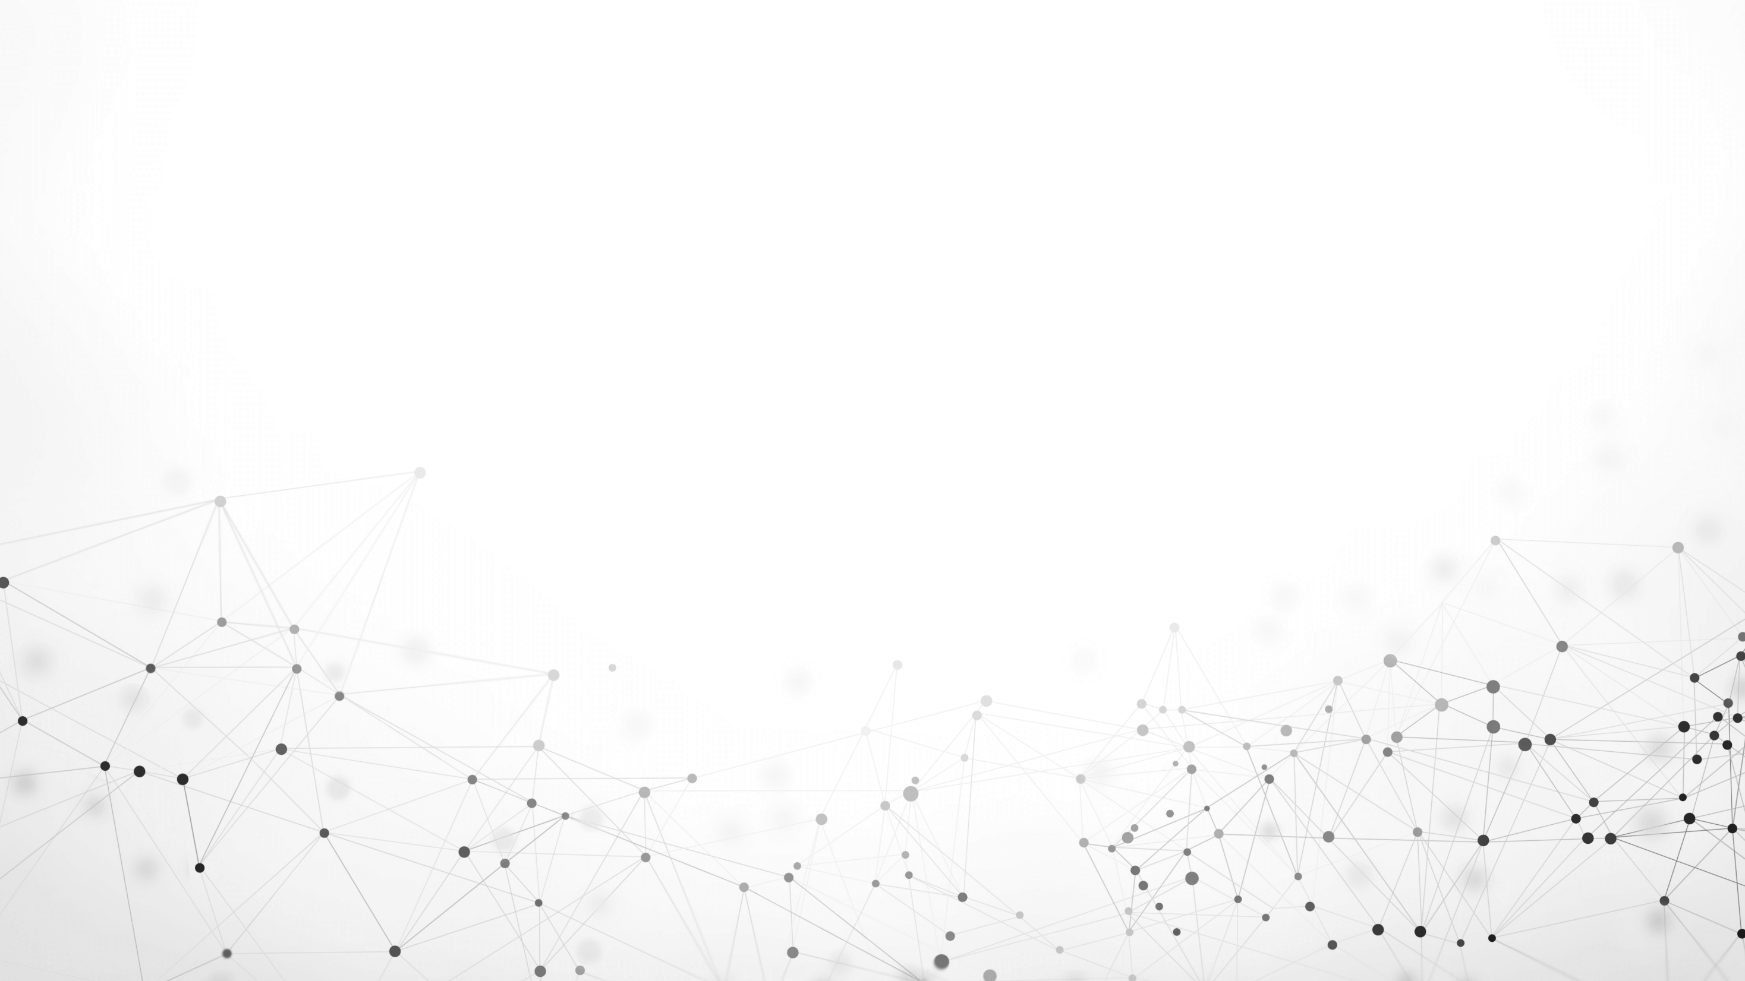
Structural Deep Clustering Network
Deyu Bo, Xiao Wang, Chuan Shi, Meiqi Zhu, Emiao Lu, and Peng Cui
In Proceedings of The Web Conference WWW ’20, April 20–24, 2020, Taipei, Taiwan
Reporter: Lin Li
Date: 2020.12.10

Slide 2
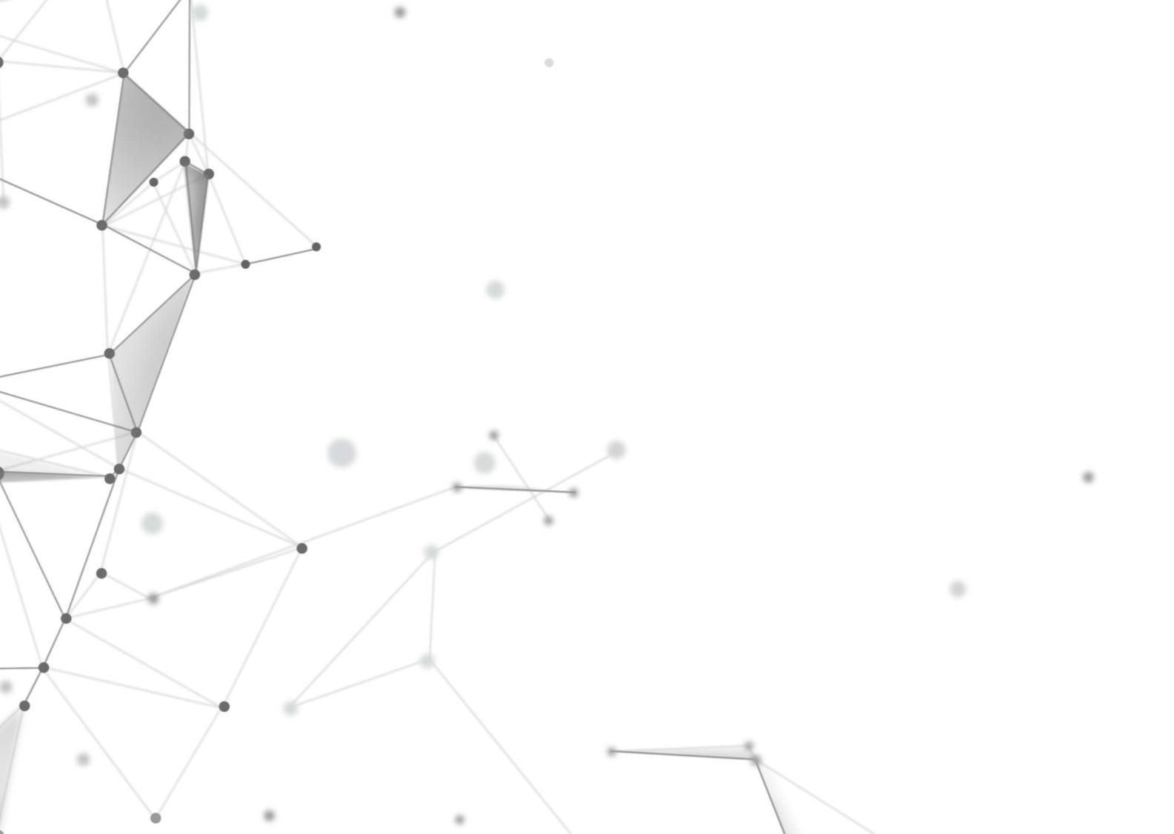
01
Introduction
CONTENTS
02
Model
03
Experimental Results
04
Conclusion

Slide 3
01
Introduction

Slide 4
one
Introduction
Deep Clustering
--Basic idea: Integrate the objective of clustering into the powerful representation ability of deep learning.
-- Achieve state-of-the-art performance.
--Seldom take the structure of data into account.
Structure of data
--Reveals the latent similarity among samples
--Provides a valuable guide on learning the representation.
Structural Deep Clustering Network(SDCN)
-- The first time to apply structural information into deep clustering explicitly.

Slide 5
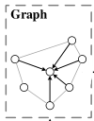
one
Introduction
Structural Deep Clustering Network
K-Nearest Neighbor (KNN) graph: capture the structural information
To capture the low-order and high-order structural information

Slide 6
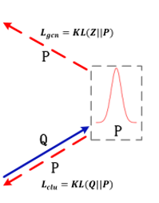
one
Introduction
Structural Deep Clustering Network
GCN
Dual self-supervised module:
uniformly guide GCN and DNN modules
Delivery
operator
DNN

Slide 7
02
Model

Slide 8
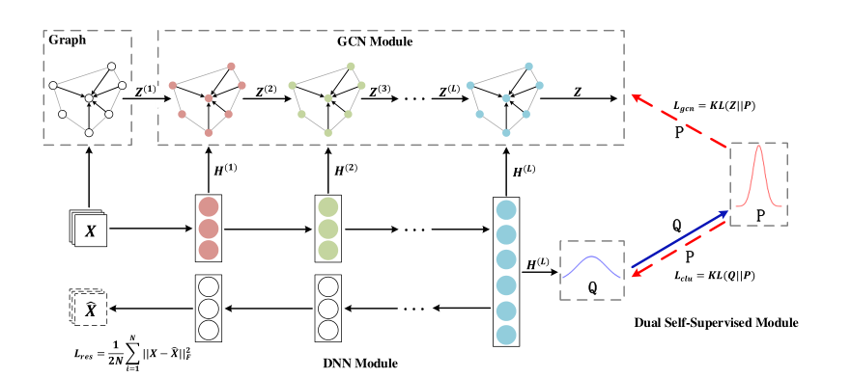
Two
Model

Slide 9
Two
Model
KNN Graph :
Find each sample’s top-K similar neighbors and set edges to connect it with its neighbors
Raw data :
: the i-th sample
N : the number of samples
d : the dimension
1.Calculate the similarity matrix
Approaches: Heat Kernel $Sij=e^{−\frac{||xi−yi||2}{t}}$, continuous data, e.g., images
Dot-product $Sij=xi^Txj$ , discrete data, e.g., bag-of-words
2. Select the top-K similarity points, construct an undirected K-nearest neighbor graph
Results: Get the adjacency matrix A from the non-graph data.

Slide 10
Two
Model
DNN Module(Basic autoencoder ):
Learning an effective data representation of the raw data
L : Layers in the autoencoder
ℓ : the layer number
The representation learned by the ℓ-th layer in encoder part : H^{(ℓ)}= ϕ($w_{e}^{l}$H^{(ℓ−1)} + $b_{e}^{l}$)
The representation learned by the ℓ-th layer in decoder part : H^{(ℓ)}= ϕ($w_{d}^{l}$H^{(ℓ−1)} + $b_{d}^{l}$)
The reconstruction of the raw data :

Slide 11
Two
Model
GCN Module:
Propagate representations generated by the DNN module.
W : the weight matrix
Z^{(ℓ)} : the representation learned by the ℓ-th layer of GCN
1.Combine Z^{(ℓ−1)}and H^{(ℓ−1)}together
2.The ℓ-th layer representation:
3.The result z _{i j}∈ Z indicates the probability sample i belongs to cluster center j, and we can treat Z as a probability distribution.

Slide 12
Two
Model
Dual Self-Supervised Module:
Unifies the autoencoder and GCN modules in a uniform framework and effectively trains the two modules end-to-end for clustering.
The blue solid line : target distribution P is calculated by the distribution Q
The two red dotted lines :the dual self-supervised mechanism.
The target distribution P to guide the update of the DNN module and the GCN module at the same time.

Slide 13
Two
Model
Dual Self-Supervised Module
q _{i j} : the probability of assigning sample i to cluster j
Q = [q _{i j}]: the distribution of the assignments of all samples
objective function:
Target distribution P:

Slide 14
03
Experimental Results

Slide 15
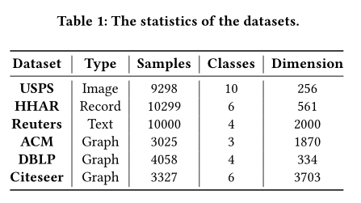
Three
Experimental Results
Datasets

Slide 16
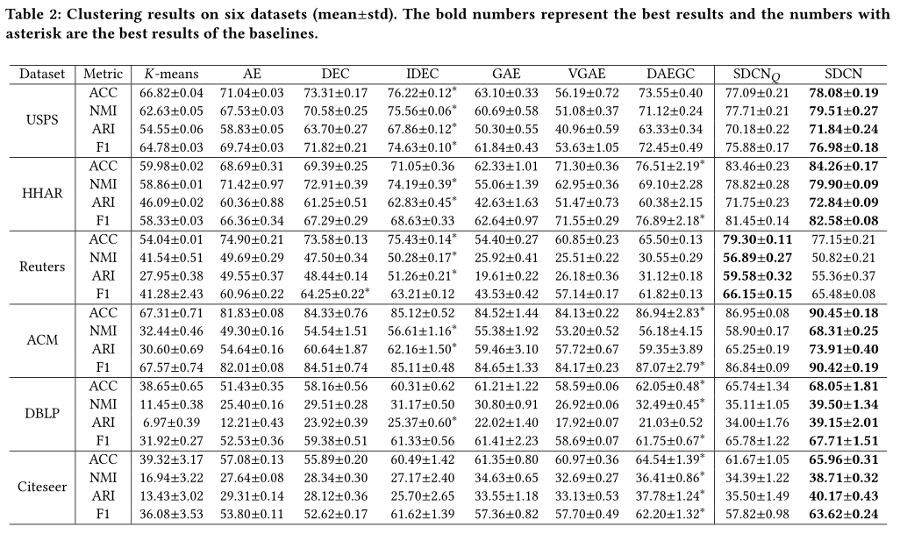
Three
Experimental Results
Results

Slide 17
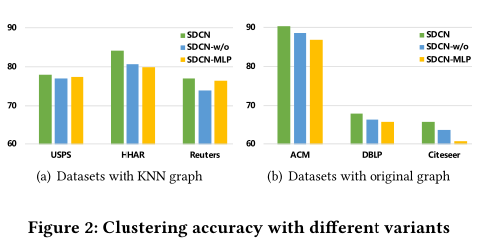
Three
Experimental Results
Analysis of Variants

Slide 18
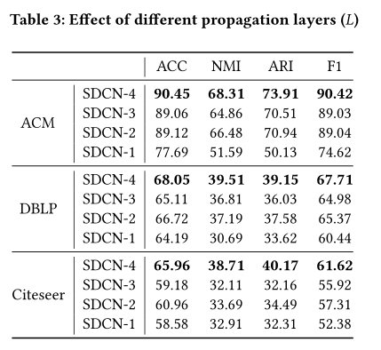
Three
Experimental Results
Analysis of Different Propagation Layers

Slide 19
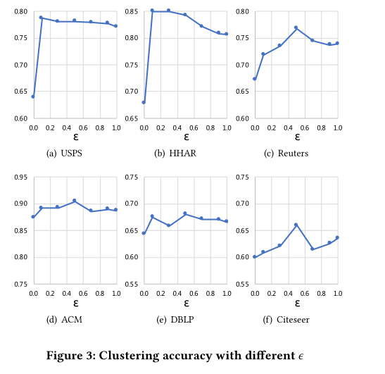
Three
Experimental Results
Analysis of balance coefficient ϵ

Slide 20
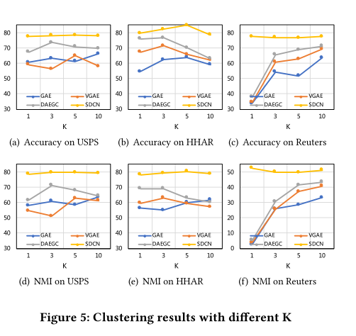
Three
Experimental Results
K-sensitivity Analysis

Slide 21
Three
Experimental Results
Analysis of Training Process

Slide 22
04
Conclusion

Slide 23
Four
Conclusion
Innovation
-- first attempt to integrate the structural information into deep clustering.
Structural Deep Clustering Network(SDCN)
-- Consists of DNN module, GCN module, and dual self-supervised module.
--Can effectively combine the autoencoder specific representation with GCN-specific representation by a delivery operator.
--consistently outperforms the state-of-the-art deep clustering methods in various open datasets.

Slide 24
Thank you

