Slide 1
Key Based Artificial Fingerprint Generation for Privacy Protection
Sheng Li , Xinpeng Zhang , Zhenxing Qian , Member, IEEE, Guorui Feng , and Yanli Ren
IEEE TRANSACTIONS ON DEPENDABLE AND SECURE COMPUTING

Slide 2
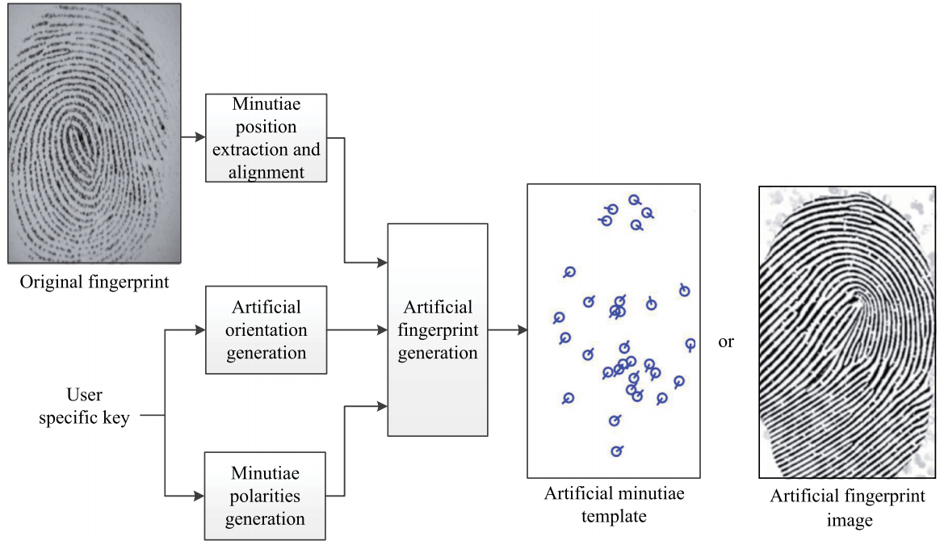

Slide 3
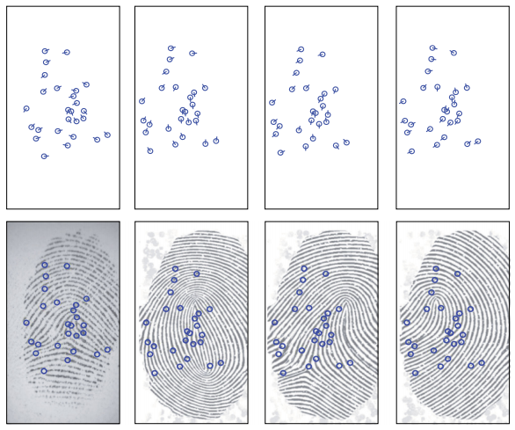

Slide 4
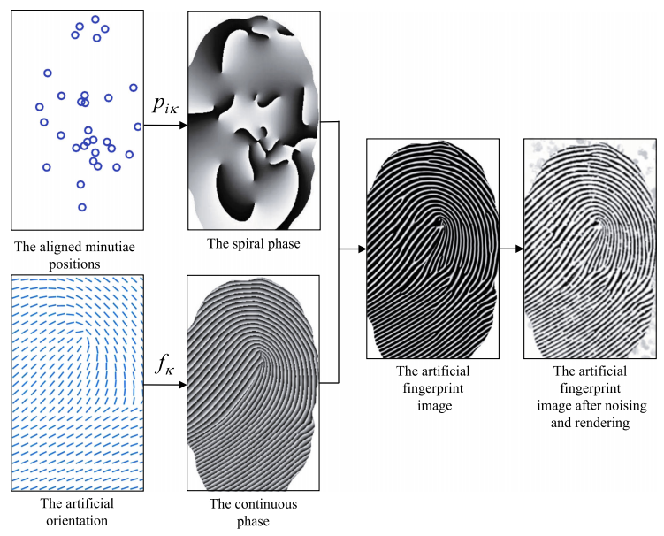

Slide 5



Extraction
Alignment
Core: p=(p_{x},p_{y}),α
e=(e_{x},e_{y})
$$β=α−\frac{π}{2}$$
Singular point: m=(m_{x},m_{y}),α

Slide 6
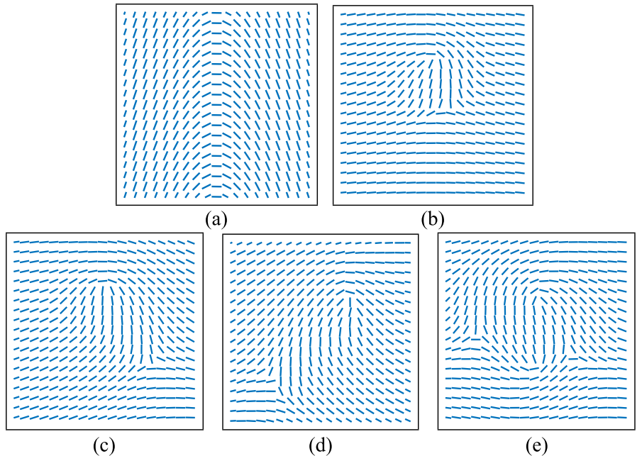
random number t[0,1]
locations of the singular points
Compute the artificial orientation

Slide 7
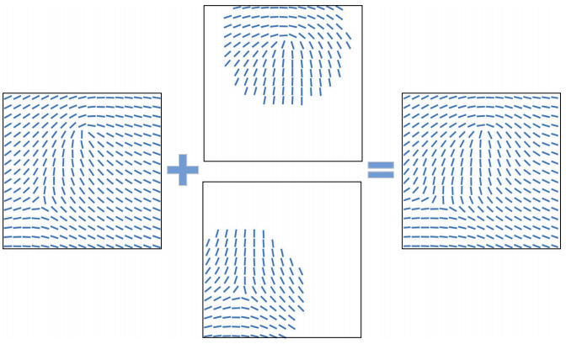



Slide 8
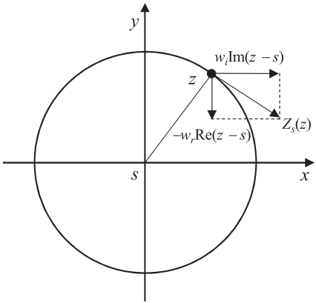


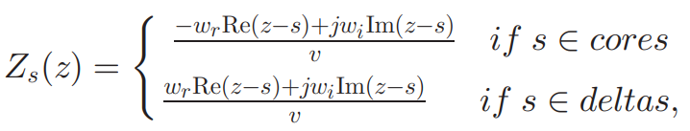
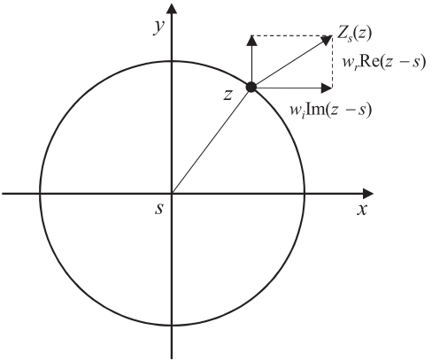


Slide 9





Minutiae Polarity
Block based
Function based

Slide 10
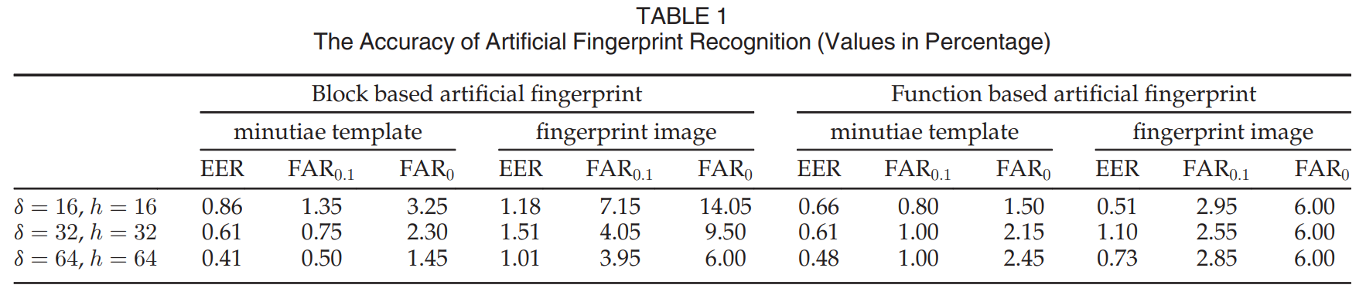

Slide 11
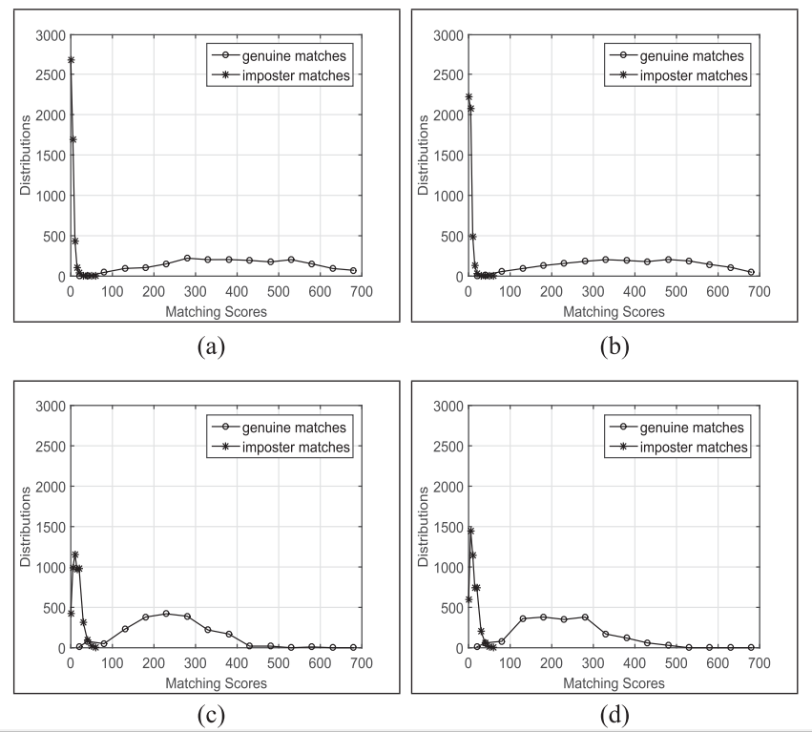

Slide 12
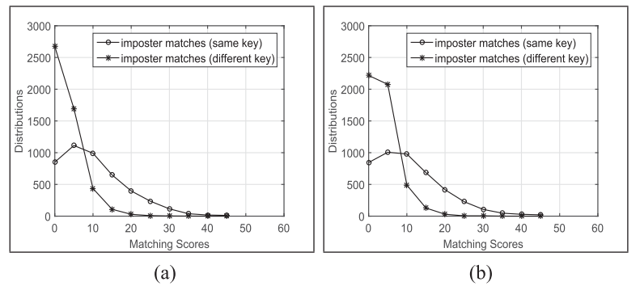
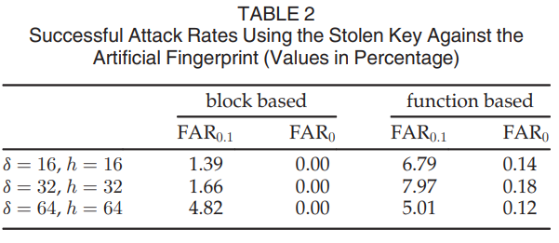

Slide 13
Thanks

