Slide 1
Deep Match to Rank Model for Personalized Click-Through Rate Prediction
Ze Lyu, Yu Dong, Chengfu Huo, Weijun Ren
Alibaba Group
—AAAI 2020
汇报人：高钰澜

Slide 2
Catalogue
1
Background
2
Model
3
Dataset
4
Experiments

Slide 3
Background

Slide 4
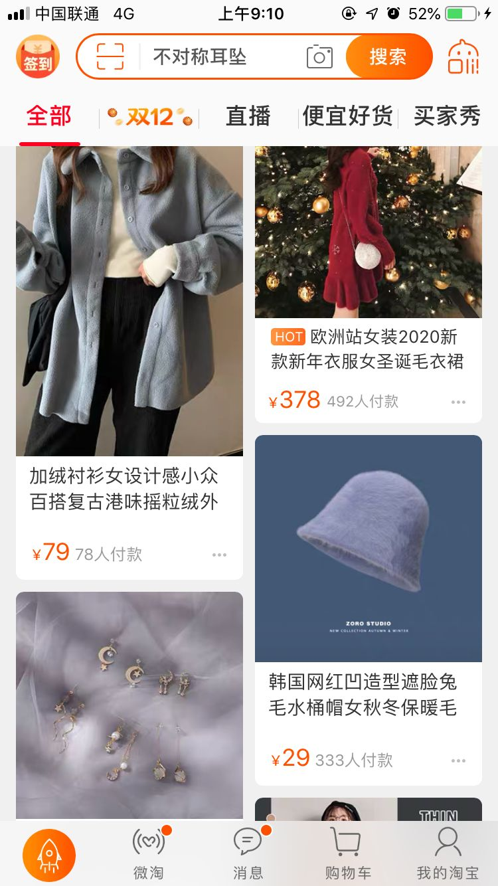
Two-Stage IR in recommender system
·Balance of efficiency and effectiveness
·Matching：CF methods are widely used to calculate user-to-item relevance
·Ranking：CTR prediction is of vital importance

Slide 5
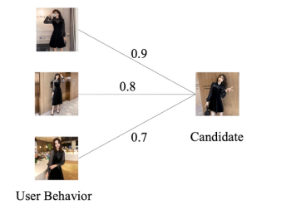
Matching/Candidate Generation
· Item-to-Item CF
1
· User-to-Item CF

Slide 6
Ranking
· Deep learning based CTR prediction model
· Feature interaction network
· Wide&Deep
· PNN
· DeepFM AFM NFM
· DCN
· User interest representation network
· DIN
· DIEN
Notes:
这些模型虽然取得了很大进展，但是只关注了用户表示，很少关注用户-项目相似性（这直接衡量了用户对目标项目的偏好程度）

Slide 7
Motivation
· Existing works in the field of CTR prediction mainly focus on user representation and pay less attention on representing the user-to-item relevance.
√ Motivated by this, we propose a novel model named Deep Match to Rank (DMR) which combines the thought of collaborative filtering in matching methods for the ranking task in CTR prediction.

Slide 8
Model

Slide 9
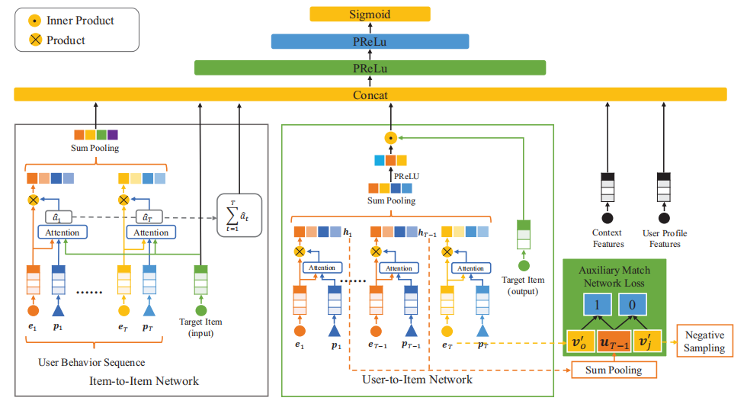
Basic structure
· Features
· User Profile
·user ID、consumption level...
· User Behavior
·the sequential list of user interacted items
with corresponding features such as item ID,category ID...
· Target Item
· Context
·time、matching method and corresponding matching score...

Slide 10
User-to-Item Network
models user-to-item relevance directly by inner product of corresponding representation.

Slide 11
User-to-Item Network
Auxiliary match network ：Push larger inner product to represent stronger relevance

Slide 12
Item-to-Item Network
Model the similarity between user interacted item and target item，and further add them up to obtain another kind of user-to-item relevance

Slide 13
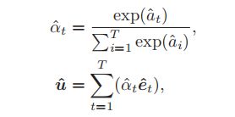
Item-to-Item Network
Target-relevant user representation

Slide 14
Inputs of MLP
· Two forms of user-to-item relevance
· User temporal interest
· Other input feature vectors
The final input of MLP is represented
by .

Slide 15
Datasets

Slide 16
public datasets
Alimama Dataset2 contains ad display and click logs randomly sampled from Taobao in 8 days.
industrial datasets
We collect impression and click logs from our online recommender system3 in Alibaba to form
the industrial dataset.

Slide 17
Experiments

Slide 18
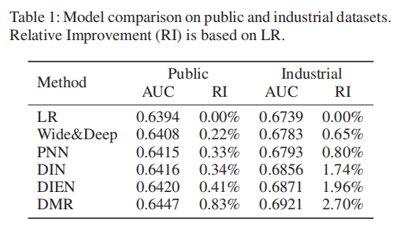
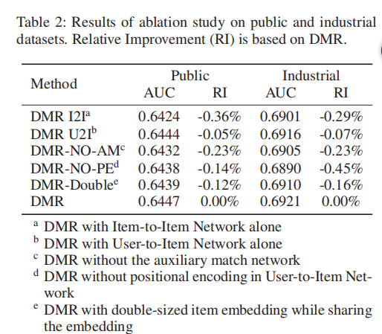
Model Comparison Results

Slide 19
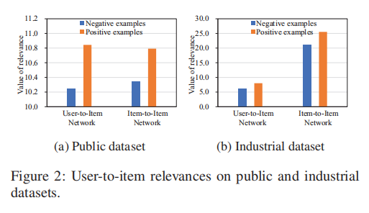
Effectiveness of User-to-Item Relevance Representation

Slide 20
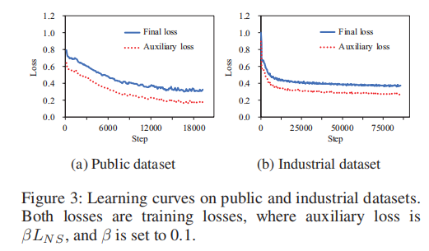
Effectiveness of Auxiliary Match Network

Slide 21
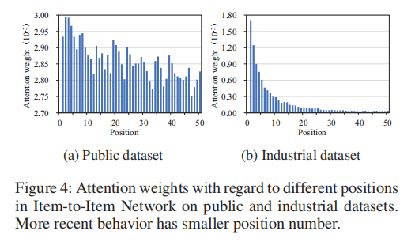
Effectiveness of Positional Encoding

Slide 22
Conclusions
· A model named DMR is proposed for personalized CTR prediction to capture the user-to-item relevance . Inspired by the thought of collaborative filtering in matching methods.
· To the best of our knowledge, DMR is the first model that jointly trains matching and ranking in CTR prediction.
· Positional encoding is introduced to model temporal interest of user in both sub-networks.
· DMR improves the performance significantly and has been deployed in our online recommender system in Alibaba.

Slide 23
Thank you

