Slide 1
Chongqing University of Technology
ATAI
Advanced Technique of Artificial Intelligence
Chongqing University of Technology
Hierarchy-Aware Global Model for Hierarchical Text Classification
Jie Zhou , Chunping Ma ,Dingkun Long et al(ACL-2020)
2020.10.27 • ChongQing
Reported by Lele Duan
Code&dataset:https://github.com/Alibaba-NLP/HiAGM

Slide 2
Chongqing University of Technology
ATAI
Advanced Technique of Artificial Intelligence
Chongqing University of Technology
1.Introduction
2.Method
3.Experiments
4.Conclusion

Slide 3
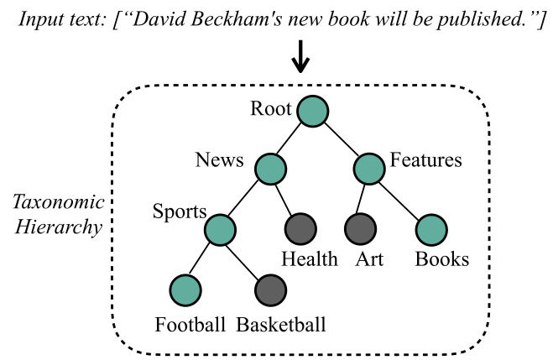
Introduction
Text classification is widely used in Natural Language Processing (NLP) applications
Hierarchical text classification (HTC) is a particular multi-label text classification (MLC) problem
The taxonomic hierarchy is commonly modeled as a tree or a directed acyclic graph, as depicted in Figure 1.
Figure 1: This short sample is tagged with news, sports, football, features and books. Note that HTCcould be either a single-path or a multi-path problem.

Slide 4
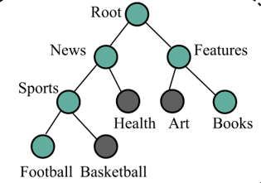
Introduction
Existing approaches for HTC could be categorized into two groups:
Local approach : Tending to constructs multiple classification models and then traverse the hierarchy in a top-down manner
Containing a large number of parameters
Easily lead to exposure bias for the lack of holistic structural information
Global approach: Treating HTC problem as a flat MLC problem, and uses one single classifier for all classes.
Recent global methods introduce various strategies to utilize structural information of top-down paths
Top
Down
Can’t encode the holistic label structure for label correlation features.
Can’t make full use of the mutual interactions between the text feature space and the label space.

Slide 5
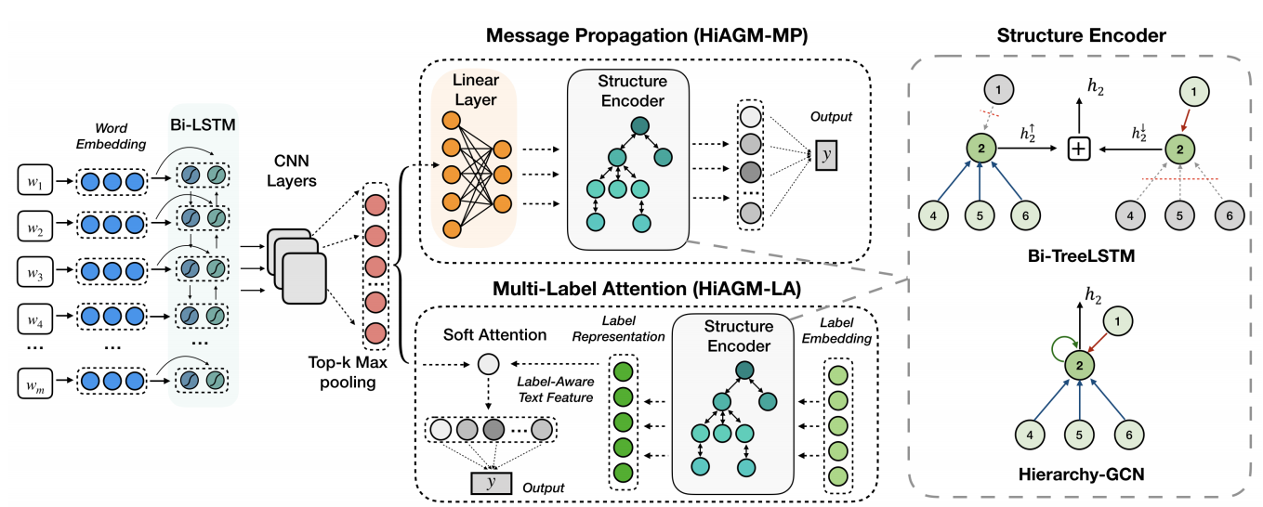
Method
Hierarchy-aware global model (HiAGM)
Hierarchy-aware structure encoder for modeling hierarchical label relations.
Two variants Hybrid Information Aggregation
Text encoder for extracting textual information

Slide 6
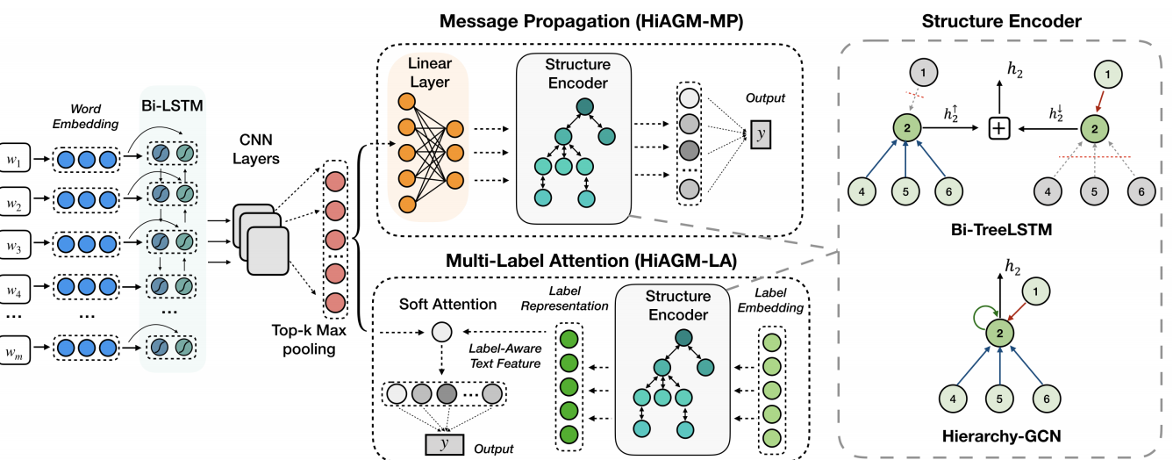
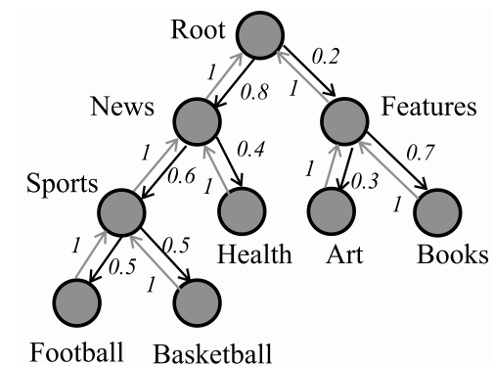
Method
Hierarchy-Aware Structure Encoder
As illustrated in Figure 2:
Define directed graph as:$G=\left(V,\vec{E},\overset{⃖}{E}\right),$
Vertex sets:$V=\left\{V_{1},V_{2},…,V_{C}\right\}$
top-down hierarchy path:
$$\vec{E}=\left\{\left(v_{i} ,v_{j}\right) | i∈V,j∈child\left(i\right)\right\}$$
bottom-up hierarchy path:
$$\overset{⃖}{E}=\left\{{(v}_{j},v_{i}\right)\left|i∈V,j∈child\left(i\right)\right\}$$
Define HTC as :H = (X, L)
Text objects: $X=(X_{1},X_{2},…X_{N})$
Supervised label sets$:L=\left(l_{1},l_{2},…,l_{N}\right)$
$l_{i}$:a label set including multiple classes.
Figure 2: Example of the taxonomic hierarchy. The number indicates the prior probability of label dependencies according to the training corpus.

Slide 7
Method
Hierarchy-Aware Structure Encoder
$e_{i},_{j}$: A hierarchy path between the parent node $v_{i}$and child node $v_{j}$.
$f(e_{i},_{j})$: edge feature represented by the prior probability:
Top-down dataflow : $f_{c\left(e_{i},_{j}\right)}=\frac{N_{j}}{N_{i}}$.
Bottom-up one adopts$:{ f}_{p\left(e_{i},_{j}\right)}=1$.
$N_{k}$ refers to the occurrence number of $v_{k}$ in the training subset
Figure 2: Example of the taxonomic hierarchy. The number indicates the prior probability of label dependencies according to the training corpus.

Slide 8
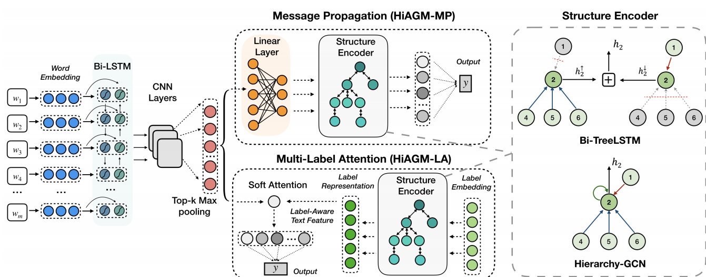
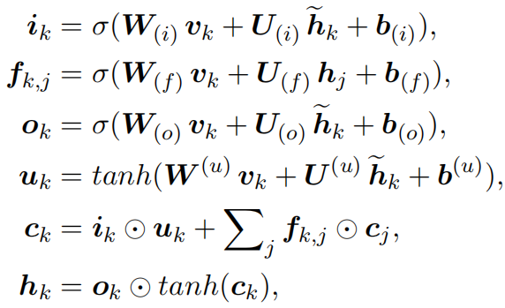
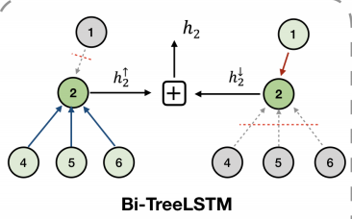
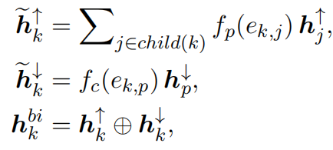
Method
Bidirectional Tree-LSTM
$h_{k}$ : the hidden state
$c_{k}$ memory cell state.
⊕ :indicates the concatenation of hidden states.
$h_{k}^{bi}$.: The final hidden state of node k

Slide 9
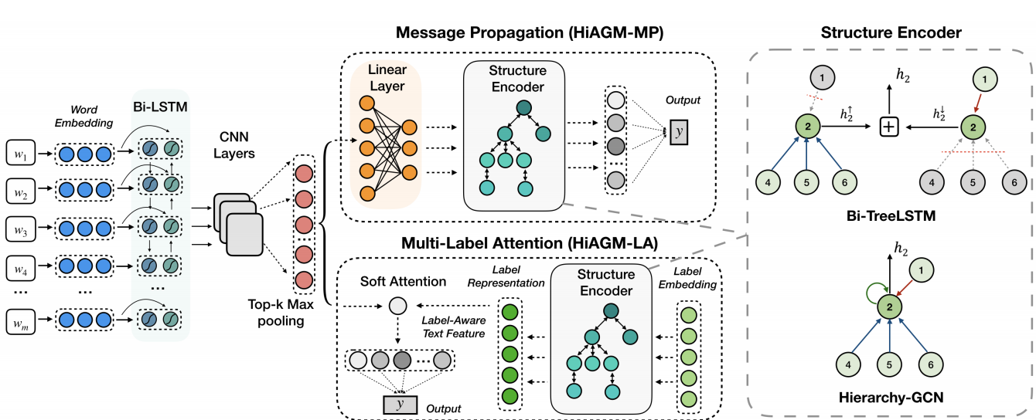
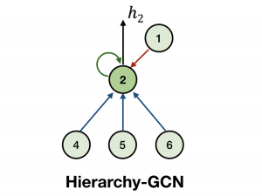
Method
Hierarchy-GCN
Encoding the hidden state of node k based on its associated neigbourhood $N\left(k\right)$= {$n_{k}$, $child(k)$,$parent(k)$} as:
Where and
: indicates the hierarchical direction from node j to node k, including top-down, bottom-up, and self-loop edges.
$a_{k},_{j}$:denotes the hierarchy probability $f_{d\left(k,j\right)}\left(e_{k_{j}}\right)$, where the self-loop edge employs $a_{k},_{k}$ = 1, top-down edges use $f_{c\left(e_{j},_{k}\right)}=\frac{N_{k}}{N_{j}}$ , and bottom-up edges use ${ f}_{p\left(e_{j},_{k}\right)}=1$

Slide 10
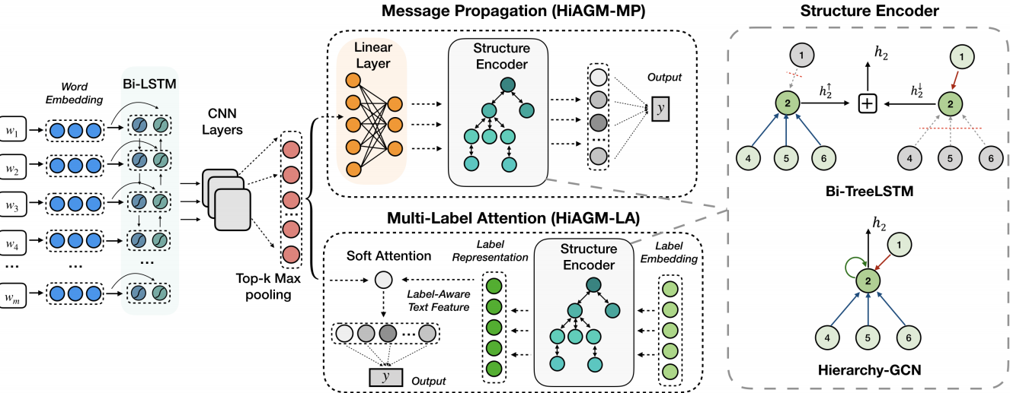
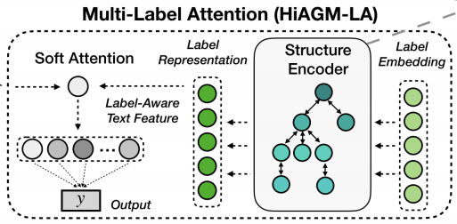
Method
Hierarchy-Aware Multi-Label Attention(HiAGM-LA)
The label embedding is initialized randomly
The output hidden state represents as the hierarchy-aware label features.
Given text representation , HiAGM-LA calculates the label-wise attention value $α_{ki}$ as:
$α_{ki}$: indicates how informative the $i−th$ text feature vector is for the $k−th$ label
We can get text features based on multi-label attention

Slide 11
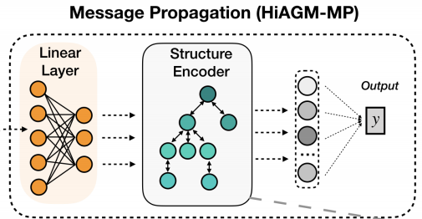
Method
Hierarchical text feature propagation(HiAGM-TP)
Takes text features S as the node inputs and updates textual information through the hierarchy-aware structure encoder
Conducting the propagation of text features
Node inputs V are reshaped from text features by a single linear transformation:
where the trainable weight matrix transforms text features to node inputs

Slide 12
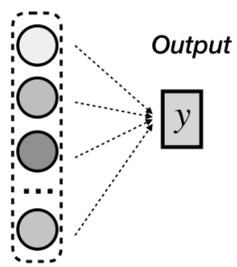
Method
Loss function
Flattening the hierarchy by taking all nodes as leaf nodes for multi-label classification, no matter it is a leaf node or an internal node.
The final hierarchy-aware features are fed into a fully connected layer for prediction.
Recursive regularization:
HiAGM uses a binary cross-entropy loss function:
where and are the ground truth and sigmoid score for the j-th label of the i-th sample.
Thus, the final loss function is

Slide 13
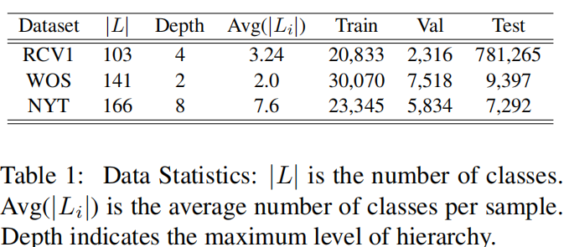
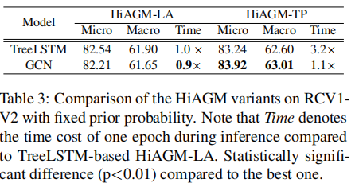
Experiment
Dataset
Comparison of the HiAGM variants on RCV1- V2 with fixed prior probability.

Slide 14
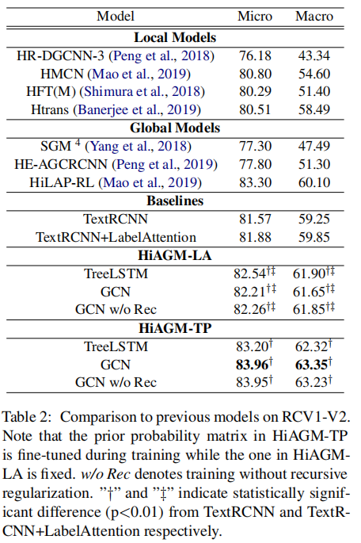
Experiment
Comparison to previous
models on RCV1-V2.

Slide 15
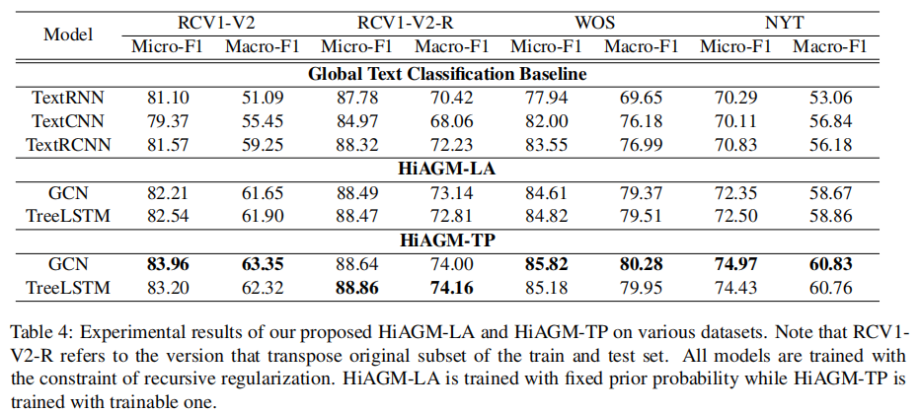
Experiment
Experimental results of our proposed HiAGM-LA and HiAGM-TP on various datasets：
HiAGM-TP has better performance than HiAGM-LA in both Bi-TreeLSTM and Hierarchy-GCN encoders
As for efficiency, HiAGM-LA is more computationally efficient than HiAGM-TP, especially in the inference process

Slide 16
Conclusion
we propose a novel end-to-end hierarchy-aware global model that extracts the label structural information for aggregating label-wise text features.
We present a bidirectional Tree-LSTM and a hierarchy-GCN as the hierarchy-aware structure encoder.
Our framework is extended into a parallel variant based on multi-label attention and a serial variant of text feature propagation.
Our approaches empirically achieve significant and consistent improvement on three distinct datasets

Slide 17
Chongqing University of Technology
ATAI
Advanced Technique of Artificial Intelligence
Chongqing University of Technology
Thank you!

